Slide 1
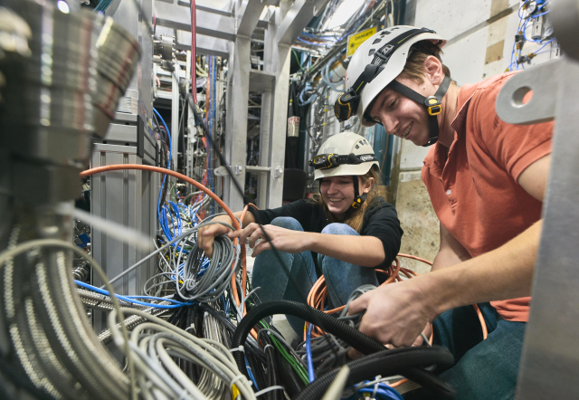

KEK-TRIUMF Symposium
Makoto C. Fujiwara
(藤原真琴）
ALPHA-Canada Spokesperson,
Senior Scientist
Particle Physics Department
TRIUMF
Cross Appointed Professor
QUP, KEK
Sep 28-29@TRIUMF
Probing Antimatter Gravity with Quantum Sensing Techniques:
ALPHA, HAICU and QUP

Slide 2
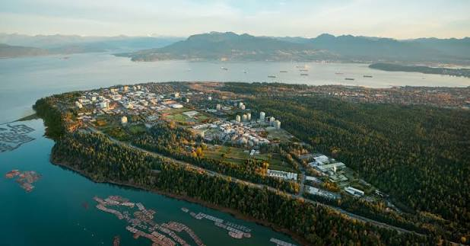
Welcome to TRIUMF!
Great to have KEK-TRIUMF collaborations
My connections with KEK
  Did undergrad thesis project with KEK Muon group (1991/92)
  Spent time at CERN with KEK DG Asai-san (1999-2004)
Collaboration with QUP
  Direct result of KEK-TRIUMF symposium in 2025!

Slide 3
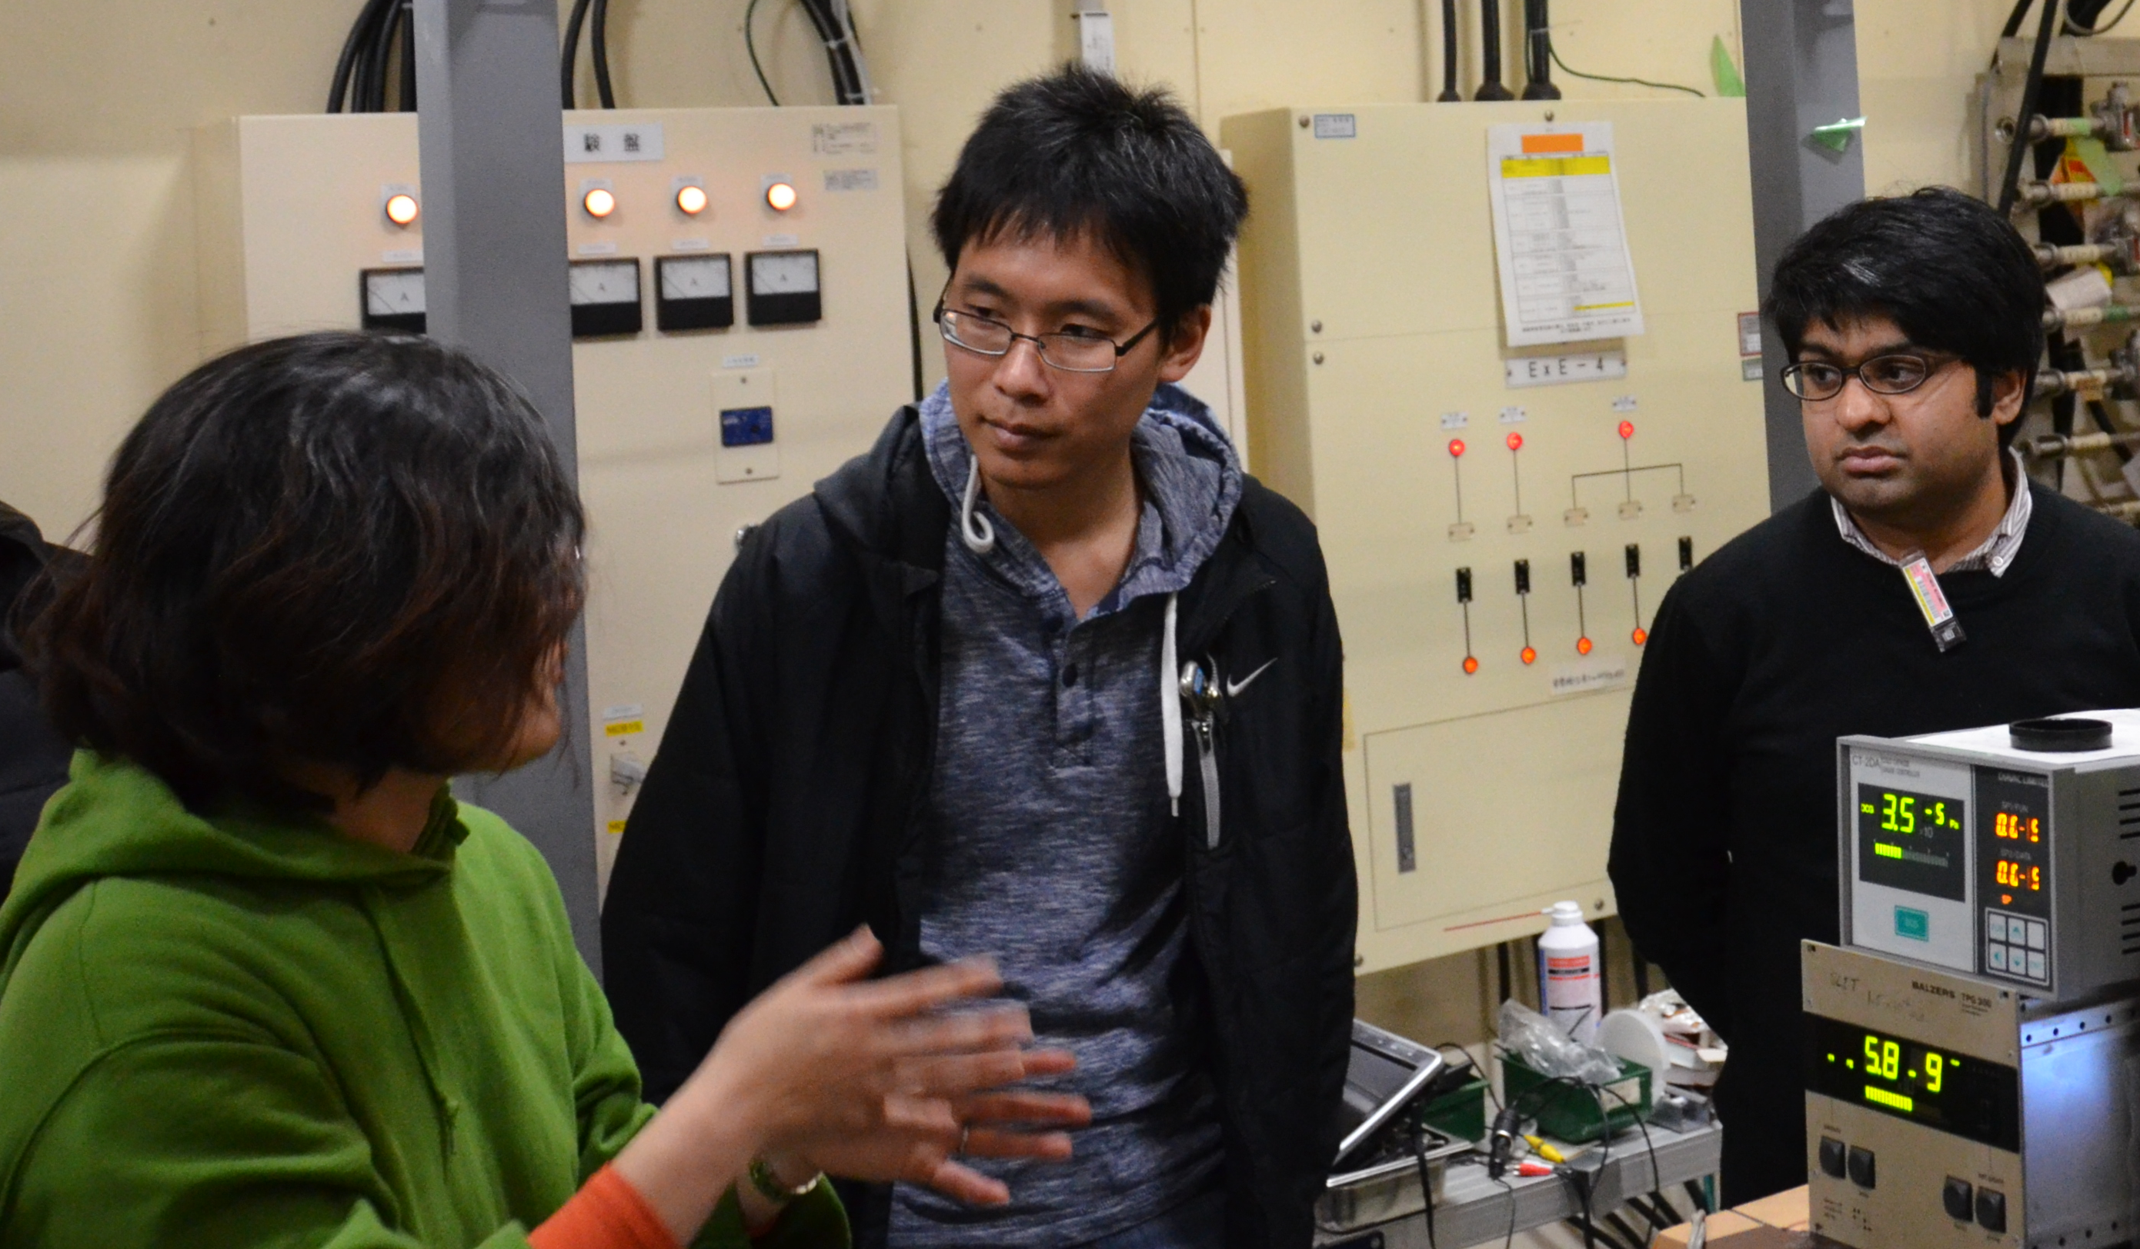
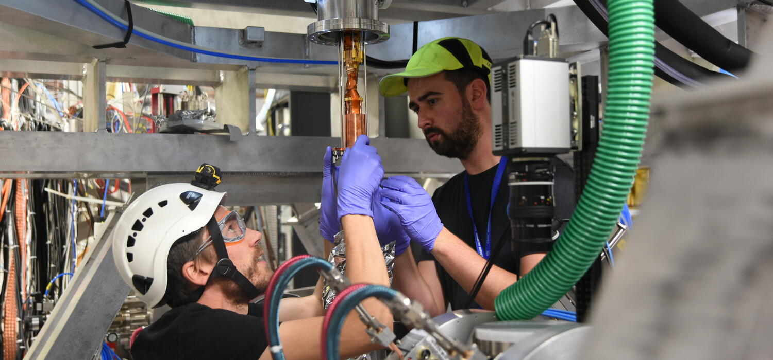
Student Exchanges
Students and postdocs benefit from KEK-TRIUMF exchange program
Chukman So
  Magnet shimming design from g-2 group
  Interested in visiting KEK on JSPS fellowship
Adam Powell
  Microwave cavity for muonium hyperfine measurements
  Already re-visited J-PARC in Dec 2024
Alberto Uribe
  Microwave muonium experiment
Jay Shu
  Visiting KEK/J-PARC in 2026
  QUP Internship (QUPIP)
Many more students are interested!

Slide 4
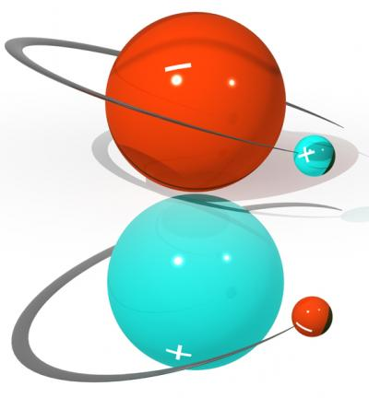
ALPHA Antimatter Experiment at CERN
Objective: Test symmetry between antihydrogen and hydrogen (CPT, Gravity etc) at highest possible precision
Image credit: Chukman So

Slide 5
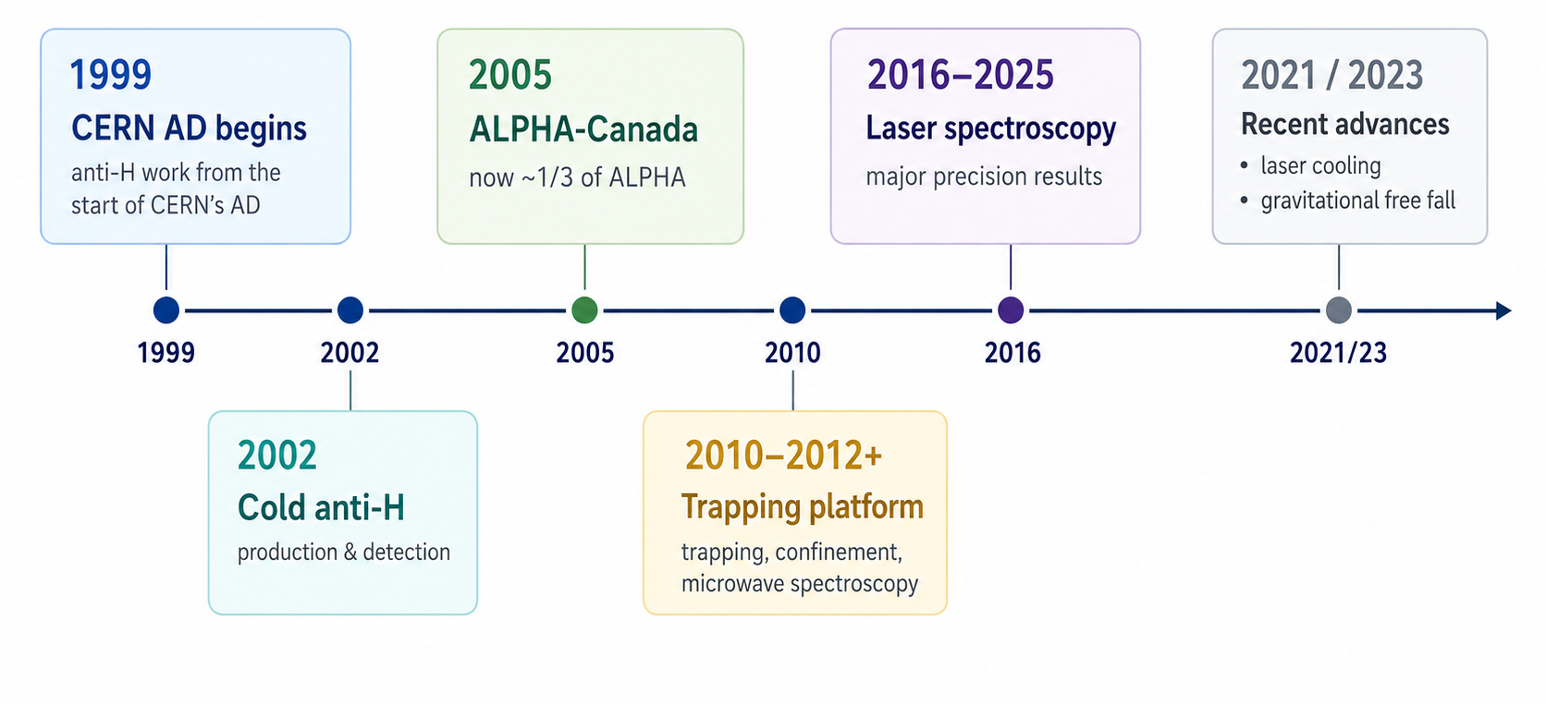
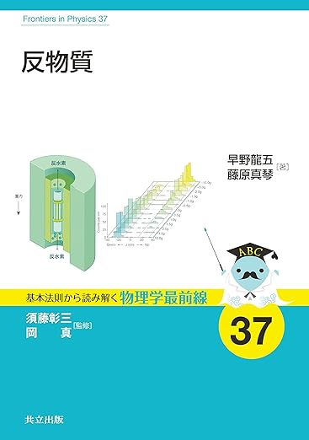
Brief Hisotry
“Antimatter”
Hayano & Fujiwara
Kyoristu Shuppan 2026
JPY 2,680
(English ver. to come)

Slide 6
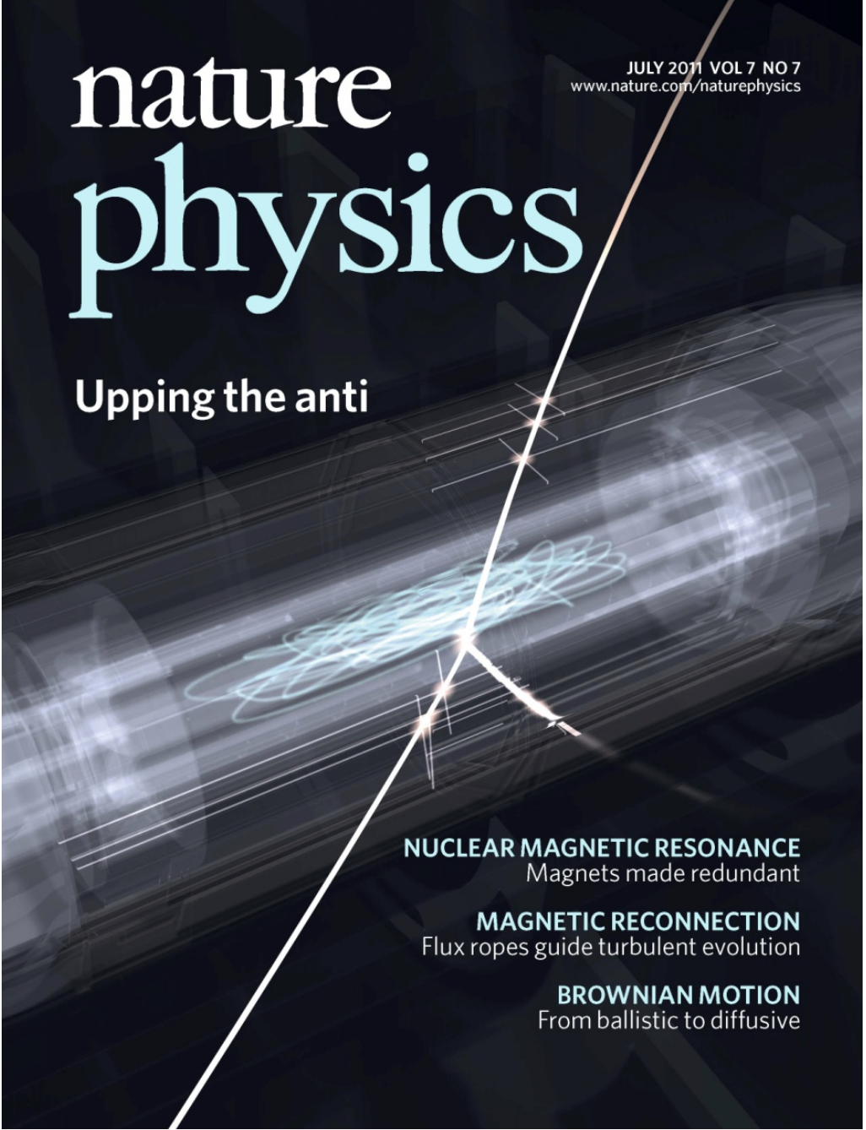
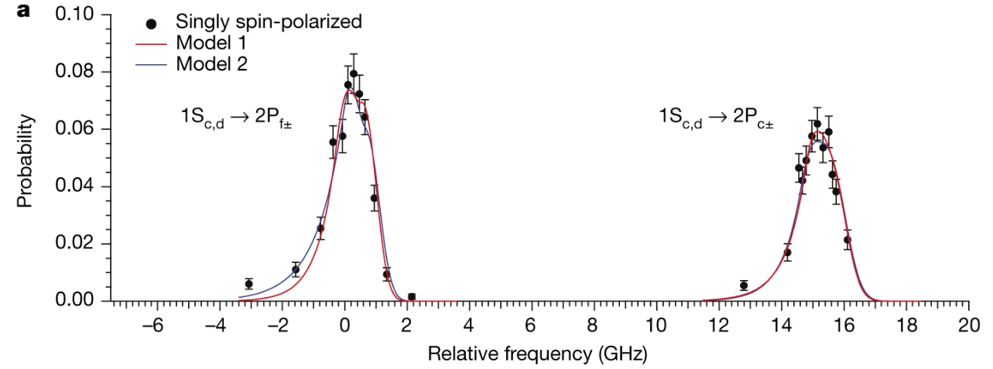
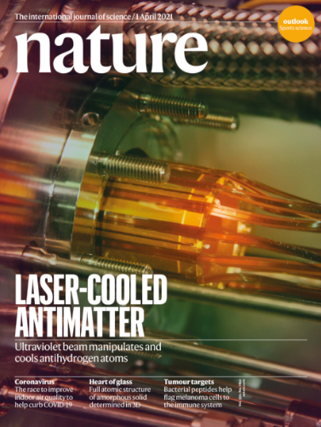
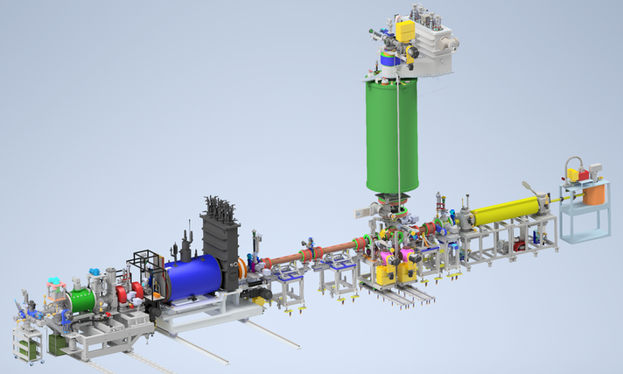
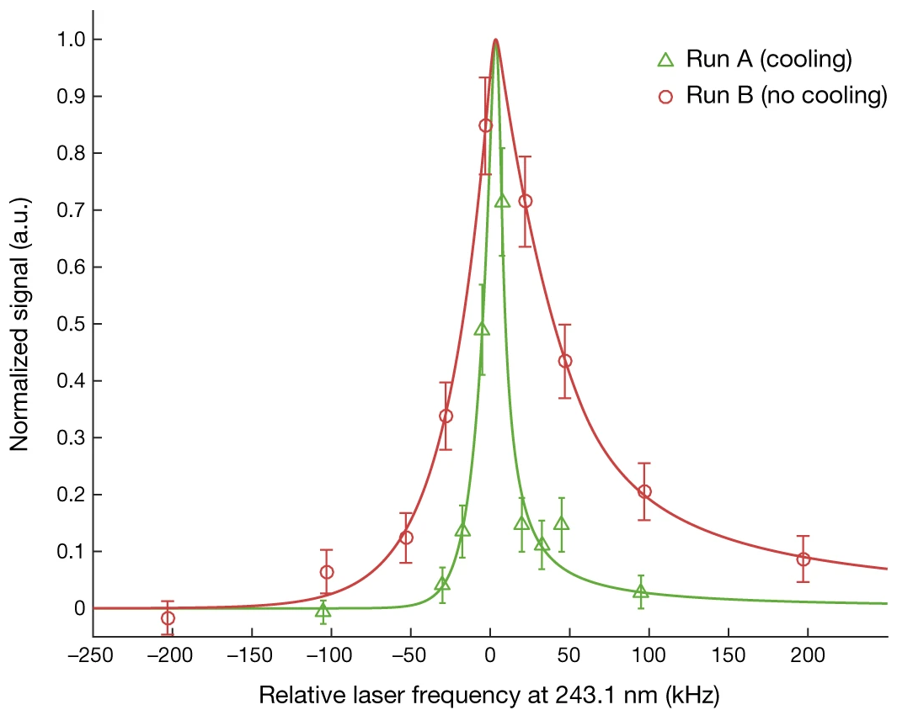
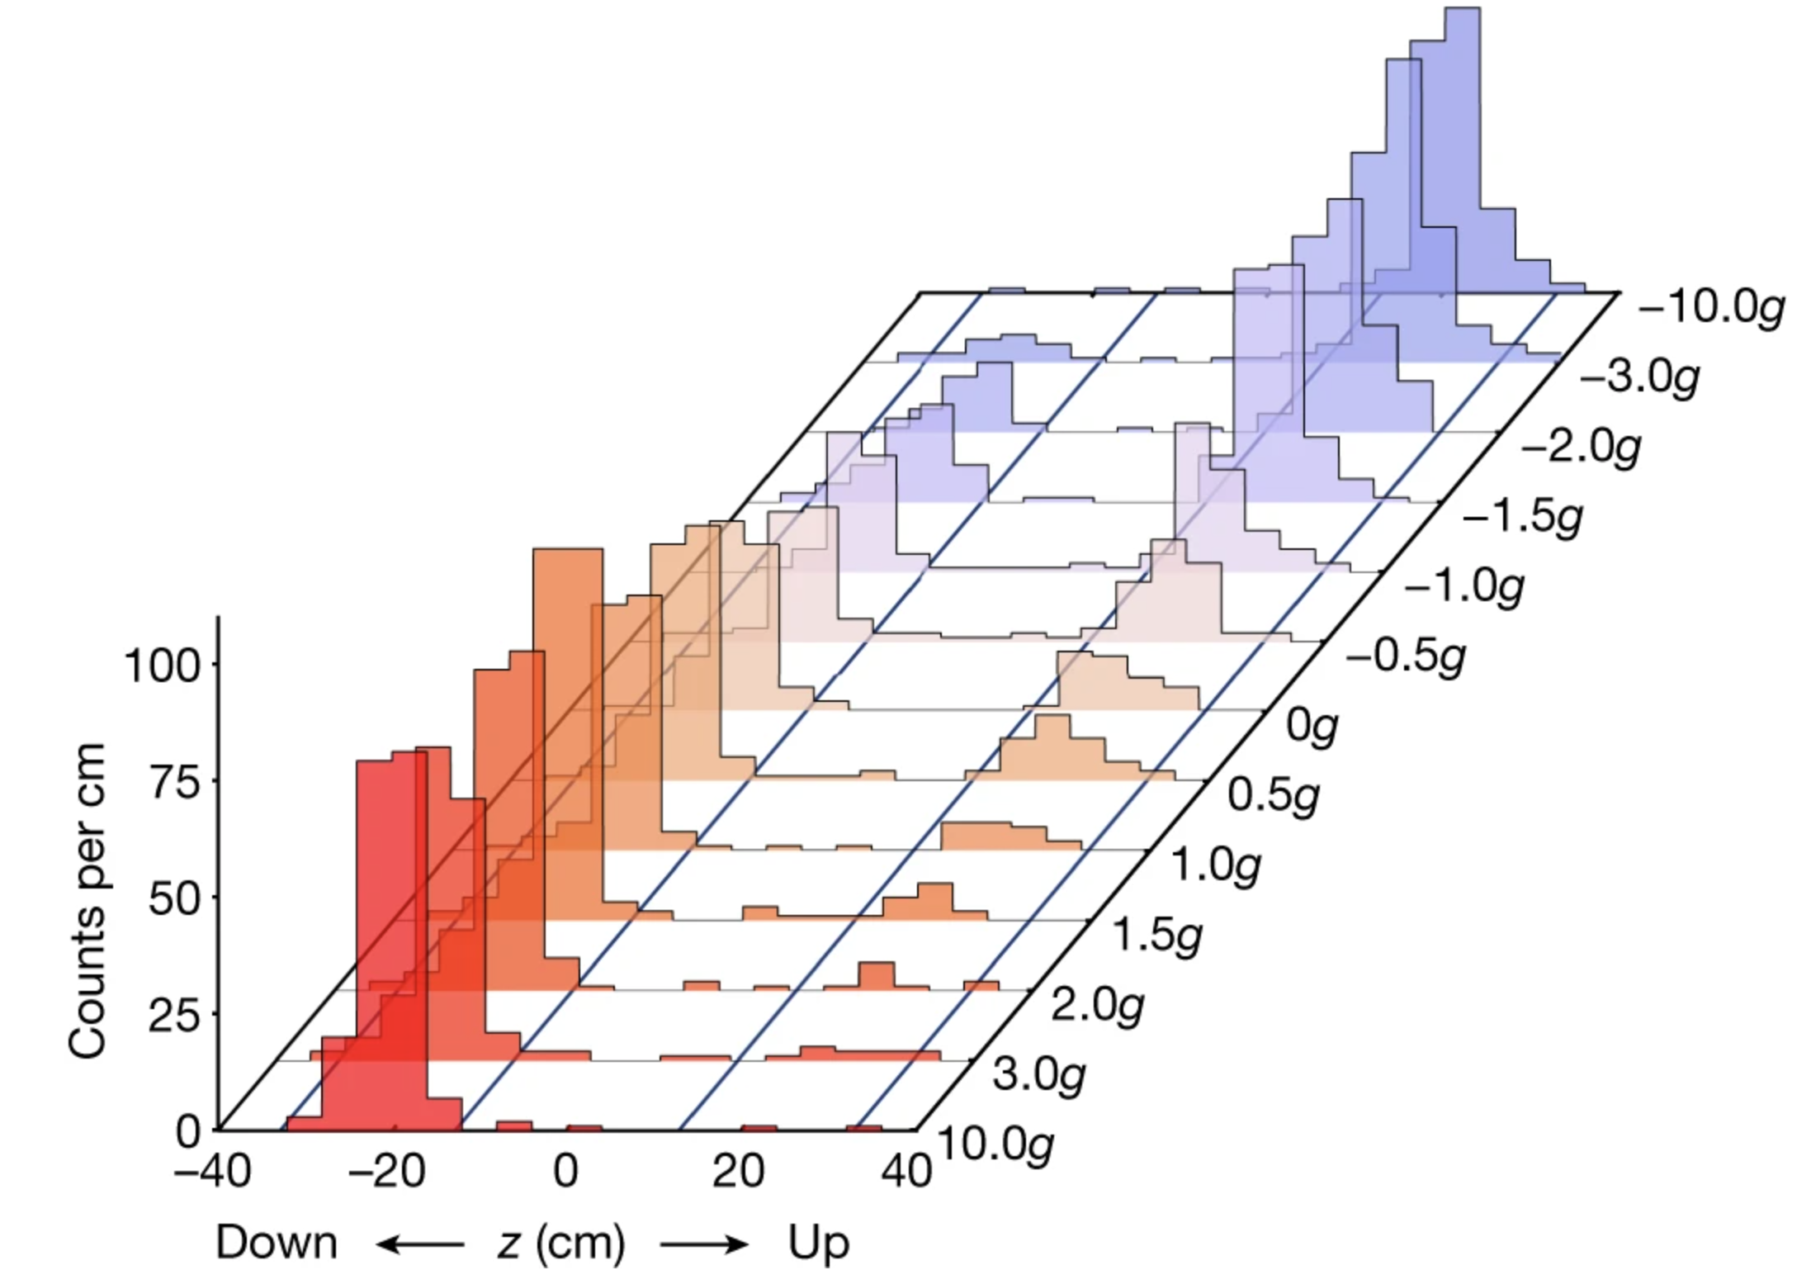
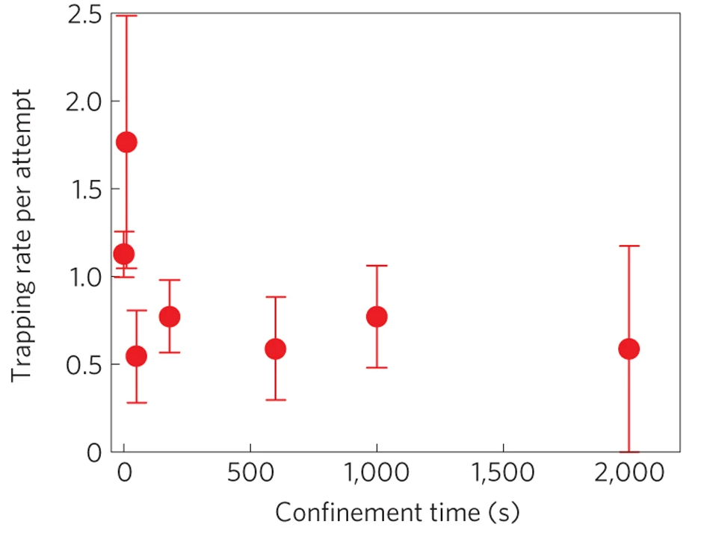
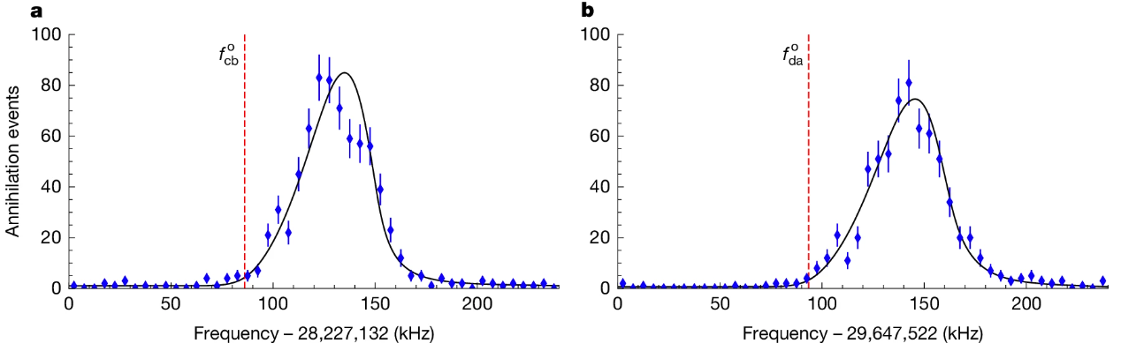
Selected previous achievements
Anti-H trapping
Laser spectroscopy
Laser cooling
Gravity
Nature 578, 375 (2020)
Microwave spectroscopy
Nature Phys. 7, 588 (2011)
Nature 653, 1022, May 27 (2026)
Nature 592, 35 (2021)
Nature 621, 716 (2023)

Slide 7
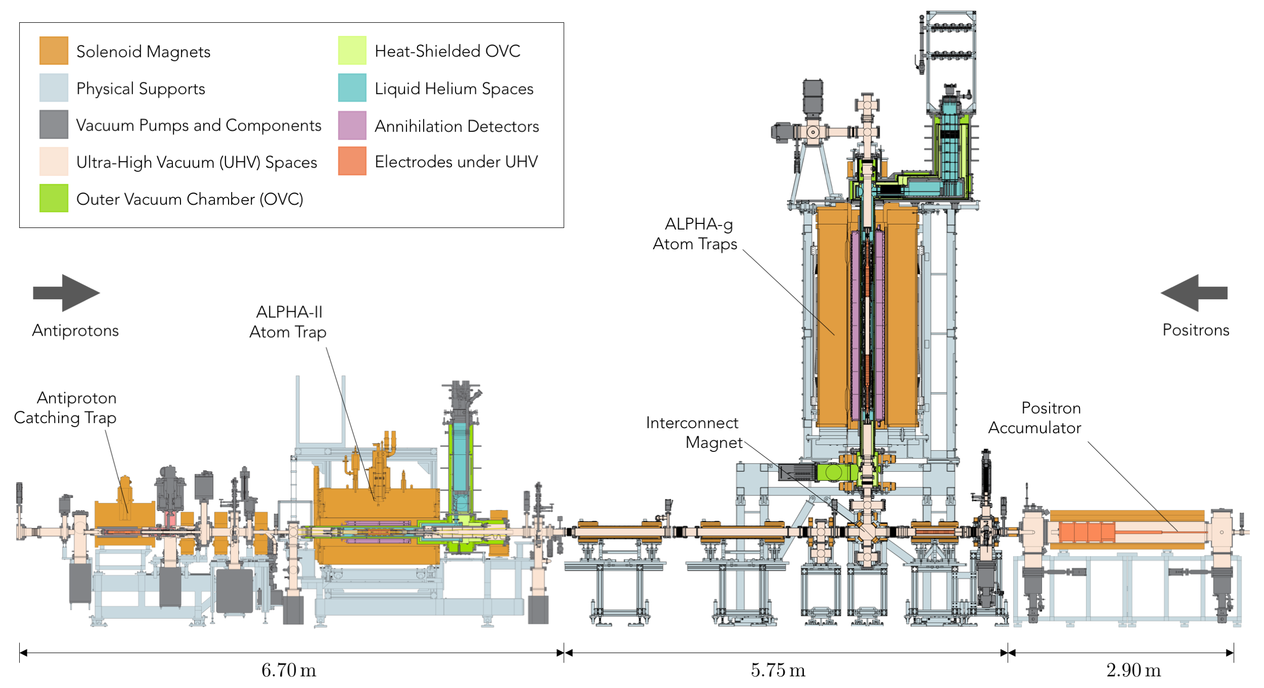
ALPHA Antihydrogen Experiment at CERN
ALPHA-g
ALPHA-3
3m
ALPHA-Canada, led by TRIUMF: Largest group, > 1/3 of ALPHA

Slide 8
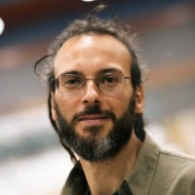
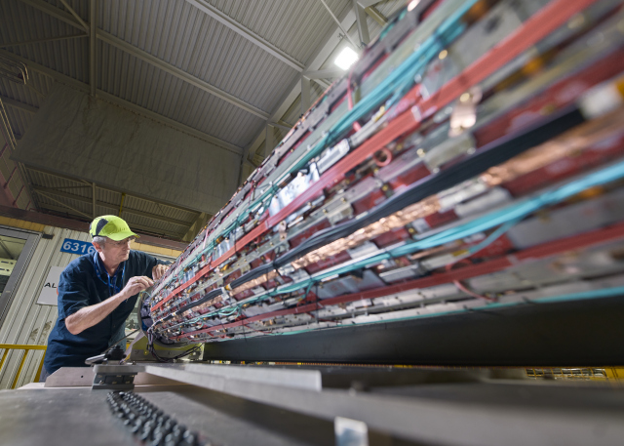
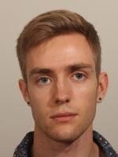
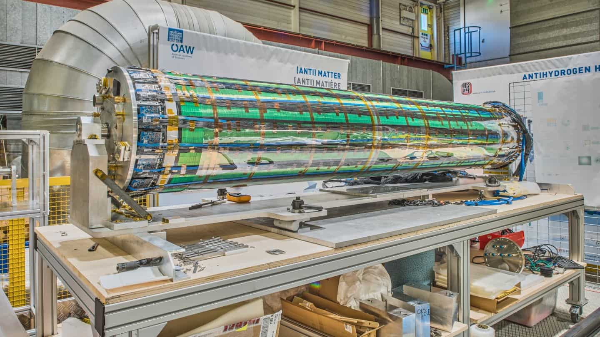
ALPHA-g TPC: synergies with T2K
Radial TPC front end, modelled after T2K TPC (”After” ASIC chip)
Barrel Veto, used SiPM based scintillators

Slide 9


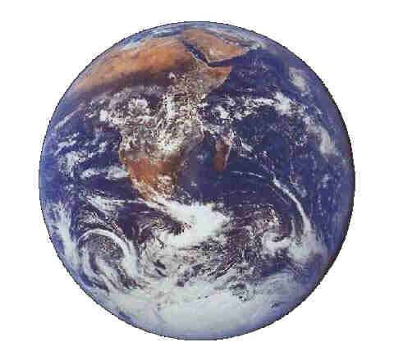
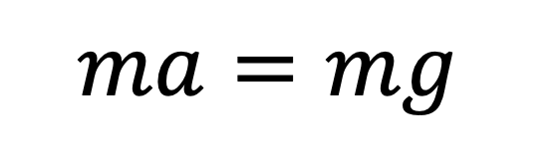
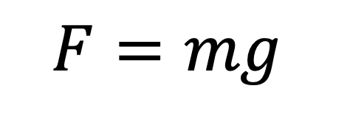
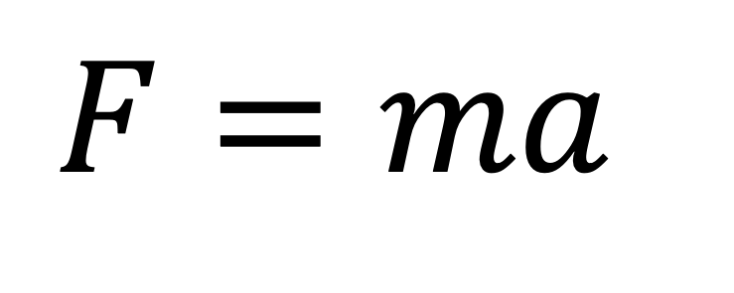
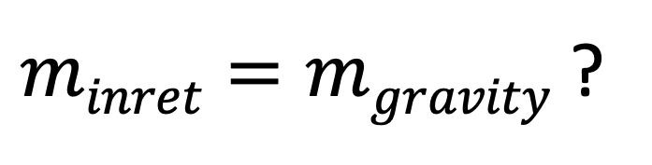

A bit of background
$$F=ma$$
g
g
Gravity force is given by
$$ma=mg$$
$$F=mg$$
g: Gravitational acceleration
(9.8 m/s²)
$$a=g$$
Gravity is universal!
$minret=mgravity$ ?
Test of Weak Equivalence Principle

Slide 10
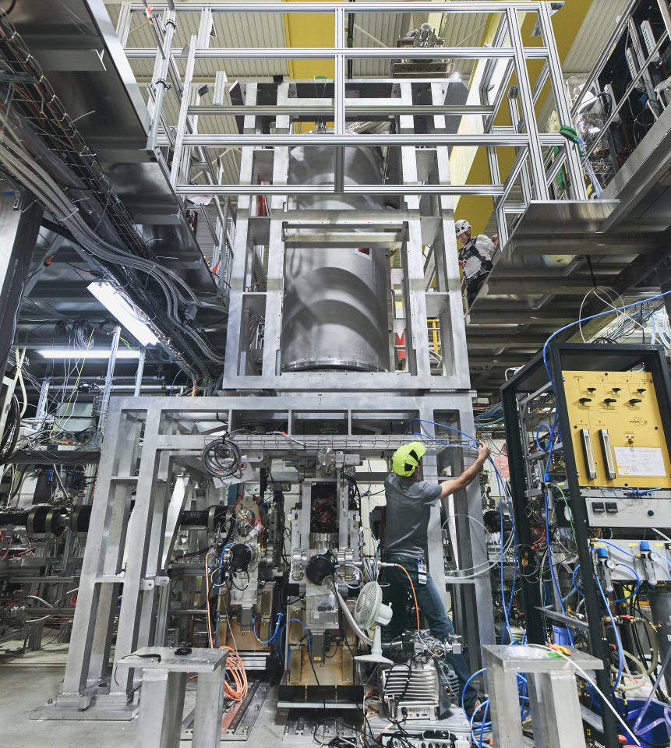
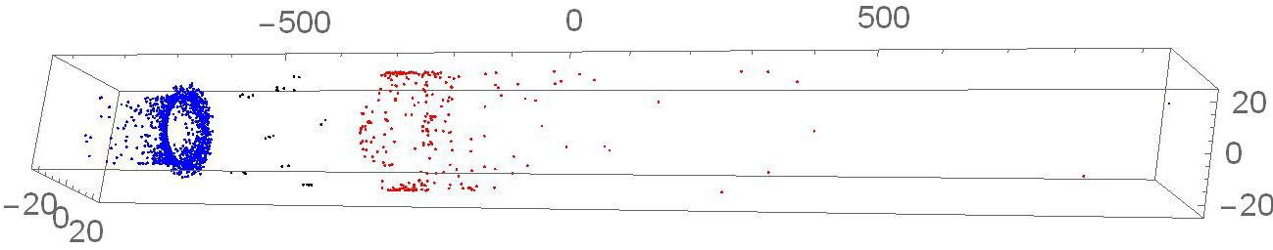

Motivations
Does antimatter fall in gravity same as matter?
Next Step: HAICU
No one has seen antimatter fall
—until recently
ANTIMATTER x GRAVITY
x QUANTUM
mm
High precision tests of Equivalence Principle
via quantum control of antimatter
e.g. (anti)atomic fountain
(anti)atomic Interferometer
First observation of antimatter free fall
(Nature 2023)

Slide 11
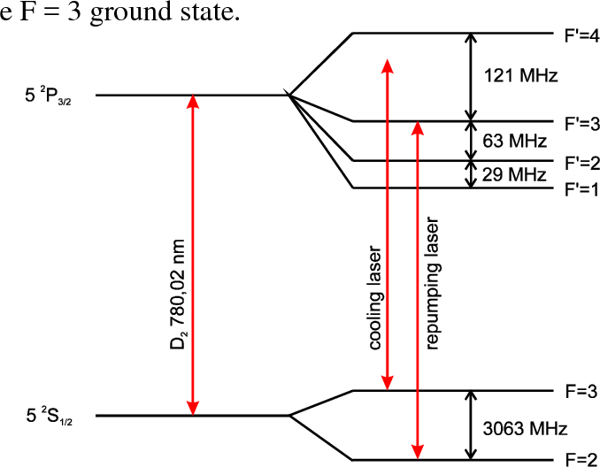
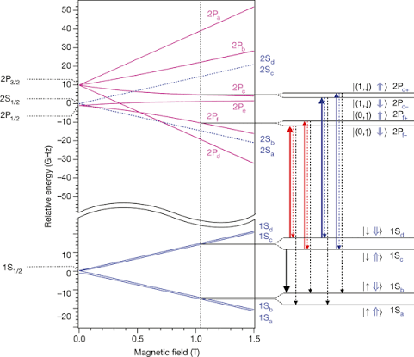
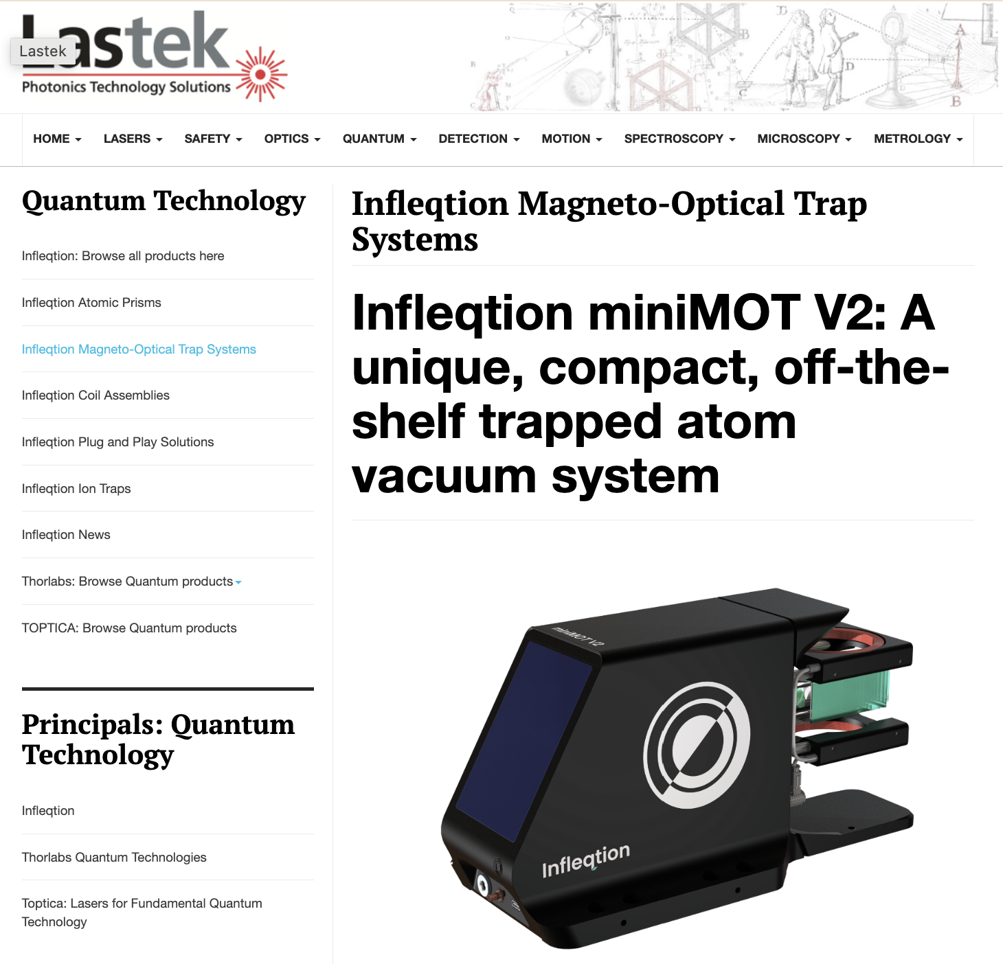

Why is quantum manipulation of (anti)H so hard?
Normal atoms, e.g. Rb
Antihydrogen / Hydrogen
Fundamental
Transitions ~ 780 nm
(1.6 eV)
Fundamental
Transitions 121 nm
（10.2 eV)
Lasers, or even traps, commercially available
Vacuum ultra-violet (VUV) light:
Does not transmit in air
No solid-state laser medium
Optics; e.g. windows only 50% efficiency
High-power narrow-line 121 nm laser would enable quantum control → goal of QUP laser project

Slide 12
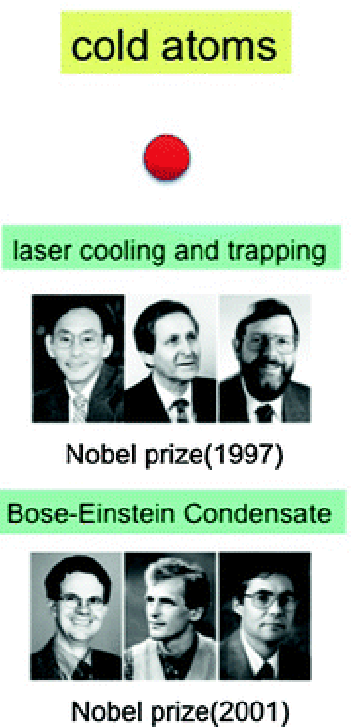
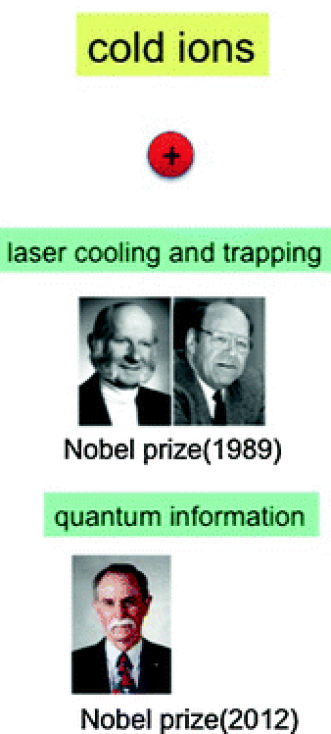
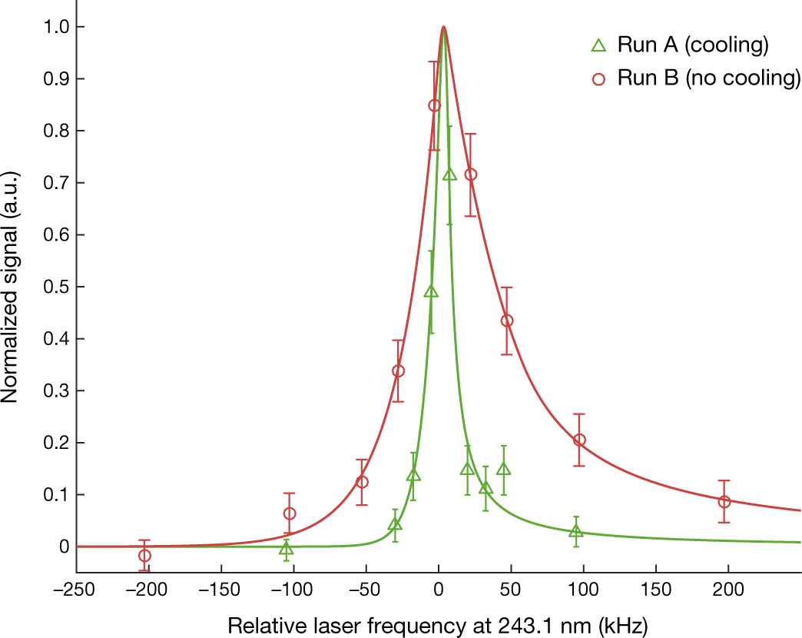
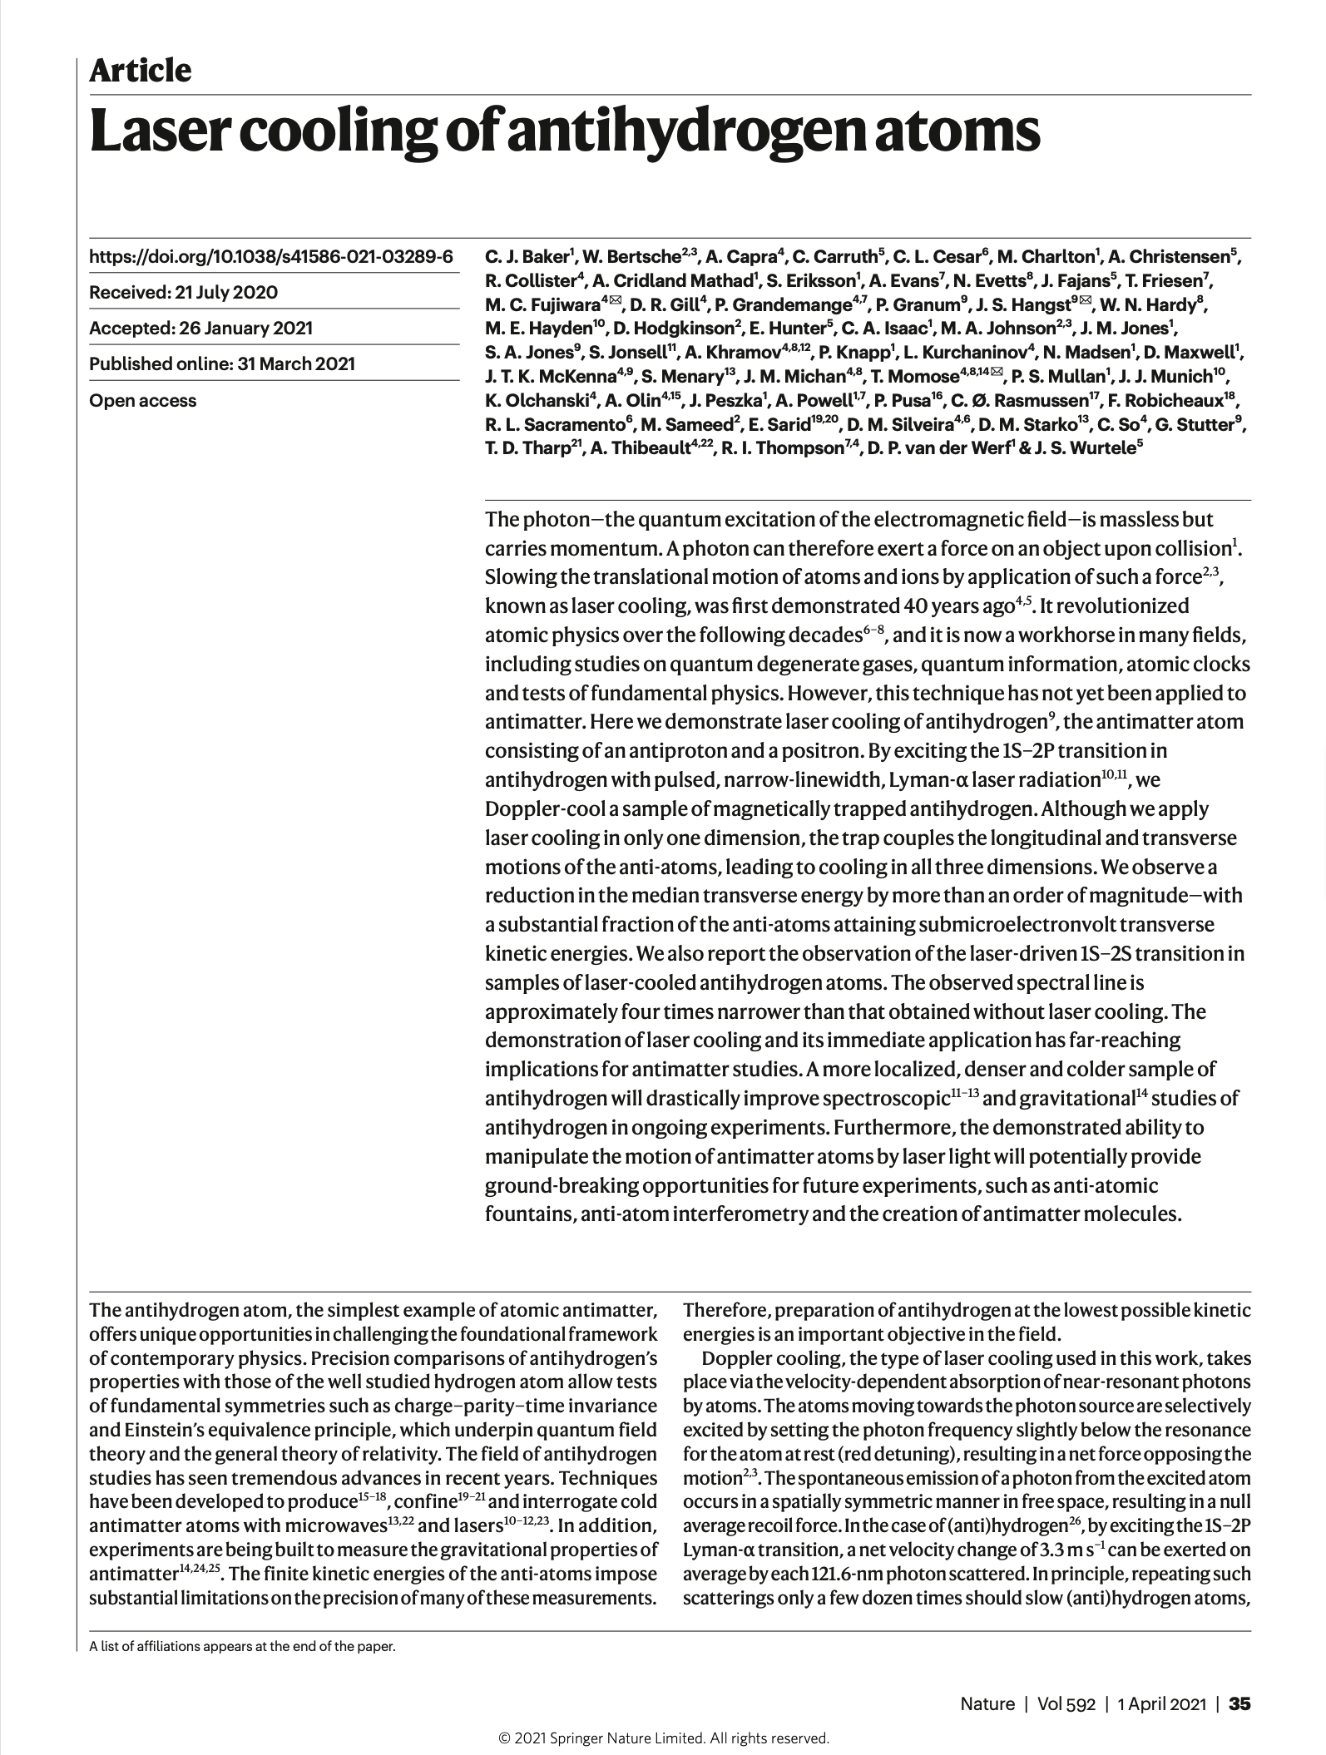
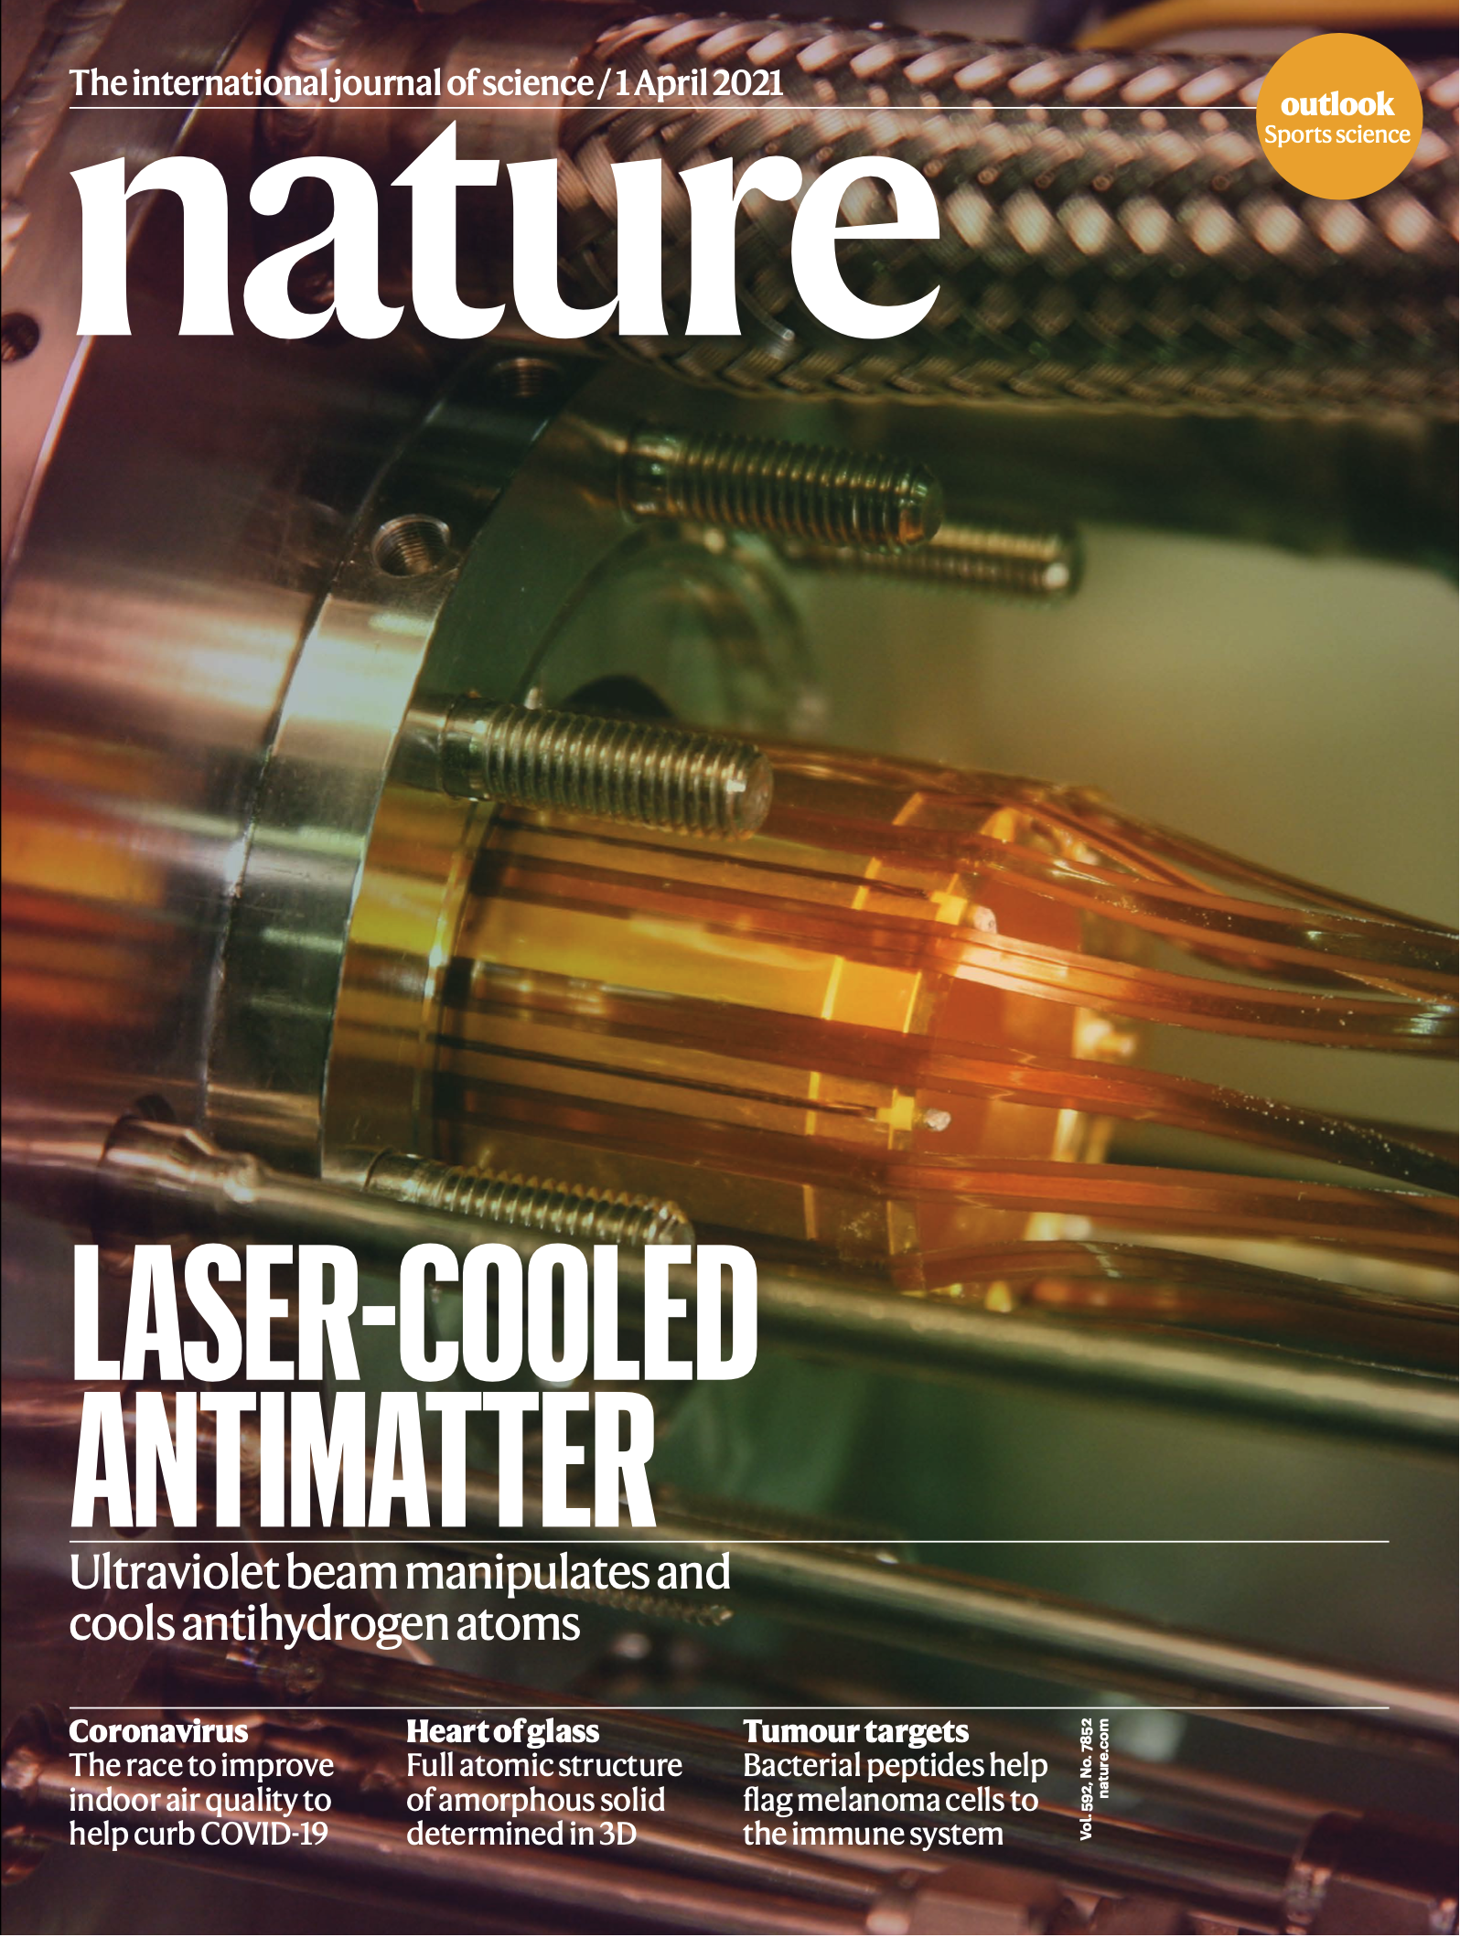
Laser cooling of antihydrogen
Laser cooling of atoms, ions revolutionized atomic physics in last 40 years
antimatter atoms
Laser cooling and trapping
Trapping (2010)
Cooling (2021)
CPT, WEP violation?
???
S. Inoue, 2017
Laser cooing demonstration: First step
April 1st, 2021, Cover

Slide 13
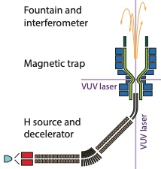
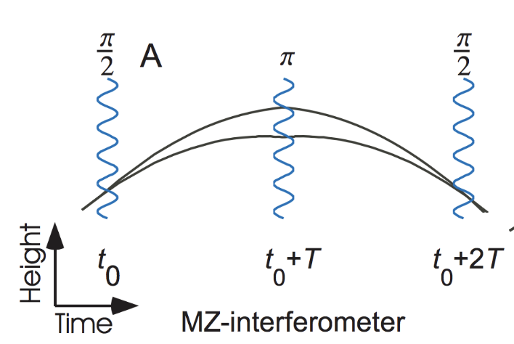
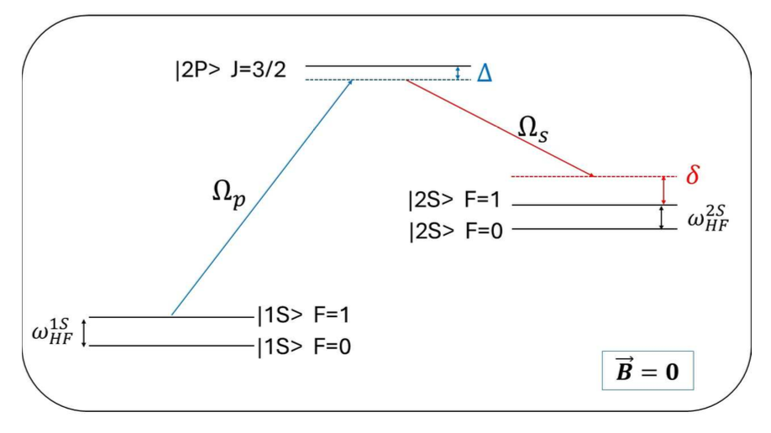
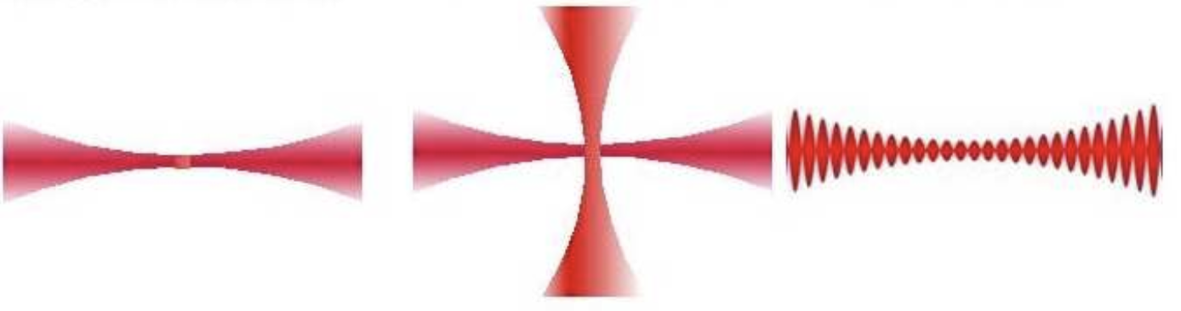
Quantum techniques for (anti)hydrogen gravity & beyond
Anti-atom Interferometers
Coherent Manipulations
Laser-cooled anti-atomic fountains
Anti-P
Anti-P
—
+
—
e+
Optical traps and clocks
Antimatter molecules
High power, narrow linewidth 121 nm Lyman-alpha laser is needed!

Slide 14
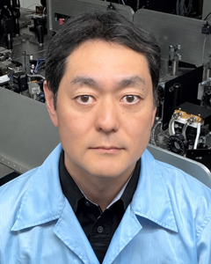
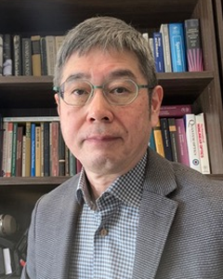
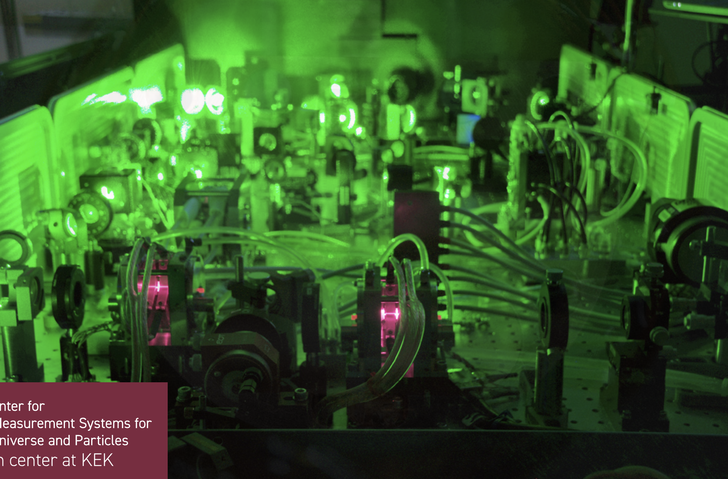
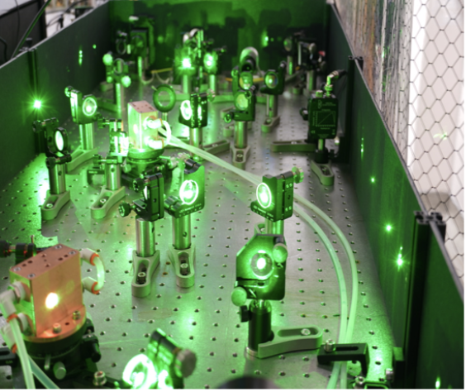
World’s unique laser development
Oishi
Momose
KEK/J-PARC
UBC/TRIUMF
QUP
10 uJ/pulse
100 MHz width
5 ns pulse length
X
=
World’s Highest Power
Narrow Line Pulse
Laser at 121 nm
>30 yrs of laser development for muon physics
121 nm via 4 wave mixing
Broad linewidth ~ 100 GHz
High power: ~ 30 uJ/pulse
>25 yrs of anti-H experience
Laser cooling on anti-H
121 nm via 3rd Harm. Gen.
Narrow line via cw seeding
Low power ~ 10 nJ/pulse
New VUV technologies
(phase & time shape control of ns pulses)

Slide 15
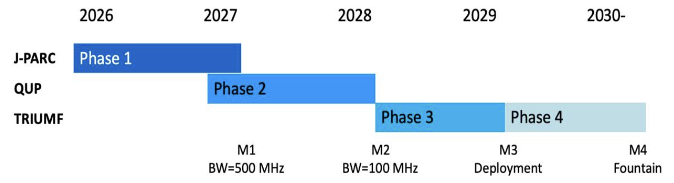
QUP Laser Project Timeline
Antimatter gravity at CERN→
Precision goal:
Δg/g: 10^-6 level
(prospects)
Initial WPI Period
Laser deployment
to HAICU at TRIUMF

Slide 16




Summary
TRIUMF-QUP collaboration
  New development since last symposium in Jan 2025
  Emerging opportunity in Quantum Research in Antimatter and Beyond
Discussion with QUP Director Azuma-san at 15:00 tomorrow （Theory Room)
Look forward to fruitful collaboration!

Slide 17
Back up

Slide 18
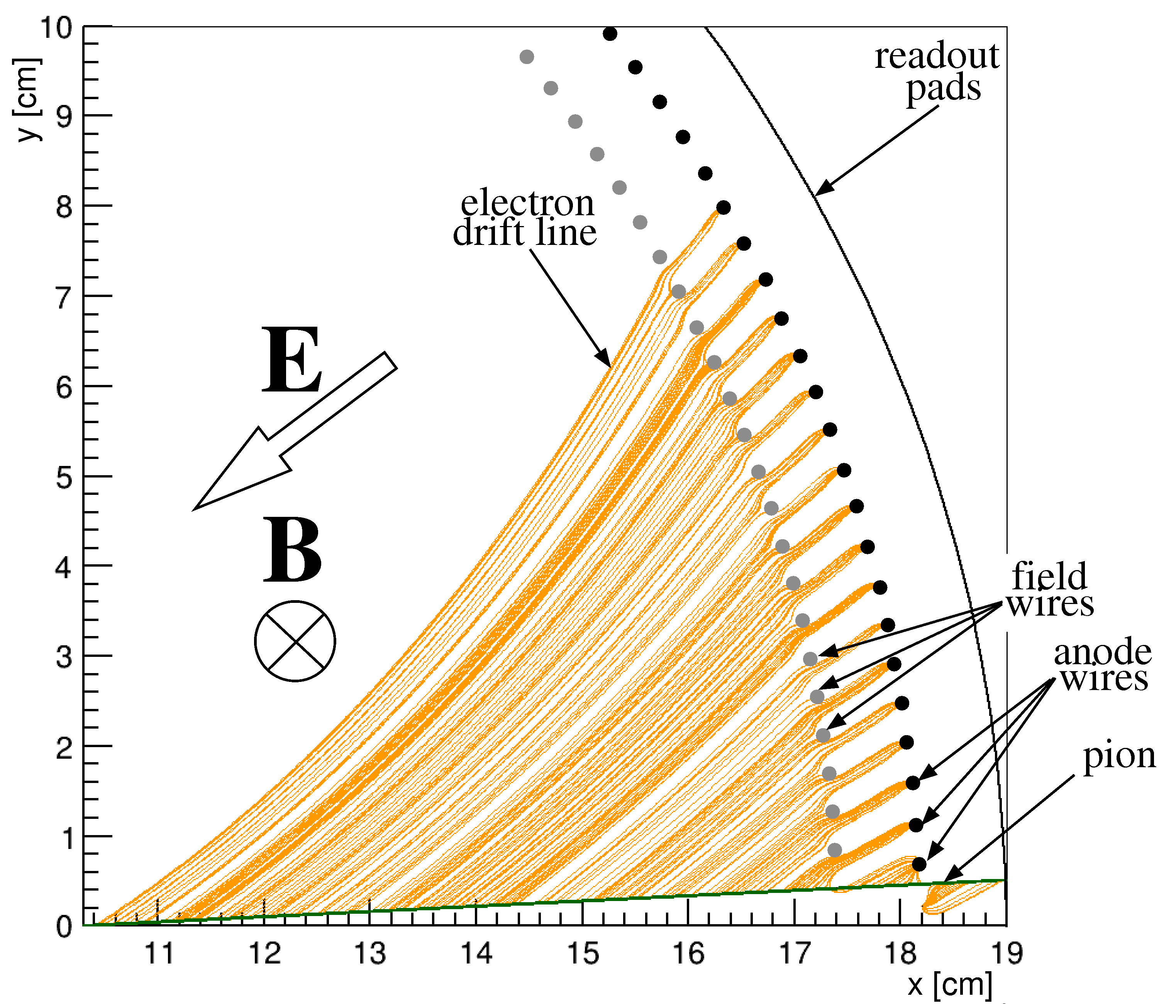
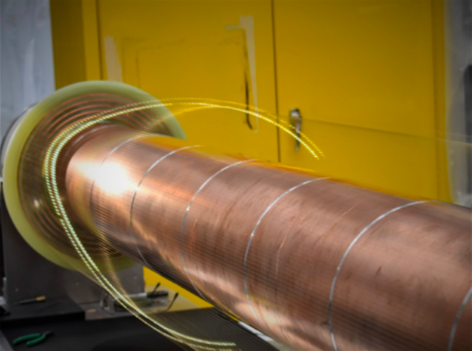
ALPHA-g detector system requirements
Tracking: Key for ALPHA successes!
  Annihilation position (few mm)
    Limited by multiple scat.
  Good pattern recognition
  Uniform efficiency
  Long length coverage (~2.4 m)
  Limited radial space (~10 cm)
  Unusual B fields (Solenoid + Octupole)
Radial-Drift TPC
(+SiPM based cosmic veto)

Slide 19
Doppler laser cooling of (anti)hydrogen
Difficult even for H!
  1s-2p transition: VUV 121 nm
  Pioneering work by Walraven et al, 1993
Even more difficult for anti-H!
  Fewer atoms (by 10 orders of magnitude!)
  Low excitation rates, no collisions
  Limited optical access
  Proposal Donnan, Fujiwara, Robicheaux, 2012
L. LeBlanc
Makoto Fujiwara
Notes:
By shooting red-detuned near resonant light onto moving atoms, you can slow its translational motion;
It’s hard for H because of the required laser at VUV; only done by one group; pioneering work by Walraven et al in 90s

