Slide 1
CMMS Activities,
focused on
Muon Imaging
and
Muonic X-Ray Analysis
Kenji M. Kojima
Centre for Molecular and Materials Science
(CMMS), TRIUMF and
Stewart Blusson Quantum Matter Institute
(SBQMI), University of British Columbia
v. 1200

Slide 2
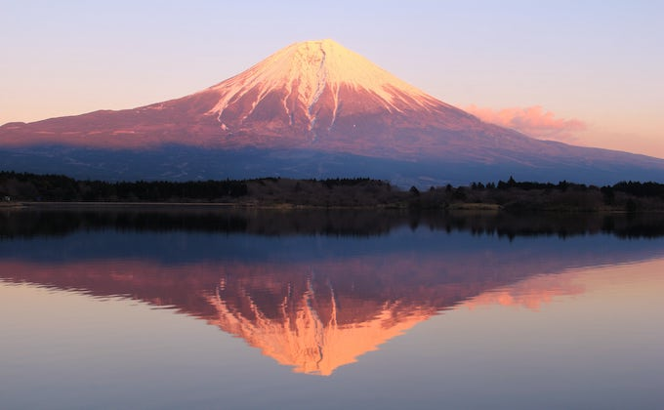
Particle / Nuclear physics and Materials Science (my view)
Peak science
Particle/Nuclear physics
Community and facility
efforts
Technology transfer
Detector crystals, new materials…
Electronics, beam optics, cryogenics, DAQ…
Broad science
Materials Science community efforts
Research infrastructure (facility)
Accelerator
Photo:https://fujiwater.co.jp/column/fujisan/photographed-place-of-upside-down-fuji.html

Slide 3
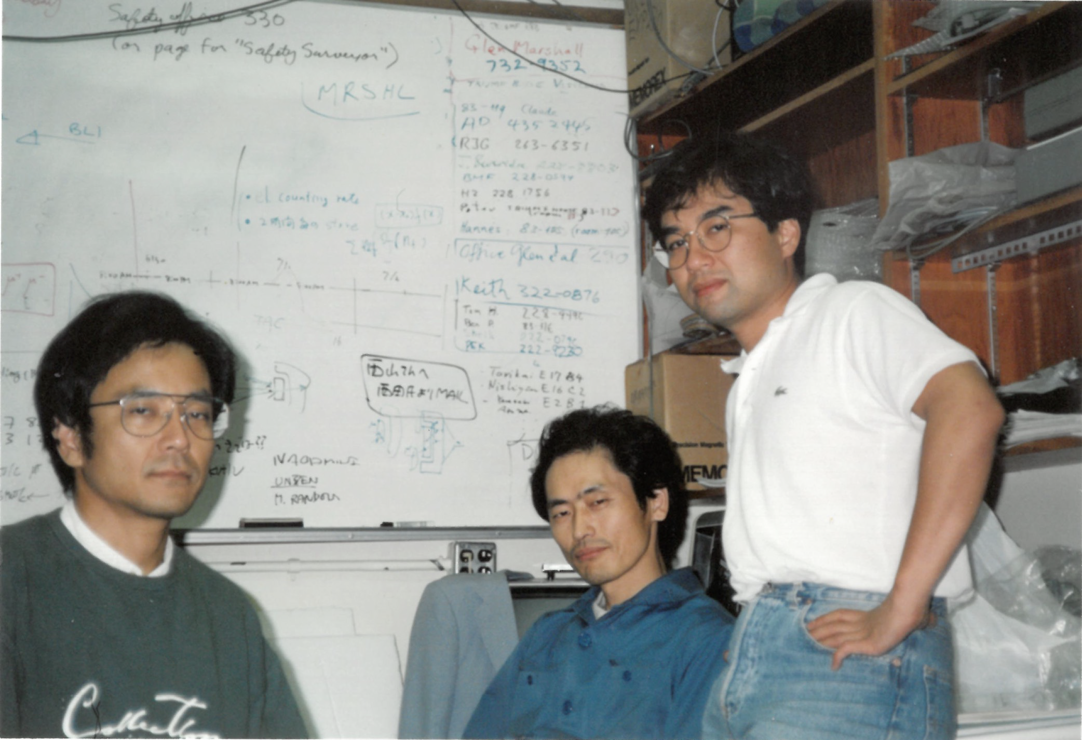
People Trajectories
  Kenji Kojima
  1968 born in Niigata
  1991 Nagamine gr.
  UTMSL/KEK muon TRIUMF M9B expt.
  1996~ Columbia U.
  1998~ U. Tokyo
  2009~ KEK, IMSS
    built µSR spectrometers
  2018~ TRIUMF
  2025 M9B→M9H
  Toshiyuki Azuma
  KEK muon user
  Makoto Fujiwara
  1991 Torikai gr.
  KEK muon user
  1992 UBC Gren Marshall gr.
    µCF at TRIUMF
  2005~ ALPHA at CERN
  Shoji Asai
  1990 Orito gr.
  ATLAS at CERN
Toshiyuki
Azuma
Kusuo
Nishiyama
built M9B
In 1986
Yasunori
Yamazaki

Slide 4
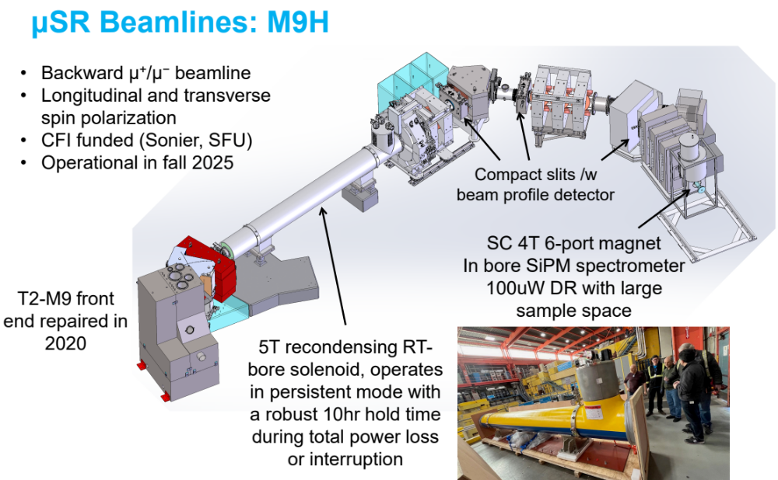

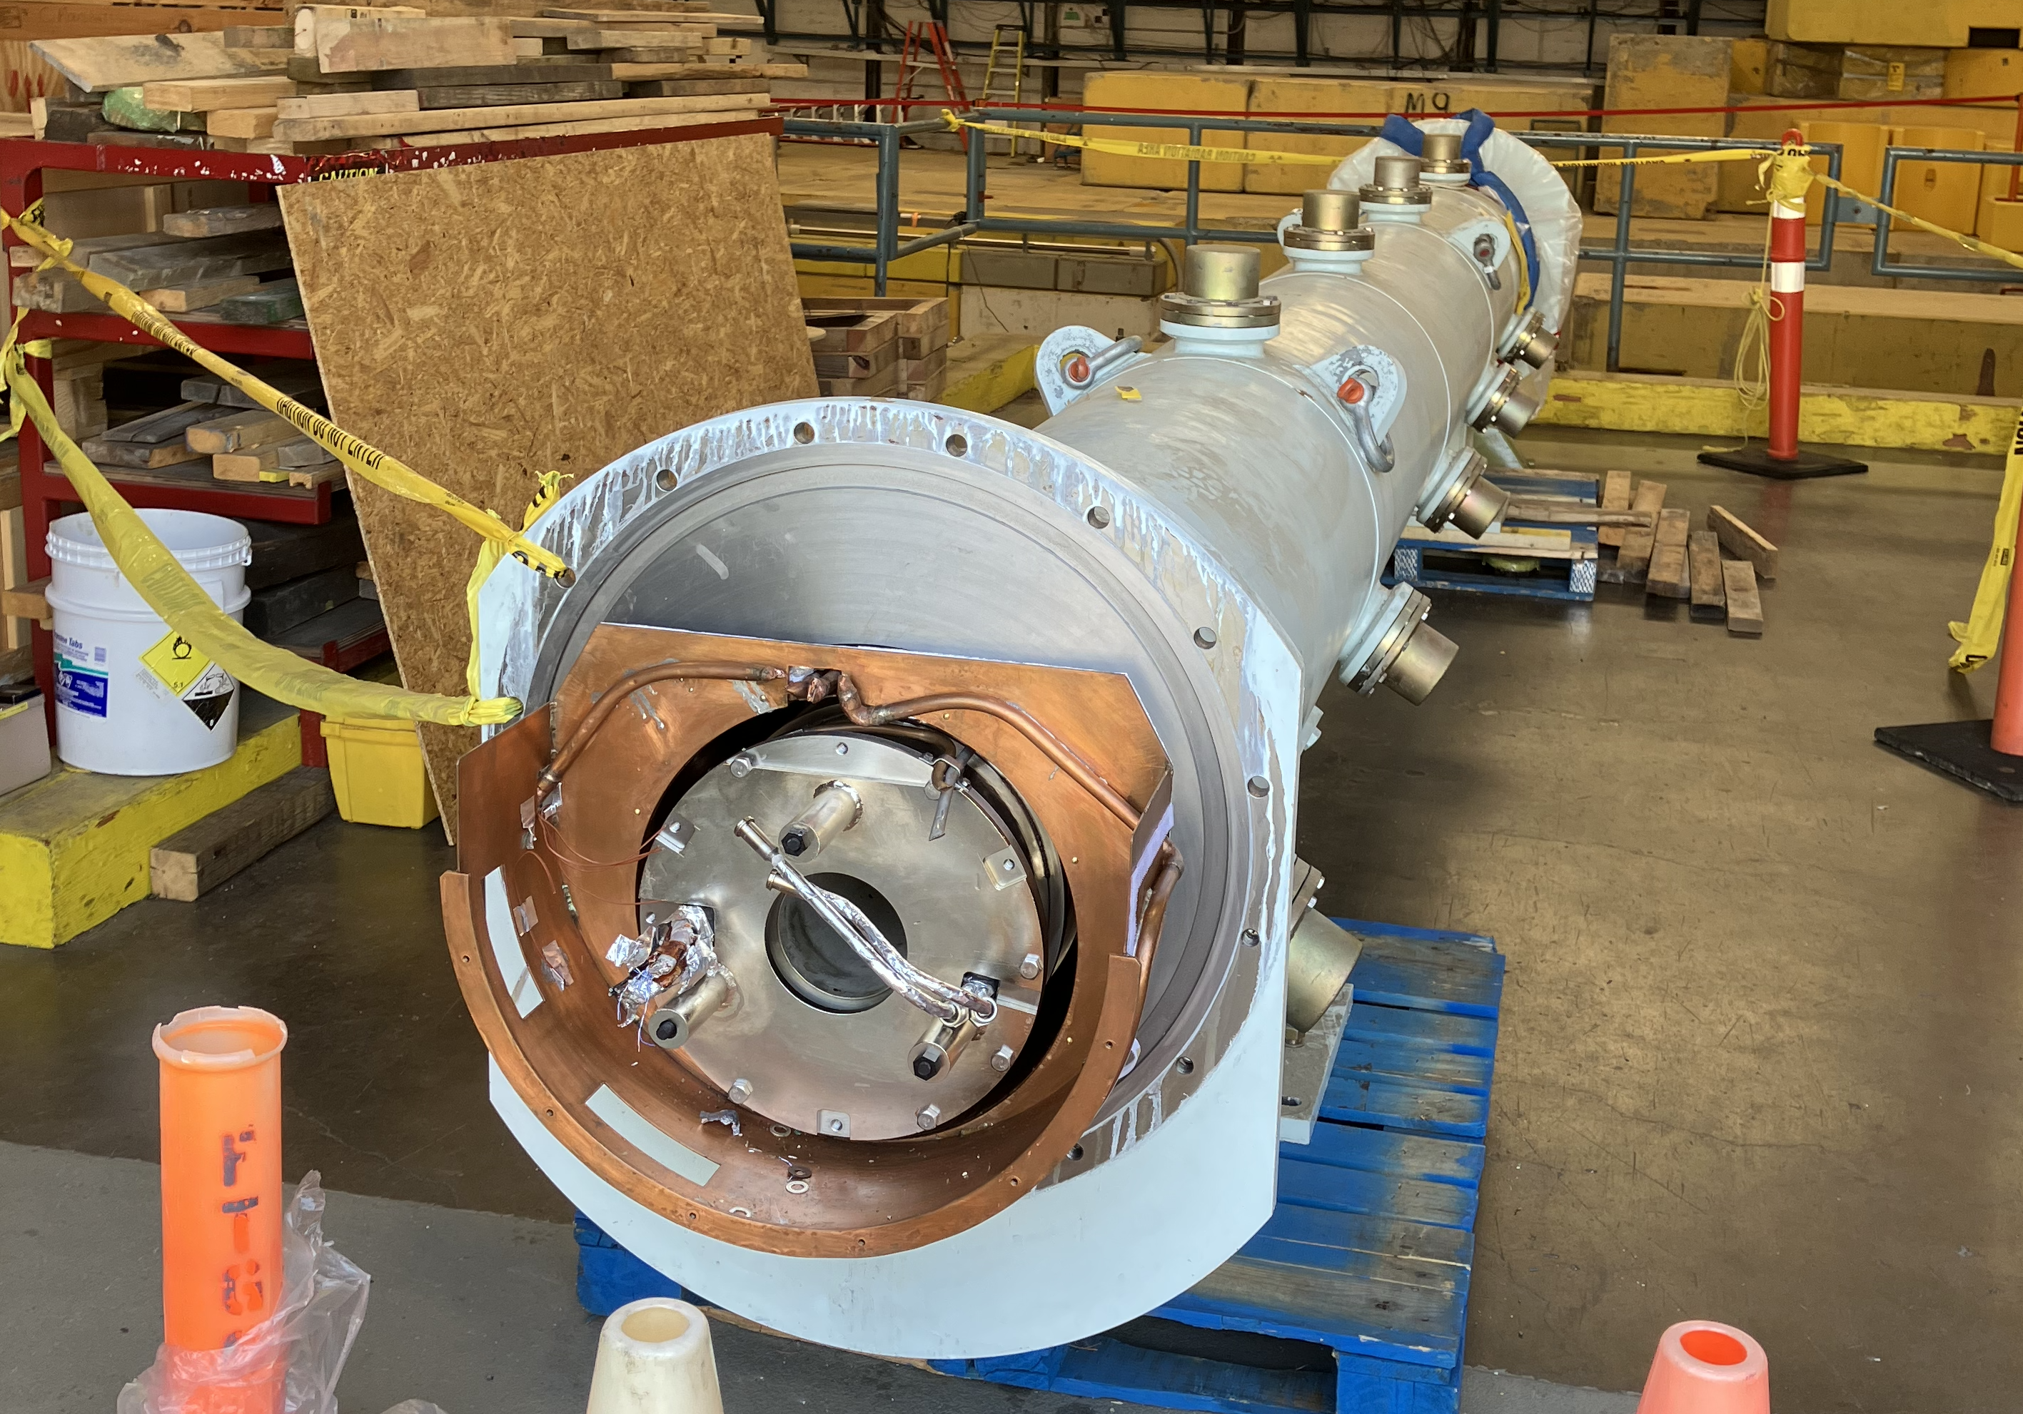
(completed and operational 2026/1~)
KEK magnets
B3 and final Q’s
Project Engineer
Mahdiar Khosravi
Old M9B solenoid
(1986~2024)

Slide 5
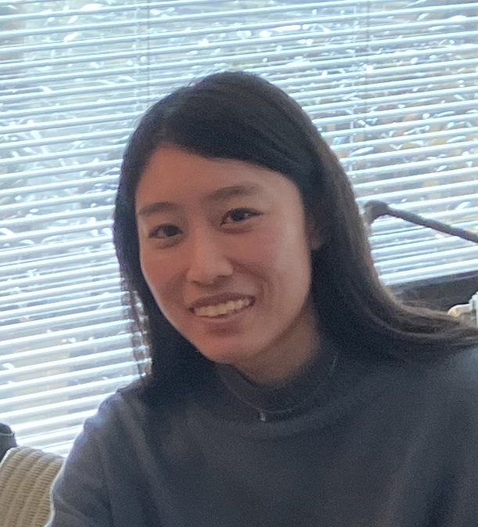
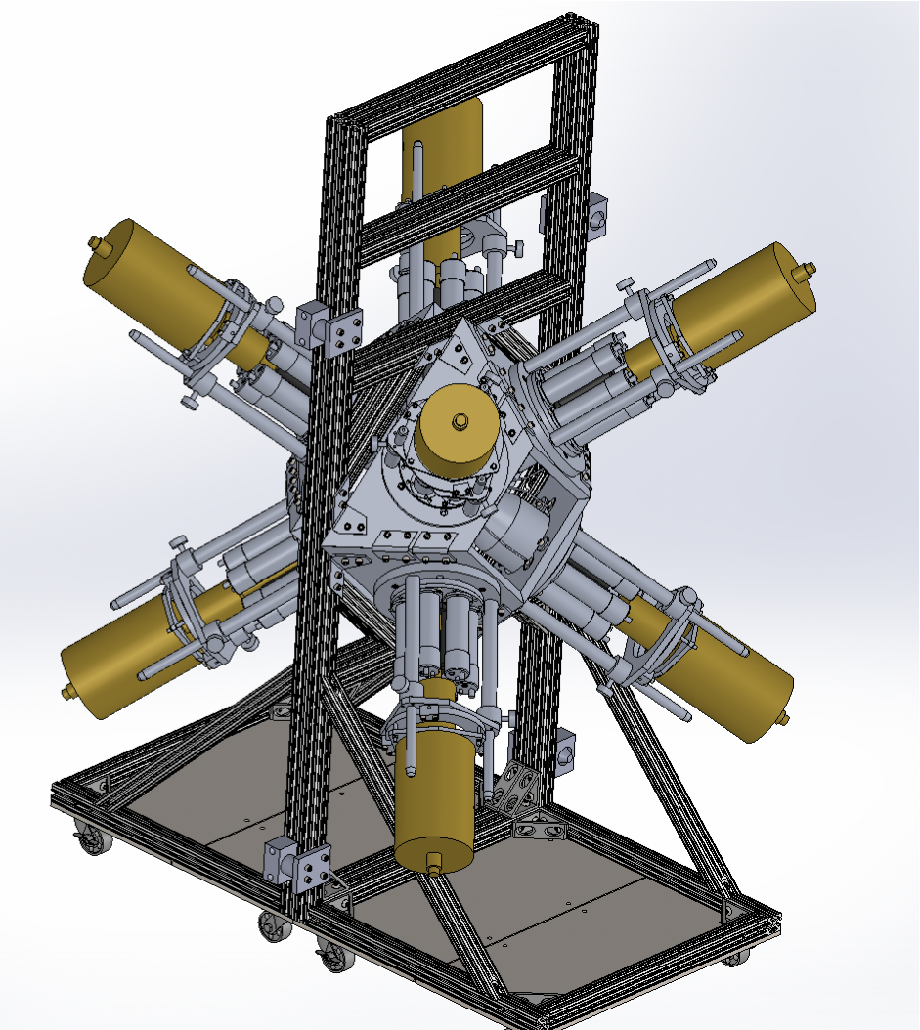
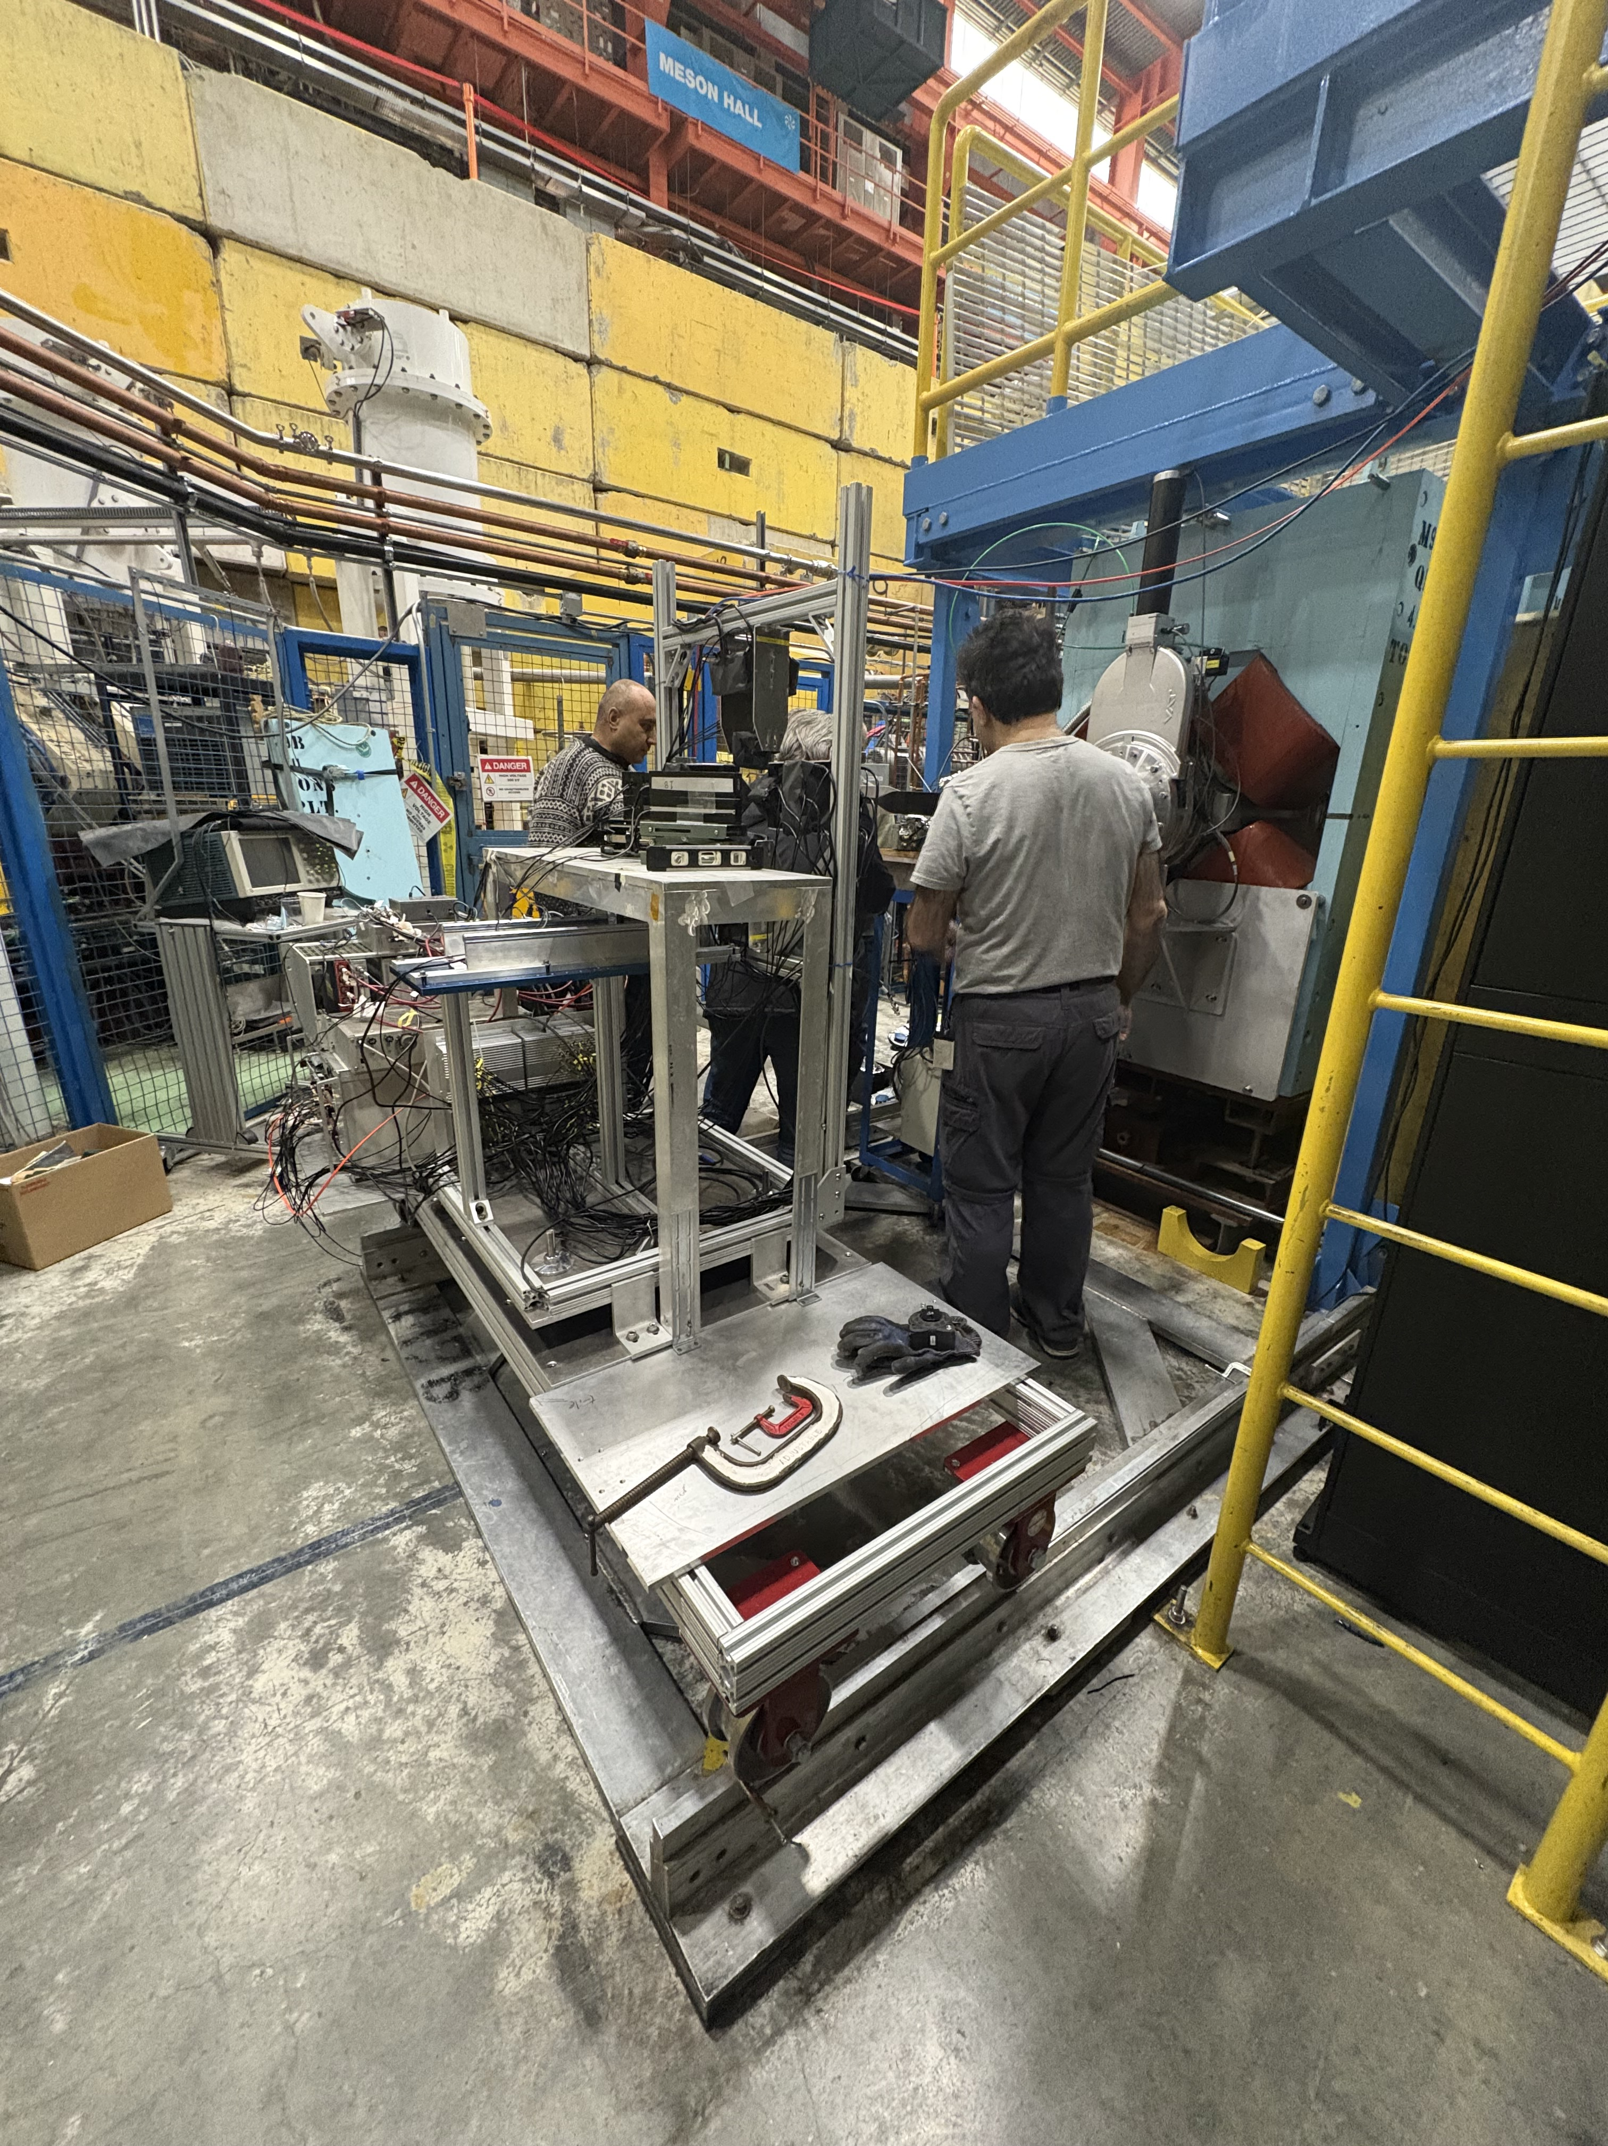
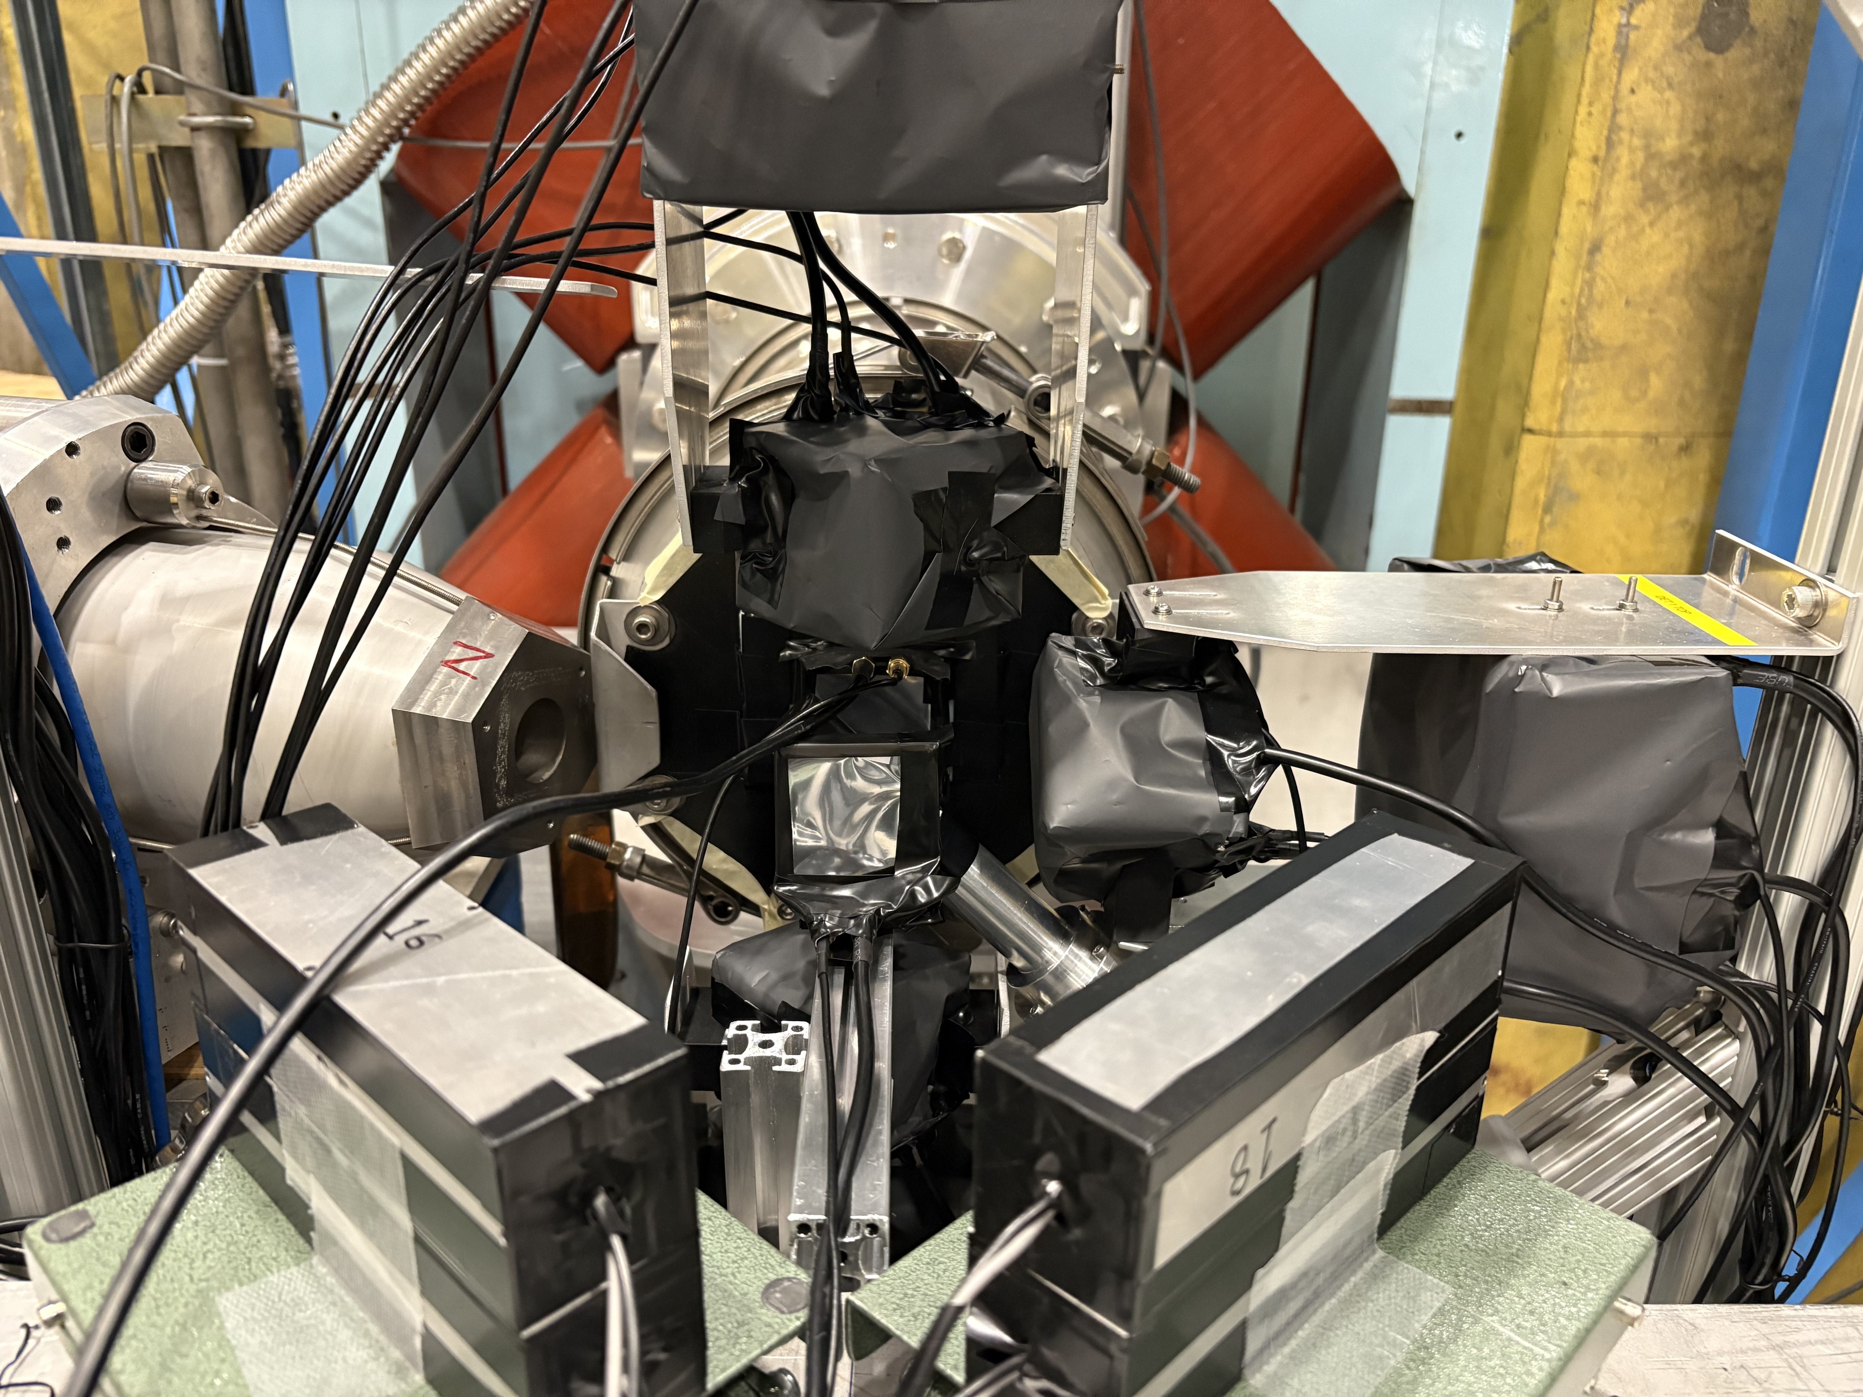
1. The first negative muonic X-ray measurement
Rurie Mizuno
  2025/4~2026/2 (JSPS oversea fellow at TRIUMF)
  2026/3~ (Riken postdoc at Nishina Centre)
+ Kris Starosta gr. (SFU) and TRIUMF Nucl. Phys. gr.
Octo-Pi (HPGe array for
Gamma-ray )
Identical frame
with Octo-Pi
Plastic sci. for neutron TOF
(Gren Marshall’s SiPM used)
HPGe w/BGO
Organic glass sci. for neutron energy

Slide 6
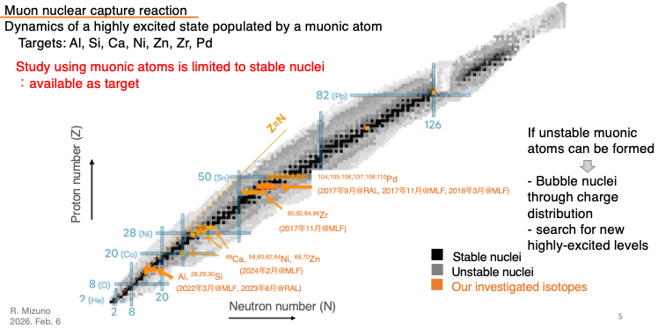
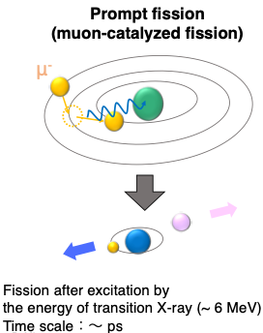
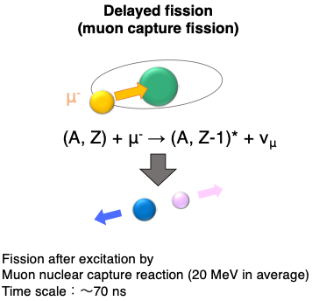
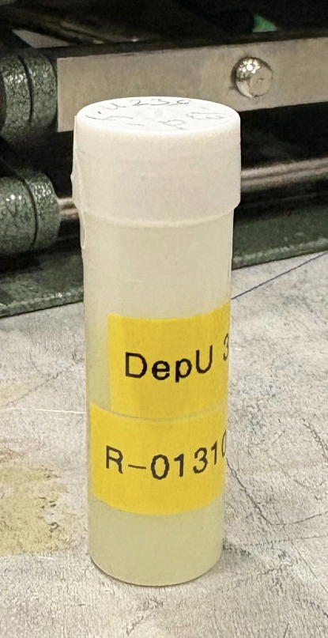
Idea of Rurie’s experiment
Two fission modes for >Uranium (Actinides)
Veto
6mm
Thin Muon
t 3mm
U
PMT
Negative muon stays with the fission product: muonic X-ray analysis of n-rich rare isotopes
²³⁸U + liq. Sci.
Initial target material is ²³⁸U

Slide 7
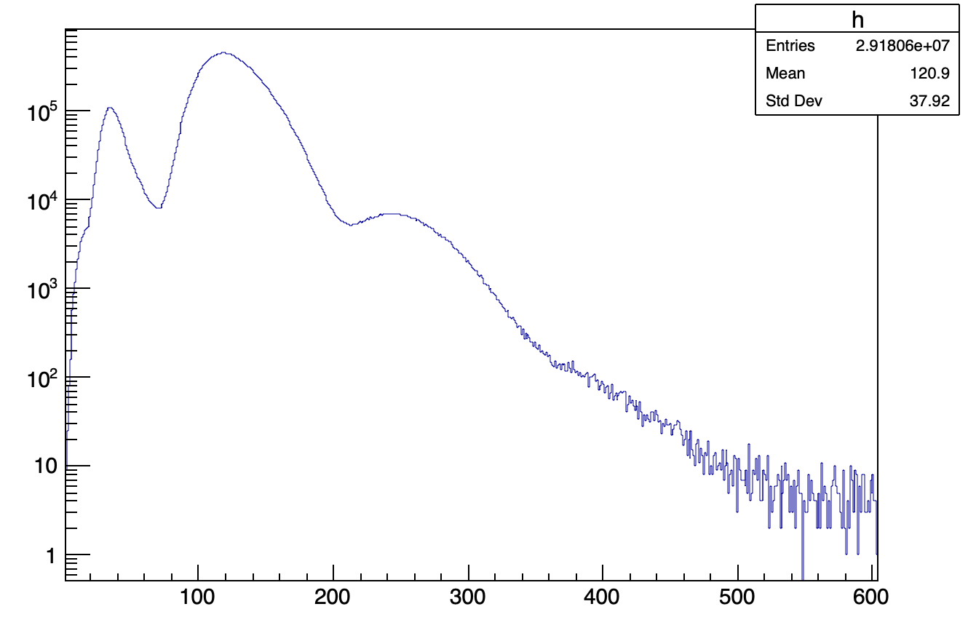
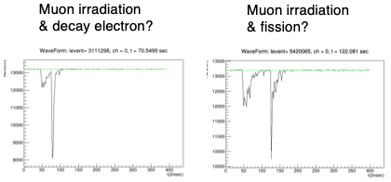
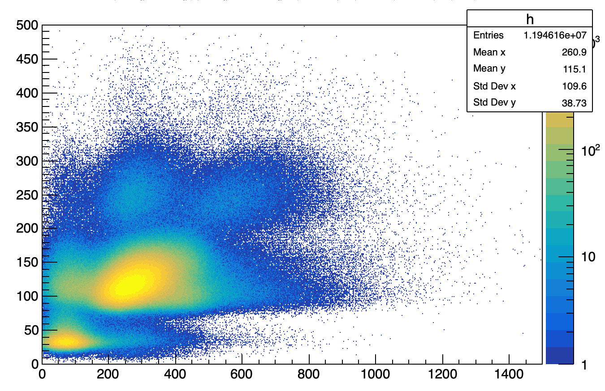
Muon was already too bright with liq. scintillator !
e⁻
µ⁻
Commissioning of M9H
01/28~29 2026
(Positive muon)
60, 90 MeV/c,
max. 80k µ+/sec
(one Q magnet is off)
01/29~02/02 2026
(Negative muon)
60 MeV/c + X-ray
10~50k µ-/sec
10~15% e- contamination.
02/02 2026 (Mon)~
long shutdown 2026
2 x µ⁻ (within 500ns)
Counts (a.u.)
Liq. Sci. pulse height (a.u.)
Preliminary
Preliminary
Thin Muon counter pulse height (a.u.)
0
Time (ns)
800
Preliminary
We were expecting that Uranium fission gives much brighter signal than single muon / electron event
→ No, muon signal dominates liq. scintillator.
Thin Muon counter (a.u.)
Veto counter (a.u.)

Slide 8
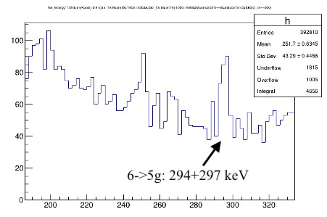
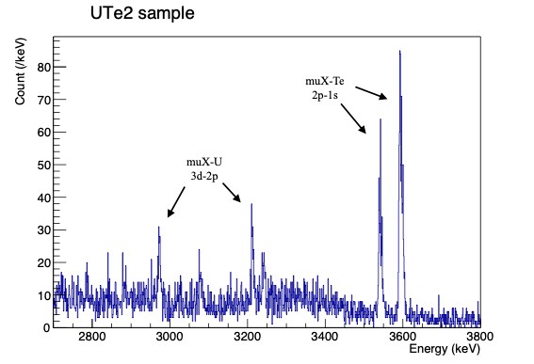
Muonic X-ray spectrum of Uranium
UTe2 Superconductor: µSR sample degraded.
Courtesy from Dunsiger et al.
U + liq. scintillator
3.6MeV
Preliminary
Te (2p→1s)
Counts (a.u.)
Counts (a.u.)
U (3d→2p)
Preliminary
U (6→5g) 294+297 keV
X-ray Energy (keV)
X-ray Energy (keV)
First Uranium (and Tellurium) muonic X-ray signals from M9H were observed !

Slide 9
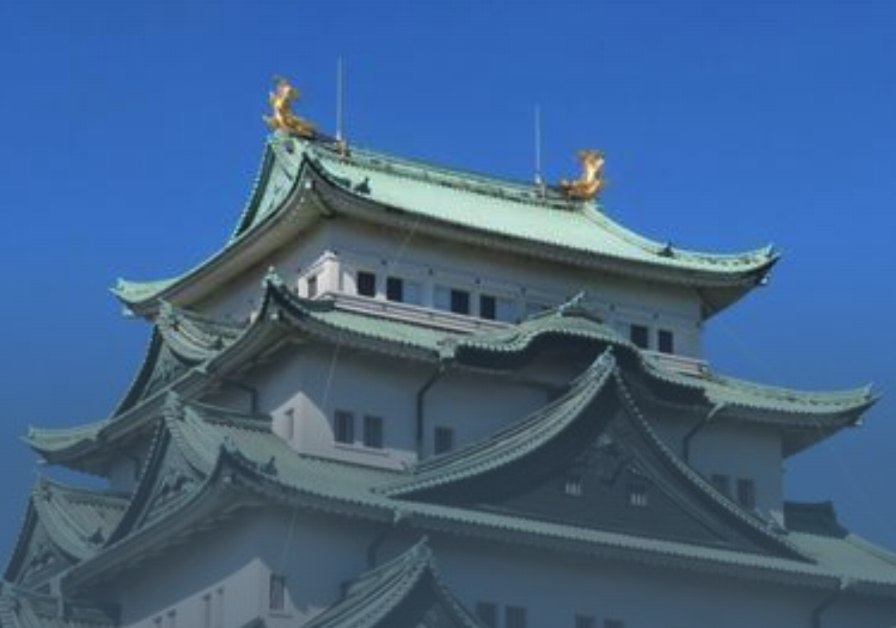
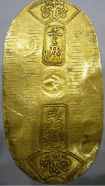
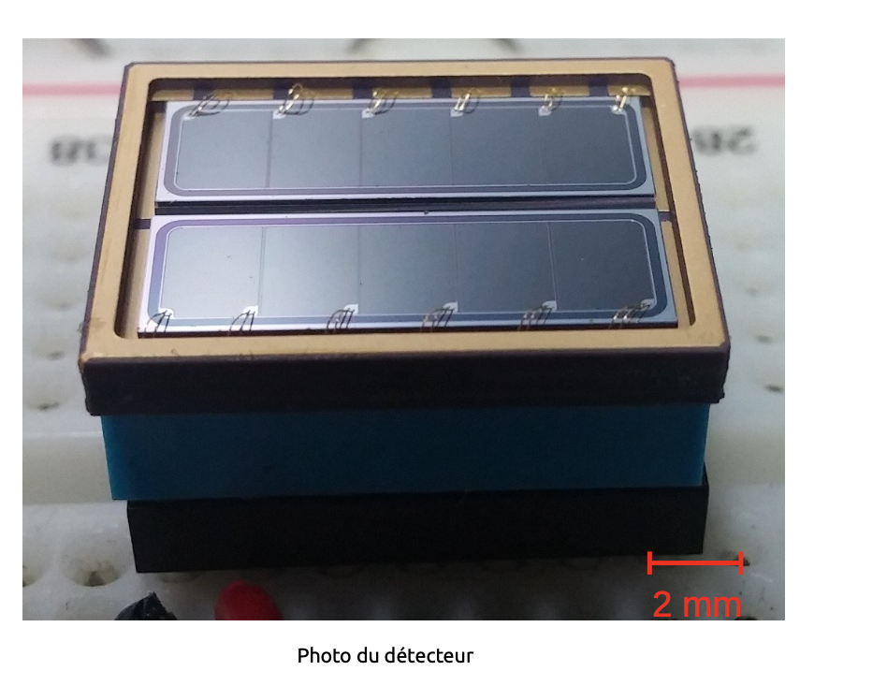
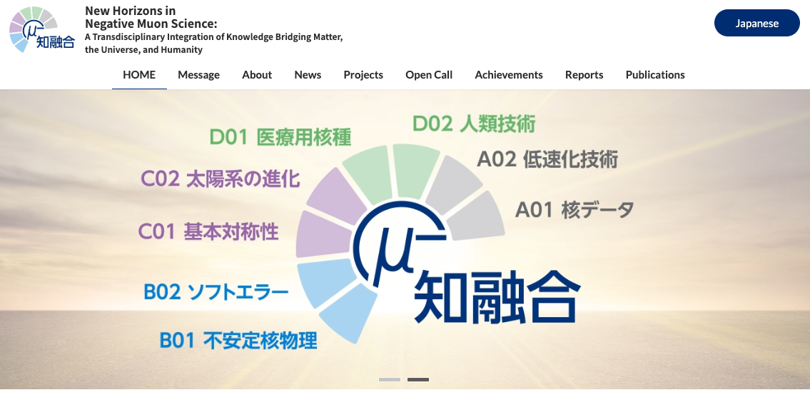
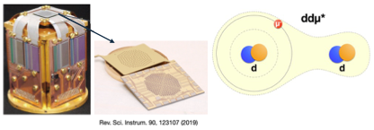
Negative muon experiments in the future
KEK/J-PARC pulsed beam is
~10 years ahead of TRIUMF in µ-
Nuclear physics experiments
Rurie’s
muon-induced fission detection
→ Fission chamber + Si detector being developed at RIKEN.
Archeology / Indigenous study in Canada
Muonic X-ray analysis of elements in the depth
NSERC Discovery Horizons application with Museum of Anthropology, UBC (deadlined Oct. 19, 2026).
TRIUMF’s DC beam is deadtime efficient
Collaboration framework:
K. Shimomura’s (KEK) leading
New Horizons in Negative Muon Science group grant （学術変革)
Idea design
https://mu-horizons.kek.jp/en/
Other experiments being consulted:
e.g. Moonshot for µCF (S. Okada). -- KEK-QUP ?
Azuma’s slide

Slide 10
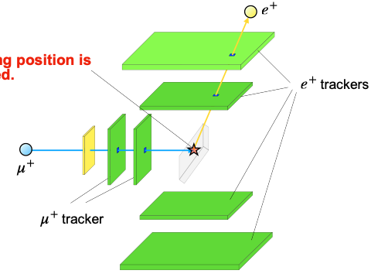
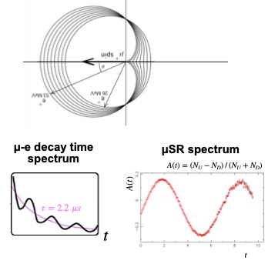
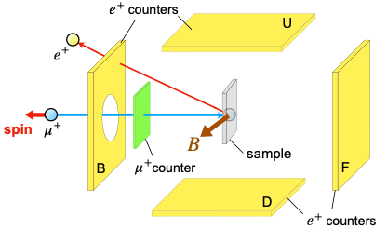
2. Muon Spin Imaging (beyond conventional µ⁺SR)
Slide from M. Mihara (Osaka U.)
e+ trackers
µ+
trackers
Time (µs)

Slide 11
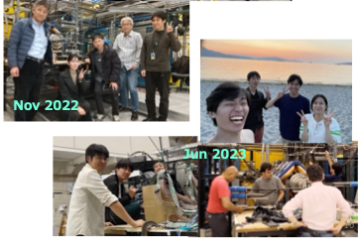
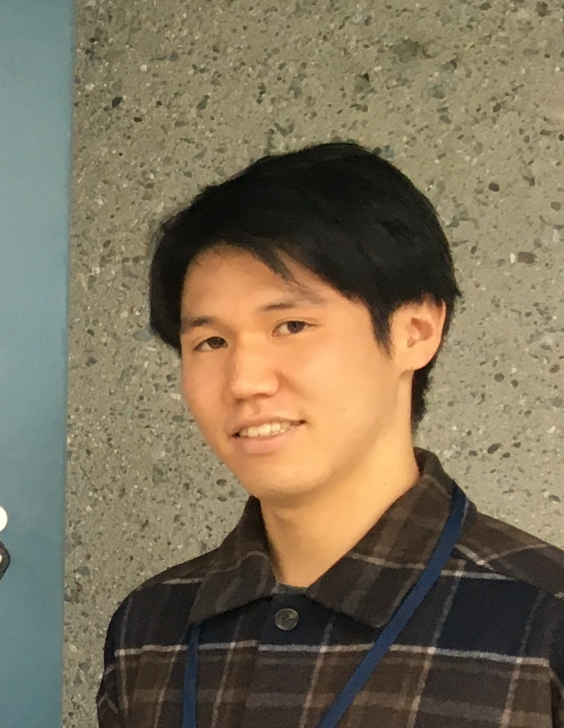
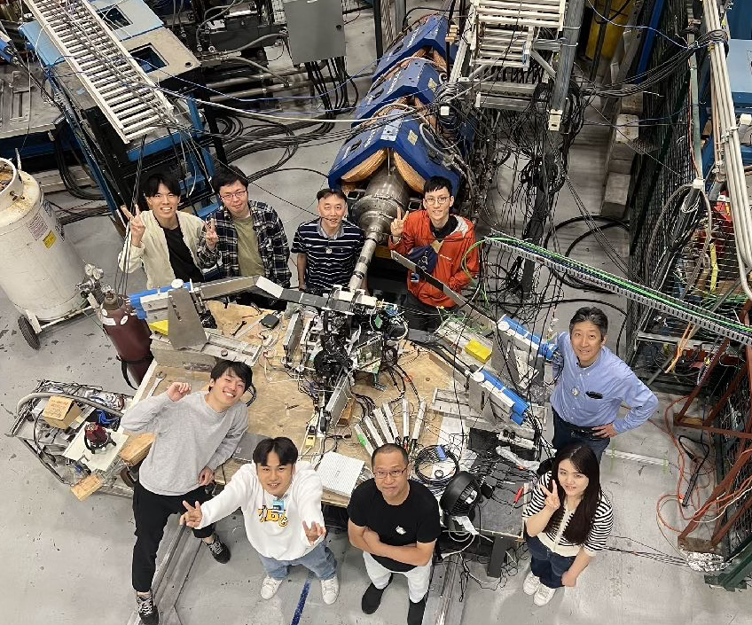
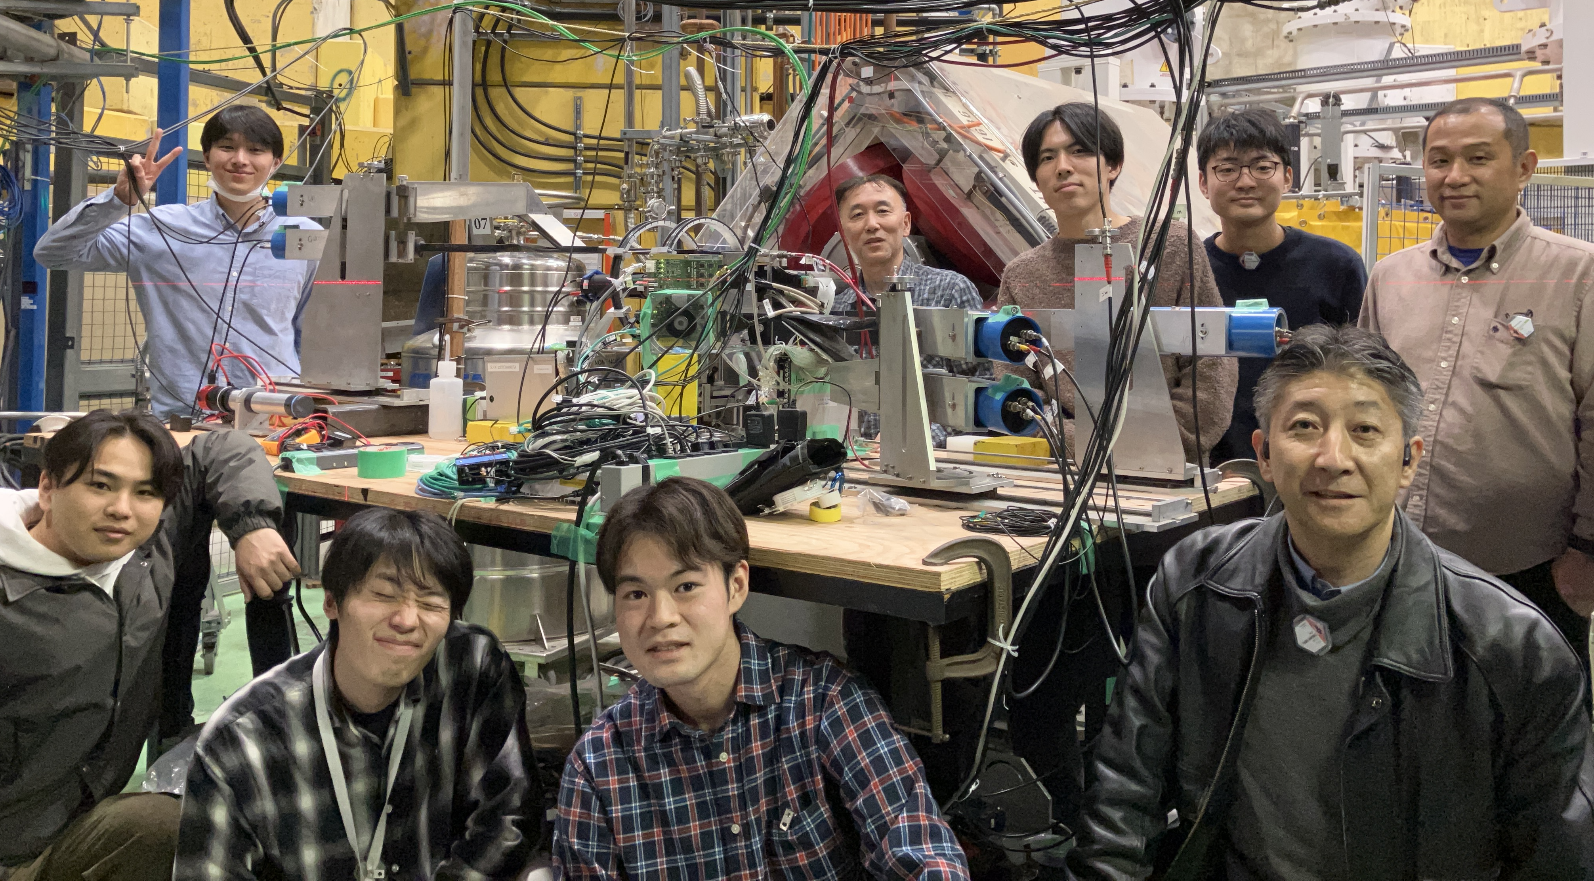
Collaboration with Osaka U. since 2022 at TRIUMF
KEK-TRIUMF EPECR
FY2023: Takato Sugisaki
M20C
FY2025: Soshi Ishitani
Sep 2024
M20C
Dec 2025
Affiliation :
CMMS, TRIUMF,
Dept. Phys., Osaka U., KYOKUGEN, Osaka U., Osaka Elec. Comm. U,
KEK, Kanazawa U., Kyushu U., Tokyo City Univ.,
Tokyo Agri. Eng. Univ.
M20C
M9A

Slide 12
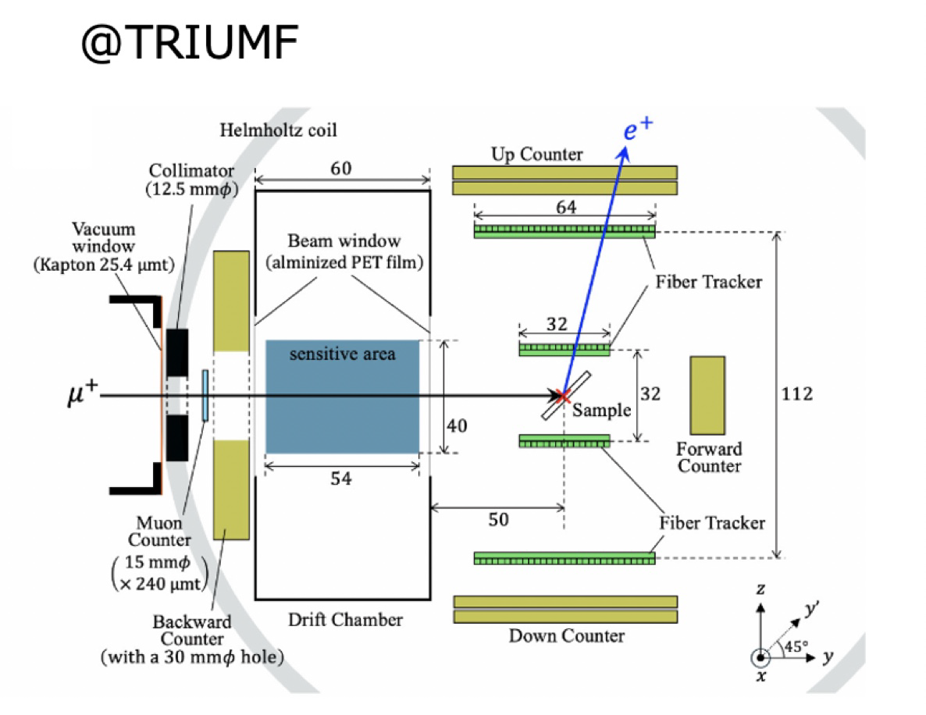
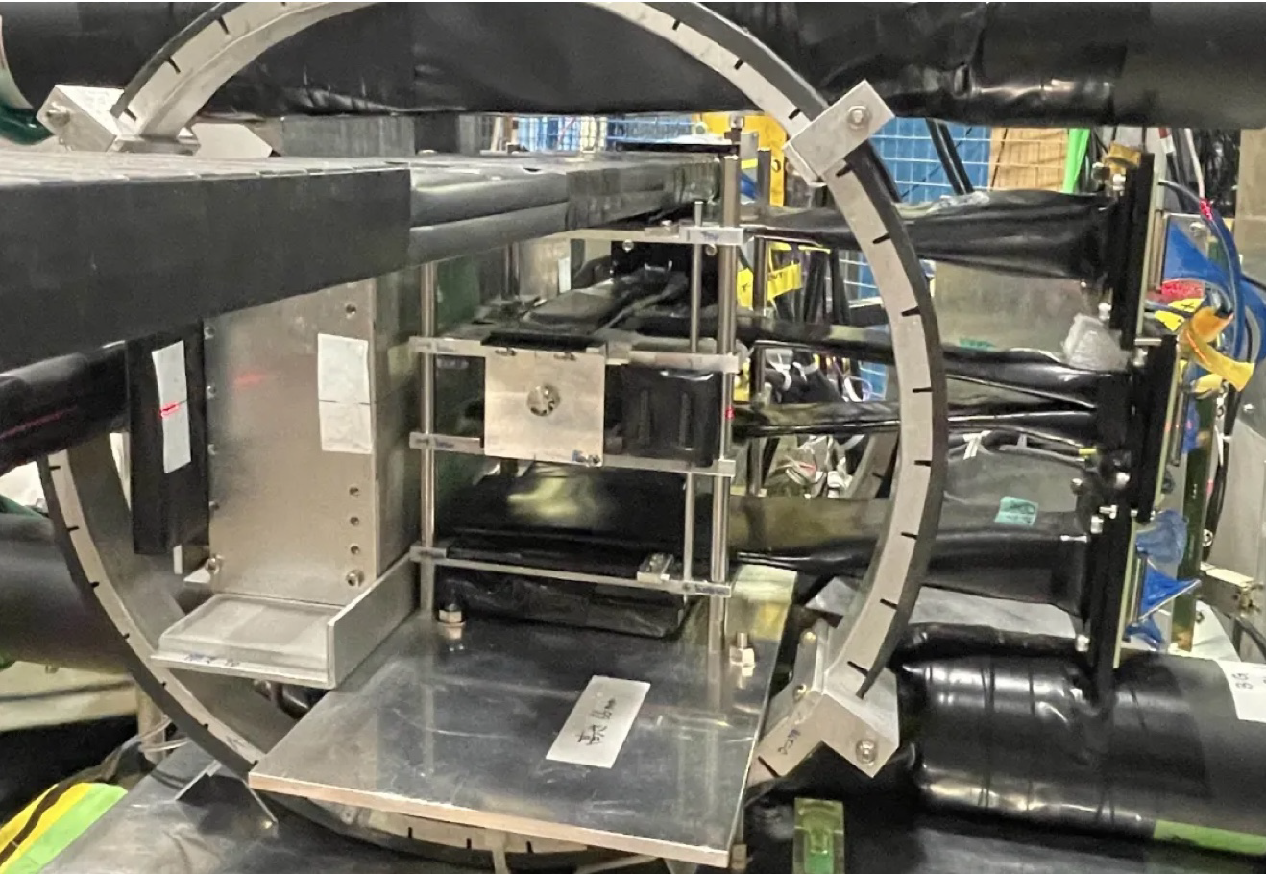
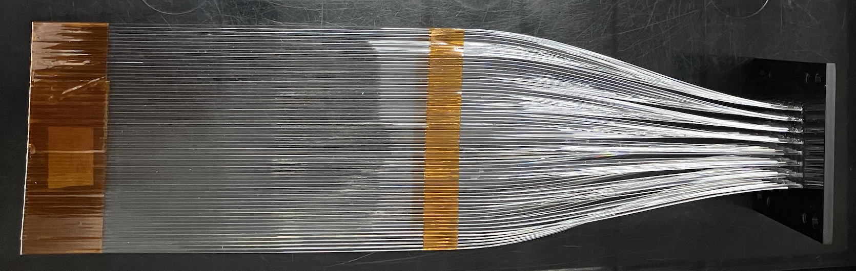
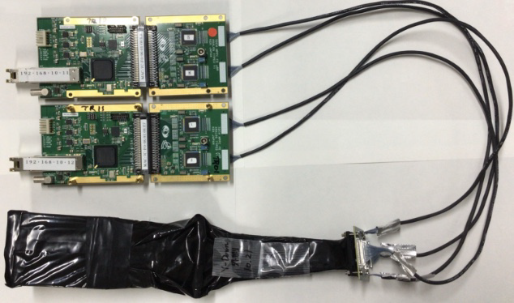
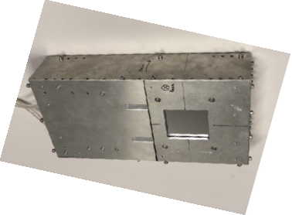
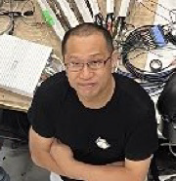
Set up at TRIUMF
Slide (re-arranged) from
M. Mihara (Osaka U.)
µ+ tracker
e+ trackers
µ+ trackers: Drift Chamber
e+ trackers: 64 ch fibre sci.
+SiPM
Readout electronics:
2022, 2023: VME TDC (Riken)
2024: Kalliope ASD+TDC (KEK: Kojima)
2025: EASIROC (KEK: Honda) + Kalliope
A. Sato
(Osaka U.)

Slide 13
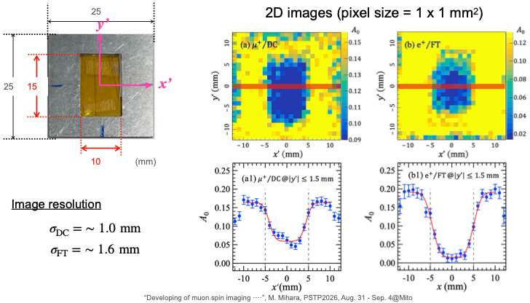
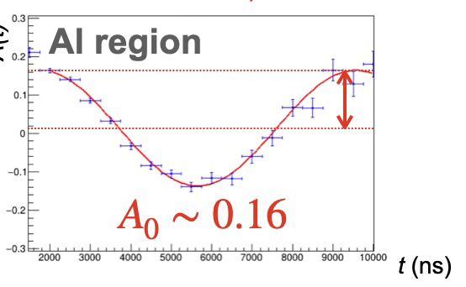
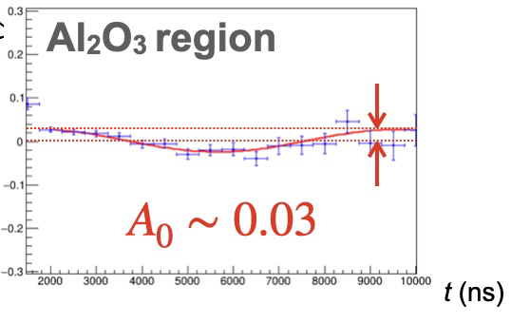
Muon Spin Imaging at TRIUMF
Slide (re-arranged) from
M. Mihara (Osaka U.)
2D image of A(t)
µ+ tracking
e+ tracking
Aluminium
Al2O3
µe decay Asymmetry A(t)
Image resolution
σ(µ+) ~1.0mm
σ(e+) ~1.6mm
2
time
10 (µs)

Slide 14
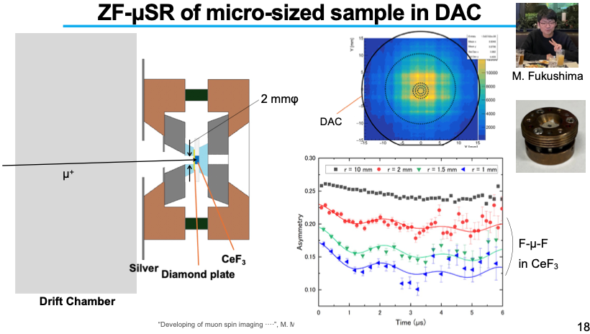
Application of Muon Imaging to Materials Science
JPS meeting Sep. 2026
Measurement in Diamond Anvil Cell for high pressure
µ+ tracking
µSR signal of
CeF3 in 2mm φ
hole observed.

Slide 15
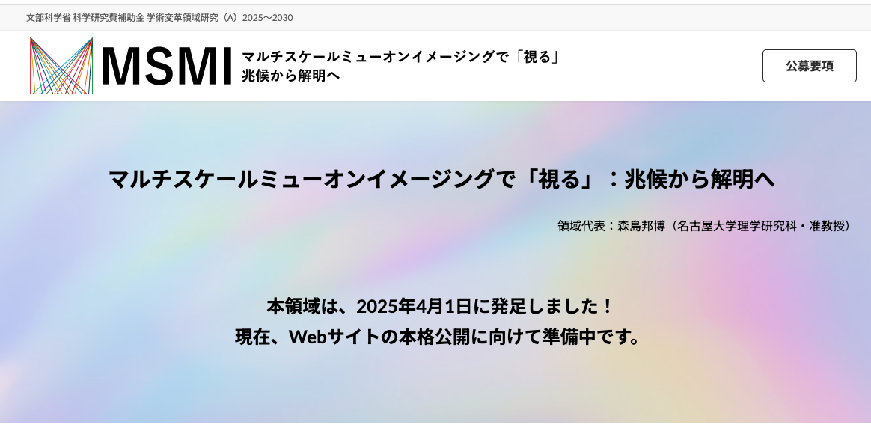
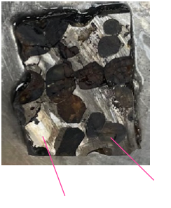
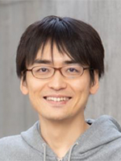
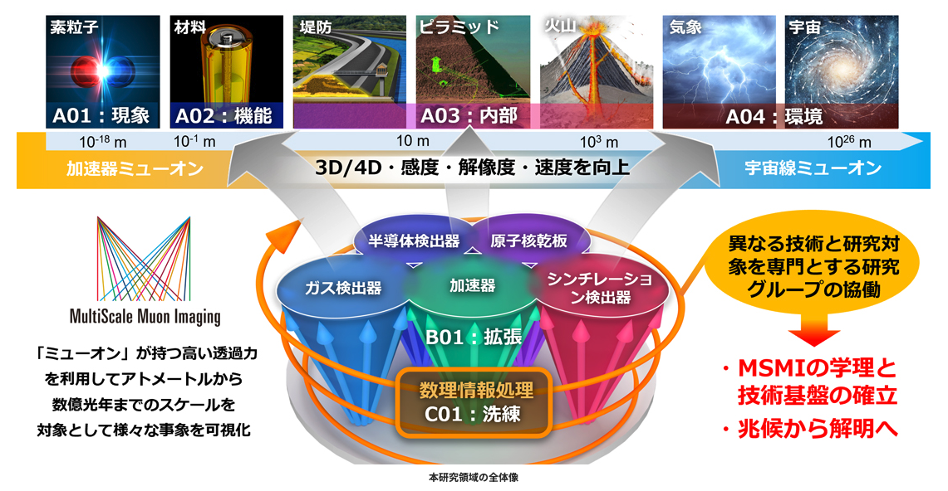
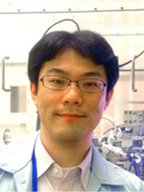
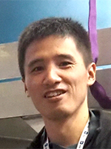
Muon Imaging experiment in the future
Osaka collaboration: real sample with structures
  Meteorite
  Biological sample
  Fuel cell: water vs. ice
K. Morishima is leading a group grant: A2 section is mainly KEK
https://msmi.jp
Multi-scale muon imaging
S. Takeshita and
M. Hiraishi (KEK)
Rock
Ni-Fe

Slide 16
Collaborators / Acknowledgement
Muon Induced fission fragment spectroscopy
R. Mizuno, M. Niikura, S. GO, T.Y Sato,
T. Matsuzaki (Riken)
H. Asch, A. Redey, Alex Woinoski, Z. Yu,
C. Andreoiu, K. Starosta (SFU)
Eiji Ideguchi, A. Sato, D. Tomono (Osaka U.)
K. Nishio, K. Hirose (JAEA)
K. Ninomiya (Hiroshima U.)
H. Nishibata, S. Kawase (Kyushu U.)
B. Reed, G. Christian, G. Lotay, I. Dillmann, C. Ruiz
(TRIUMF)
Muon Spin Imaging
M. Mihara, S. Ishitani, K. Yasuda, G. Takayama, A. Sato,
M. Fukuda, R. Taguchi, S. Shimizu, K. Horie, R. Imai, S. Ide,
S. Sugano (Dept. Physics, U. Osaka)
K. Shimizu, M. Kamon, M. Fukushima (KYOKUGEN, U. Osaka)
Y. Mizoi (Osaka Elec. Comm. U)
A. Koda, S. Kanda (KEK)
B. T. Mizukami, W. Sato (Kanazawa Univ.)
D. Nishimura (Tokyo City U)
M. Fukutome, M. Tanaka (Kyushu Univ.)
Multidisciplinary PhD Program for Pioneering Quantum Beam Application (PQBA) at Osaka University.
Scholarship of Graduate School of Science of Osaka University for Overseas Research Activities.
Fundamental Electronics Research Institute (FERI), Osaka Electro-Communication University (OECU).
JSPS Kakenhi Grant Number JP22H00110, JP25K01029, 26H01500.
KEK-TRIUMF Exchange Program for Early Career Researchers (EPECR)
NSERC Discovery Grant RGPIN-2021-03467

Slide 17
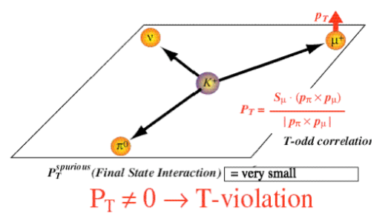
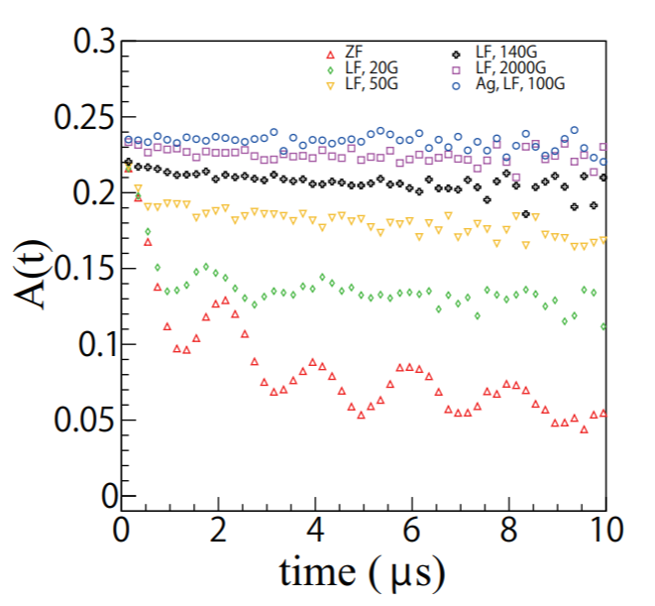
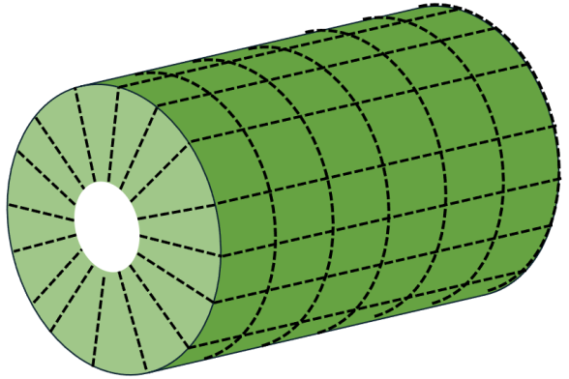
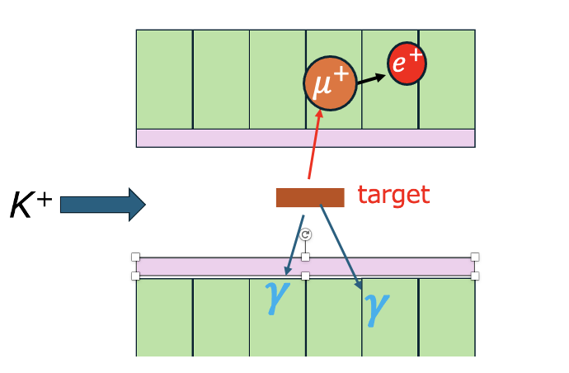
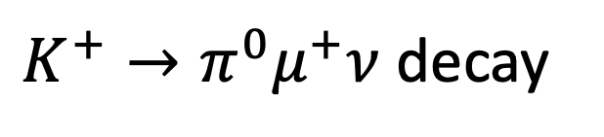
Technology transfer from Materials science to Particle physics
CeF₃ scintillator which holds muon polarization
Slide from S. Shimizu
(Osaka. U)
K. Horie et al.,
Nucl. Instrum. Methods A 1037 (2022) 166932
H//z (local)
Full polarization
H//z=140 G
$K^{+}→π^{0}μ^{+}ν$ decay
CeF₃
blocks
In NaI (Alkaline Halides), muon
quickly depolarizes.
KEK / J-PARC MLF data
CeF₃ blocks as the muon stopper
muon and positron scintillator / calorimeter

Slide 18
Summary
TRIUMF is equipped with M9H the pion decay channel
  Capability of negative muons + high momentum muons
Complementary to KEK / J-PARC’s MLF D-line muons
TRIUMF has developed Muon Spin Imaging
  µSR has gained imaging capability
Complementary to KEK / J-PARC’s imaging project
Collaborations with KEK-lead group funds (学術変革) on µ- and muon imaging are underway
µ-: https://mu-horizons.kek.jp/en/
Muon imaging: https://msmi.jp

