Slide 1



Study in EPECR About the Heating Test of
Superfluid Helium, Gradient Measurement
Kaito Abe, TUCAN Collaboration

Slide 2
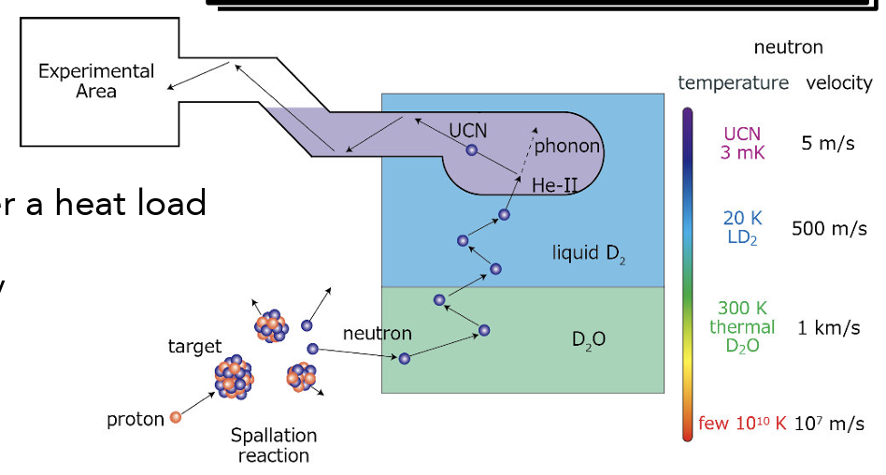
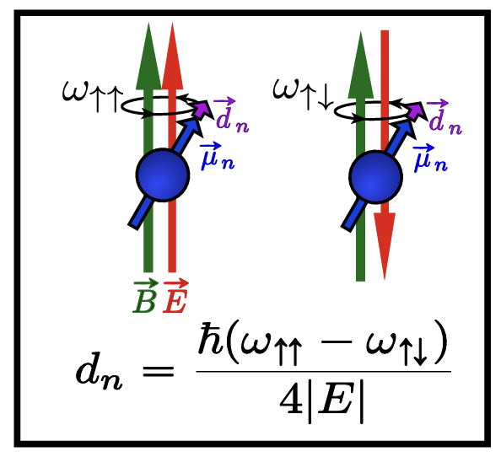
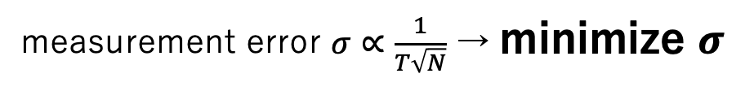
Motivation
We make UCN to measure nEDM
Cryostat
Trapping in the container
UCNs can be caught in the trap due to small momentum
Maximize the measurement time $T$ and lifetime $τ$
By exciting phonon by incidental neutron,
we generate UCN
measurement error $σ∝\frac{1}{T\sqrt{N}}$ → minimize $σ$

Slide 3
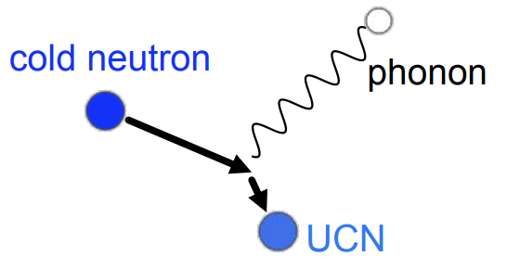
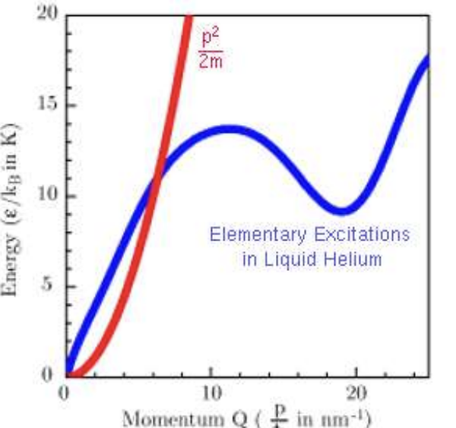
Phonon scattering
We use superfluid Helium to produce UCNs by phonon scattering
Phonon scattering
Dispersion curve
Phonon scattering never
occurs when neutrons and
superfluid are not specific
temperature
Generate UCN by phonon excitation

Slide 4
Phonon scattering
We use superfluid Helium to produce UCNs by phonon scattering
Phonon scattering
Dispersion curve
Phonon scattering never
occurs when neutrons and
superfluid are not specific
temperature
Generate UCN by phonon excitation
Cryostat can keep the superfluid temperature to occur phonon scattering

Slide 5
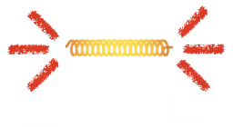
Temperature gradient in Helium
Temperature gradient occurs in superfluid He due to neutron beam
”Fluctuation” is generated between the components of superfluid and normal fluid,
and a number of vortex appear
These vortices interfere heat transfer and this causes
temperature gradient
Superfluid He
vortex
This causes a decrease in UCN generation efficiency
Superfluid
Normal fluid
Turbulence

Slide 6
Temperature gradient in Helium
Temperature gradient occurs in superfluid He due to neutron beam
”Fluctuation” is generated between the components of superfluid and normal fluid,
and a number of vortex appear
These vortices interfere heat transfer and this causes
temperature gradient
Superfluid He
vortex
This causes a decrease in UCN generation efficiency
Superfluid
Normal fluid
We have to know how gradient occurs
to generate UCNs efficiently
Turbulence

Slide 7
Preparations for measurement the gradient
We can learn from references about temperature gradient if the reference exist,
however, does not, actually
I am going to measure the temperature gradient in superfluid helium
in the actual cryostat experiment during the EPECR period
Diagram of the cryostat
Superfluid helium
Heater

Slide 8
Preparations for measurement the gradient
Installing temperature sensor in the cryostat
Making wires for temperature sensor
to MIDAS
Wire
Temperature sensor
Goal: measure the temperature gradient, especially below 1K

Slide 9
Conclusion
Cryostat can keep superfluid temperature to generate UCNs
Neutron beam heats the cryostat and helium,
and this prevents from efficient generation of UCNs
We should know how temperature gradient forms in superfluid
however there is no reference about it
I am going to measure gradient in the actual cryostat, and to do that,
some preparations about sensor and wire are required

Slide 10
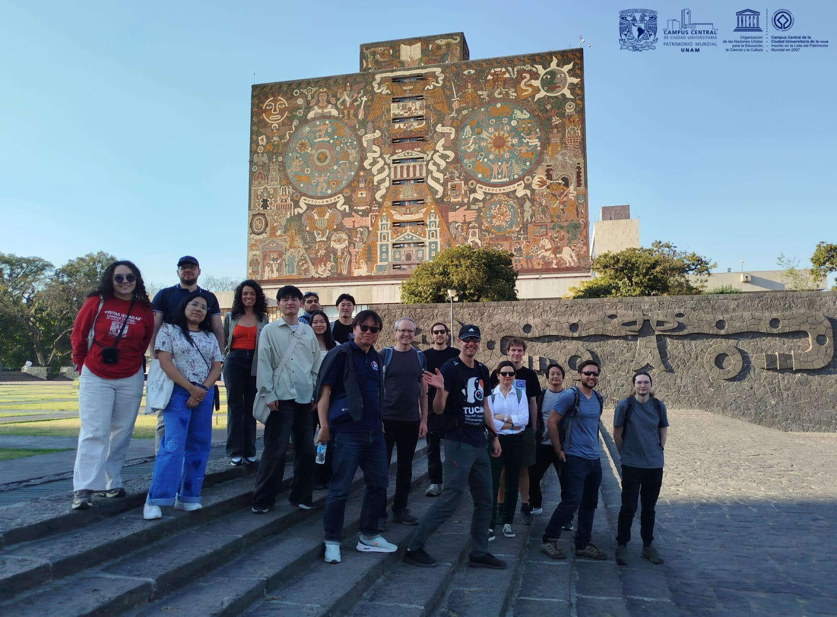
Plans in EPECR
Oct. 2026
Nov.
Dec.
...
Start making wires for temperature sensors and get qualifications for confined space
Install sensors in the cryostat and conduct functional test
Measure temperature gradient in the cryostat and analyze the result
TUCAN Collaborators in Mexico
Feb. 2026

