Slide 1



Study in EPECR About the Heating Test of
Superfluid Helium, Gradient Measurement
Kaito Abe, TUCAN Collaboration
Notes:
Now, I would like to start my presentation about my EPECR studies.
Title is Study in EPECR About the Heating Test of Superfluid Helium, Gradient Measurement.
Presenter is Kaito Abe, Nagoya University students, behalf of TUCAN Collaboration.

Slide 2
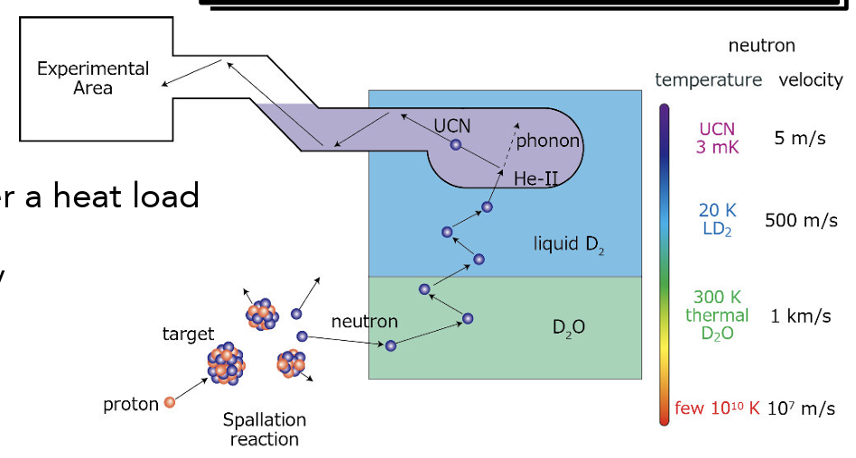
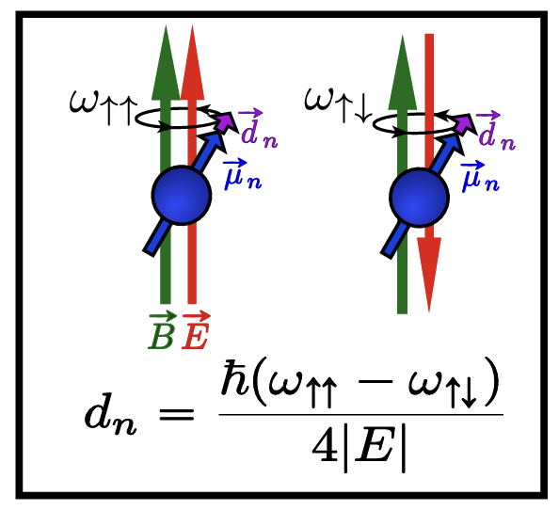
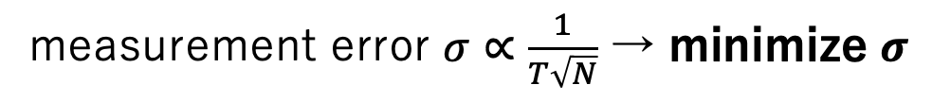
Motivation
We make UCN to measure nEDM
Cryostat
Trapping in the container
UCNs can be caught in the trap due to small momentum
measurement error $σ∝\frac{1}{T\sqrt{N}}$ → minimize $σ$
By exciting phonon by incidental neutron,
we generate UCN
Maximize the measurement time $T$ and the number of neutrons $N$
Notes:
Firstly, I talk about the motivation of the experiment.
We are searching for neutron UCN in order to discover CP violation.
If nEDM exists in neutrons, the frequency of Larmor precision increases when neutron is in electric field.
Whether we measure the frequency in upper and lower electric field, and if there is nonzero difference of frequency between in upper and lower, this means discovery of nEDM.
By the way, neutrons under the room temperature is too fast to measure EDM, so we make ultracold(UCN) neutron to measure nEDM.
UCNs have so small energy that they can be trapped in the container, so we can measure nEDM in the long time.
measurement error is in proportion to measurement time, so we can minimize the error.
UCNs are generated in this cryostat by phonon scattering.
In the next page I would like to explain the principle of phonon scattering.

Slide 3
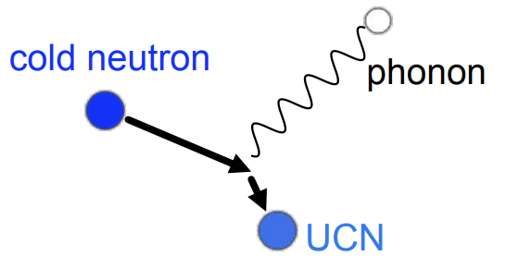
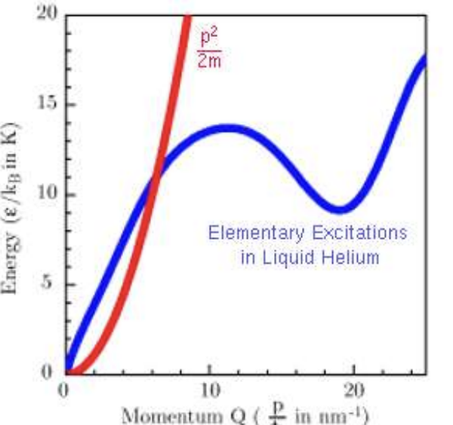
UCN is generated by phonon excitation
We use superfluid Helium to produce UCNs by phonon excitation
Phonon excitation
Dispersion curve
Generate UCN by phonon excitation
Notes:
Cold neutron excites phonon in superfluid helium in the cryostat, cold neutron loses its energy and we can generate UCN.
The left diagram shows the brief explain of phonon scattering.
Right graph shows dispersion curve, horizonal and vertical axis are momentum and energy, respectively.
Red curve is neutron, and blue curve is superfluid helium.

Slide 4
UCN is generated by phonon excitation
We use superfluid Helium to produce UCNs by phonon excitation
Phonon excitation
Dispersion curve
At this intersection, UCN can be most generated
Generate UCN by phonon excitation
Notes:
It must consist energy conservation between neutron and superfluid helium, so phonon scattering occurs only under specific temperature.
The temperature is at the intersection of neutron and superfluid.
In order to generate UCNs efficiently, we have to keep this temperature.
The cryostat can keep the superfluid temperature to occur phonon scattering.

Slide 5
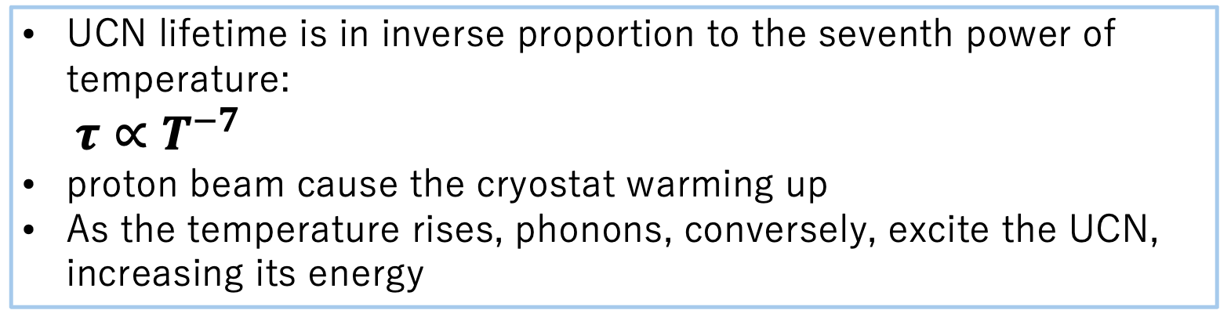
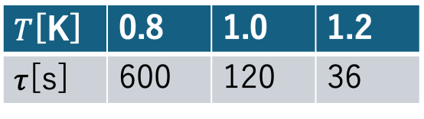
Temperature gradient in Helium
UCN lifetime is in inverse proportion to the seventh power of temperature:
$τ∝T^{−7}$
proton beam cause the cryostat warming up
As the temperature rises, phonons, conversely, excite the UCN,
increasing its energy
$T$[K] | 0.8 | 1.0 | 1.2
$τ$[s] | 600 | 120 | 36
Important for keeping the helium temperature low
What is the upper limit of beam current intensity?
We are going to conduct an experiment using a heater to simulate the thermal
load of the beam and measure the temperature rise in the cryostat
Notes:
This slide shows how important keeping temperature by the cryostat is.
Firstly, UCN lifetime is in inverse proportion to the seventh power of temperature, so a little temperature rising causes significant decline of UCN lifetime.

Slide 6
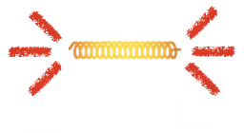
Temperature gradient in Helium
Temperature gradient occurs in superfluid He due to proton beam
”Fluctuation” is generated between the components of superfluid and normal fluid,
and a number of vortex appear
These vortices interfere heat transfer and this causes
temperature gradient
Superfluid He
vortex
This causes a decrease in UCN generation efficiency
Superfluid
Normal fluid
Turbulence
Notes:
By the way, there is a problem about the cryostat.
That is superfluid helium in the cryostat warms up due to neutron beam.
For this reason, temperature gradient occurs in superfluid helium.

Slide 7
Temperature gradient in Helium
Temperature gradient occurs in superfluid He due to proton beam
”Fluctuation” is generated between the components of superfluid and normal fluid,
and a number of vortex appear
These vortices interfere heat transfer and this causes
temperature gradient
Superfluid He
vortex
This causes a decrease in UCN generation efficiency
Superfluid
Normal fluid
We have to know how gradient occurs
to generate UCNs efficiently
Turbulence

Slide 8
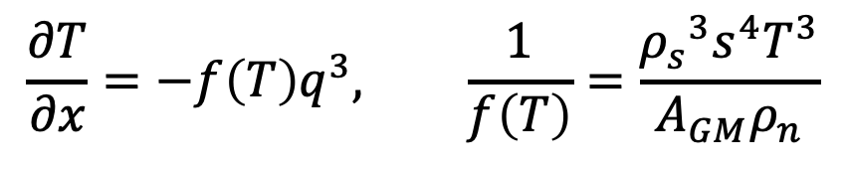
Temperature gradient in Helium
Equation describing the temperature gradient
$$\frac{∂T}{∂x}=−f\left(T\right)q^{3}, \frac{1}{f\left(T\right)}=\frac{{ρ_{s}}^{3}s^{4}T^{3}}{A_{GM}ρ_{n}}$$
...Gorter-Mellink equation
There is no reference about temperature gradient in
superfluid helium below 1K
It is also valuable as research into physical properties themselves
We are going to conduct the experiment in the actual cryostat

Slide 9
Preparations for measurement the gradient
We can learn from references about temperature gradient if the reference exist,
however, does not, actually
I am going to measure the temperature gradient in superfluid helium
in the actual cryostat experiment during the EPECR period
Diagram of the cryostat
Superfluid helium
Heater

Slide 10
Preparations for measurement the gradient
Installing temperature sensor in the cryostat
Making wires for temperature sensor
to MIDAS
Wire
Temperature sensor
Goal: measure the temperature gradient, especially below 1K

Slide 11
Conclusion
Cryostat can keep superfluid temperature to generate UCNs
Neutron beam heats the cryostat and helium,
and this prevents from efficient generation of UCNs
We should know how temperature gradient forms in superfluid
however there is no reference about it
I am going to measure gradient in the actual cryostat, and to do that,
some preparations about sensor and wire are required

Slide 12
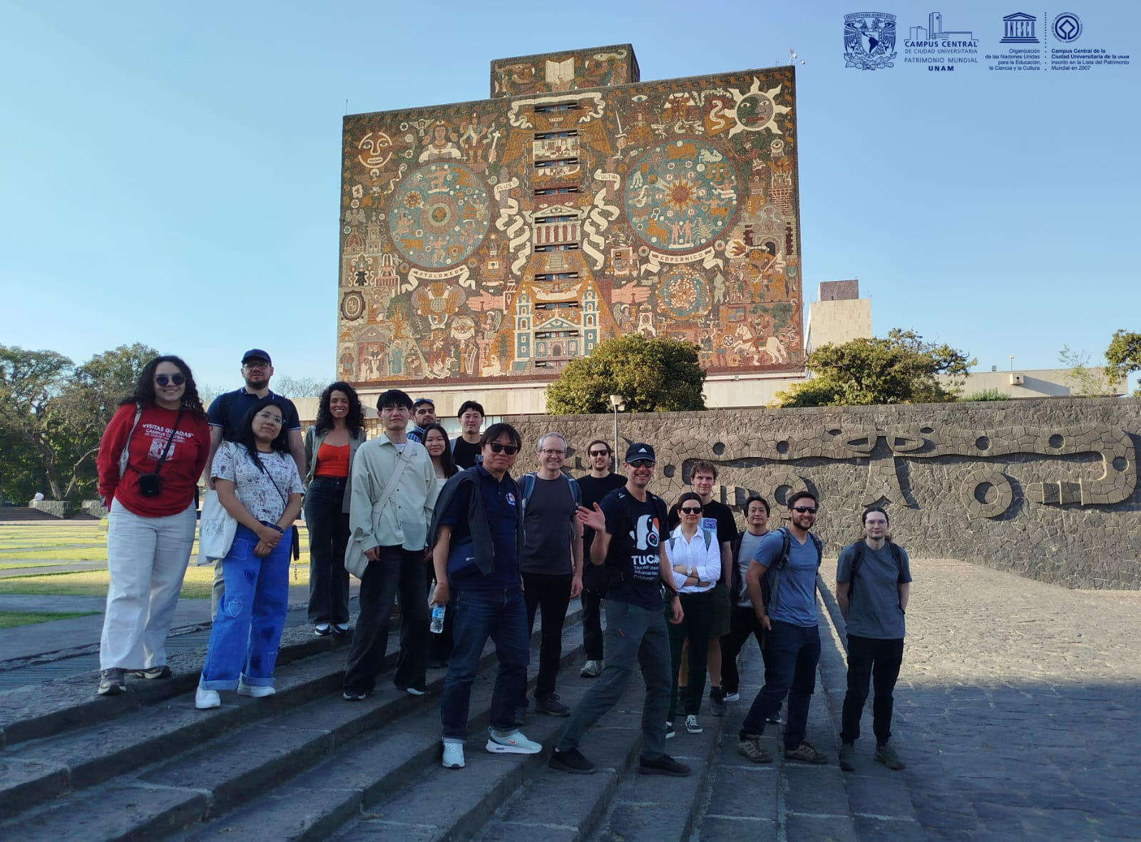
Plans in EPECR
Oct. 2026
Nov.
Dec.
...
Start making wires for temperature sensors and get qualifications for confined space
Install sensors in the cryostat and conduct functional test
Ready to measure temperature gradient in the cryostat and analyze the result
TUCAN Collaborators in Mexico
Feb. 2026

