Slide 1
Particle Physics Faculty Meeting
Agenda
  News/Update/Discussion
  Committee updates

Slide 2
TRIUMF is located on the traditional, ancestral, and unceded territory of thexʷməθkʷəy̓əm (Musqueam) people, who for millennia have passed on their culture, history, and traditions from one generation to the next on this site.
TRIUMF’s home has always been a seat of learning.

Slide 3
Values Moment
Excellence & Integrity
We have a passion for excellence in all that we do.
We are decisive, bold, courageous, and compassionate.
We take responsibility for our actions, our commitments, and our contributions to the larger community.
Safety & Accountability
We respect the health and safety of our employees, our visitors, and our neighbours.
We build quality into our processes and seek continual improvement in all of our systems.
We embrace transparency and authenticity, and hold ourselves and each other accountable.
Equity & Inclusion
We empower our people and foster an inclusive work environment, enriching our science and our community.
We value teamwork and open communication to ensure that everyone belongs and all voices are heard.
We respect each other, take care of each other, and support the success of all.

Slide 4
Safety Moment
Drinking Water quality at TRIUMF
  last water quality testing was done in 2021 (during Covid) and did not include the MOB kitchen (Rm 297)
  1/12 test point (drinking water faucet in the Design Office Lunchroom - Rm 204) was above lead levels set by Health Canada
  water filtration stations were equipped with filters after those results
  quality might be better following return of staff to lab but never tested despite recommendation by CSO to perform regular checks including other untested water outlets.
Follow up questions
  Is the MOB kitchen water supplied through a filtration system equipped with lead-removal filters?
  Can testing be conducted for the MOB kitchen as well, given that it is an obvious source of drinking water?
  If testing cannot be completed promptly and there are any concerns regarding water quality, could temporary signage be posted advising against drinking the water until testing has been completed.
message from Adrian 16th of June 2026 “A new water filter package and new filtered water spout is in the process of being installed in MOB 297 and will be operational in about an hour or so. We’ve also added it to our maintenance contract with the company for regular maintenance and filter changes.”

Slide 5
Safety Moment
All safety notes: https://documents.triumf.ca/docushare/dsweb/View/Collection-21974
Other safety concerns/reports?

Slide 6
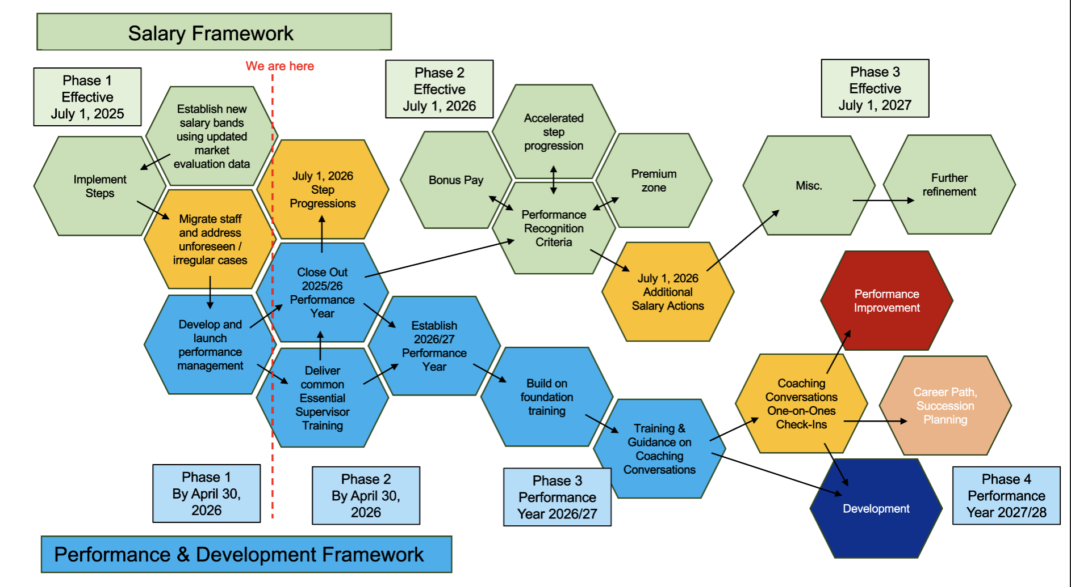
New Performance Framework
Revised Due Date for Performance Review Completion: April 30th
Revised Due Date for Performance Planning: May 15th

Slide 7
New Performance Framework
Ian’s email
Performance & Development Planning Timeline (timelines have been further revised to support this years’ implementation)
  Commence planning: May 11th
  All plans must be completed by June 30th
  The 1st check-in should be completed by August 30th

Slide 8
e-learning
Complete Code of Conduct e-learning by June 21st

Slide 9
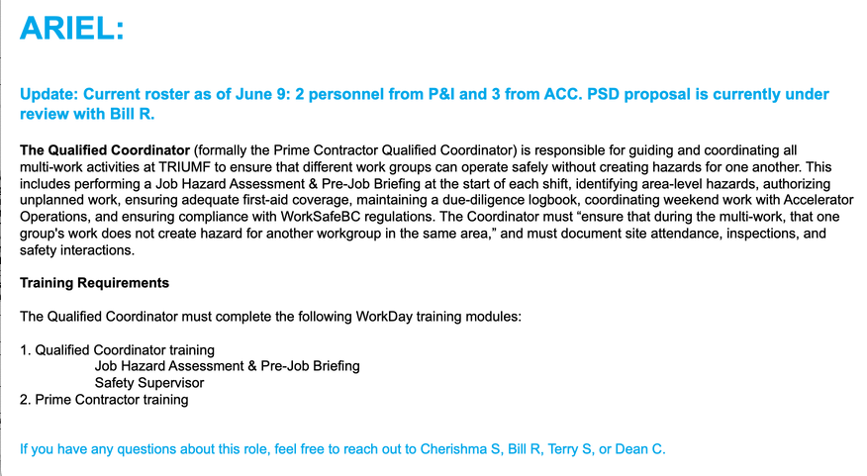
Qualified Coordinator

Slide 10
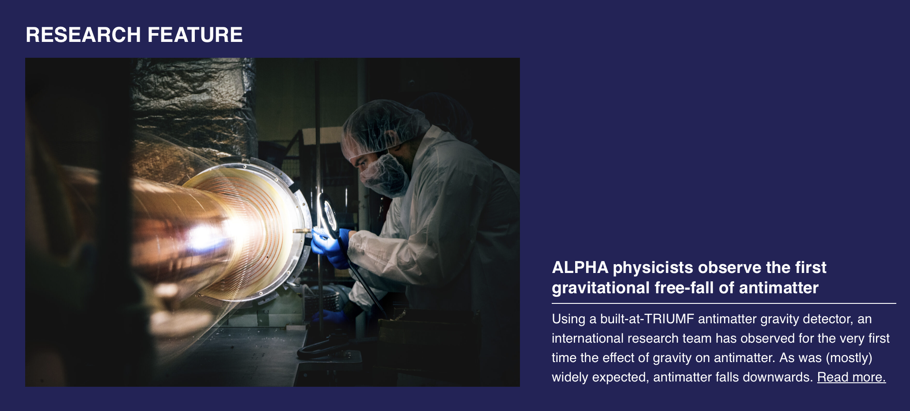
PP Website updates
Update the research feature every ~month
Suggested an image carousel to Communications
New features: UCN production highlights, ALPHA Nature, others?

Slide 11
Various
CFI internal review outcome and follow-up
Discussion on Services and KPIs
Cyclotron Vault tour (Noah)

Slide 12
Next Meeting
  Regular July 16th

Slide 13
AOB

Slide 14
Committee Updates
  IPP Council / CINP / CAP
  Science Council
  Space
  Seminar/Colloquia
  SciTech seminars / Quantum Forum / Dark Matter Forum
  Mixer
  Science Week
  TUEC
  Safety
  Summer schools
  International committees

