Slide 1
Particle Physics Faculty Meeting
Agenda
  News/Update/Discussion
  Safety moment
  Plans for PSD retreat in October
  Proposal for a new Particle Physics conference series (PEAKS) - Chloe
  Update from the IPP board meeting (Mark)
  LRP slides presented at CAP (there is a survey with deadline by the end of the month)
  Other committee updates

Slide 2
Safety Moment
Slides from SMM this week

Slide 3
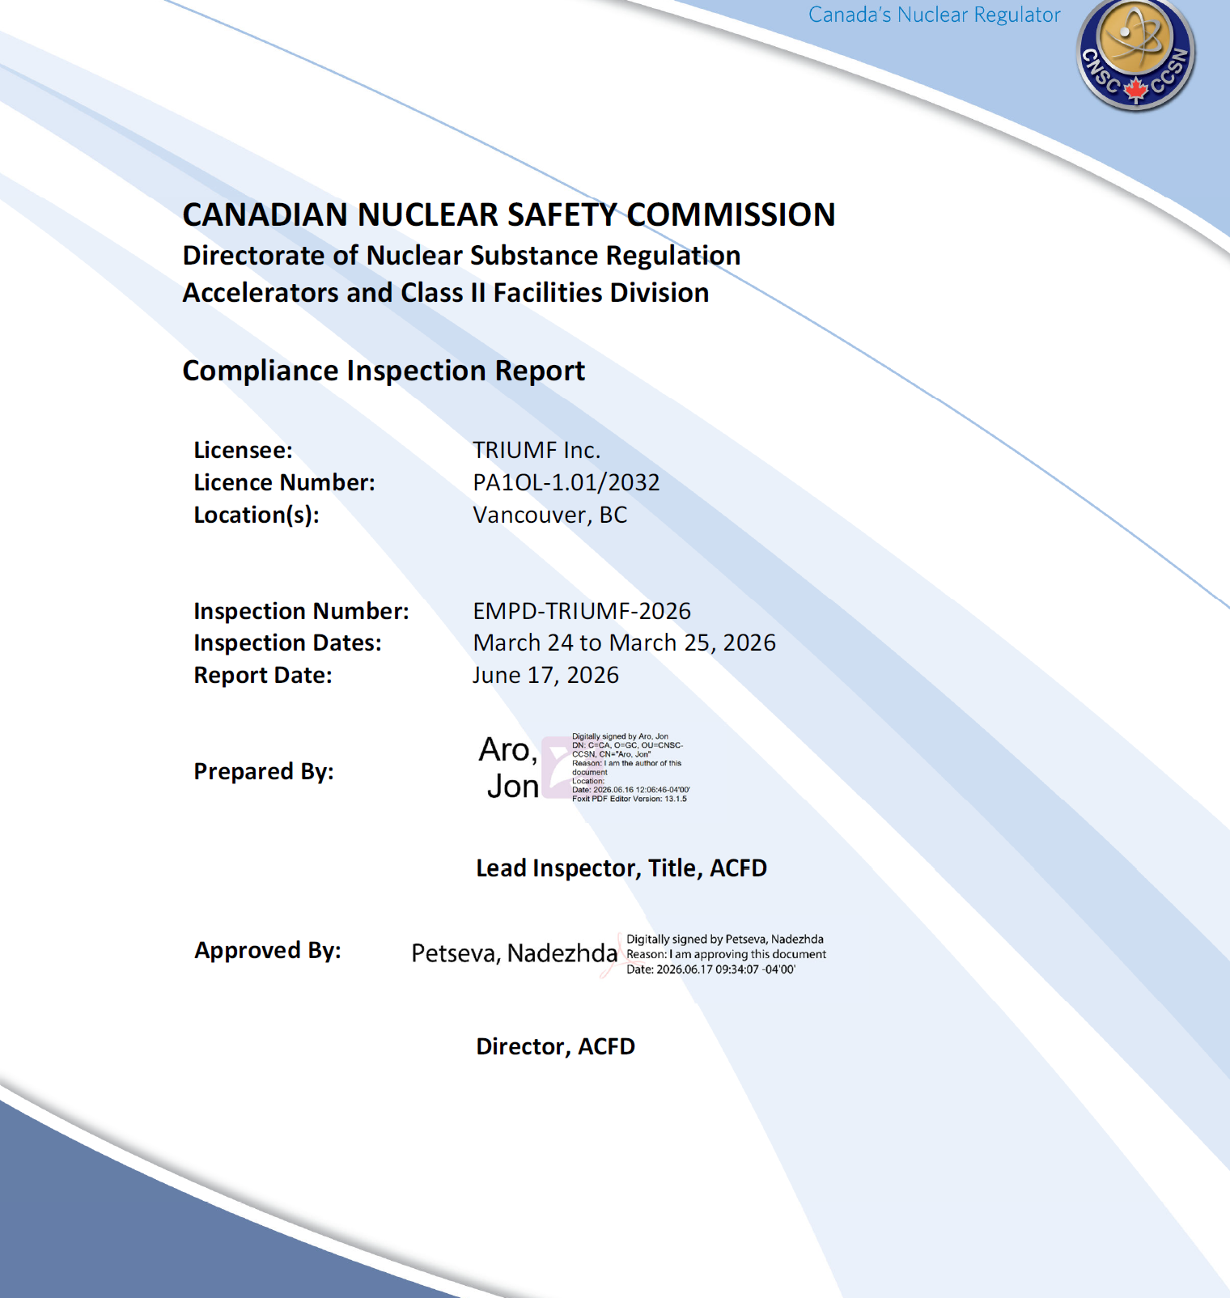
CNSC Emergency Preparedness Inspection Overview
CNSC Inspection: EMPD-TRIUMF-2026 – March 2026
Scope
Emergency Management & Fire Protection Program
Management System
Occupational Health & Safety
Follow-up on 2021 inspection findings
Overall Result
11 Notices of Non-Compliance (NNCs)
4 Recommendations
No immediate risk to workers, public, or environment identified
CNSC determined corrective actions are required
Inspection Rating
Key CNSC Conclusion: TRIUMF has not allocated sufficient resources to oversight and regulatory compliance of its emergency preparedness and response program
Safety & Control Area | Rating
Management System | Satisfactory
Emergency Management & Fire Protection | Below Expectations
Occupational Health & Safety | Satisfactory

Slide 4
CNSC Emergency Preparedness Inspection Key Findings
Housekeeping and Fire Hazards
combustible materials
Fire extinguisher maintenance deficiencies
Fire department connections obstructed
Compressed gas storage deficiencies
Program Governance
Roles unclear
Document control
External support
Emergency readiness
Inventory gaps
Documentation gaps following eMaint implementation
Defective and poorly maintained emergency communication equipment
TRINAT Facility
Fire-safety issues
Electrical and access concerns
Access/Housekeeping
Fire Protection
Fire Plans gaps
FRNA missing
Deficiencies in drills

Slide 5
What’s next
Assess
Reviewed all CNSC findings
Developed corrective action plan
Prioritized actions based on risk and regulatory deadlines
Remediate
Cross-departmental support identified
Assigning owners and accountabilities
Corrective actions in progress
Restore Confidence
Meet CNSC commitments
Strengthen emergency preparedness program
Return future inspections to a Satisfactory rating
The inspection identified significant weaknesses in emergency preparedness and fire protection program management. While this resulted in a Below Expectations rating, the findings are correctable, corrective actions are underway, and TRIUMF is committed to meeting all CNSC deadlines and restoring program excellence.
Full Report is Stored in Docushare – Link can be provided

Slide 6
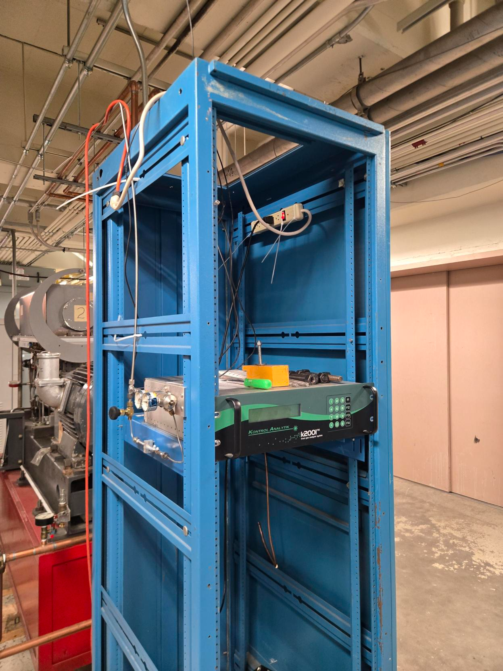
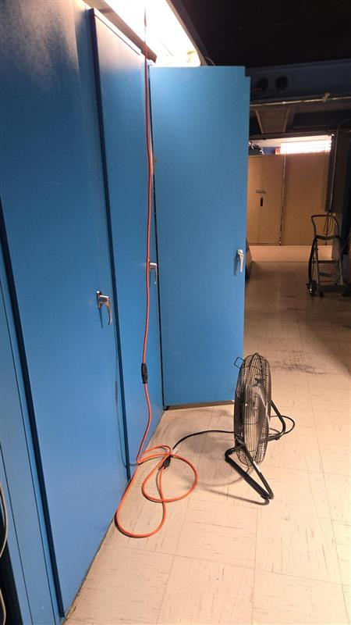
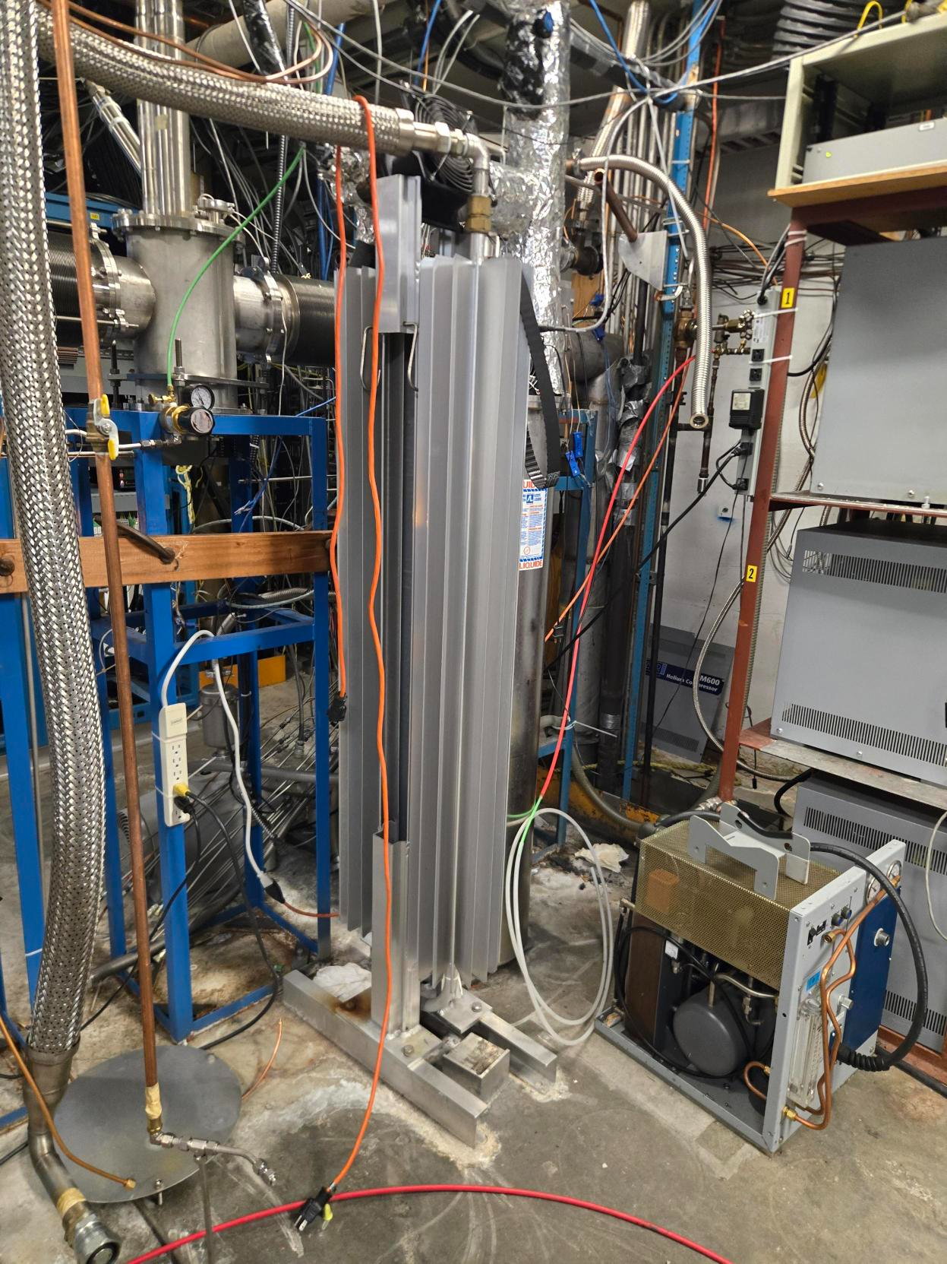
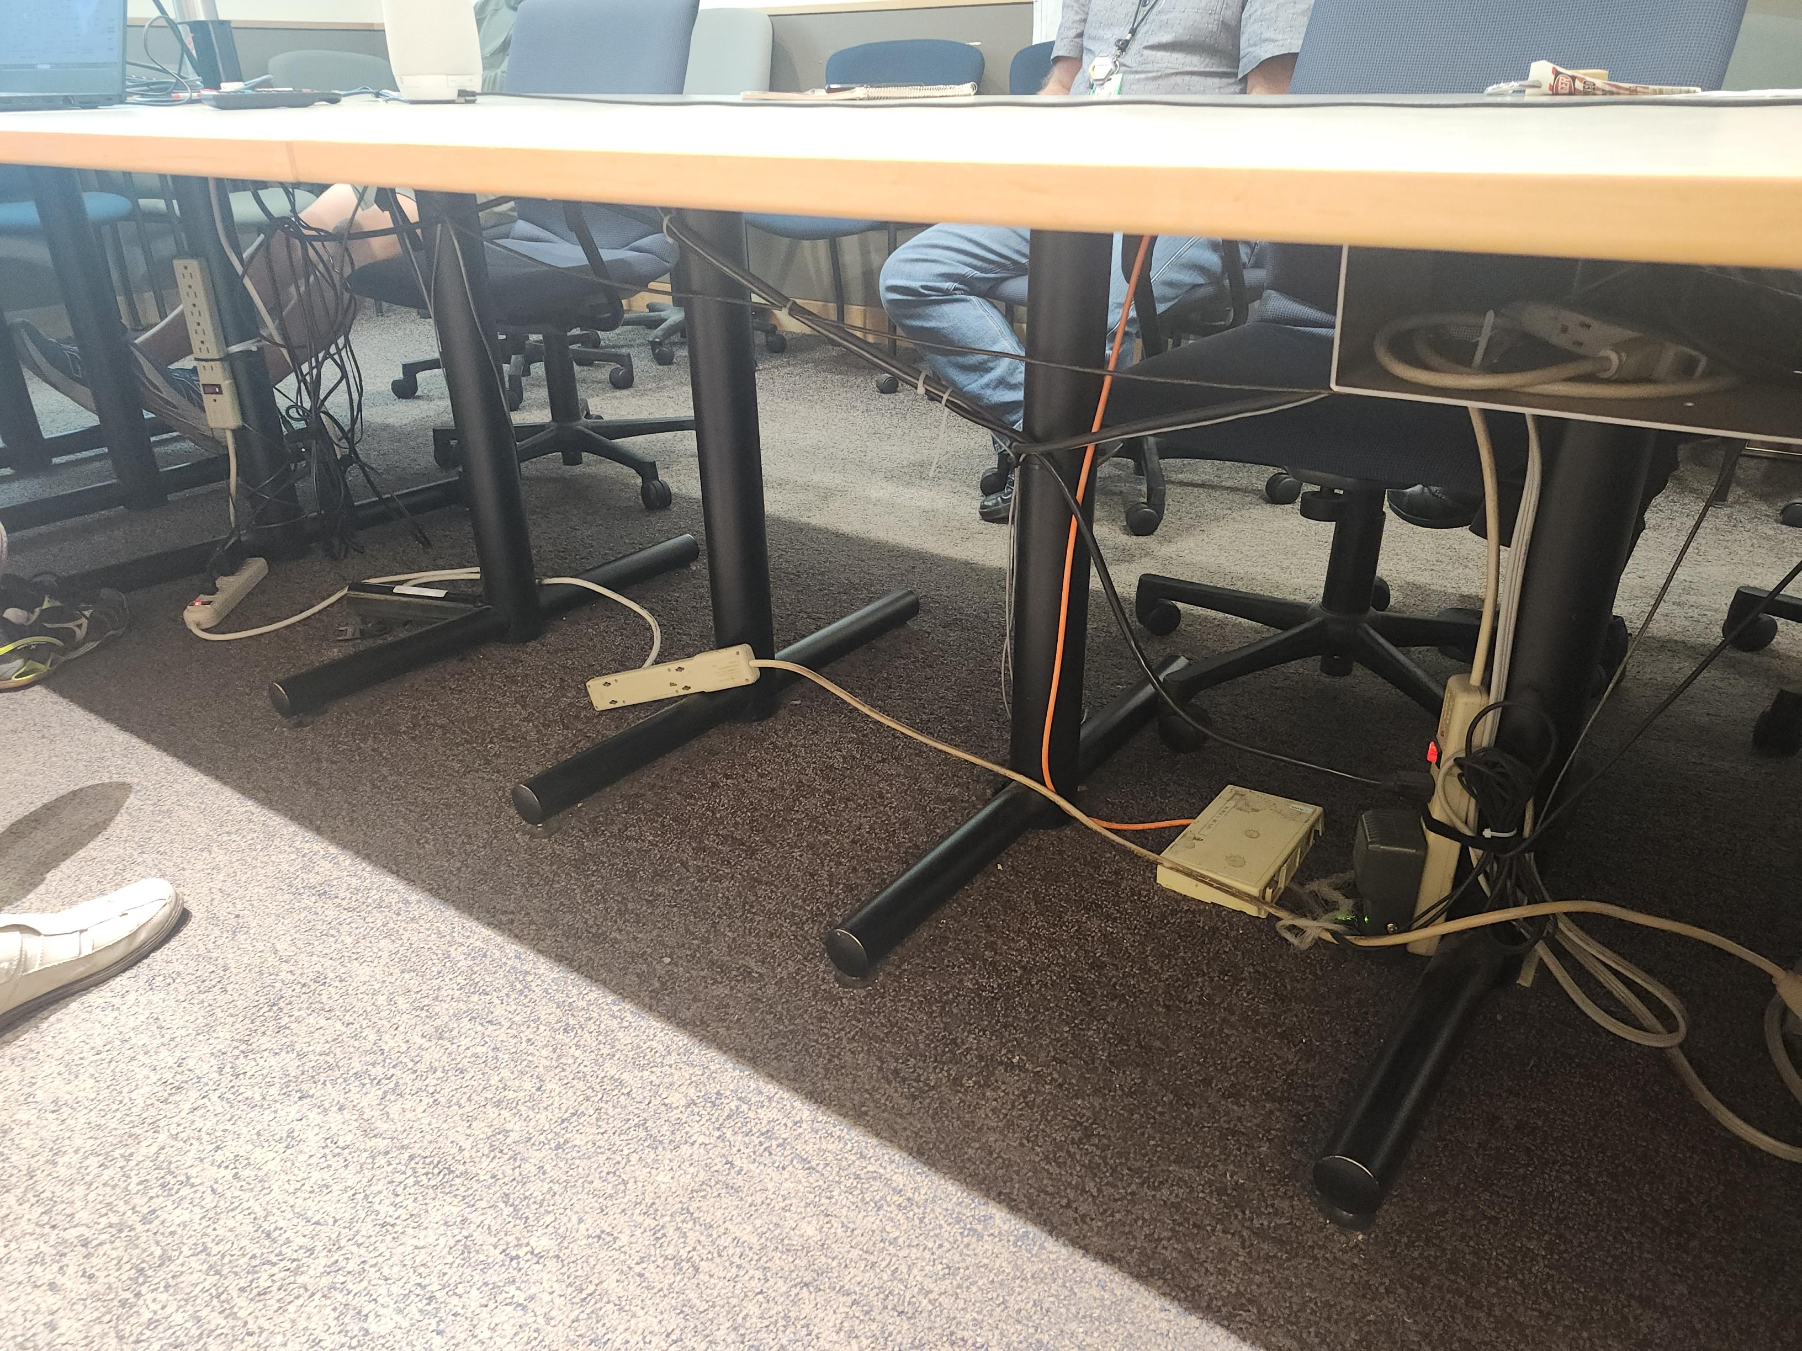
Daisy Chaining

Slide 7
Daisy Chaining
is the practice of plugging one power bar, extension cord, or surge protector into another instead of plugging each device directly into a wall outlet.
Hazards:
  Overloading the circuit
  Heat Buildup
  Increased risk of loose connections
  Equipment ratings can be exceeded

Slide 8
Best Practice
Do not connect power bars to other power bars.
Do not connect extension cords to extension cords (temporary basis, not permanent)
Plug power bars directly into wall outlet
Use a properly rated power bar with built-in overload protection.
Have additional permanent outlets installed if more power is needed.
Inspect cords and power bars regularly for damage.
Before new installations, examine power needs and locations

Slide 9
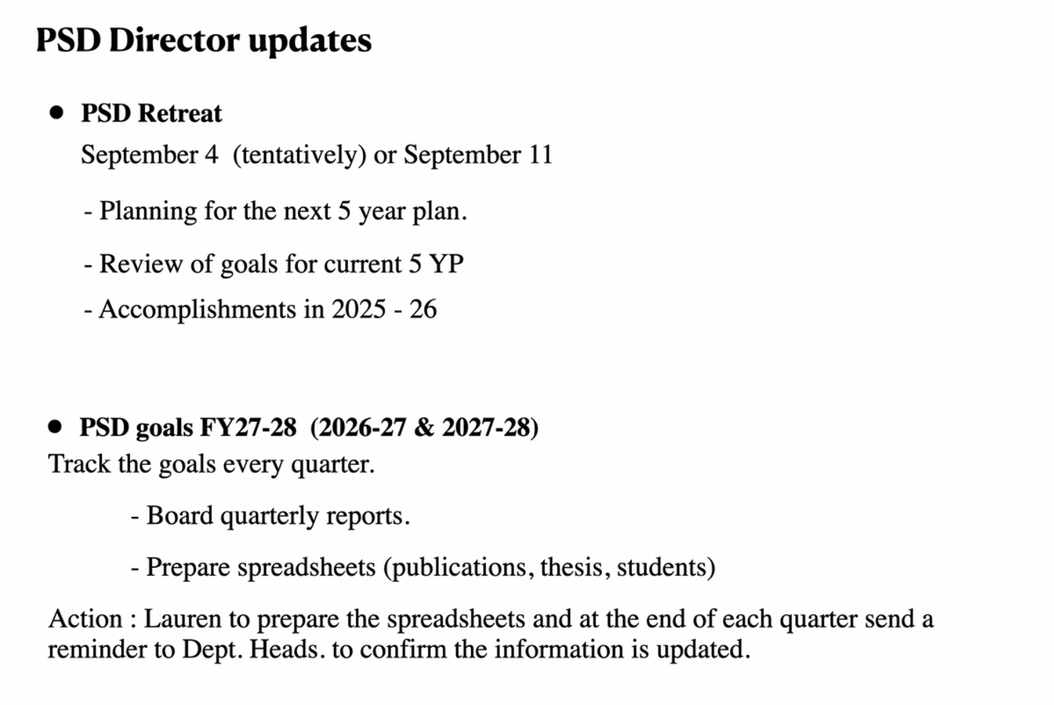
PSD Retreat (from Ritu)
Pushed back to October (TBC)

Slide 10
.
Goals
2-year (April 2026 - March 2028) goals for each experiment
ATLAS: Data analysis and publications of Run 2 and 3 data, 2 NSW wheels on surfaces, decide on maintenance, complete nominal ITK module and petal production, commission LAr Phase-2 upgrades
T2K/Hyper-K: Complete construction of Hyper-K detector. All components of IWCD ready. Analysis and publication from WCTE. Building and installing new OTR beam monitor components.
TUCAN: Routine operation of UCN source, commission single cell EDM experiment and publish results
ALPHA: Demonstrate Hydrogen trapping with HAICU, upgrade of ALPHA
SuperCDMS: Complete commissioning of the experiment and take and analyze first science data
PIONEER: Secure funding through CFI IF 27 call for construction of the LGAD target
Perform beam tests at PSI in 2026 and 2027 for target demonstrator
DarkLight: Complete 30 MeV run, publish commissioning run results
XLZD: Contribute to XLZD CDR, secure funding for R&D related to XLZD through CFI IF 27
Secure NSERC funds, support efforts toward a compelling case for XLZD at SNOLAB

Slide 11
Cyclotron vault tours (thanks Noah for organizing)
  Monday, July 20 at 11:00
  Tuesday, July 21 at 13:00
  The meeting point is the lunchroom beside the main control room. No advance sign-up is needed, but it would be good to arrive a few minutes early, because Doug will leave on time.
  Everyone can decide individually which tour they would like to join.)
Qualified Coordinators (ARIEL)
  Thank you for volunteering.
  BAE’s starting work/doing training: Andrea, Nigel H., Max, Kate, Oliver, Reda
  Feedback so far?
From Noah: Quantum Seminar: The free neutron lifetime experiment tauSPECT
  Julian Auler Johannes Gutenberg University Mainz
  Thu Jul 30, 2026, 14:00
Various

Slide 12
Committee Updates
  IPP Council / CINP / CAP
  Science Council
  Space
  Seminar/Colloquia
  SciTech seminars / Quantum Forum / Dark Matter Forum
  Mixer
  Science Week
  TUEC
  Safety
  Summer schools
  International committees

Slide 13
Next Meeting
  Aug 20th

