Slide 1
A Brief Introduction to Project Management
Peter Bayliss
Director, Project Management

Slide 2
TRIUMF is located on the traditional, ancestral, and unceded territory of the xʷməθkʷəy̓əm (Musqueam) People, who for millennia have passed on their culture, history, and traditions from one generation to the next on this site.
TRIUMF’s home has always been a seat of learning.
Learn more: https://triumf.ca/people/land-acknowledgements

Slide 3
Some PM fundamentals
Planning 101 – How to plan your projects
Putting the plan into action - leading project teams
Leading discussions with project teams and stakeholders
Why Project Management?

Slide 4
Planning 101
Scope
Work Breakdown Structure (WBS)
Estimating : time and cost
Making a Schedule
(Risk)
PLANNING YOUR OWN PROJECTS
Notes:
Very brief introduction to planning
Some of it may seem like common sense – if so, that’s great, you’re already thinking like a project manager

Slide 5
Planning ≠ Scheduling
Don’t being with scheduling
Foundation
Walls
Roof
Move in!
New House

Slide 6
Scope
What will your project do?
  Be specific
    A House.
    How many bedrooms? Bathrooms?
  Be realistic
    Swimming pool(s)?
  Write it down
  And get your stakeholders (team, supervisors, etc) to agree
  Be careful of adding (scope creep)
    We need to add a games room!

Slide 7
Work Breakdown Structure (WBS)
Take some time with your team to define the work
Use a tool or whiteboard with sticky notes
Ask yourself what have you missed?
New House
Roof
Foundation
Walls
Regulatory
Shingles
Framing
Permits
Think about interfaces.
How do the pieces fit together? That’s where projects can often fail,
especially when there are different teams or locations
Rafters
Drywall
Engineering review
Gutters

Slide 8
Estimating Cost – Use the WBS as a framework
New House
$$$ ?
Roof
Foundation
Walls
WBS
Roof | Shingle | $X per sq foot
Roof | Gutters | Sub-Contractor
 |  | …
Shingles
Framing
Rafters
Drywall
Gutters

Slide 9
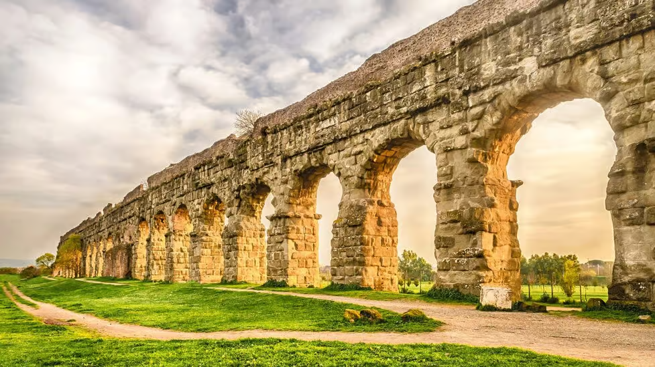

Estimating Labour Effort
Its hard!
  Particularly when you’re estimating something unique
People typically don’t like it!
  Giving estimates makes people uncomfortable
  May not want to commit
  Or be fear being blamed

Slide 10
Estimating Labour Effort – Tips and Techniques
Involve the person doing the job in the estimating
  You’ll get a better estimate
  and more buy-in from the person doing the work
Be a facilitator
  Ask questions … what problems or delays might there be?
  How long would it take if you do it?
    What if someone else does the work?
  (or ask yourself …)
Consider a 3-point weighted average estimate
  Optimistic
  Likely
  Pessimistic
  Eg: 1 day, 1 week or 1 month
Add some risk
“but I don’t know how long this will take!”
  (but I will let you know when I’m finished)

Slide 11
Validating your estimates
Previous process was bottom up estimate
Top Down:
  Gives a comparison to bottom up
  Another similar project was more/less complex than my project
  But costs have increased by estimated 20%
  What if the 2 methods don’t match?
Ask AI?

Slide 12
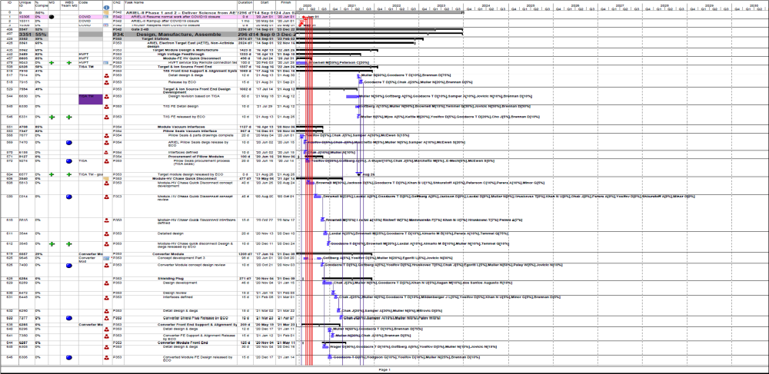
Now you can make a schedule!
Notes:
That’s a whole other presentation
Lets assume that you;ve used your estimates and favourite tool for scheduling …

Slide 13
A plan is a basis for change
Change is inevitable
“Plans are worthless, but planning is everything.“
  - Dwight D. Eisenhower
"Everyone has a plan until they get punched in the mouth".
  - Mike Tyson
Notes:
ARIEL schedule has 6000 lines
If we graded success on how good the original schedule maybe C+
Tasks change constantly
If we graded the team on how well they’ve adapted this year to change the schedule every week of the LS26, A+

Slide 14
Putting the plan into action
Leading successful project teams

Slide 15
Managing and Leading Teams
Getting the best out of your team by enabling not micro-managing
  “What do you need?” …. not “why aren’t you finished”
Honesty:
  Be honest with your team
    Explain the Why
    Share the project goals and deadlines
    Try to avoid hiding the real deadline
      E.g. don’t set a Tuesday deadline if its really due Friday
  Encourage the team to be honest with you about their progress
  All this encourages accountability
    for most people

Slide 16
Managing work
Be firm, but you have to find your own voice
Treat people the way you’d want to be treated

Slide 17
Managing your own time
Lead by example
  In what you do
  and how you do it
But don’t be a hero and burn yourself out

Slide 18
Things will still go wrong!

Slide 19
Celebrate the successes!

Slide 20
Safety
New and Young workers are most at risk of injury
If you’re supervising a young/new worker you have an extra duty of care for them
And to yourself
No project deadline is worth someone getting hurt
All workers have the right to refuse unsafe work
How we do the work is as important as what we do, including Safety
Do your TRIUMF Supervisor training

Slide 21



Safety is everyone’s responsibility
Think Safe, Act Safe, Stay Safe
In case of emergency ALWAYS call the Driver Control Room first¹
Report all incidents and near-misses and hazards to your supervisor or EHS immediately (https://web.accel.triumf.ca/ncr/dbfault.pl)
Radiation contamination/spill incidents must be reported to RPG via the Driver Control Room (x7333 or 604-222-7333) without delay
Know the alarms and emergency exits, if you hear an alarm evacuate quickly and safely and proceed to the closest assembly location
If the alarm goes off in the badge room DO NOT LEAVE THE BADGE ROOM, stay calm and report it to the Driver Control Room immediately. Use the phone provided in the badge room.
¹911 can be called directly if impractical
Notes:
Young and new workers are statistically most at risk

Slide 22

Leading discussions with project teams and stakeholders

Slide 23
Meetings: Plan Ahead
Decide what is your objective for the meeting
Plan what you want to say
  Time and effort to prepare should be proportional to the importance of the meeting
  Anticipate questions
The basics:
  Have an agenda, try to stick to it
  Keep minutes
    For larger meetings (more than 3 people), ask someone else because it’s hard to run the meeting and take notes
Notes:
Minutes: women – don’t get caught being the secretary. It happens
Guys: don’t ask your female peers unless its ok with them

Slide 24
Team meetings
Don’t forget that it’s your meeting
Don’t let someone else hijack the meeting (even if unintentional)
Don’t lose control of the agenda
Watch the time. Discussion is good but cut it off if you need to
Tip:
Don’t get caught in a 1-on-1 conversation with someone who asks a question
  Respond to them directly,
  then answer the question to the whole room,
  which gives you back control of the meeting

Slide 25
Why Project Management?
To stifle your creativity?
To give you and your project the best chance of success …
  To meet your objectives
  Stay within budget and schedule
  Leave some room for issues if when they arise
  Build a great team

Slide 26

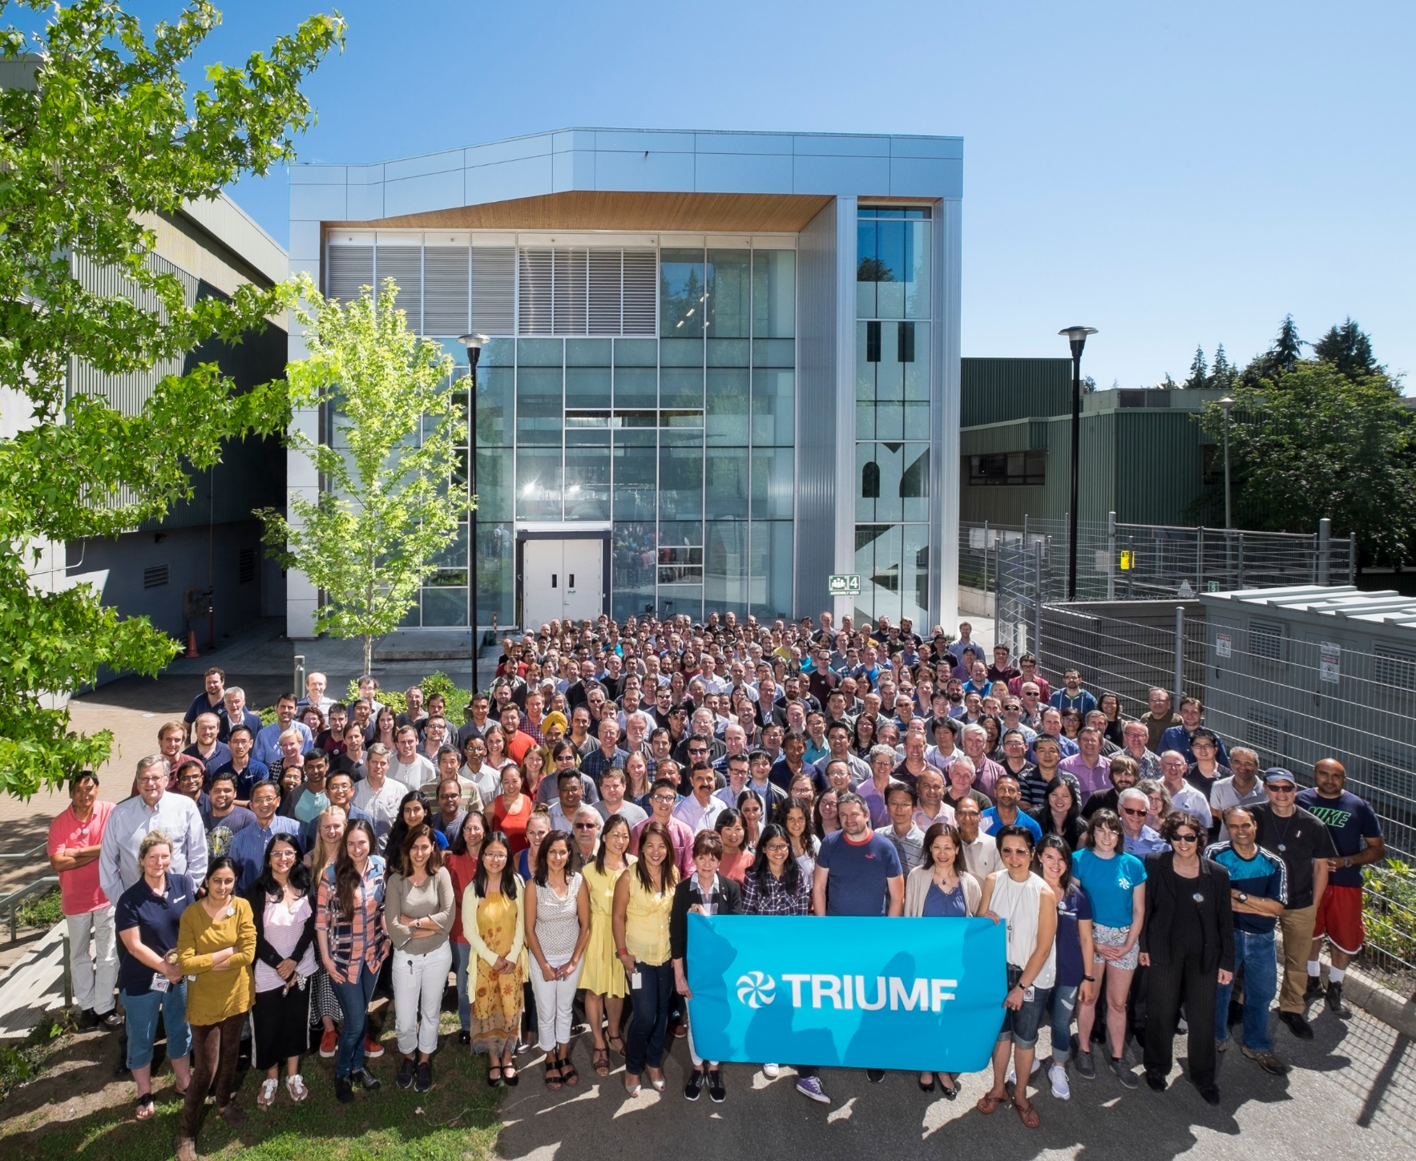


Thank You!
Merci!
www.triumf.ca
@TRIUMFLab

Slide 27
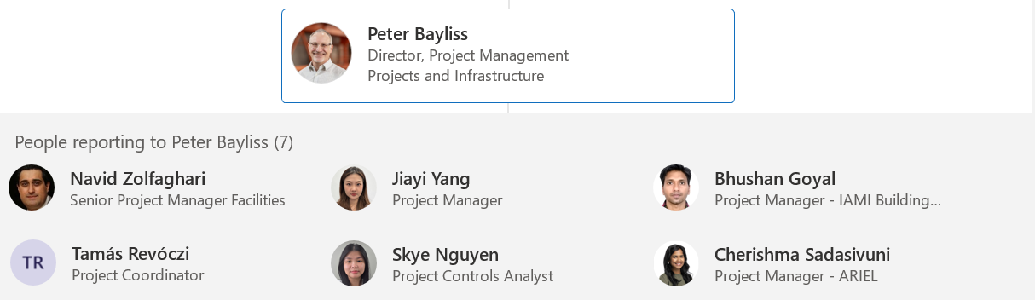
TRIUMF PMO Team

Slide 28


