Slide 1
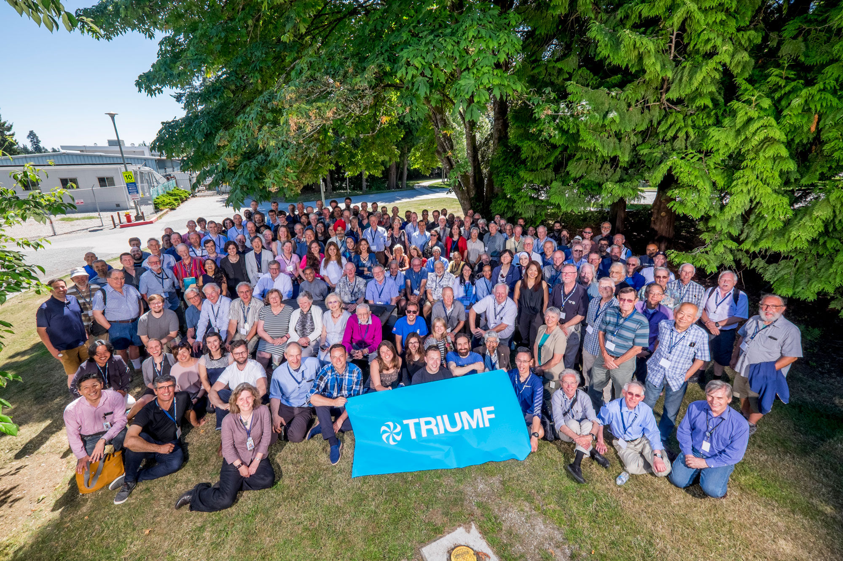

TRIUMF-
Quantum Retreat
Intro and Goals
Jens Dilling
Associate Laboratory
Director- Physical Sciences
November 28, 2019

Slide 2
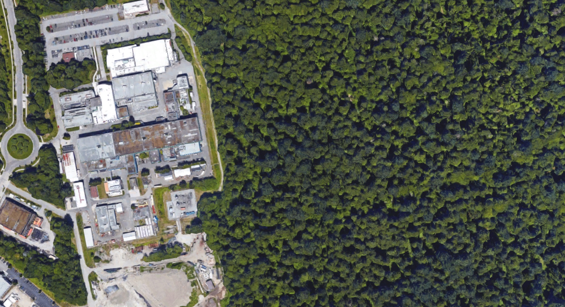
TRIUMF is one of Canada's major investments in large-scale research infrastructure
Founded in 1968, the laboratory has delivered 50 years of science and innovation for Canada

Slide 3
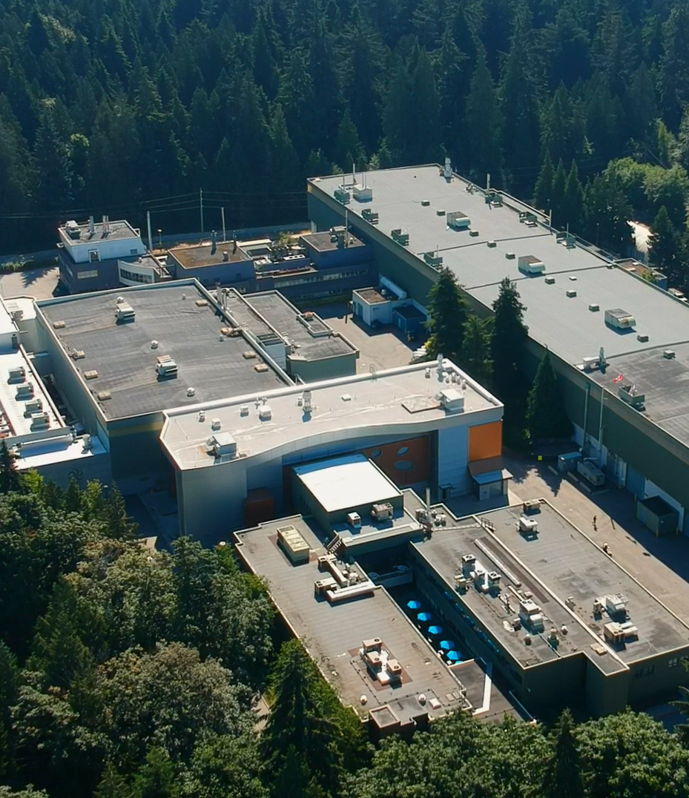
Our Mission is to serve as Canada’s particle accelerator centre:
We advance isotope science and technology, both fundamental and applied. We collaborate across communities and disciplines.
We operate major user infrastructure and participate in research and innovation together with our partners.

Slide 4
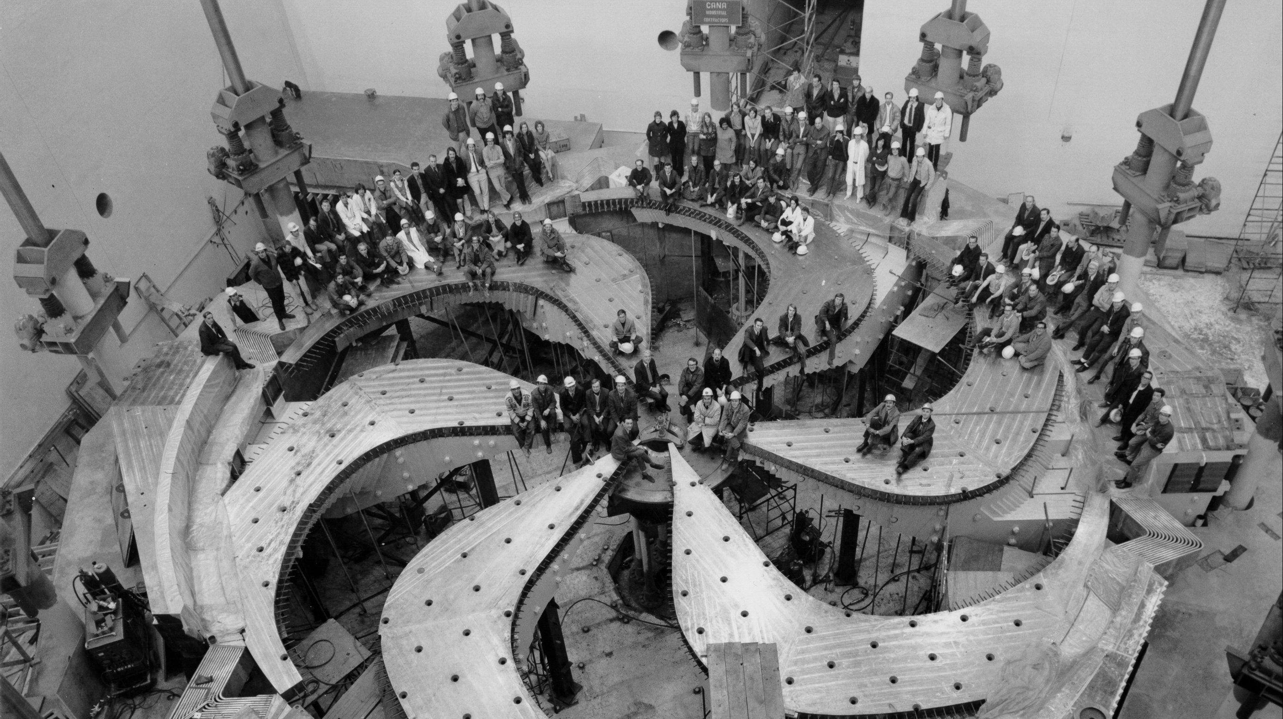
World’s Largest Cyclotron

Slide 5
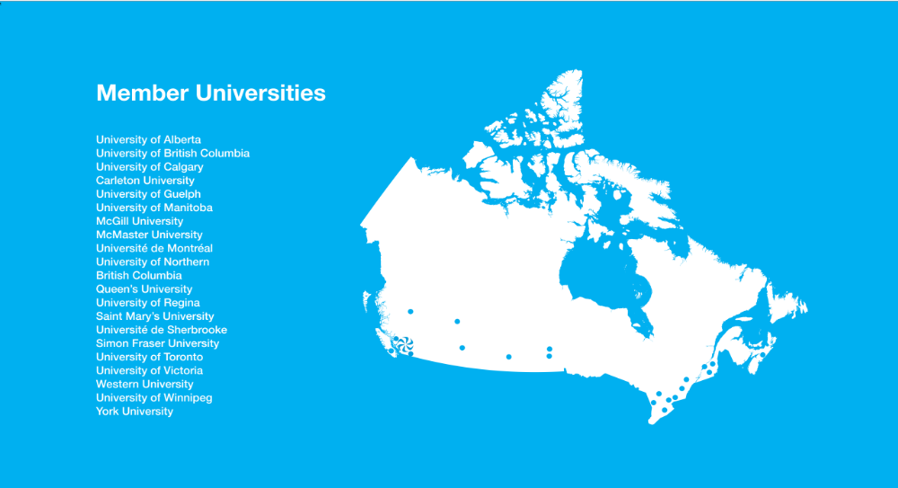


Owned and operated by a consortium of 20 member universities across Canada
Our multidisciplinary community uses its world-class accelerator infrastructure to drive leading-edge research that delivers impact in science, medicine, and business

Slide 6






Scale of Operations
HIGHLY QUALIFIED PERSONNEL
INTERNATIONAL
ENGAGEMENT
KNOWLEDGE
BUSINESS
> 500 staff¹
> 200 students & postdoctoral researchers²
1000+ scientist & researcher visits per year
~80% of Canada’s subatomic physics research involves TRIUMF
60+ international agreements & partnerships
Generated over $600M in economic activity from 2012 - 2018
1 – Total across funding sources
2 – Includes external students and post-docs

Slide 7
Scientific Users and Visitors by Field (2018)
Multidisciplinary
CY 2018:
1002 Scientific Users and Visitors
TRIUMF is a major user facility that operates research infrastructure and makes it available to the scientific community (merit-based).
!

Slide 8
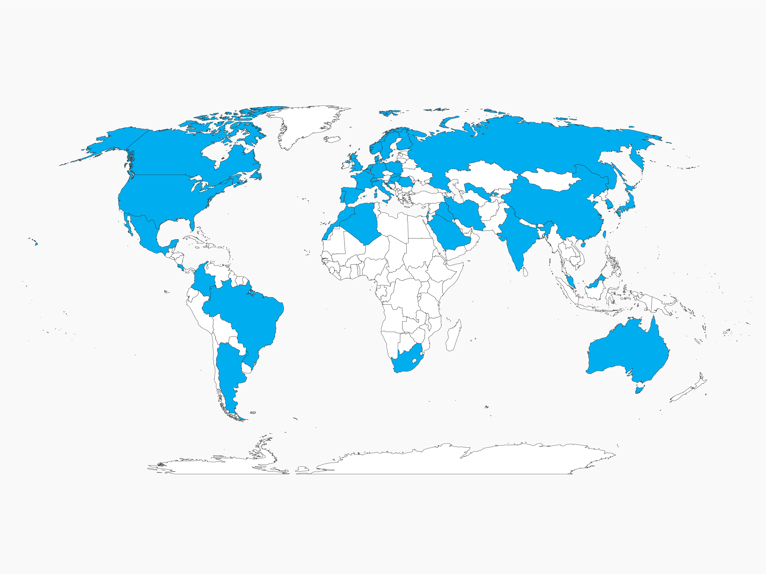
TRIUMF’s Global Reach
TRIUMF Users
in 42 Countries
(2013-2018)

Slide 9
Revenue Sources (2015-2020)
Funding
FY18/19:
$87.3M Total Revenues
~540 Employees

Slide 10
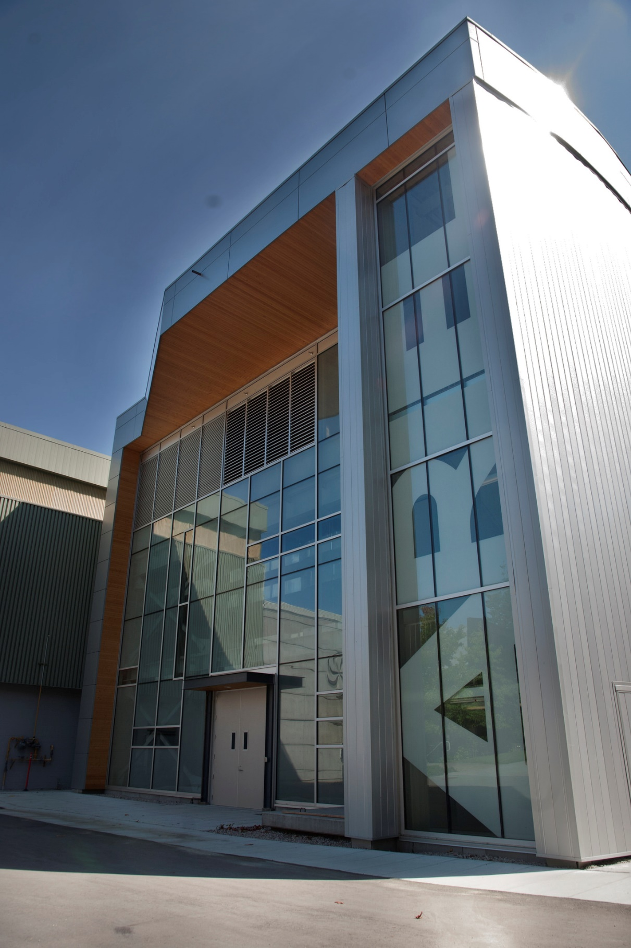
Science and Technology
  Advanced Rare Isotope Laboratory (ARIEL)
  Leveraging made-in-Canada super-conducting RF accelerator technology, ARIEL will triple TRIUMF’s rare isotope production capacity – enabling more science, more training, and more commercial activity
  Represents ~$100 million investment by federal and provincial governments
  Supported by 21 universities from across Canada
  New science capacity will be unlocked in stages beginning in 2019

Slide 11
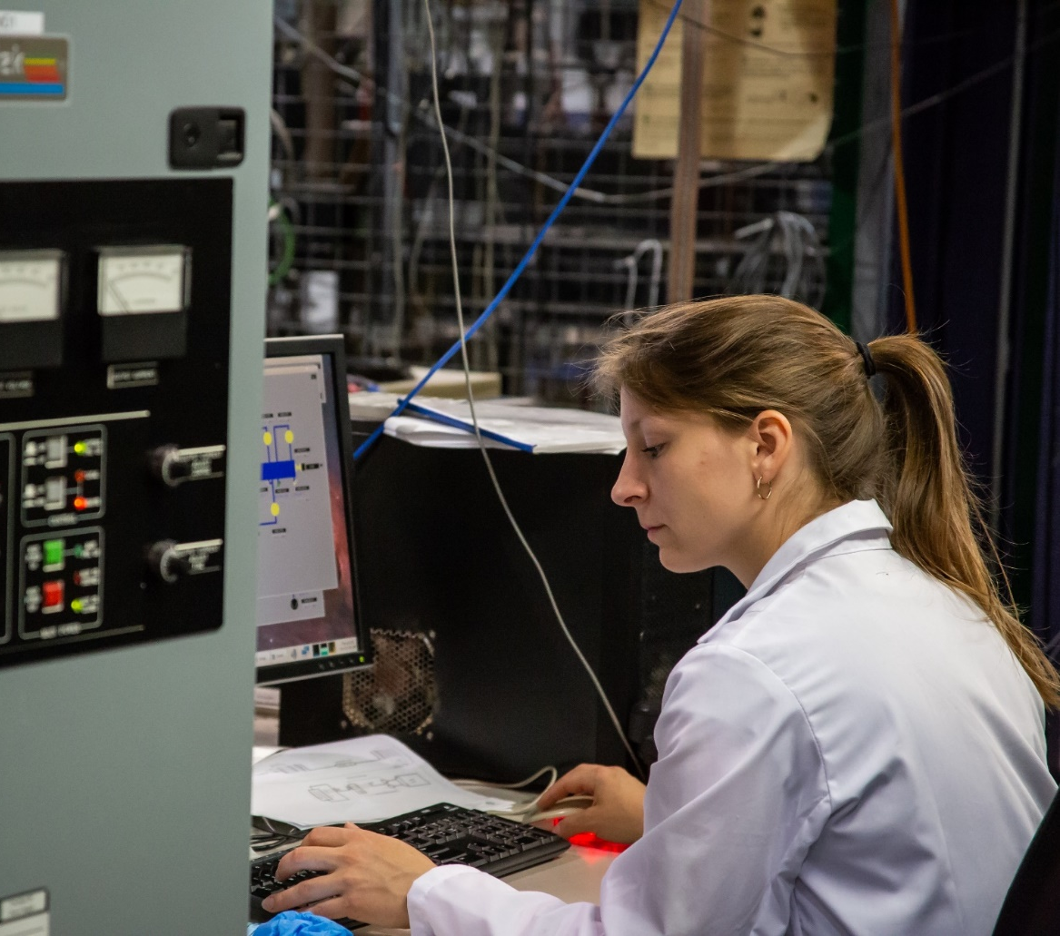


People and Skills
  TRIUMF plays an important role in the development of Canada’s next-generation workforce
  Supporting and complementing Canada’s universities, we provide unique interdisciplinary opportunities that help train people at all levels – from high school to postdoctoral researchers
  Annually, we host over 100 undergraduate co-op students in disciplines ranging from physics and engineering to business and communications – and we aim to expand such efforts over the next five years
211 students and postdocs hosted in 2017,
a 40% increase since 2012
137 students graduated in the last five years with data from TRIUMF under supervision of TRIUMF researchers

Slide 12
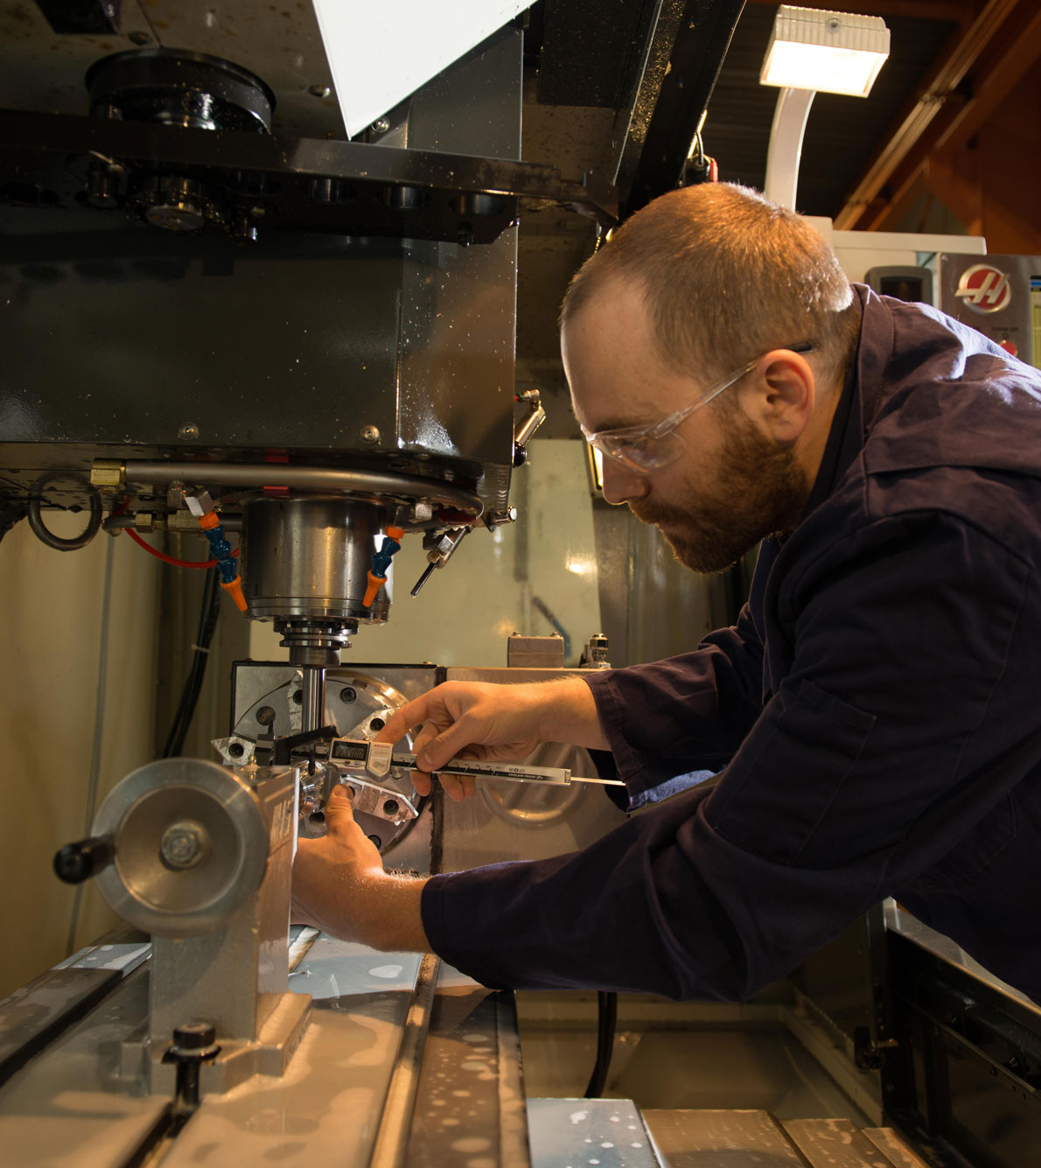



Innovation and Collaboration
  TRIUMF Innovations – the laboratory’s commercialization arm – leverages research capabilities to solve real-world problems and deliver benefits to Canadians
$1.1B in gross economic output, and >$600M in GDP activity between 2012-2018
30 patents filed over the last five years
$8M in private sector investment into five spin-off companies

Slide 13
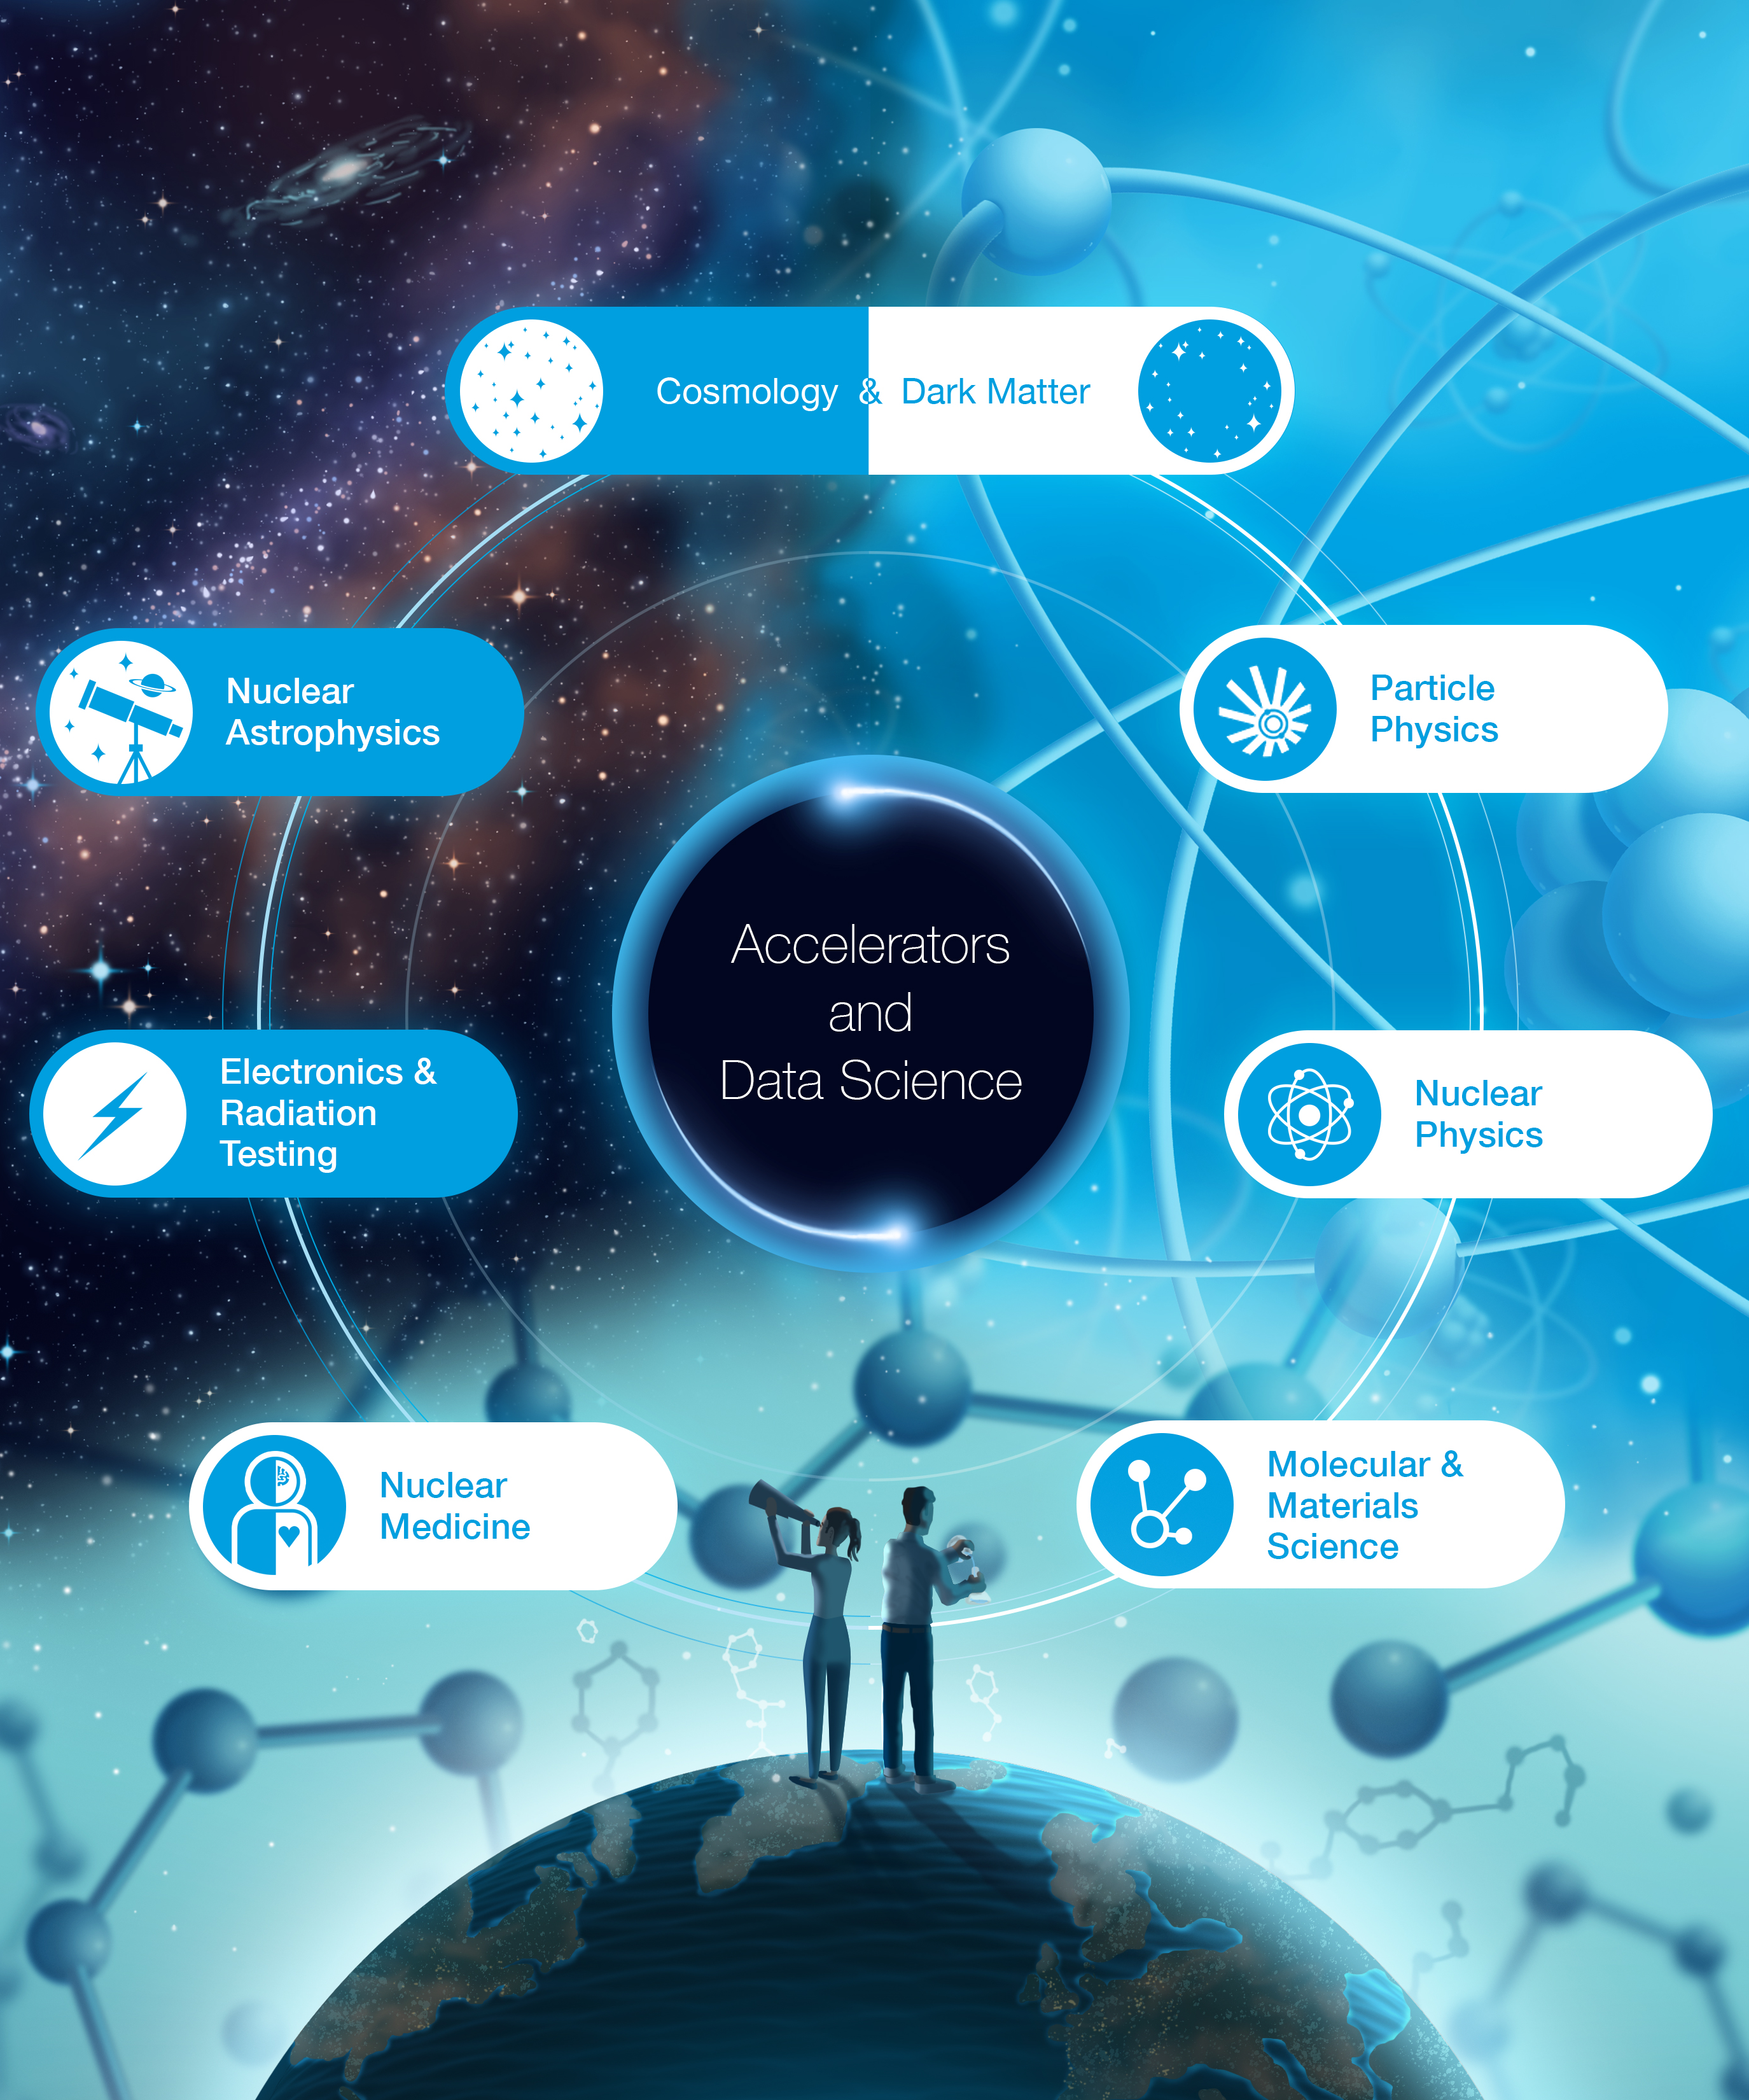




TRIUMF’s Research
Both fundamental and applied:
Expanding the boundaries
of human knowledge
Accelerators
Detectors
Data Science
Advancing the treatment
of critical diseases
Developing new technologies
and innovations
Deepening our understanding
of the natural world

Slide 14
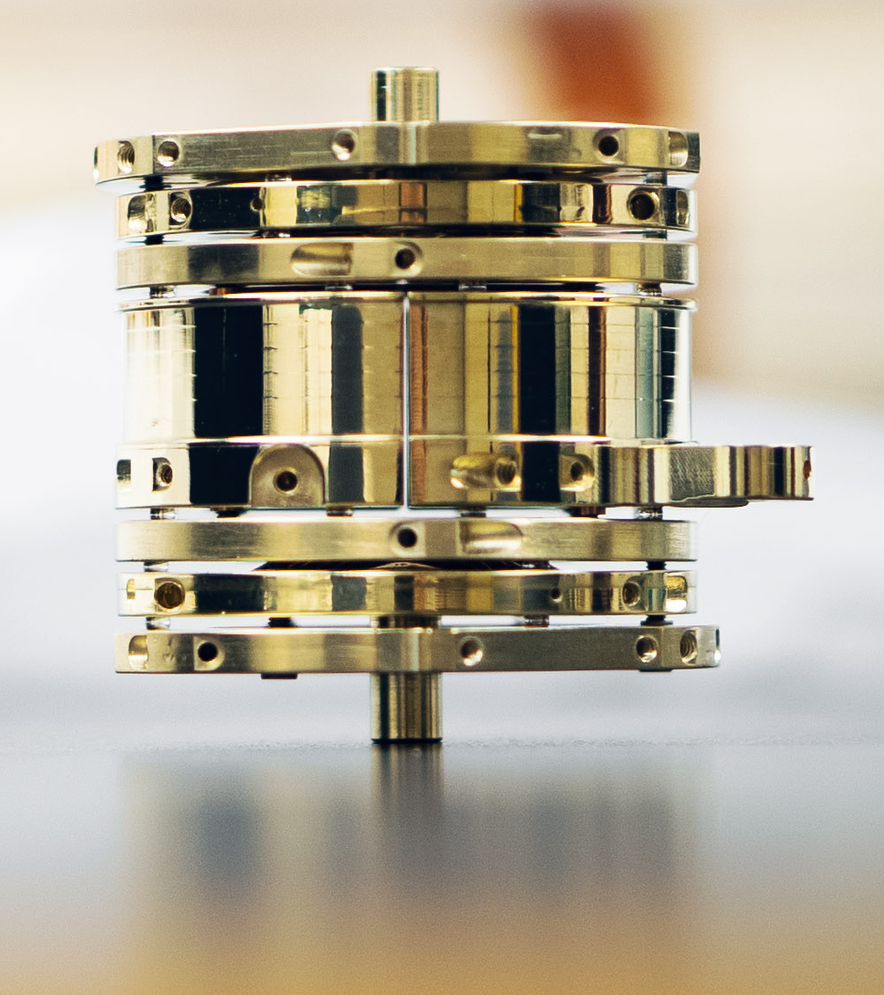
Research and Operation
On-site programs
  Accelerator-based operations
  On-site experiments
  Technical developments and manufacturing
Off-site experimental programs
  Particle physics experiments at
    CERN (Europe)
    J-Parc (Japan)
    SNOLAB (Canada-underground)

Slide 15
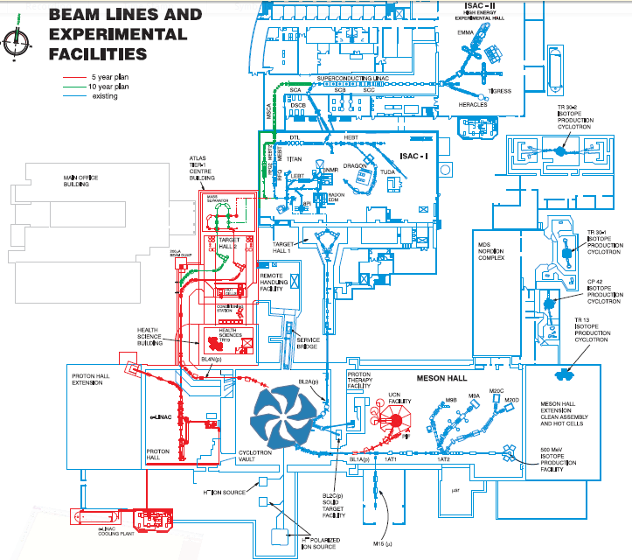
TRIUMF’s accelerator complex
40 MV SRF
Heavy Ion Linac
ISAC-II
>10 AMeV
Nuclear Physics
Nuclear Structure
Nuclear Astrophysics
Fund. Symmetries
Advanced Rare Isotope Laboratory
(ARIEL)
ISAC-I
60 keV, 1.7 AMeV
e-LINAC
30-100 kW photo-fission driver
CMMS
Centre for Molecular and Material Science
Cyclotron
500 MeV
350 μA
Particle Physics
Ultra Cold Neutrons

Slide 16
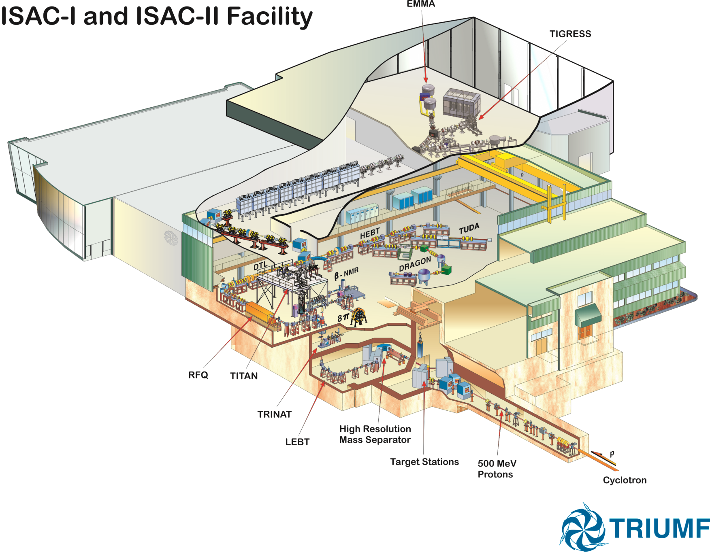

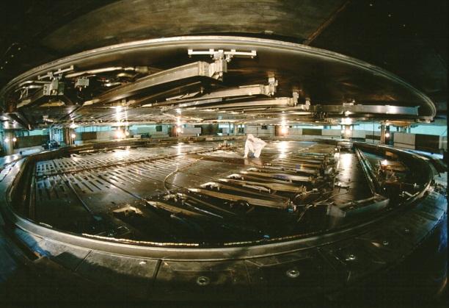
Radioactive beam made via ISOL method.
High Energy
16.5 A MeV
Medium Energy
1.8 A MeV
Low Energy
60 keV
Mass
Separator
Target
500 MeV
protons

Slide 17
ISAC facility:
3000 h of beam operation each year (24/7 for 9 months)
93% operational availability
Once ARIEL is on-line triple the beam time
Merit-based access (international expert committee)
User-office, liaison scientists, guest house, etc
‘free of charge’ for academic users (publish results)
Notes:
ALTERNATIVE SLIDE: see slide 57

Slide 18

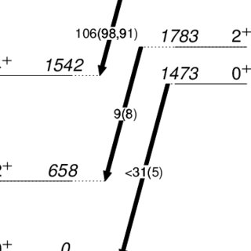
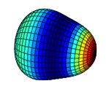
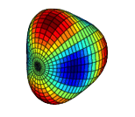
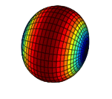
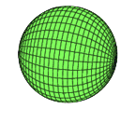
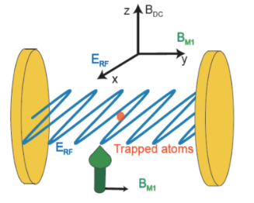
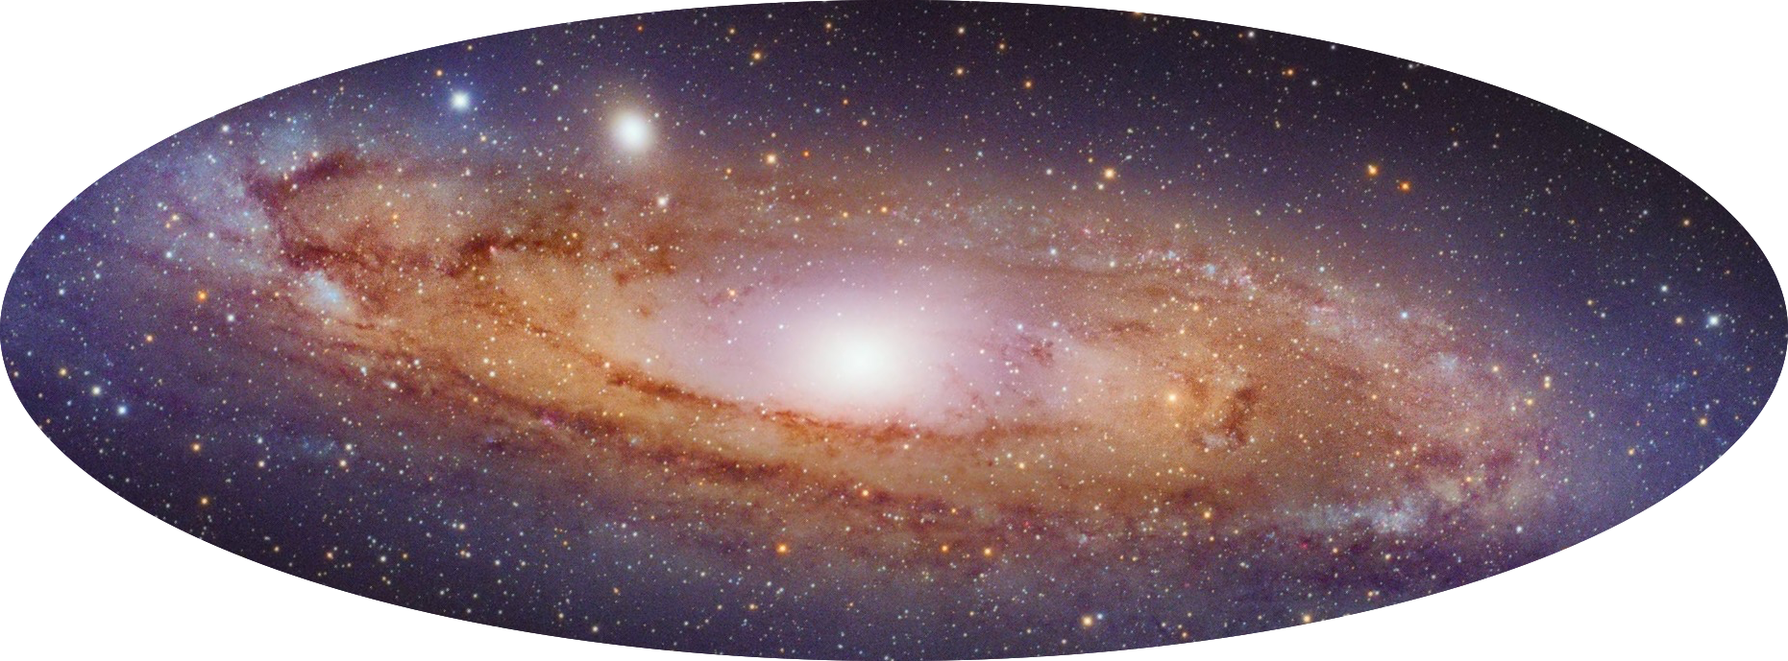
Nuclear Physics at TRIUMF
Exploration of evolution of nuclear shell structure, deformations, shapes, ground & excited state properties
GRIFFIN/DESCANT
TITAN
Laser Spectroscopy
IRIS
EMMA
TIGRESS/SHARC
SONIK
TUDA
Talks by A. Kwiatkowski
& G. Gwinner
Nuclear Structure & Dynamics
Precision Tests of Fundamental Interactions
Nuclear Astrophysics
TRINAT
FRANCIUM
GRIFFIN
TITAN
MTV
Precision tests of Fundamental Physics using ion/atom trapping, laser manipulation
Direct and indirect measurements of important reactions and decays for nucleosynthesis and stellar evolution
The “Three Pillars” of experimental nuclear physics research at TRIUMF-ISAC
DRAGON
TUDA
SONIK
EMMA
TIGRESS/SHARC
GRIFFIN
(BRIKEN)

Slide 19
TRIUMF’s accelerator complex
40 MV SRF
Heavy Ion Linac
ISAC-II
>10 AMeV
Nuclear Physics
Nuclear Structure
Nuclear Astrophysics
Fund. Symmetries
Advanced Rare Isotope Laboratory
(ARIEL)
ISAC-I
60 keV, 1.7 AMeV
e-LINAC
30-100 kW photo-fission driver
CMMS
Centre for Molecular and Material Science
Cyclotron
500 MeV
350 μA
Particle Physics
Ultra Cold Neutrons

Slide 20

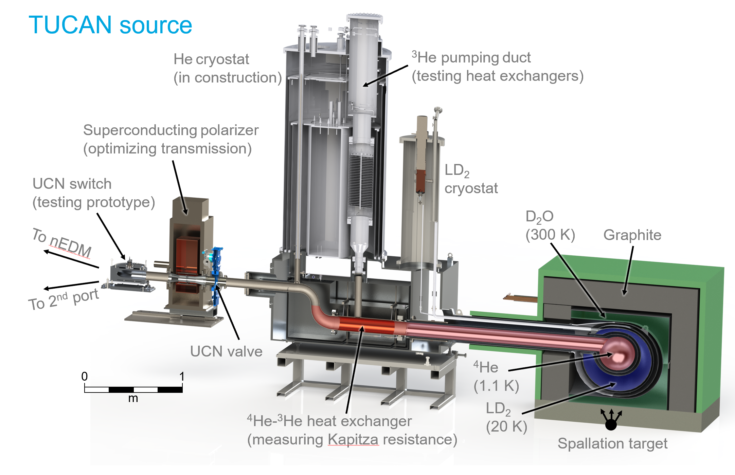







TUCAN: next generation UCN source progress
Construction of main cryostat started summer 2019
State-of-the-art UCN production using spallation neutron source
Providing unprecedented UCN yield
Installation planned for 2021
Allows competitive nEDM measurement at 10⁻²⁷ ecm
UCN platform,
Meson hall
Talk by
& G. Gwinner
UCN beam switcher

Slide 21
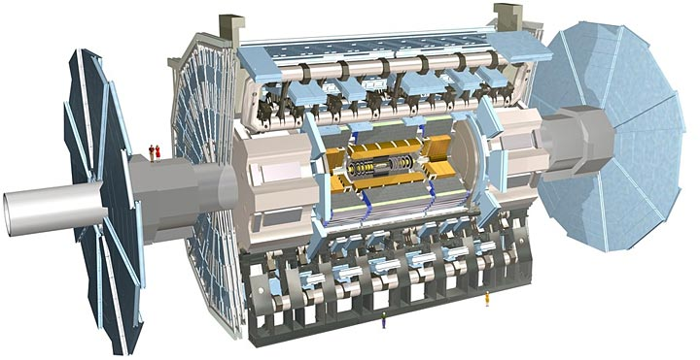
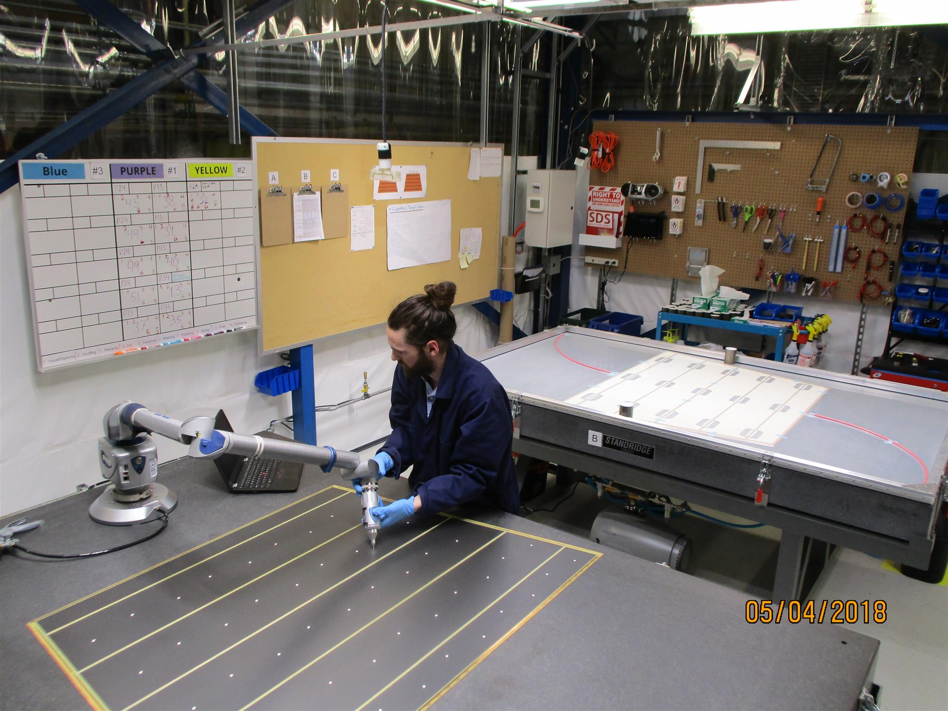
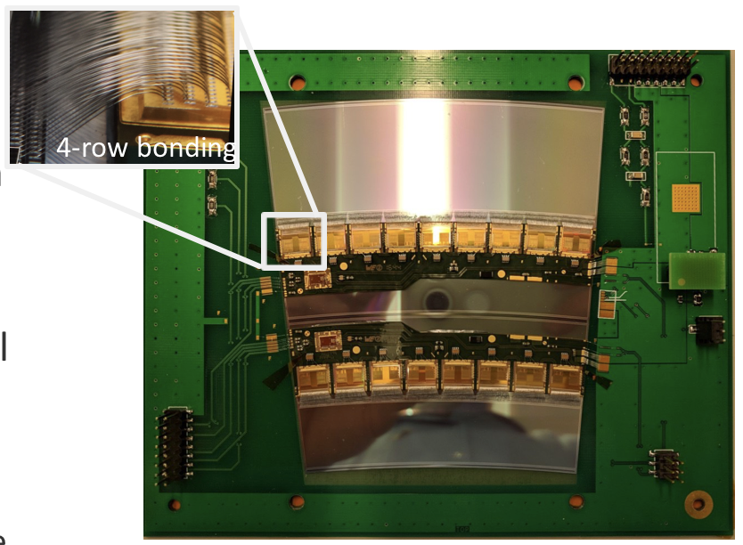
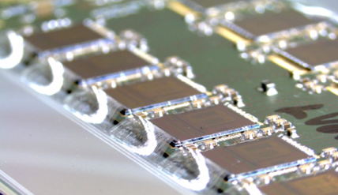
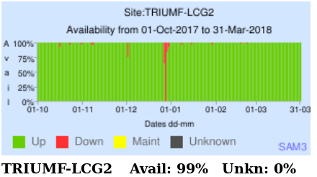
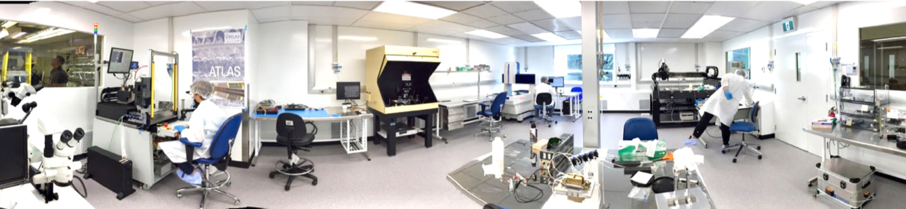
Particle Physics off-site: ATLAS
LHC & ATLAS Run 2 and beyond
    Final year of Run 2 about to start
    Searches for New Physics
    Higgs boson characterization
ATLAS Upgrades
Phase 1 2019-2020
  LAr electronics and New Small Wheel in full production
Phase 2 2024-2026
  New Inner Tracker, LAr front-end electronics
ATLAS Tier-1 computing center
    Smooth 24/7 operations (maintenance end of Dec)
    Cluster at SFU in production (federation)

Slide 22
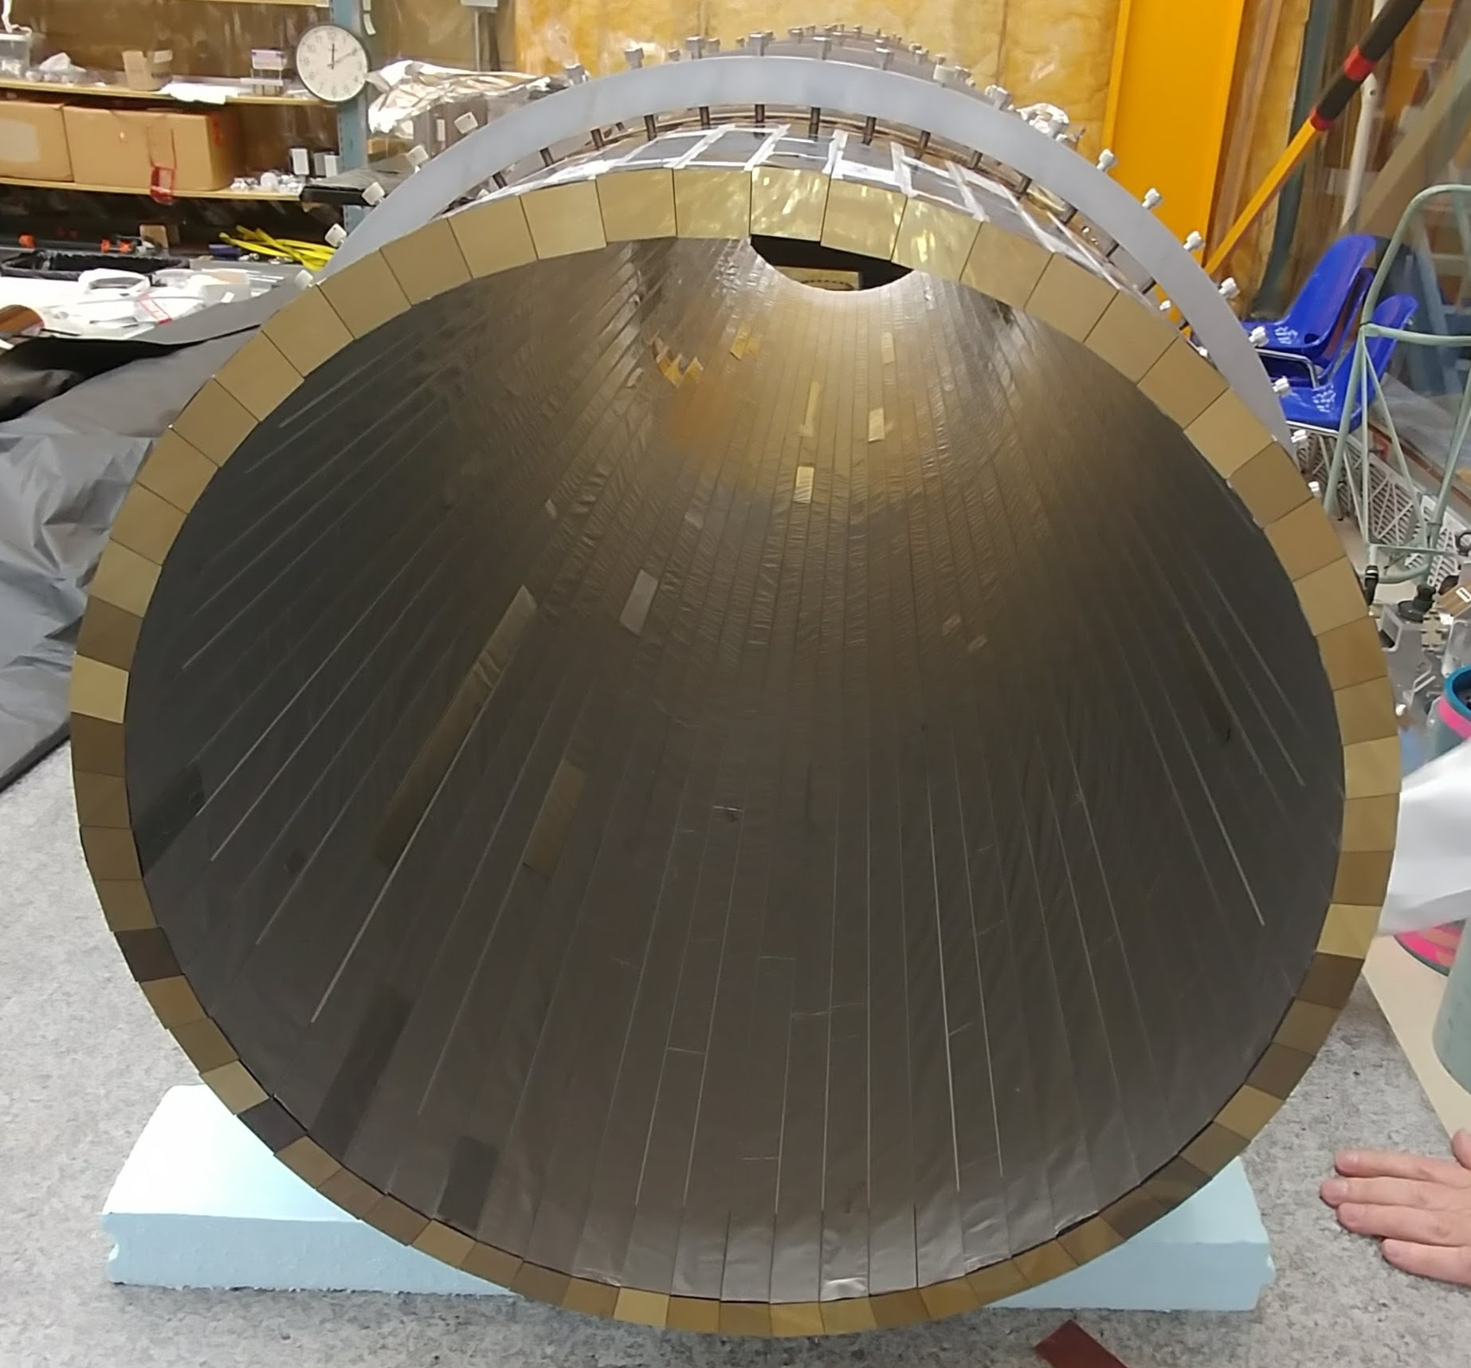
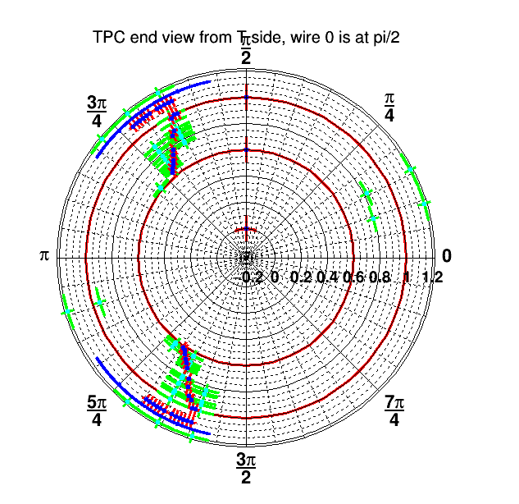
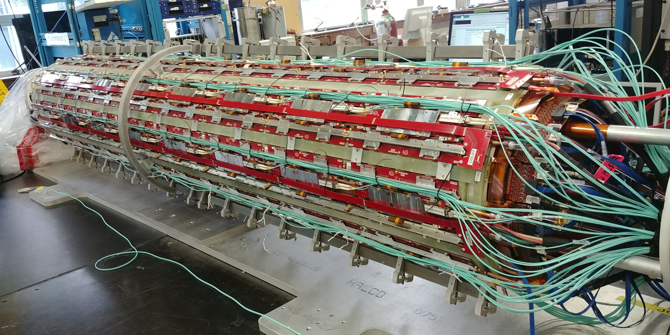
Particle Physics: Science Technology
ALPHA-G full detector and ion trap system
ALPHA cryogenic system design
Tracks in full TPC
Improved gas system
Talk by
& G. Gwinner
Barrel scintillator
Fully assembled TPC

Slide 23
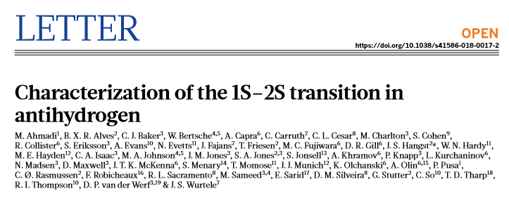
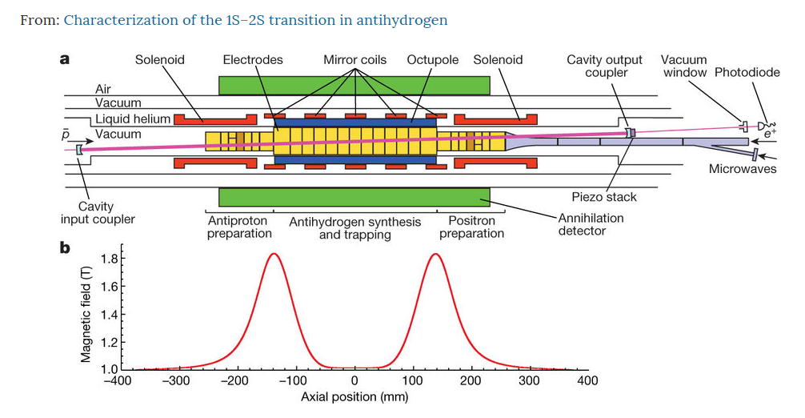

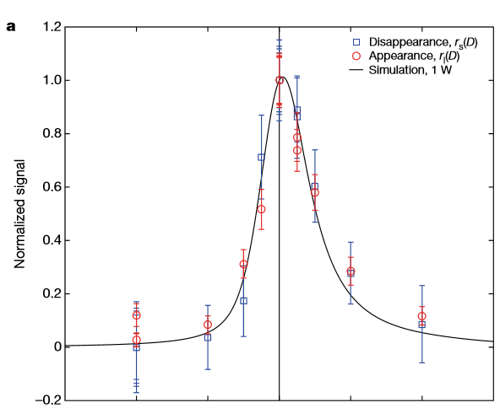





Particle Physics Department Highlights: ALPHA
(2.4660611030794 +/- 0.0000000000054) x 10¹⁵ Hz
anti-hydrogen 1s-2s transition frequency measured to 2x10⁻¹²

Slide 24
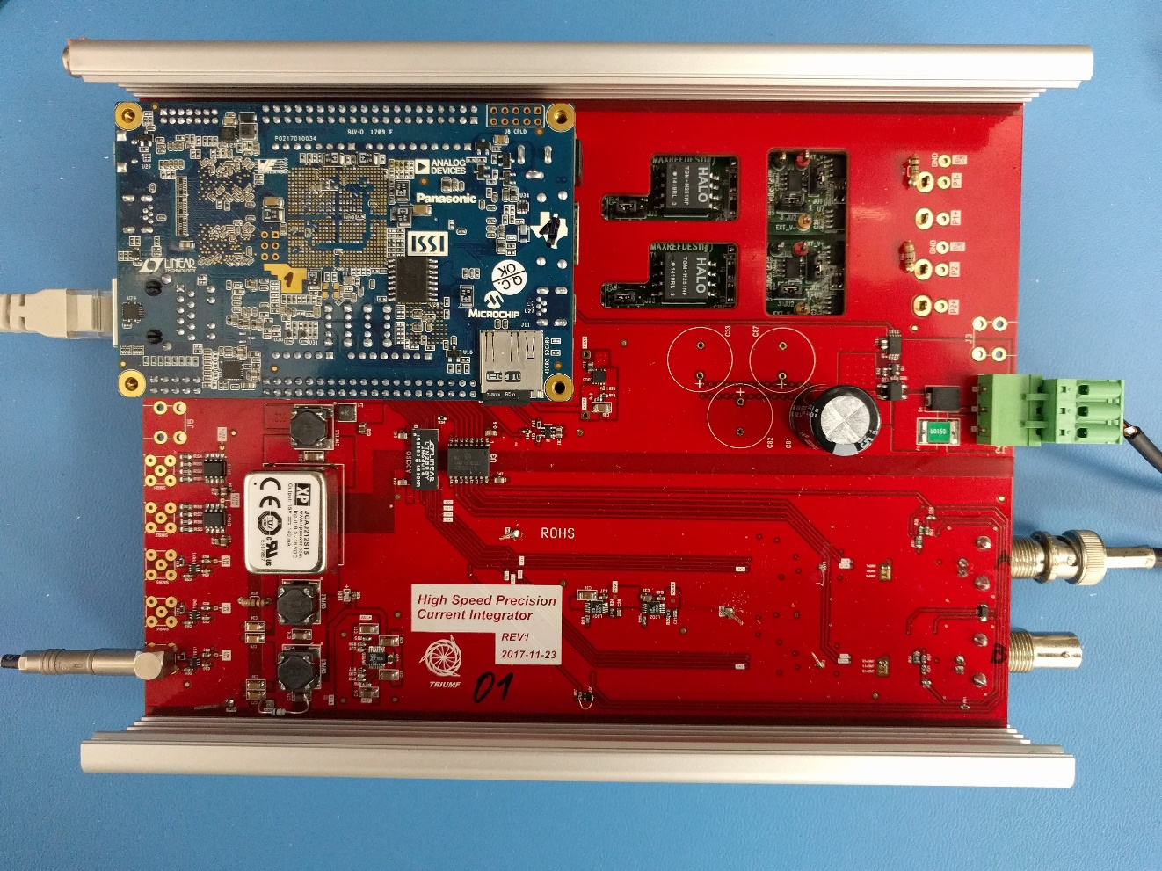
Science Highlights: Science Technology Department
ARIEL involvements:
Machine protection system
Beam monitoring electronics
  fC/fA level charge/current measurement
  Boards proto-typed
    Ready for production
    Meeting all specifications
ARIEL Yield station
  Mechanical engineering and DAQ
ARIEL beam line installation
  Overseeing implementation
Talk by
& F. Retiere
beam monitoring electronics board

Slide 25
Goals of the Retreat
Bring the community together to discuss opportunities for TRIUMF to add value to the science portfolios
Opportunities to enhance quantum literacy and quantum proficiency, while capitalizing on leading-edge technology developments and capabilities in Canada and TRIUMF.
Canada is considered to be a leader world-wide in things-quantum…we need opportunities to build in this.
TRIUMF is a major user facility that knows how to run accelerators (RF system, UHV, laser systems, cryogenics, control systems, etc) successful and execute user programs.
TRIUMF is (was) host to the ATLAS Tier1 computing center, and operates 63 computing clusters for experiments.
Look at what TRIUMF can do, and identify what the community needs and how to get there.

Slide 26


Goals of the Retreat
Define needs:
  Quantum sensing
  Quantum technologies
  AMO opportunities for access to Nuclear Physics technologies (DAQ, FPGAs, etc)
  Access to quantum computing opportunities:
    Commercial systems
    Experimental (open) systems
  Others…
Define opportunities:
  Connection to Quantum Strategy
  Look at Funding opportunities

Slide 27
Goals for the Retreat
Generate discussions
Bring the community (and perhaps new fields for TRIUMF) together
Identify needs & opportunities
Perhaps have another meeting or link up with existing efforts
Generate a White Paper that summarizes the outcomes for our academic community (and can be put together as exec summary for agencies or the government.
Or think about a possibility for a NFRF LOI…

Slide 28
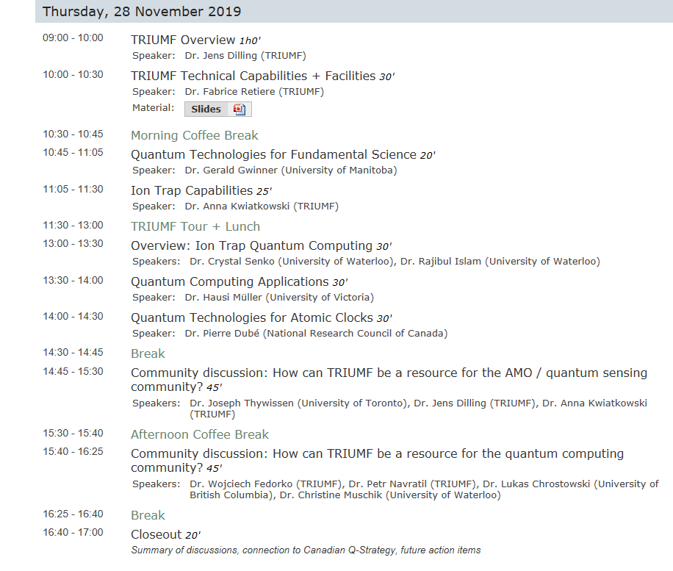

Slide 29
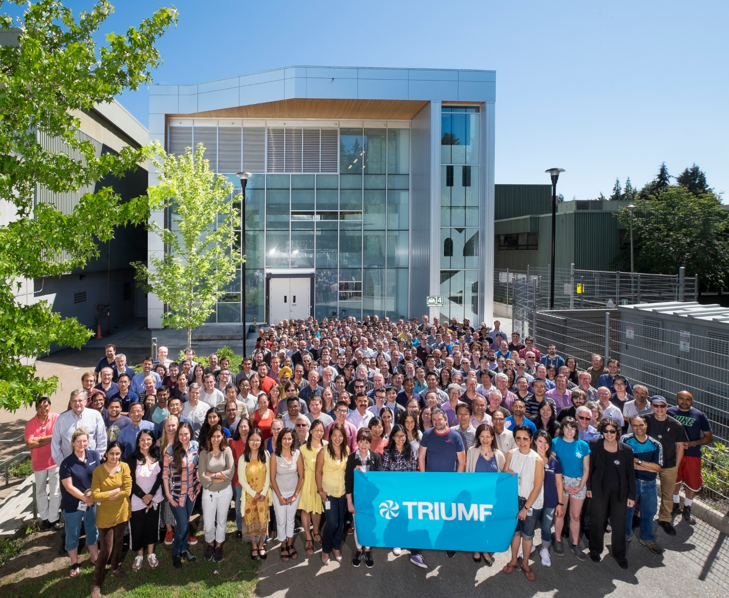



Thank You!
Merci!
www.triumf.ca
@TRIUMFLab

Slide 30
extra

Slide 31
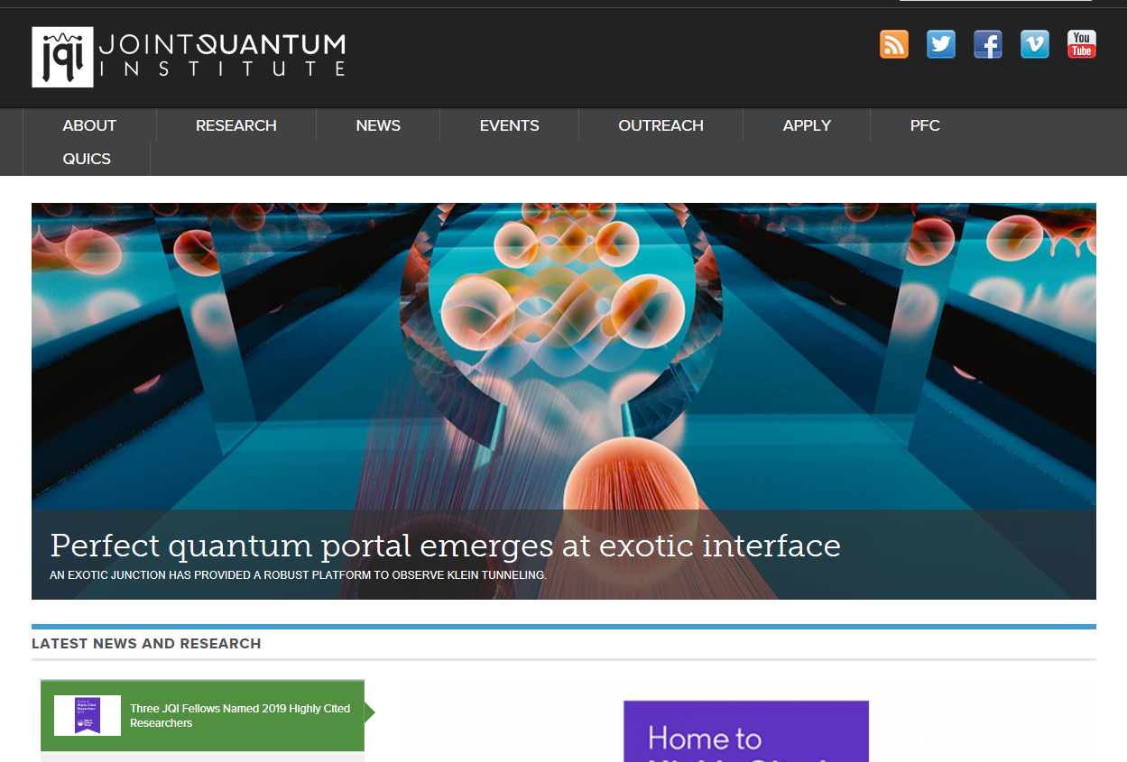

Slide 32
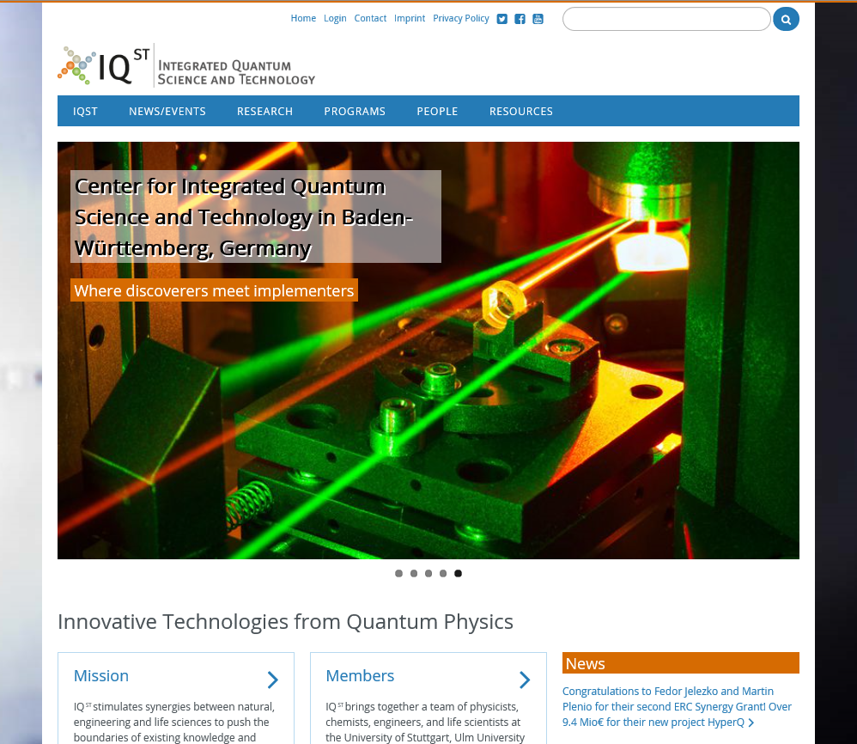

Slide 33
