Slide 1
P179/P363 Overview
BL4N / EHBT
ASSC Fall 2026
Oct 1-2, 2026
Project Leaders:
Yuri Bylinskii & Thomas Planche
Project Integrator:
Jason Chak
Tunnel Construction Coordinator:
Claire Pearce

Slide 2
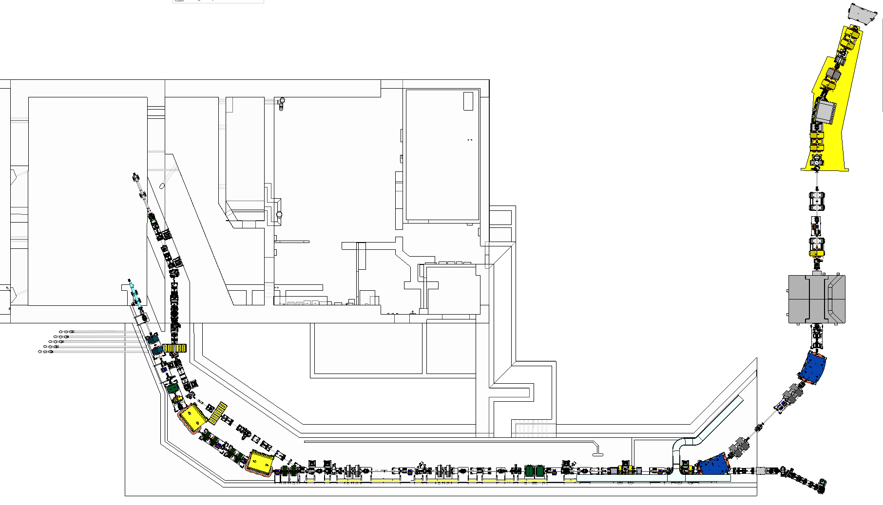
Beamlines Overview
EHBT (Electron Beam Transport) delivers an electron beam from the E-LINAC to the AETE Target Station
BL4N (Beam Line 4 North) delivers a proton beam from the Cyclotron to the APTW Target Station
NORTH
BL4N Vault region
AETE
BL4N Pharoah’s tomb region
APTW
BL4N Proton Cave region
BL4N & EHBT
Straight Tunnel section
BL4N & EHBT
North Tunnel bend section
EHBT dogleg region

Slide 3
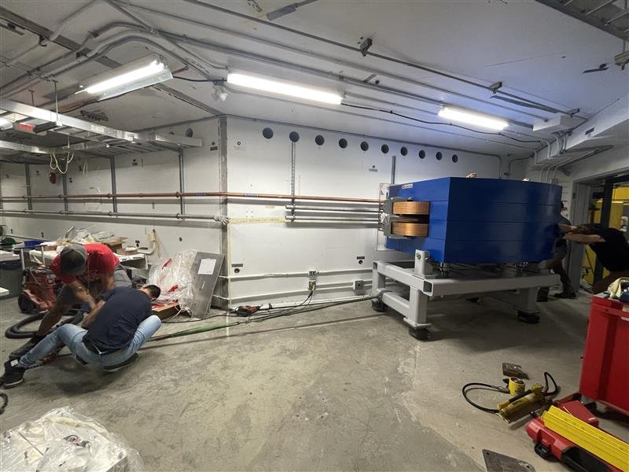
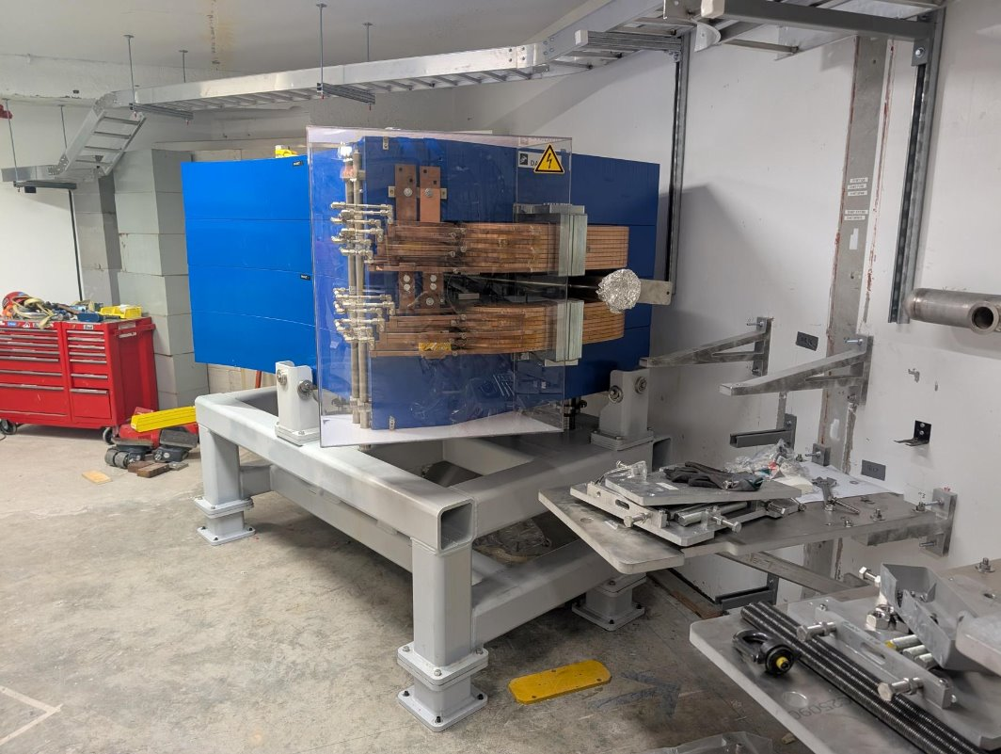
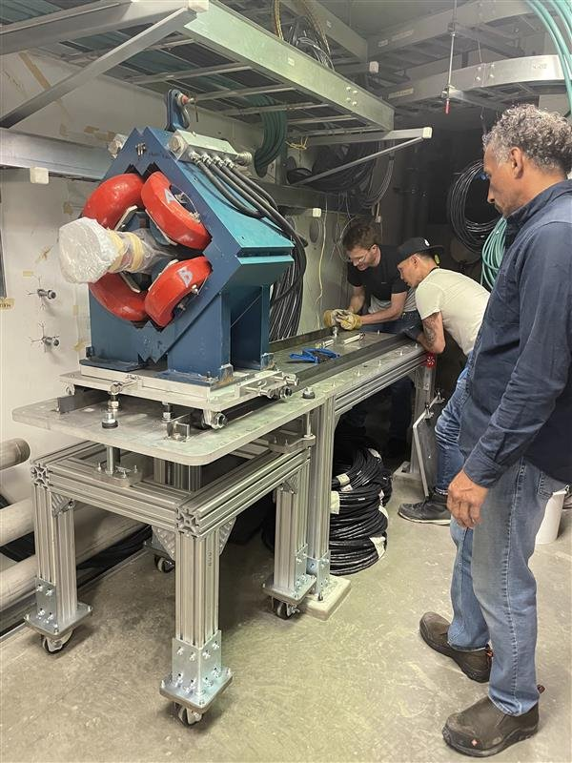
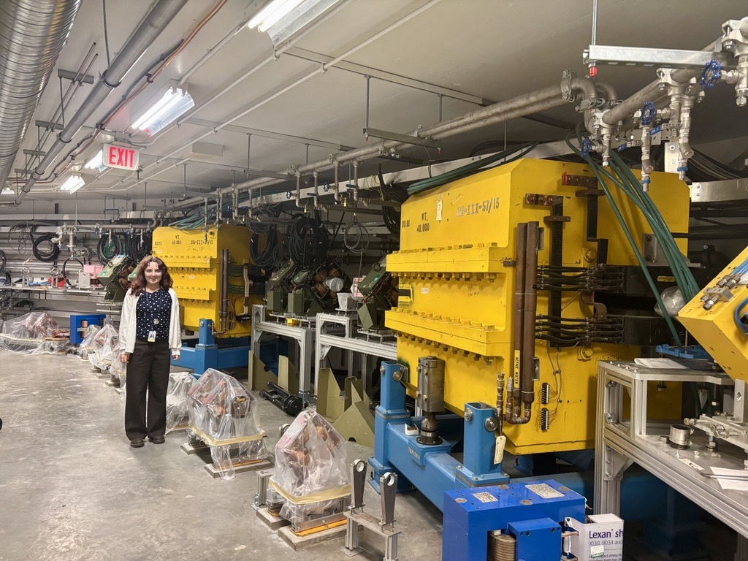
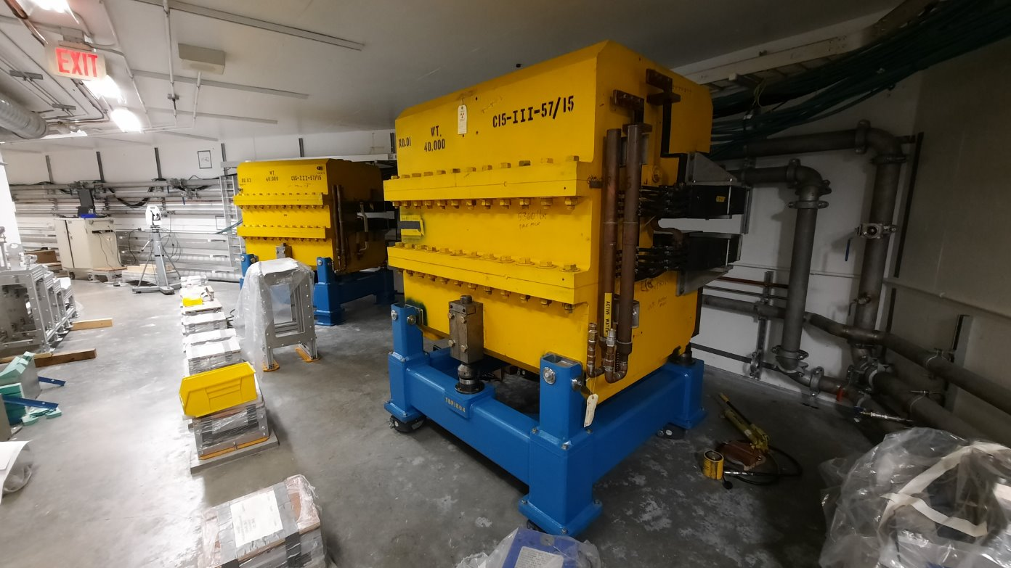
Accomplishments since last ASSC meeting
BL4N
Design of all installation critical components is complete
Fabrication of diagnostics is complete
All tunnel stands installed
All tunnel magnets & steerers installed using transfer cart
MB16 installed
Pulling MB16 into place
MB16 installed
Ariel North Tunnel - Before
Ariel North Tunnel - After
Installing BL4N magnets using Transfer Cart

Slide 4
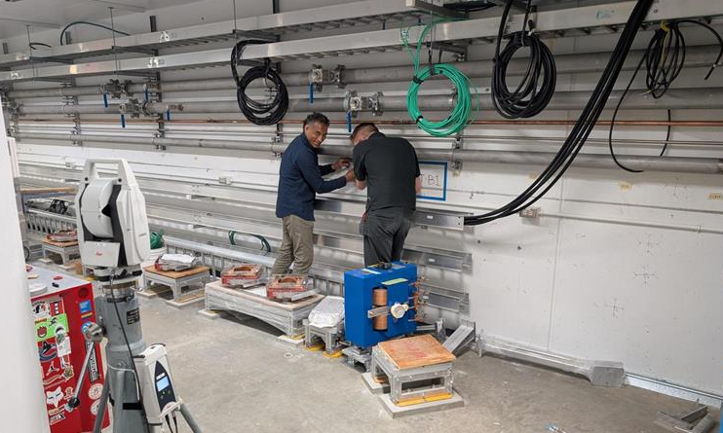
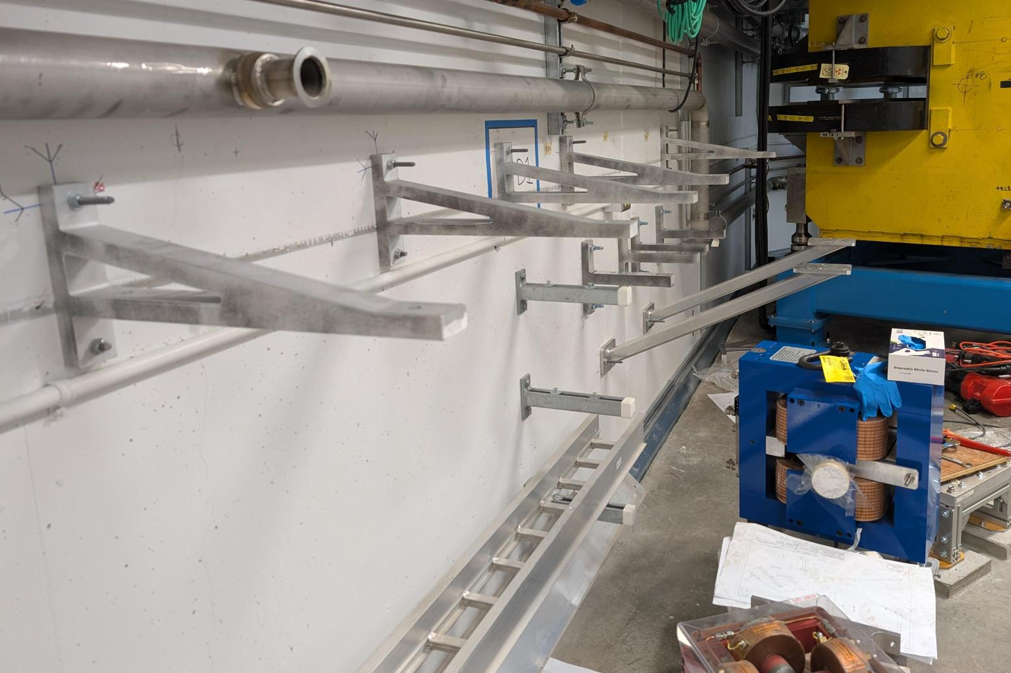
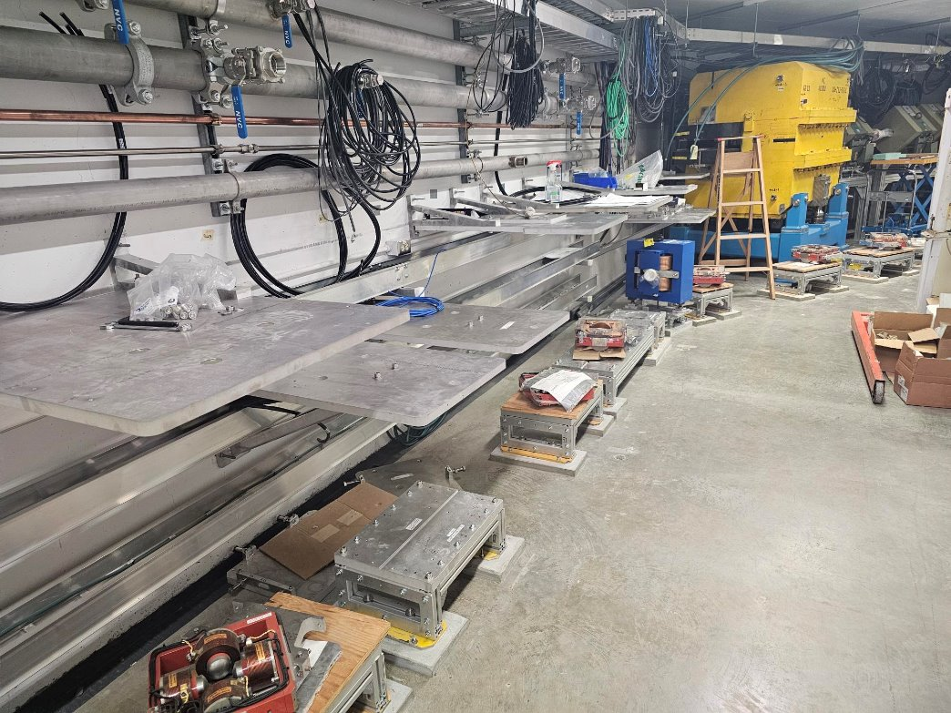
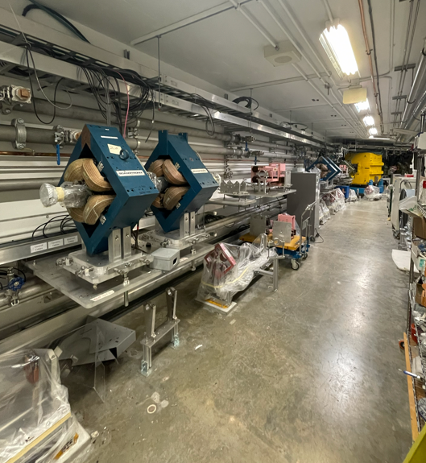
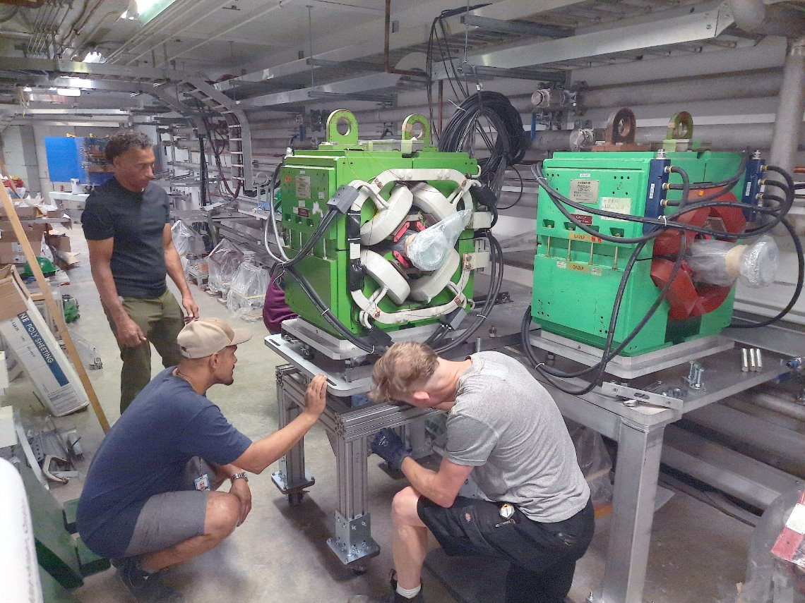
Accomplishments since last ASSC
1. Drilling & Marking Anchors
2. Installing Stand Supports
3. Assembled BL4N Stands
5. Quads & Steerers on Stands
4. Putting Magnets on Stands using Transfer Cart

Slide 5
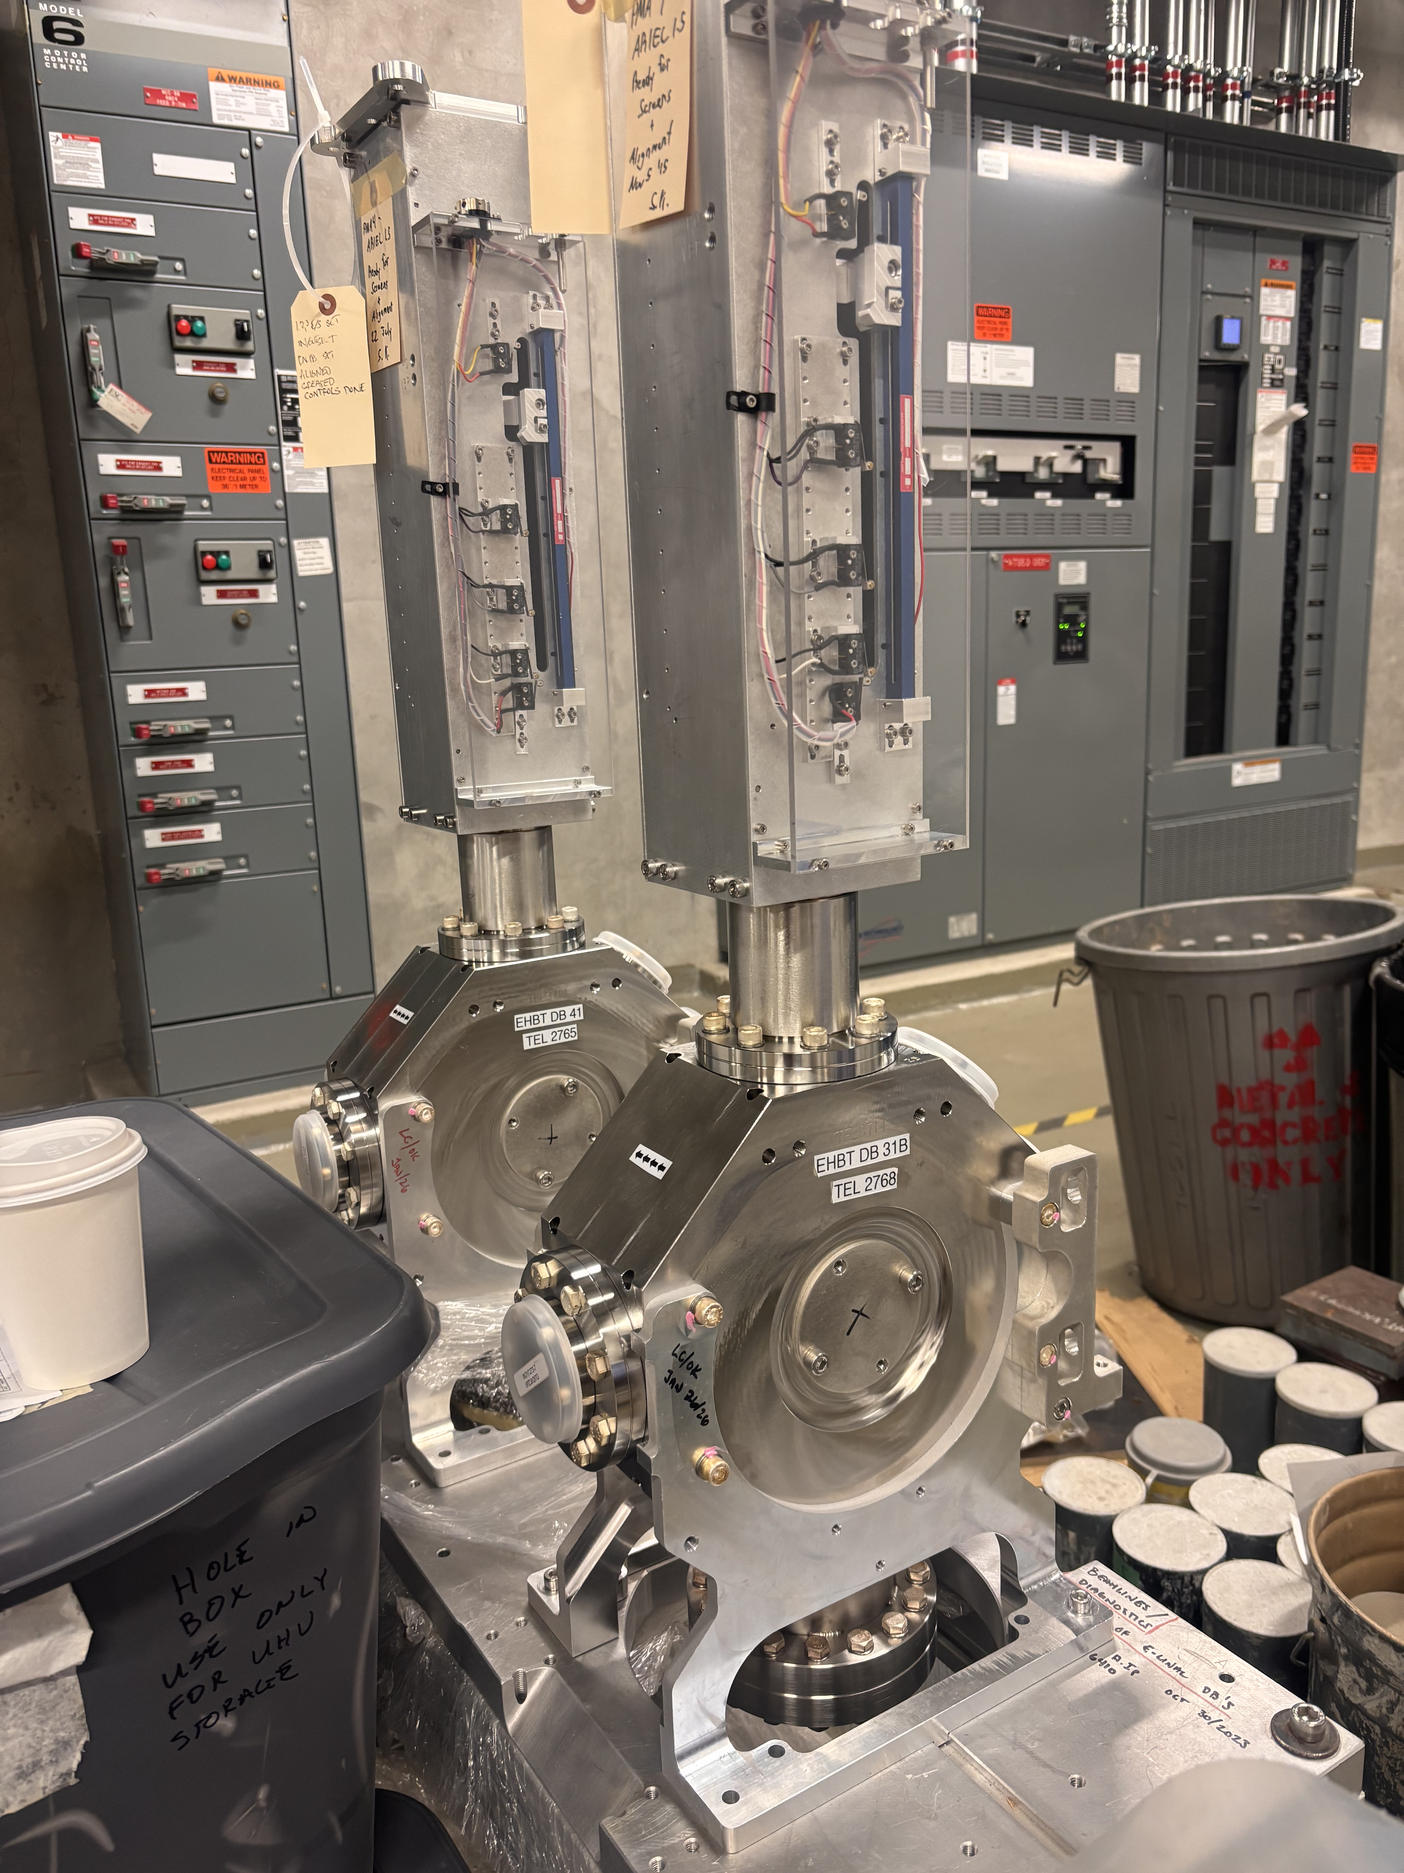
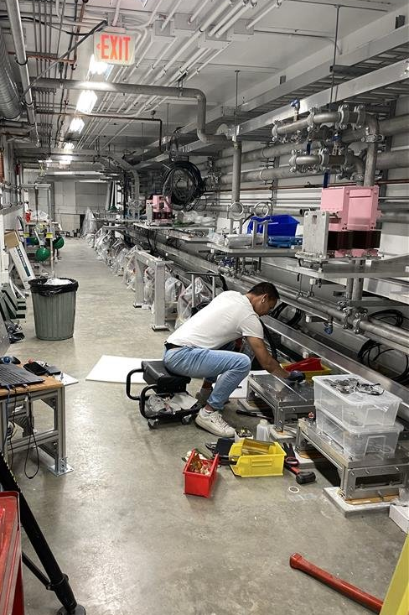
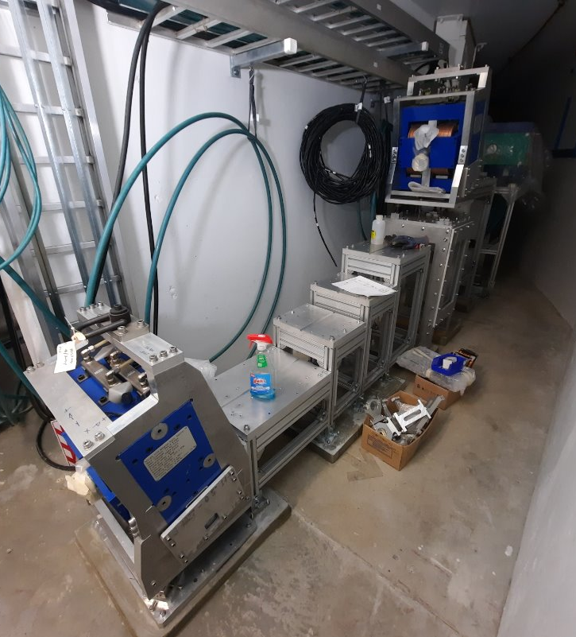
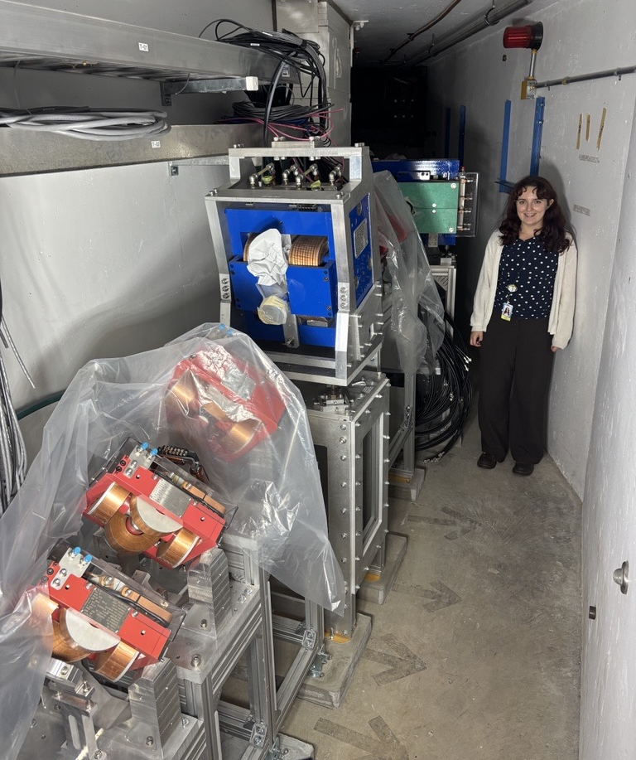
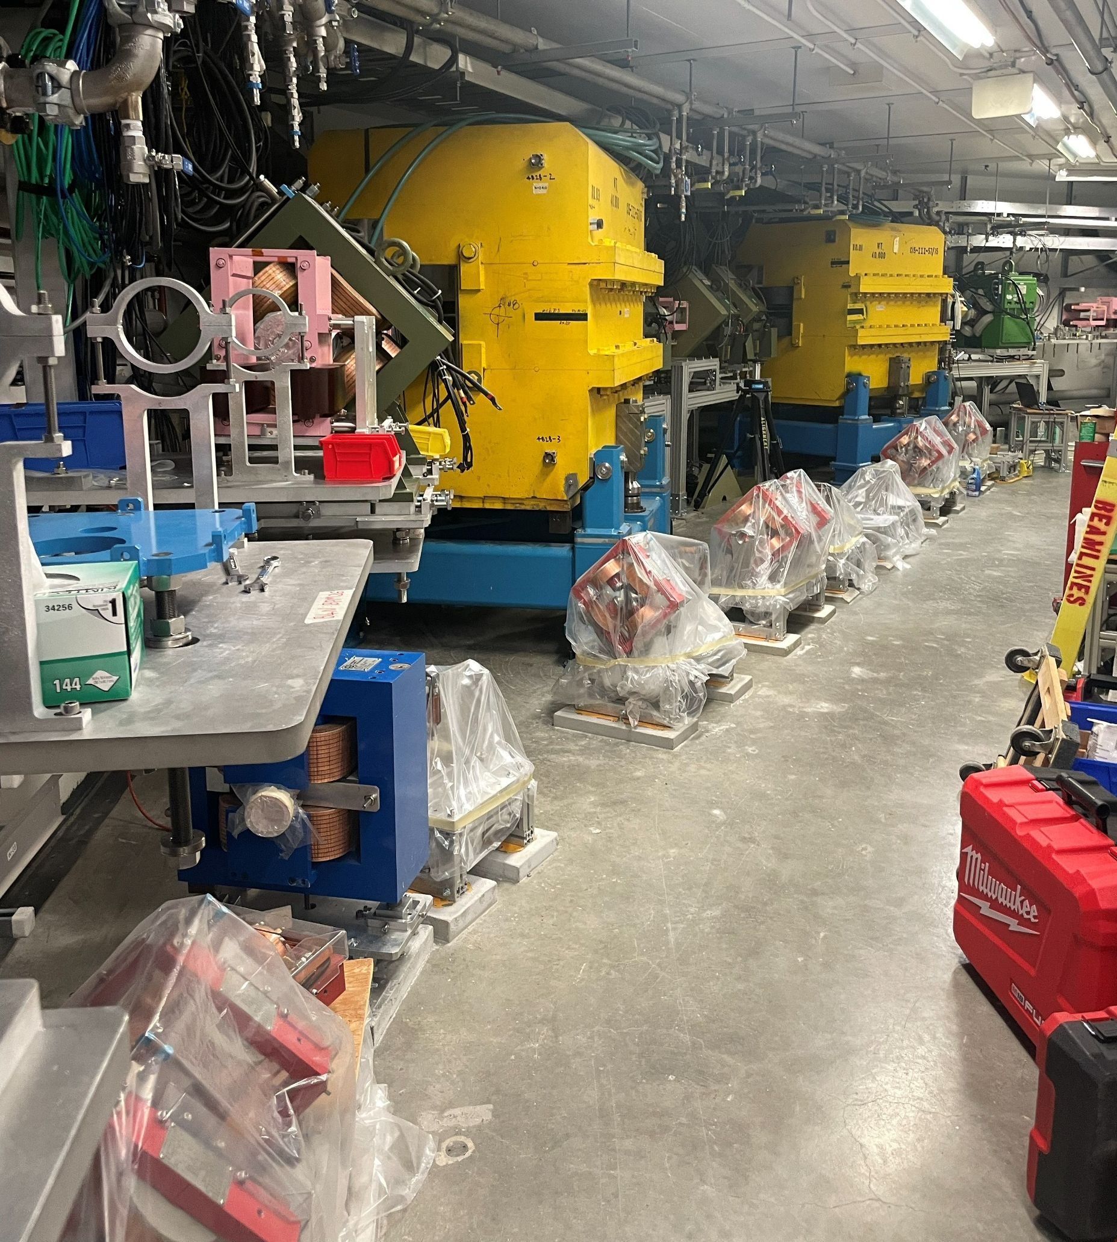
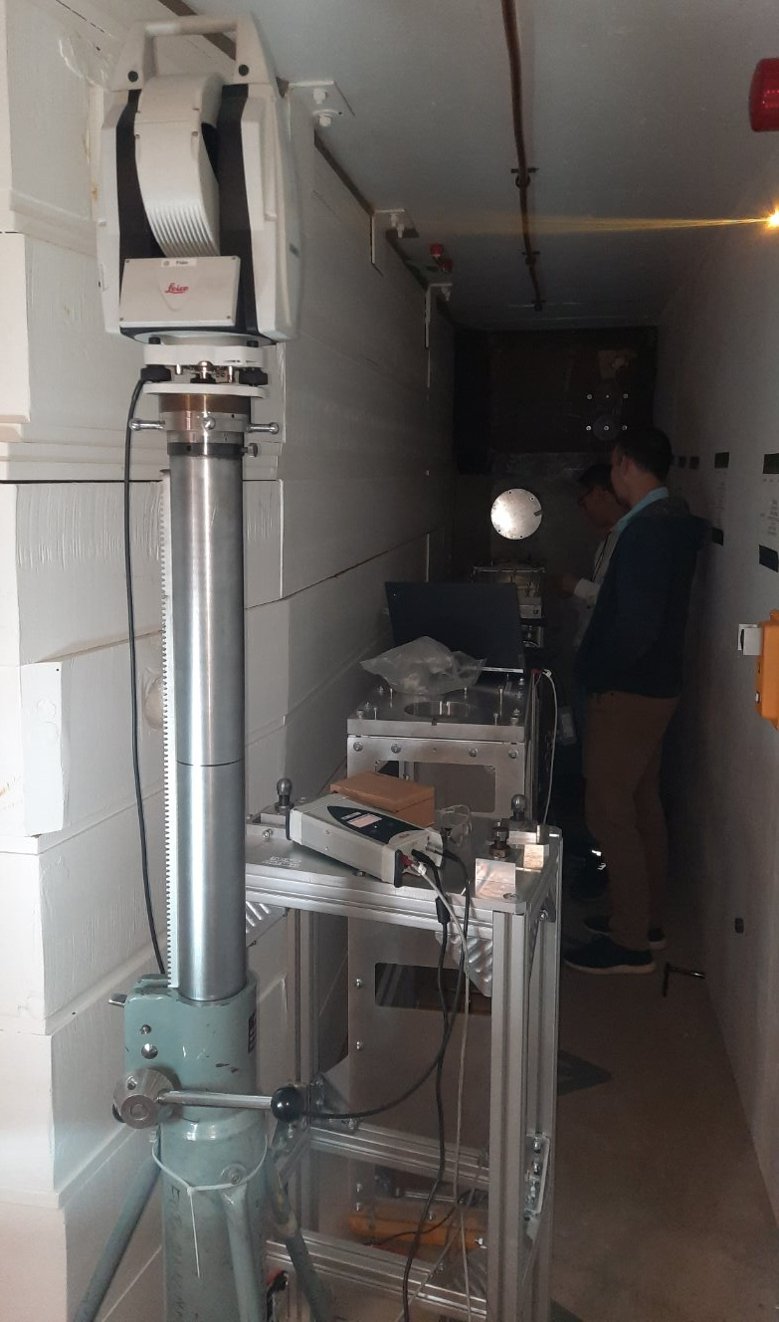
Accomplishments since last ASSC
E-line
All stands installed and re-aligned
  Building settled and device alignment was off and needed to be re-adjusted
All magnets in up to Q41 installed
Diagnostics are ready to install on stands
  Holding off to protect fragile devices
Diagnostics installed on boxes, ready to go
Grouting & Re-Aligning Stands
EHBT – Quads & Stands Aligned
EHBT - Before

Slide 6
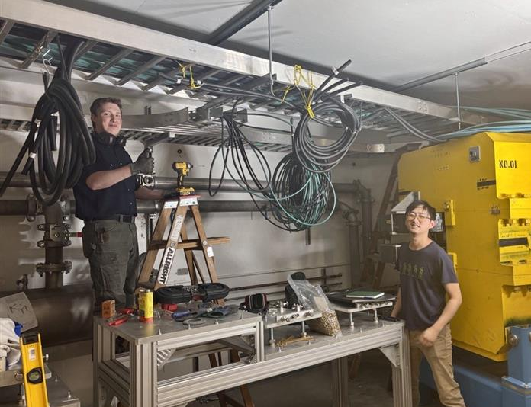
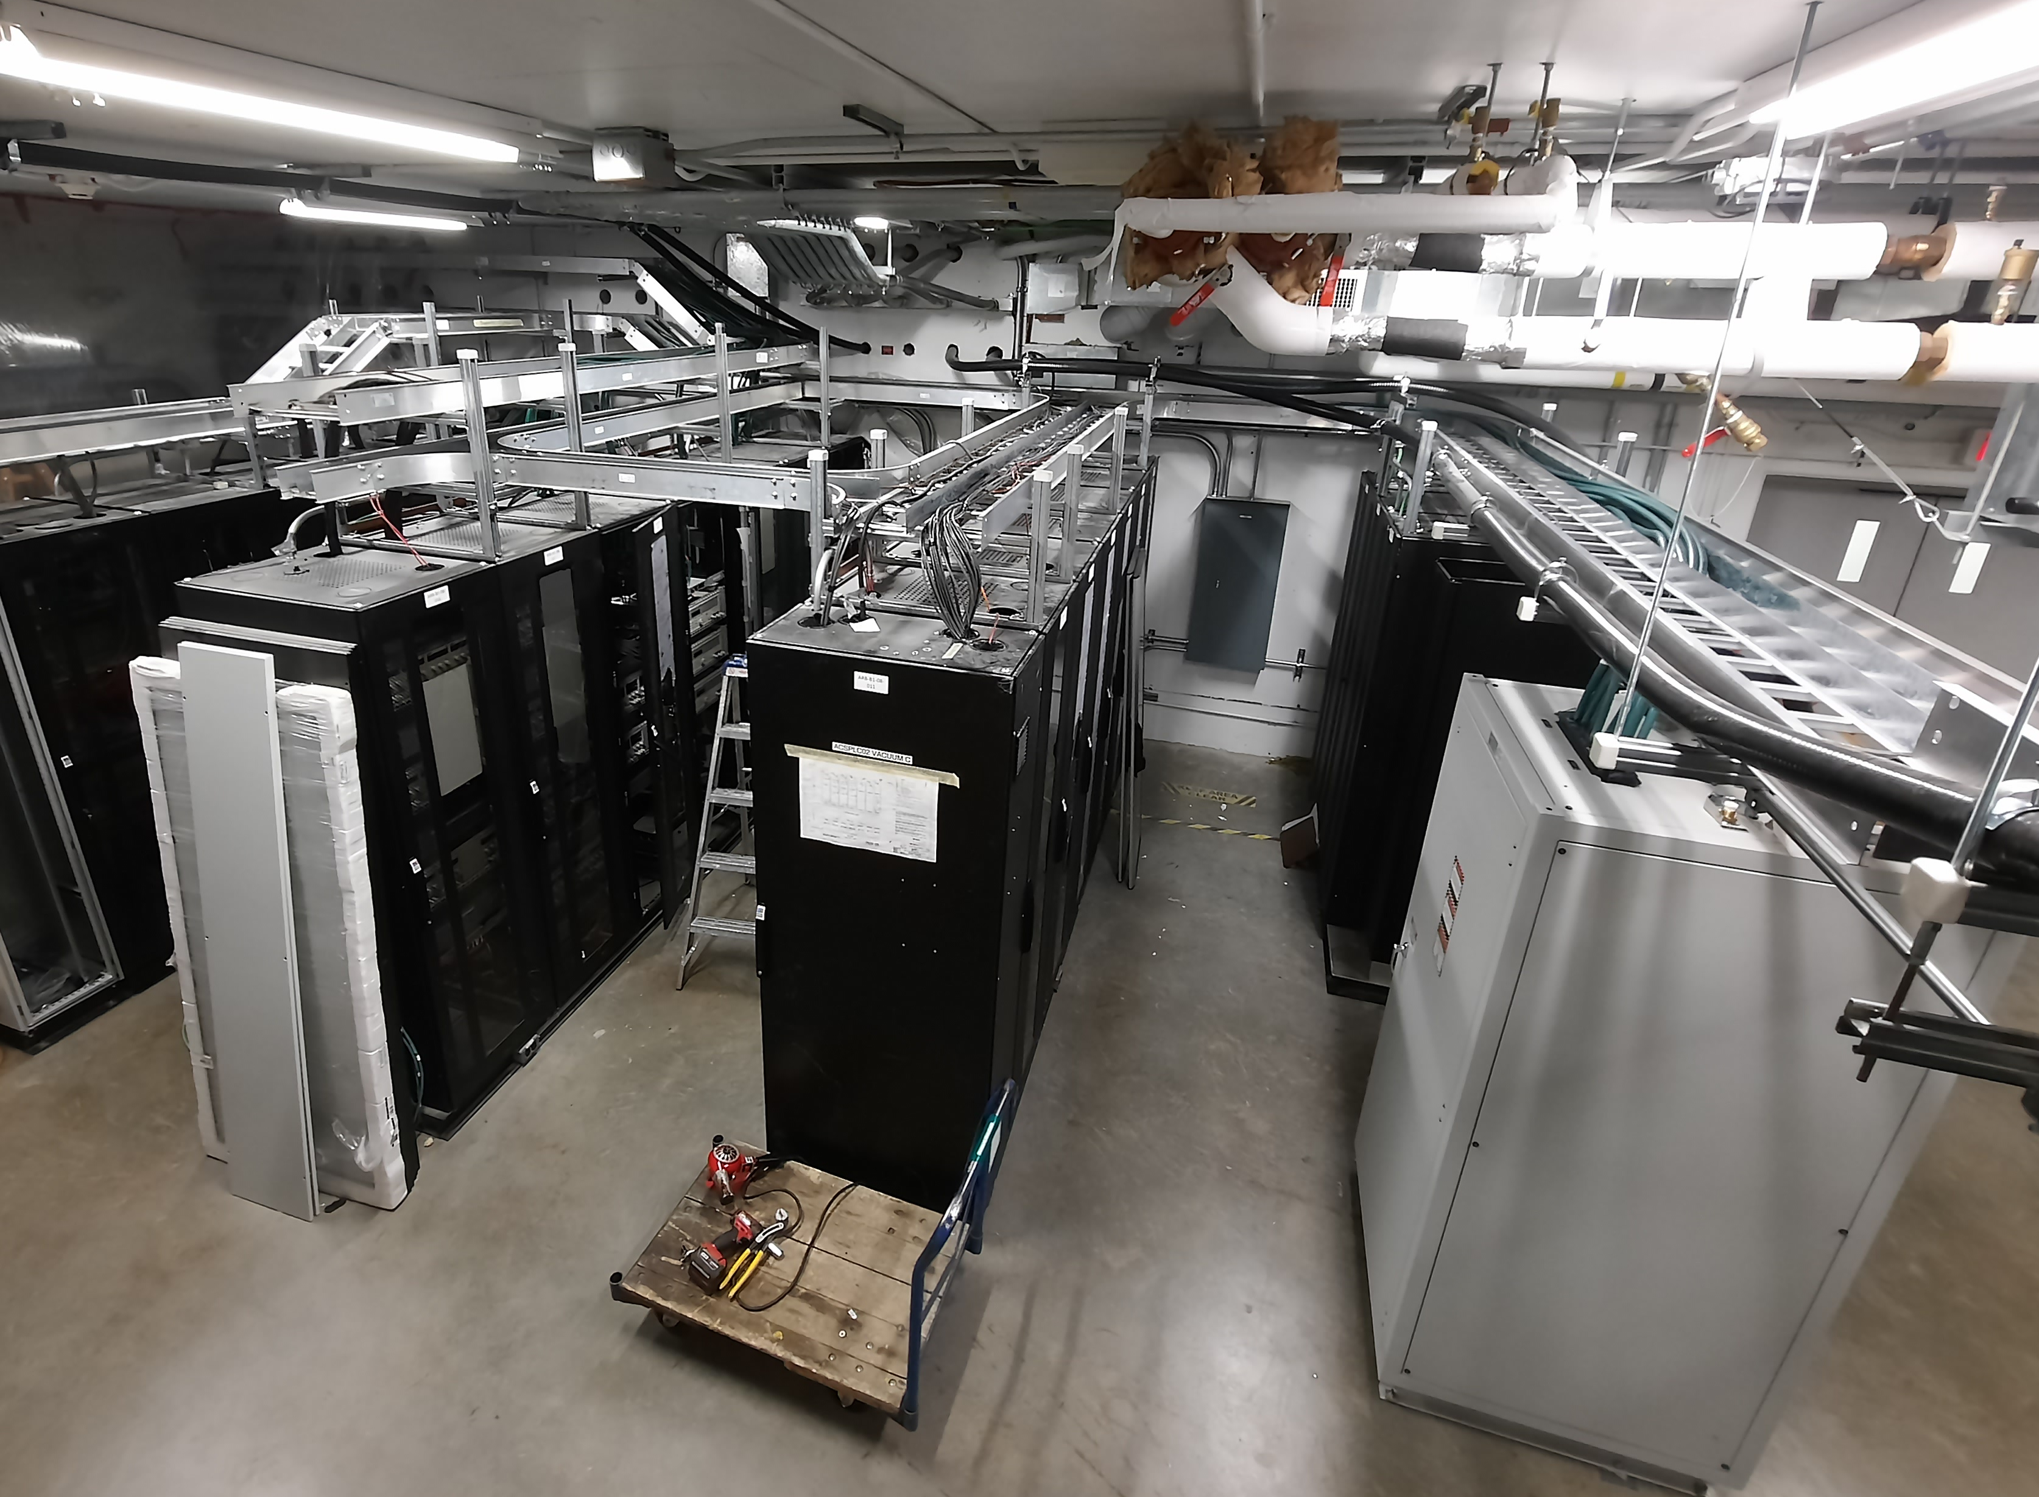
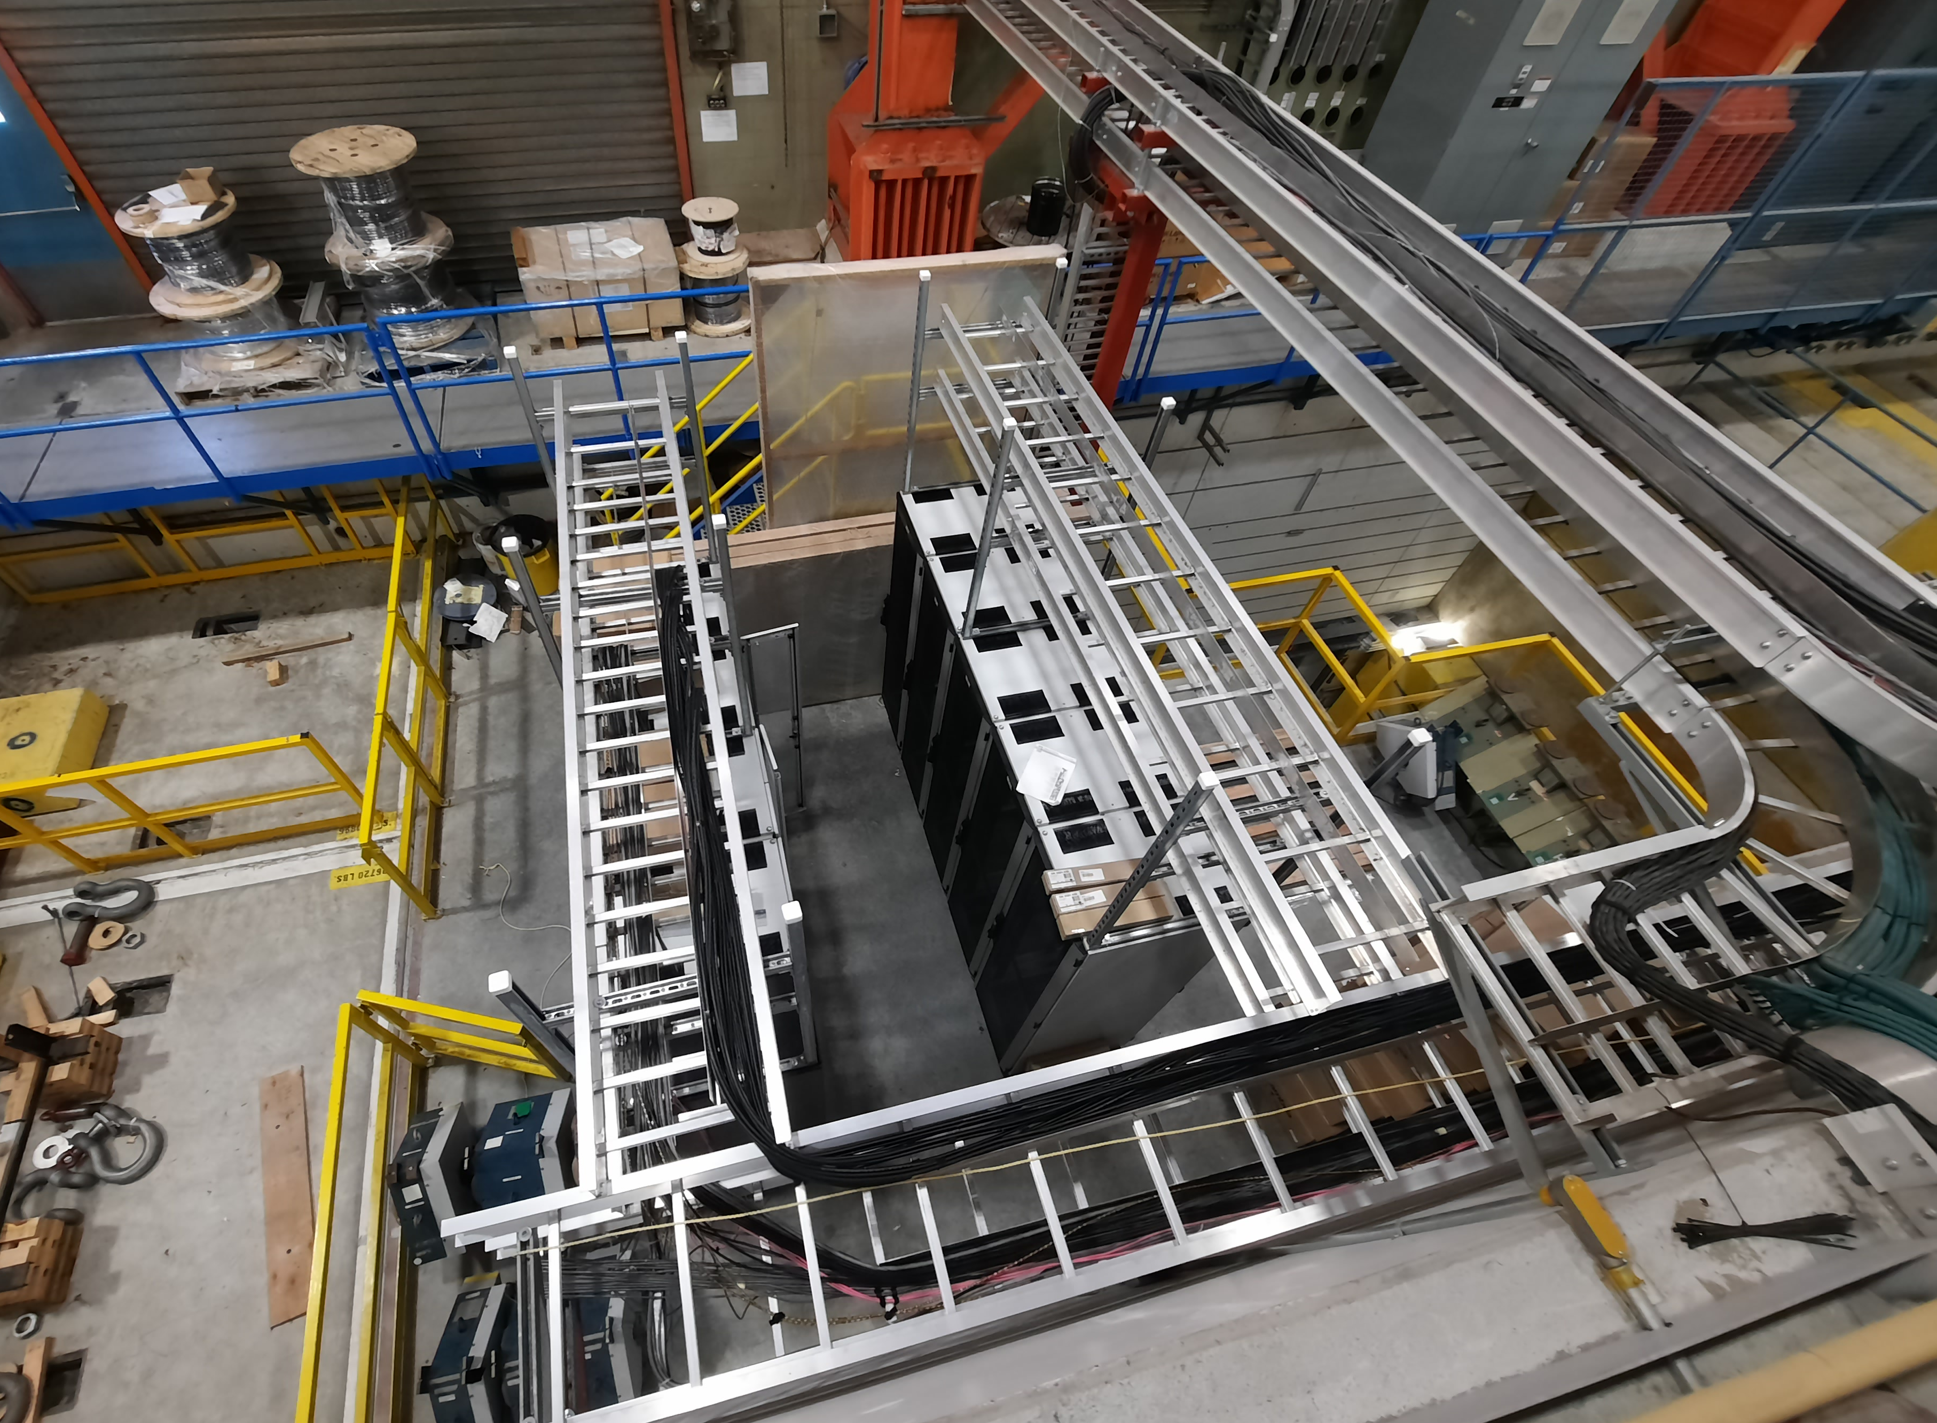
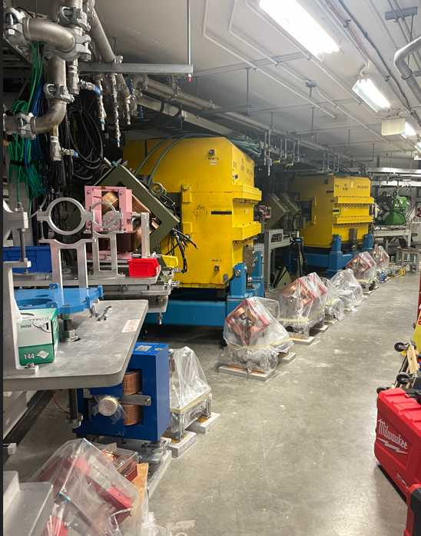
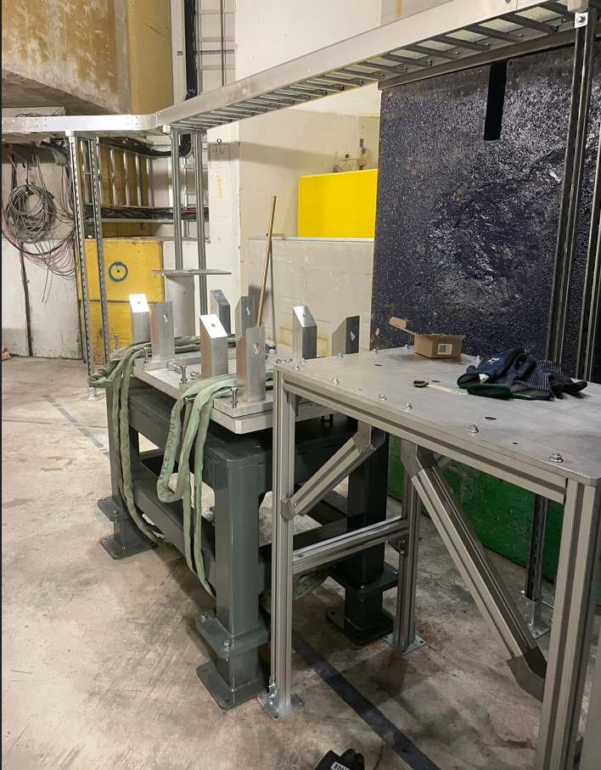
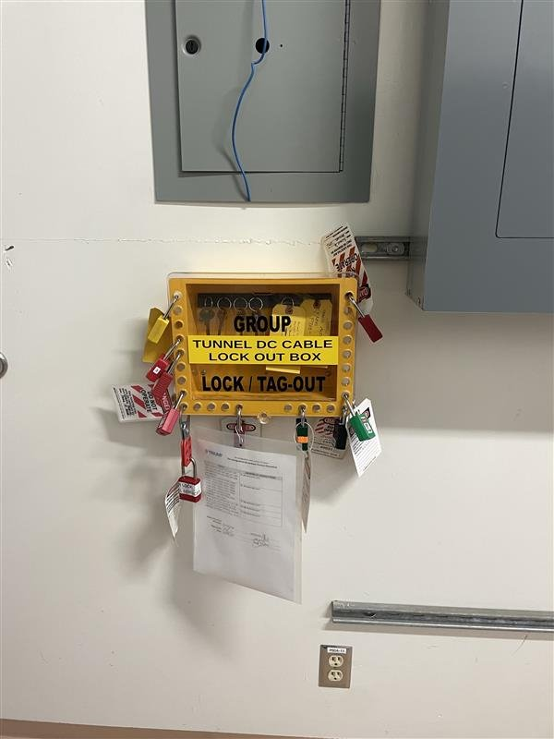
Accomplishments since last ASSC meeting
Top level project & services
Mechanical & Electrical services design complete
Cable schedule released
BL4N tunnel mechanical services installation mostly complete
North tunnel cable pulling complete (DC & Signal)
Cable tray installations complete
B2 Proton Cave Shielding Procured and installation underway
Completed fire safety & trained 150 people to access tunnel
Implemented a lock-out/tag-out system
BL4N North tunnel DC cable installation
ARIEL B1-08 racks & cable trays
284’ cable trays
Proton Cave cable trays & shielding
Tunnel Lock-out Box
BL4N Mechanical Services – North Tunnel

Slide 7
Progress on Plans Presented at previous ASSC Meeting
Items Planned from Last ASSC (May 2025) | Oct 2026 Status | Comment
Complete mechanical services design for the north part of the tunnel | Done
Complete detailed design of the tunnel section of the beam line | Done
Commence fabrication of BL components for the tunnel north section | Done
Complete electrical services design for ARIEL B1-08 | Done
Notes:
Discuss where plans have been realized and where / how we had to divert from the presented plans. The committee will want to understand how well we’re prepared for the installation phase during the long shutdown.
It is helpful for the reviewers when things are placed into the big picture and if they understand if changes impact the overall timeline or scope.
Use the outcome of the recent check-ins where available.

Slide 8
Plans and Objectives for the Next 6 Months
Items Planned from last ASSC (Nov 2025) | Oct 2026 Status | Comment
Completed all remaining BL4N & EHBT beamline designs and procurement underway for all items | Done | All beamline components designed
Completed mech services design and installations for Tunnel and Proton Cave (P358) | 65% | Design is complete. BL4N tunnel almost done installation. E-line delayed due to installation sequencing
Installed all cable trays, procured and pulled all cables (partly P358) | 60% | All cable trays done & cable schedule released. All North tunnel cables pulled. Only South tunnel remains
Assembled Diagnostics devices | Done
Installed EHBT MB25 to Q44 | 80% | Magnets & Stands installed and aligned. Deliberately waiting to install Diagnostics, Vacuum equipment, and beampipes, to protect fragile components. Installed additional sections of beamlines already
Installed BL4N MB28 to Q36 | 80%
Completed MPS system design | 75% | Finalizing placement of devices. Manufacturing progress at 10%
Completed Safety Systems design | Done | Manufacturing progress at 50%
Notes:
Sub-set of LS26 planning and accomplishments critical for the milestones in the MTA.
Focus on procurement and installation tasks

Slide 9
Milestone Trend Analysis
General assessment:
We should be able to get to substantial physical completion of both BL4N & EHBT beamlines by end of Dec 2026.
They will look like complete beamlines by then!
Some areas that may not hit the end of 2026 milestone:
MPS – start Nov 2026, finish Jan 2027
Safety Systems – start Dec 2026, finish Fall 2027
Connection to APTW and AETE depend on P354 readiness of Entrance Modules in Target Stations

Slide 10
Major Risks, Issues, Concerns
Risk / Issue | Comments & Mitigation
Risk: South tunnel/pharaoh’s tomb cables pulled incorrectly/unlabeled. May require rework. Scheduled pull is delayed | Operators helping do cable inventory
Risk: MPS installation late | 10/30 LICs have been built. Mounting devices requires some design work as well. MPS team has some extra support now. Installs to begin in November and finish mid January
Risk: BL4N collimator alignment features are not easily adjustable | There’s a risk that the BL4N collimator may have shifted due to building settlement but we haven’t measured this. It cannot be adjusted because it would require removing all the shielding above it including the access to the Ehall.
Issue: EHBT doesn’t have proper position adjusters | The stands are pre-aligned and grouted, and magnets are supported by fixed brackets. We had to re-align the EHBT line because the building settled. Further building settlement could pose a problem, but beam steering may be able to overcome this relatively easily.
Issue: technician & space availability​ | We are monitoring construction activity daily, and trying to optimize the space & time usage, as well as forecasting a week ahead.
Issue: Proton Cave walls are not straight / flat / vertical, causing fitment issues​ for shielding blocks | There’s some nominal clearance between blocks that we can use up. Otherwise, we may need to have a contractor to grind or cut some blocks.

Slide 11
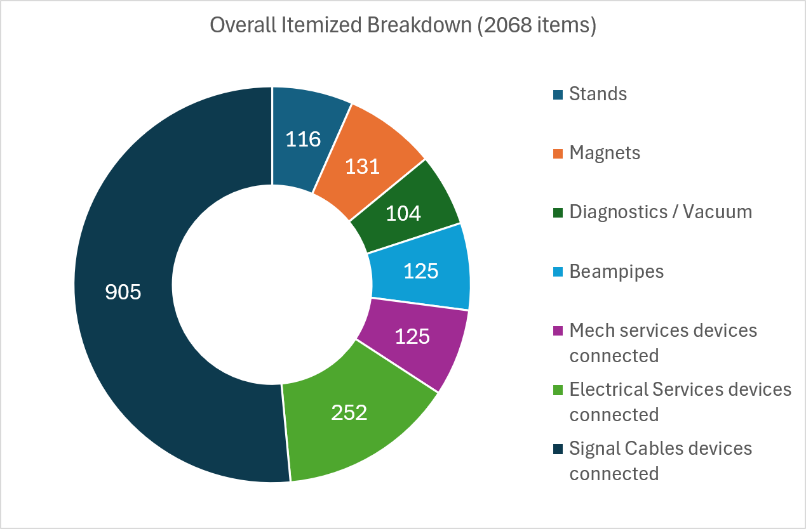
Installation Progress
Overall Install Progress (2068 items) | BL4N | EHBT
Stands | 86% | 86%
Magnets | 84% | 96%
Diagnostics / Vacuum | 0% | 2%
Beampipes | 42% | 0%
Mech services pipes run & connected | 26% | 0%
Power Cables pulled & connected | 36%
Signal Cables devices connected | 29%
NORTH

Slide 12
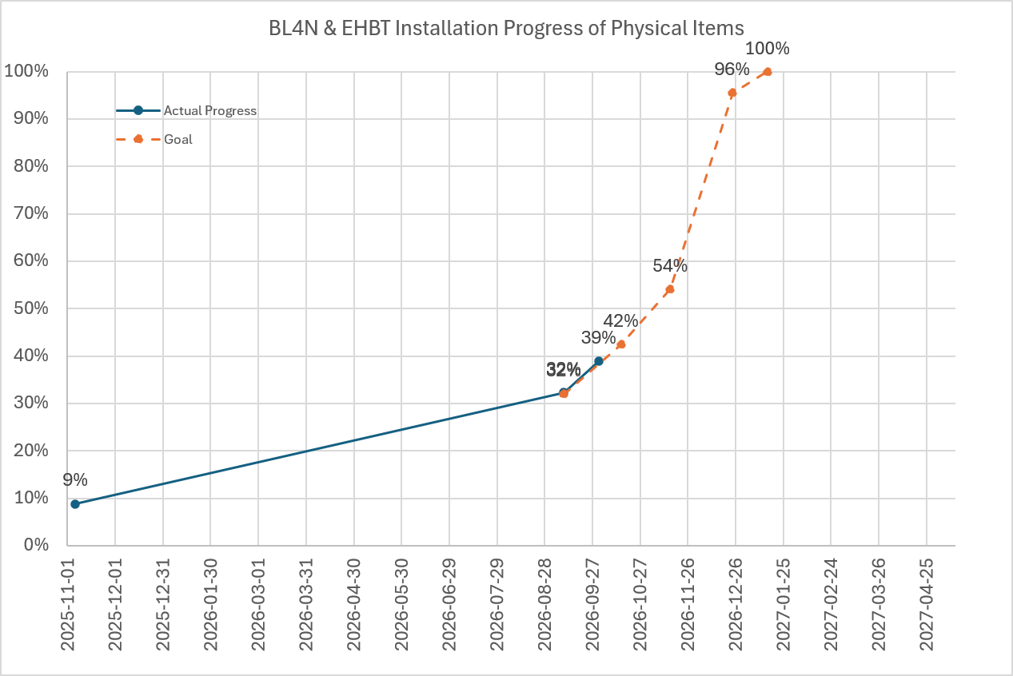
Installation Progress & Forecast
Overall: 39% of 2068 items installed.
Disclaimer! This is not proportional to time required to install each item. (E.g. cables make up 57% of all items here) Not everything is included here either.
Delays added 8 weeks due to fire safety closures, tunnel dust requiring cleaning, BL4N magnet bender move, and ARIEL building settlement requiring new scans and re-aligning EHBT,
MPS and Safety Systems installed
All diagnostics, vacuum, beampipe installed.
All shielding installed.
All cables connected.
Today
Start of current installation efforts (previous ASSC)
All Mech services connected.
All magnets installed.
Tunnel cleaning started
Quarterly Check-in
All cables pulled. Lower shielding installed.

Slide 13
Major Schedule Sequence to Gate-4A readiness
October | November | December | January | February | March | April
Install Stands
Oct 23 [86%]
Holiday closure
This sequence repeats in each of the 8 beamline work zones we’ve designated
Dates are for the last work zone to reach completion and subject to change!
Install Magnets
Oct 23 [88%]
Install MPS
Jan 15 [0%]
Install mech services
Dec 18 [65%]
Final Tunnel cleaning
Nov 20 [0%]
Start Installing Safety Systems
Mar 31 [0%]
Install diagnostics & beampipes & final alignment
Nov 27 [1%]
Install vacuum devices
Dec 18 [0%]
Pull signal cables
Nov 20 [36%]
Connect signal cables
Jan 15 [9%]
Pull power cables
Oct 23 [60%]
Connect Magnets to power
Nov 20 [0%]
Controls functional testing
Mar 31 [0%]
Gate 4A
Apr 9
Commissioning

Slide 14
Remaining Designs for LS26
All critical components for installation have been released & fabricated
Outstanding Designs | Size of task | Number of People Involved | Status
Magnet covers | Small | 1 | Detailed & to be released by ECO ~1 week
Concrete shield plugs | Small | 1 | Detailed & to be released by ECO ~1 week
MPS system mounting | Medium | 3 | Developing simple concept which can be installed at later date
Seismic restraints for steel blocks | Small | 1 | Waiting for structural engineering drawings
Redesign of stands for ease of Exclusion Area lock up procedures | Small | 1 | Needs follow-up consult with operators for concepts
Conduit routing for Safety Systems | Medium | 2 | Waiting for Electrical Services drawings.
Cable tray redesign in Cyclotron Vault | Small | 1 | Project team needs to write instructions for electrical Services

Slide 15
Gate 3 Affirmation
Task | Current Status (Yes/No/Partial%) | Comment
All released documents up-to-date? | 100%
Commissioning plan drafted? Note: Different types of projects have different criteria and terminology for ‘commissioning’ | 50% | EHBT and BL4N currently being drafted and to be circulated for review in a week
Drawings, diagrams or schematics released by ECO? | 99% | Overall design is complete. A few designs have been added
All Requirements Specification documents released to Docushare? | 100%
Schedule critical path understood? | Yes
Budget by fiscal year is updated and remaining funds enough to cover projected costs? | Insufficient | Request made for ~$200k last week
Have you sent to the Procurement Department a list of all major items (>$75k) to be purchased, with a timeframe, and agree with them on a procurement strategy for each? Note: List major in next 6 months | Yes | All major purchases complete
Top risks identified, with credible mitigation actions? | Yes | Mentioned in earlier slide
Integration and test plans reviewed by experts and project stakeholders (e.g. users)? | 75% | EHBT at approval stage BL4N at review stage
Controls (EPICS, data acquisition, MPS, etc…) specified? | Yes | Controls waiting for installs so they can move on to functional testing​
Summary of lessons to learn thus far, presented at Gate review? | Yes
Show how ready the project is to fulfill the gate review requirements. For some WBS this might include gate 2 or be a gate 3 re-affirmation.
Notes:
Show how ready the project is to fulfill the gate review requirements. For some WBS this might include gate 2 or be a gate 3 re-affirmation.

Slide 16
Plans and Objectives for the Next 6 Months
Items Planned | Oct 2026 Status | Comment
Completion of BL4N magnets and stands in Proton Cave/Pharaoh’s Tomb install | 40% | Major work of pharaoh’s tomb done: collimator & shielding. Preliminary install work for remainder underway
All devices (EHBT/BL4N) aligned | 38% | All installed EHBT optics aligned, some BL4N devices aligned
All mechanical services installed and devices connected (EHBT/BL4N) | 15% | 42% of pipes have been installed. No devices connected yet
All devices (EHBT/BL4N) connected to power | 36% | North cables pulled and connected to power supplies, but not magnets. South cables pulling started this week
All devices (EHBT/BL4N) connected to signal cables | 29% | North cables pulled. South cables pulling planned for mid-October
All diagnostics/vacuum/beampipes (EHBT/BL4N) installed | 11% | 99% Diagnostics, 100% Vacuum devices, and 99% beampipes ready for install
MPS system complete & installed | 10% | Some devices fabricated
All Proton Cave Shielding installed | 70% | All shield blocks ready for install when schedule dictates
Notes:
Sub-set of LS26 planning and accomplishments critical for the milestones in the MTA.
Focus on procurement and installation tasks

Slide 17
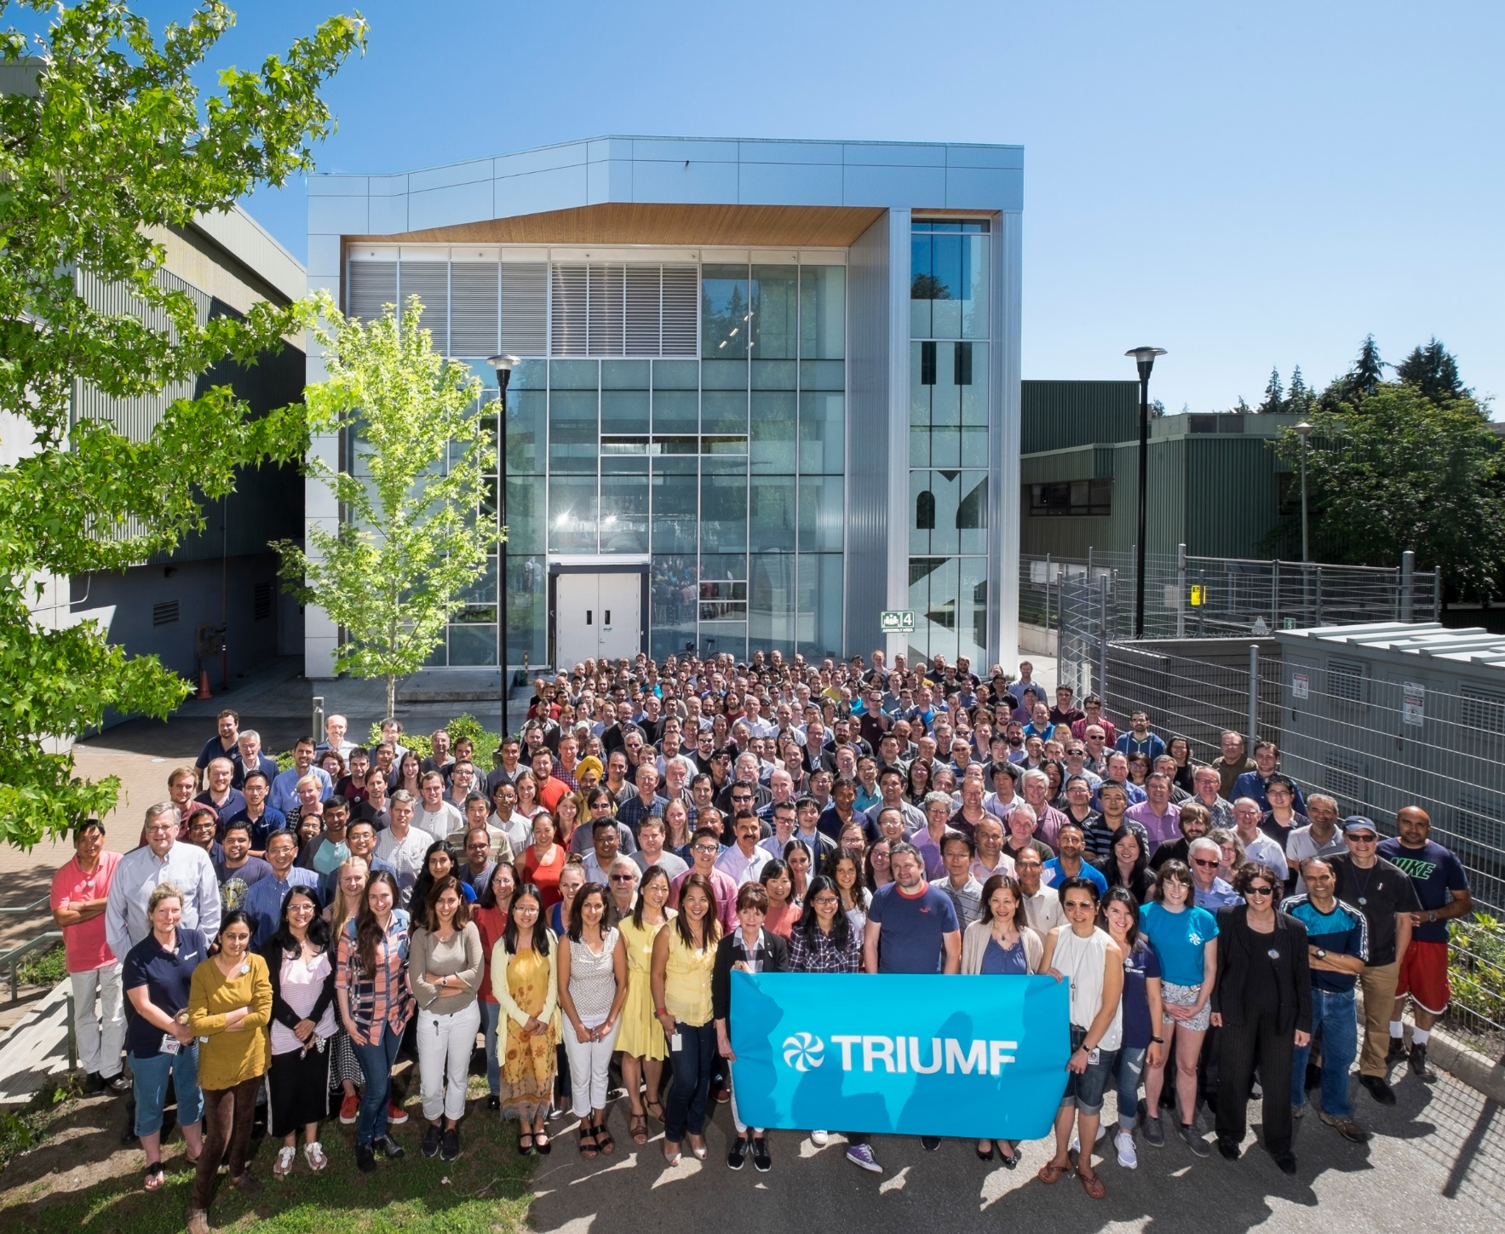




Thank you
Merci
www.triumf.ca
Follow us @TRIUMFLab
Discovery,
accelerated

