Slide 1
P424 Overview
Target Hall Infrastructure
ASSC Fall 2026
Oct 1-2, 2026
Project Leader:
Asita Perera
Project Integrator:
Michael Vogel

Slide 2
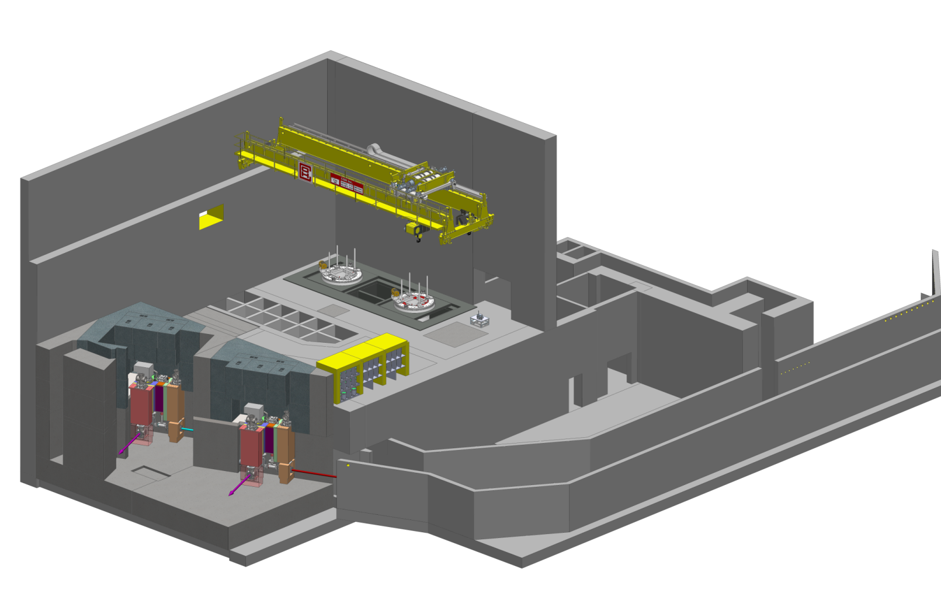
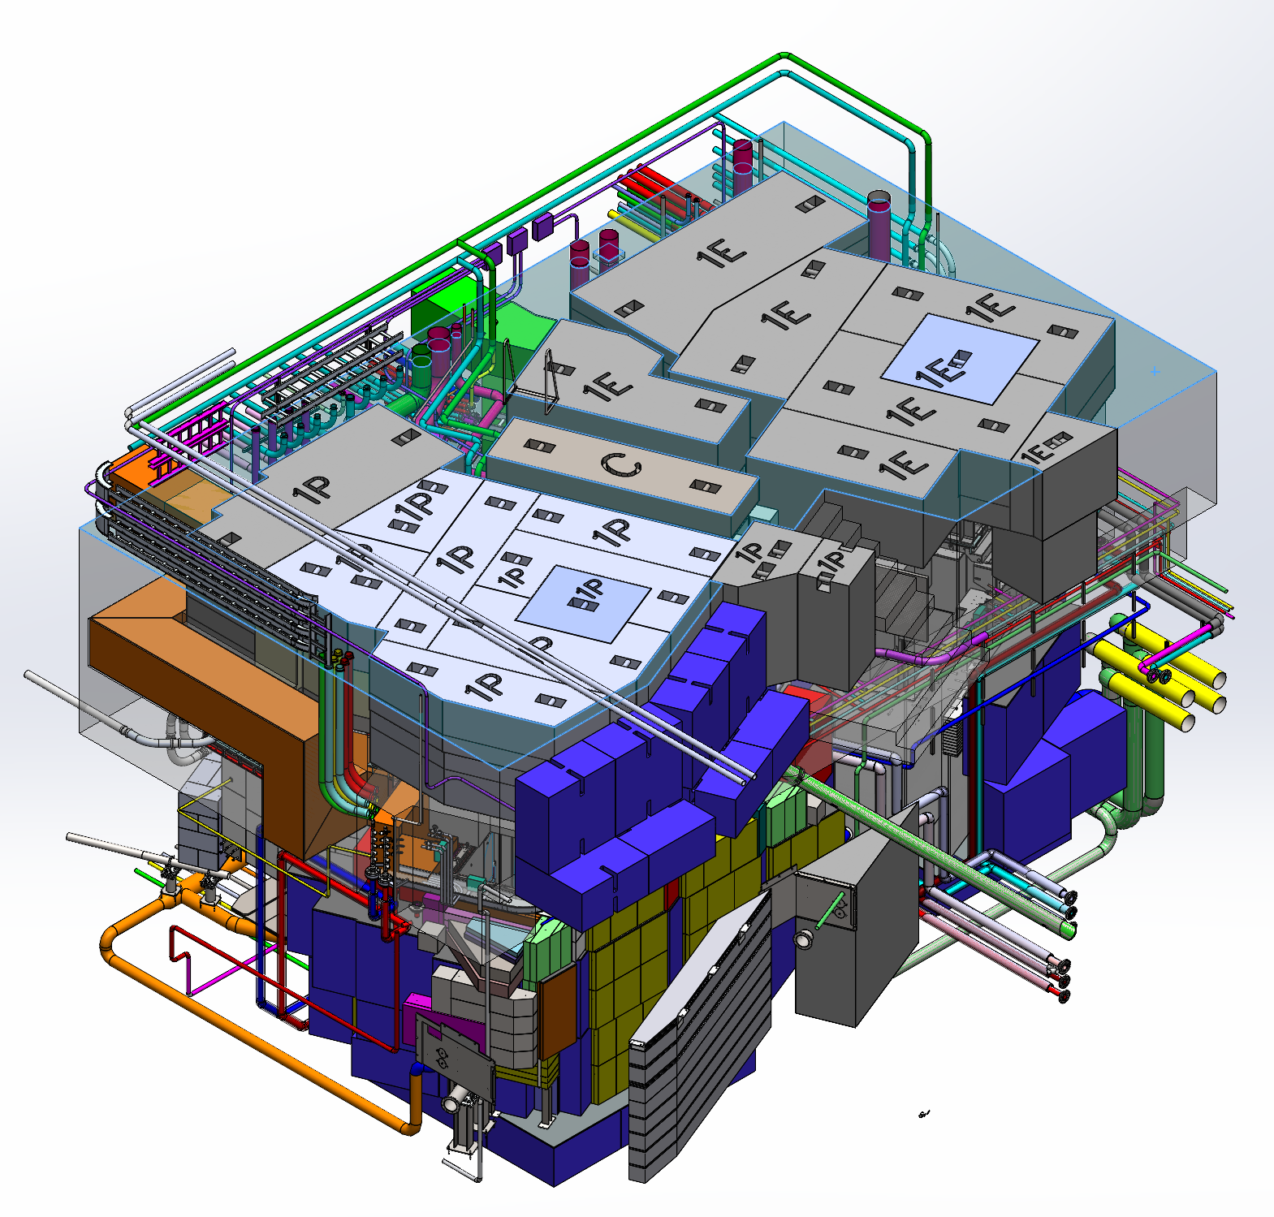
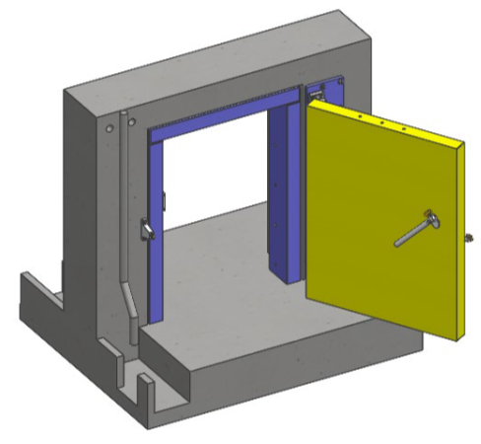
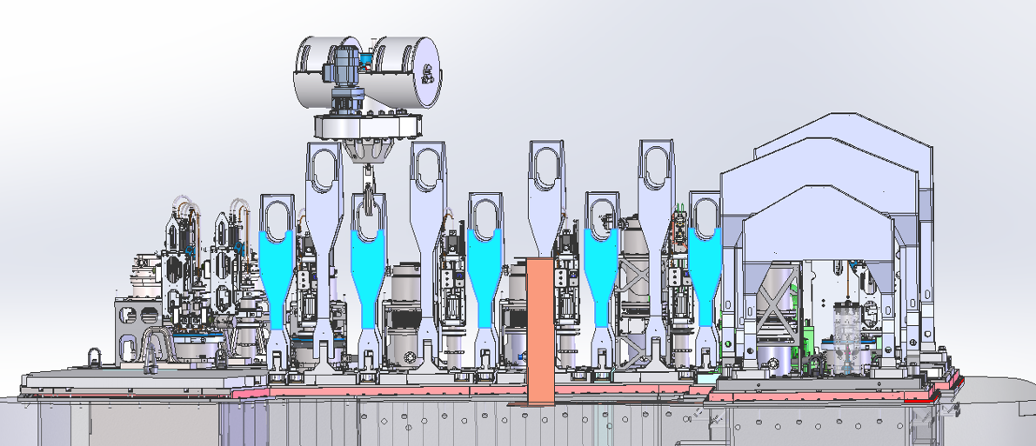
P424 Scope
Target Hall Infrastructure is comprised of the following:
Target Pit Shielding
  9 layers of Fixed Shielding
  Removable Shielding
  Embedded Services
Target Station Structural Supports
Module Storage
Target Hall Entrance Shielding
Target Pit Service Room (TPSR) Entrance Shielding
Remote Handling Tools & Initial Infrastructure
Medical Target Transfer Line
Laser Ion Source (ALIS) Shielding

Slide 3
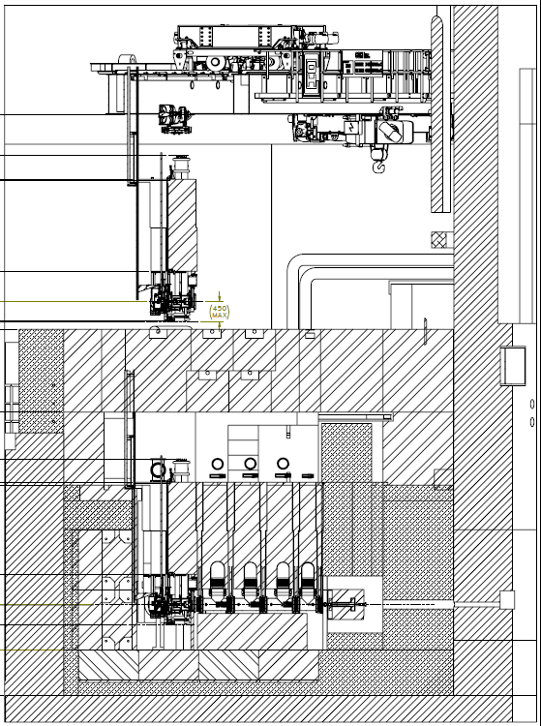
Shielding Design Structure
Level 4b: Removable Cap Shielding
Level 4a: Fixed Cap Shielding
Level 3: Service Space
Level 2-4, 2-5, 2-6: Upper Canyon
Level 2-1, 2-2, 2-3: Lower Canyon
Level 1: Below Station
8.1m
COMPLETED

Slide 4
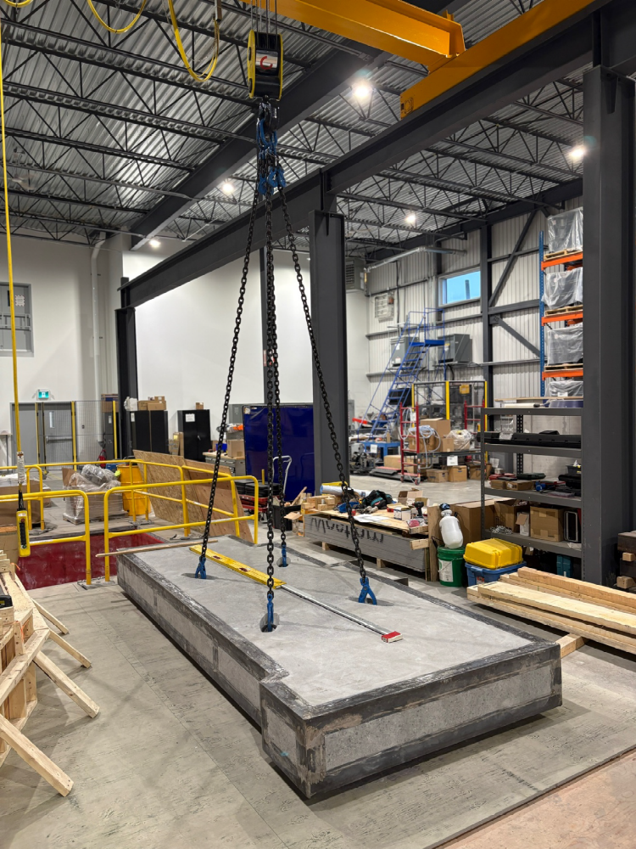
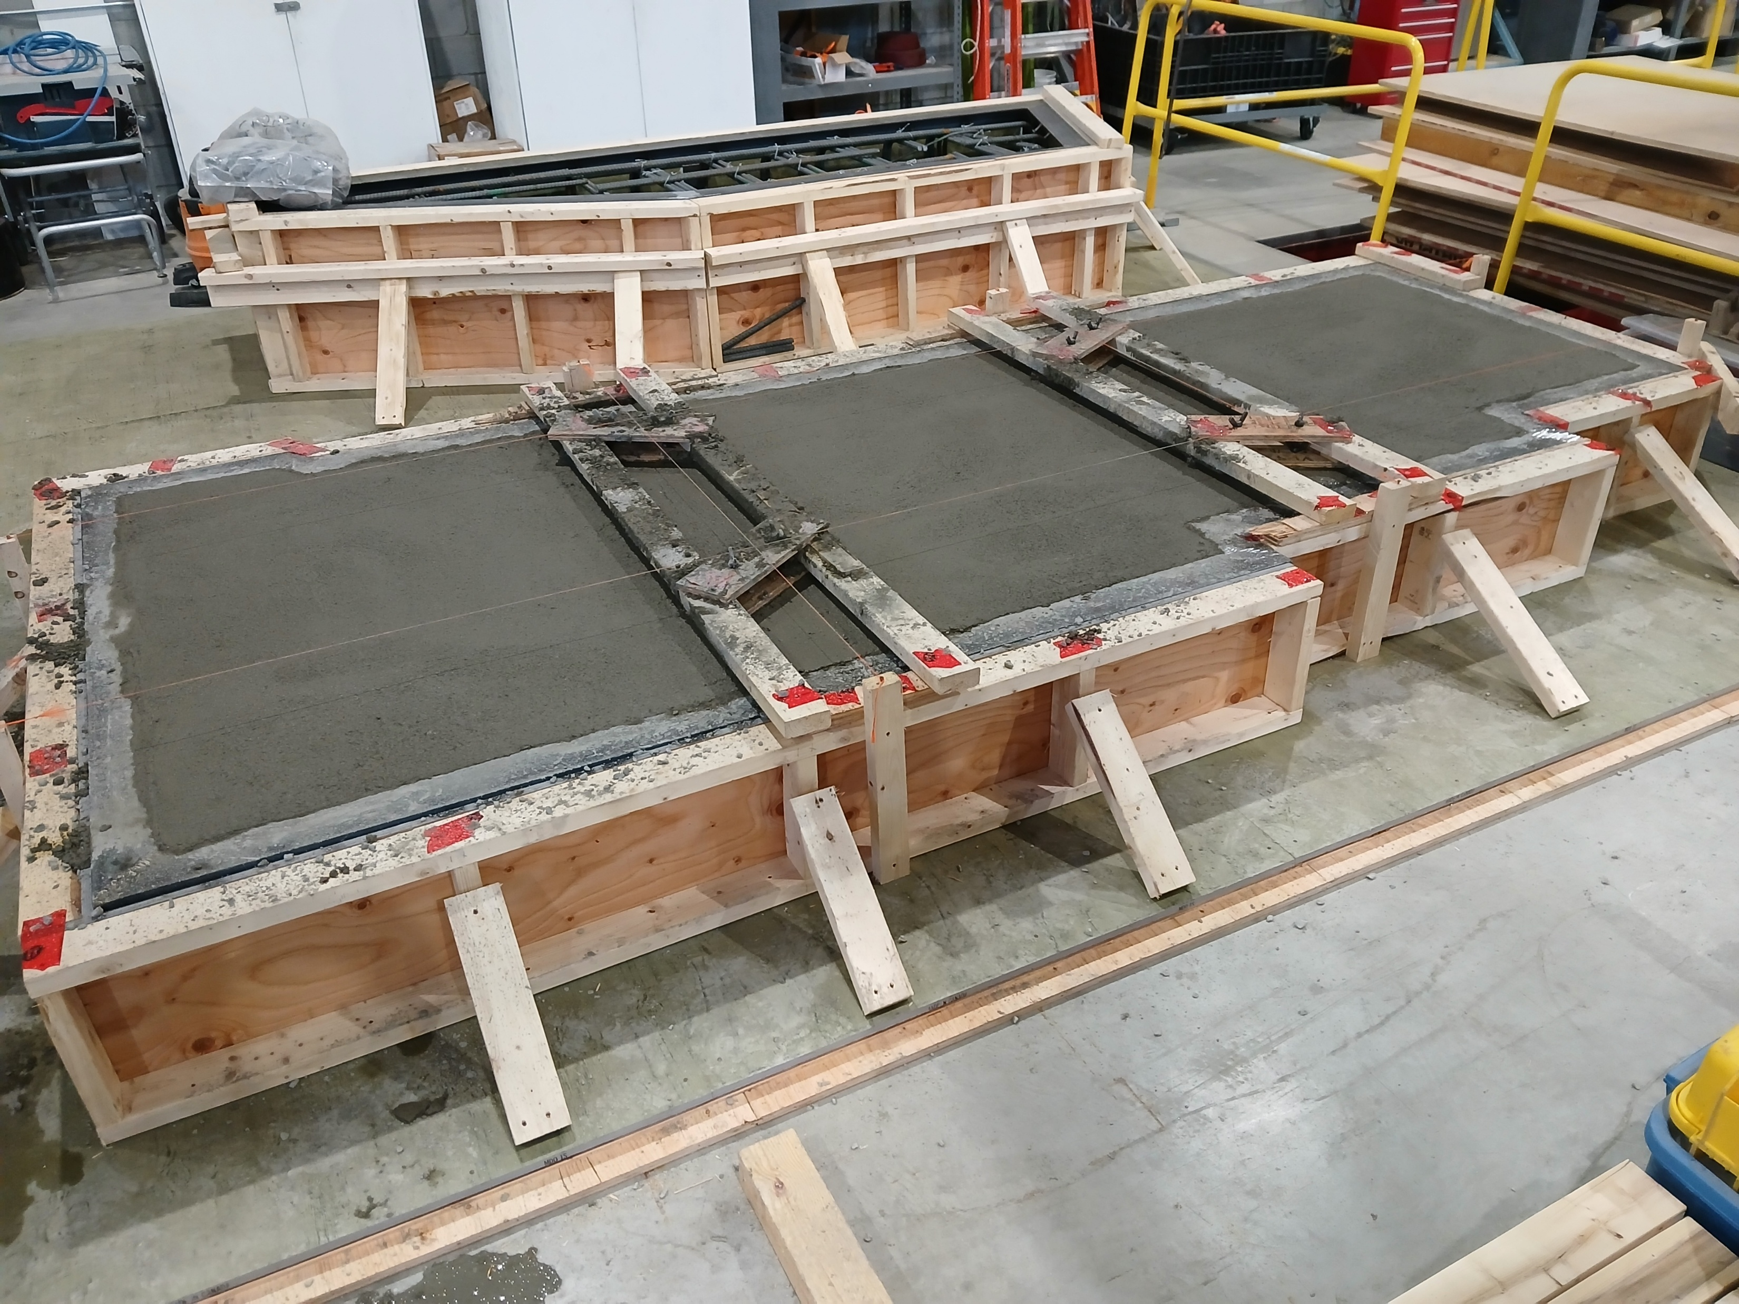
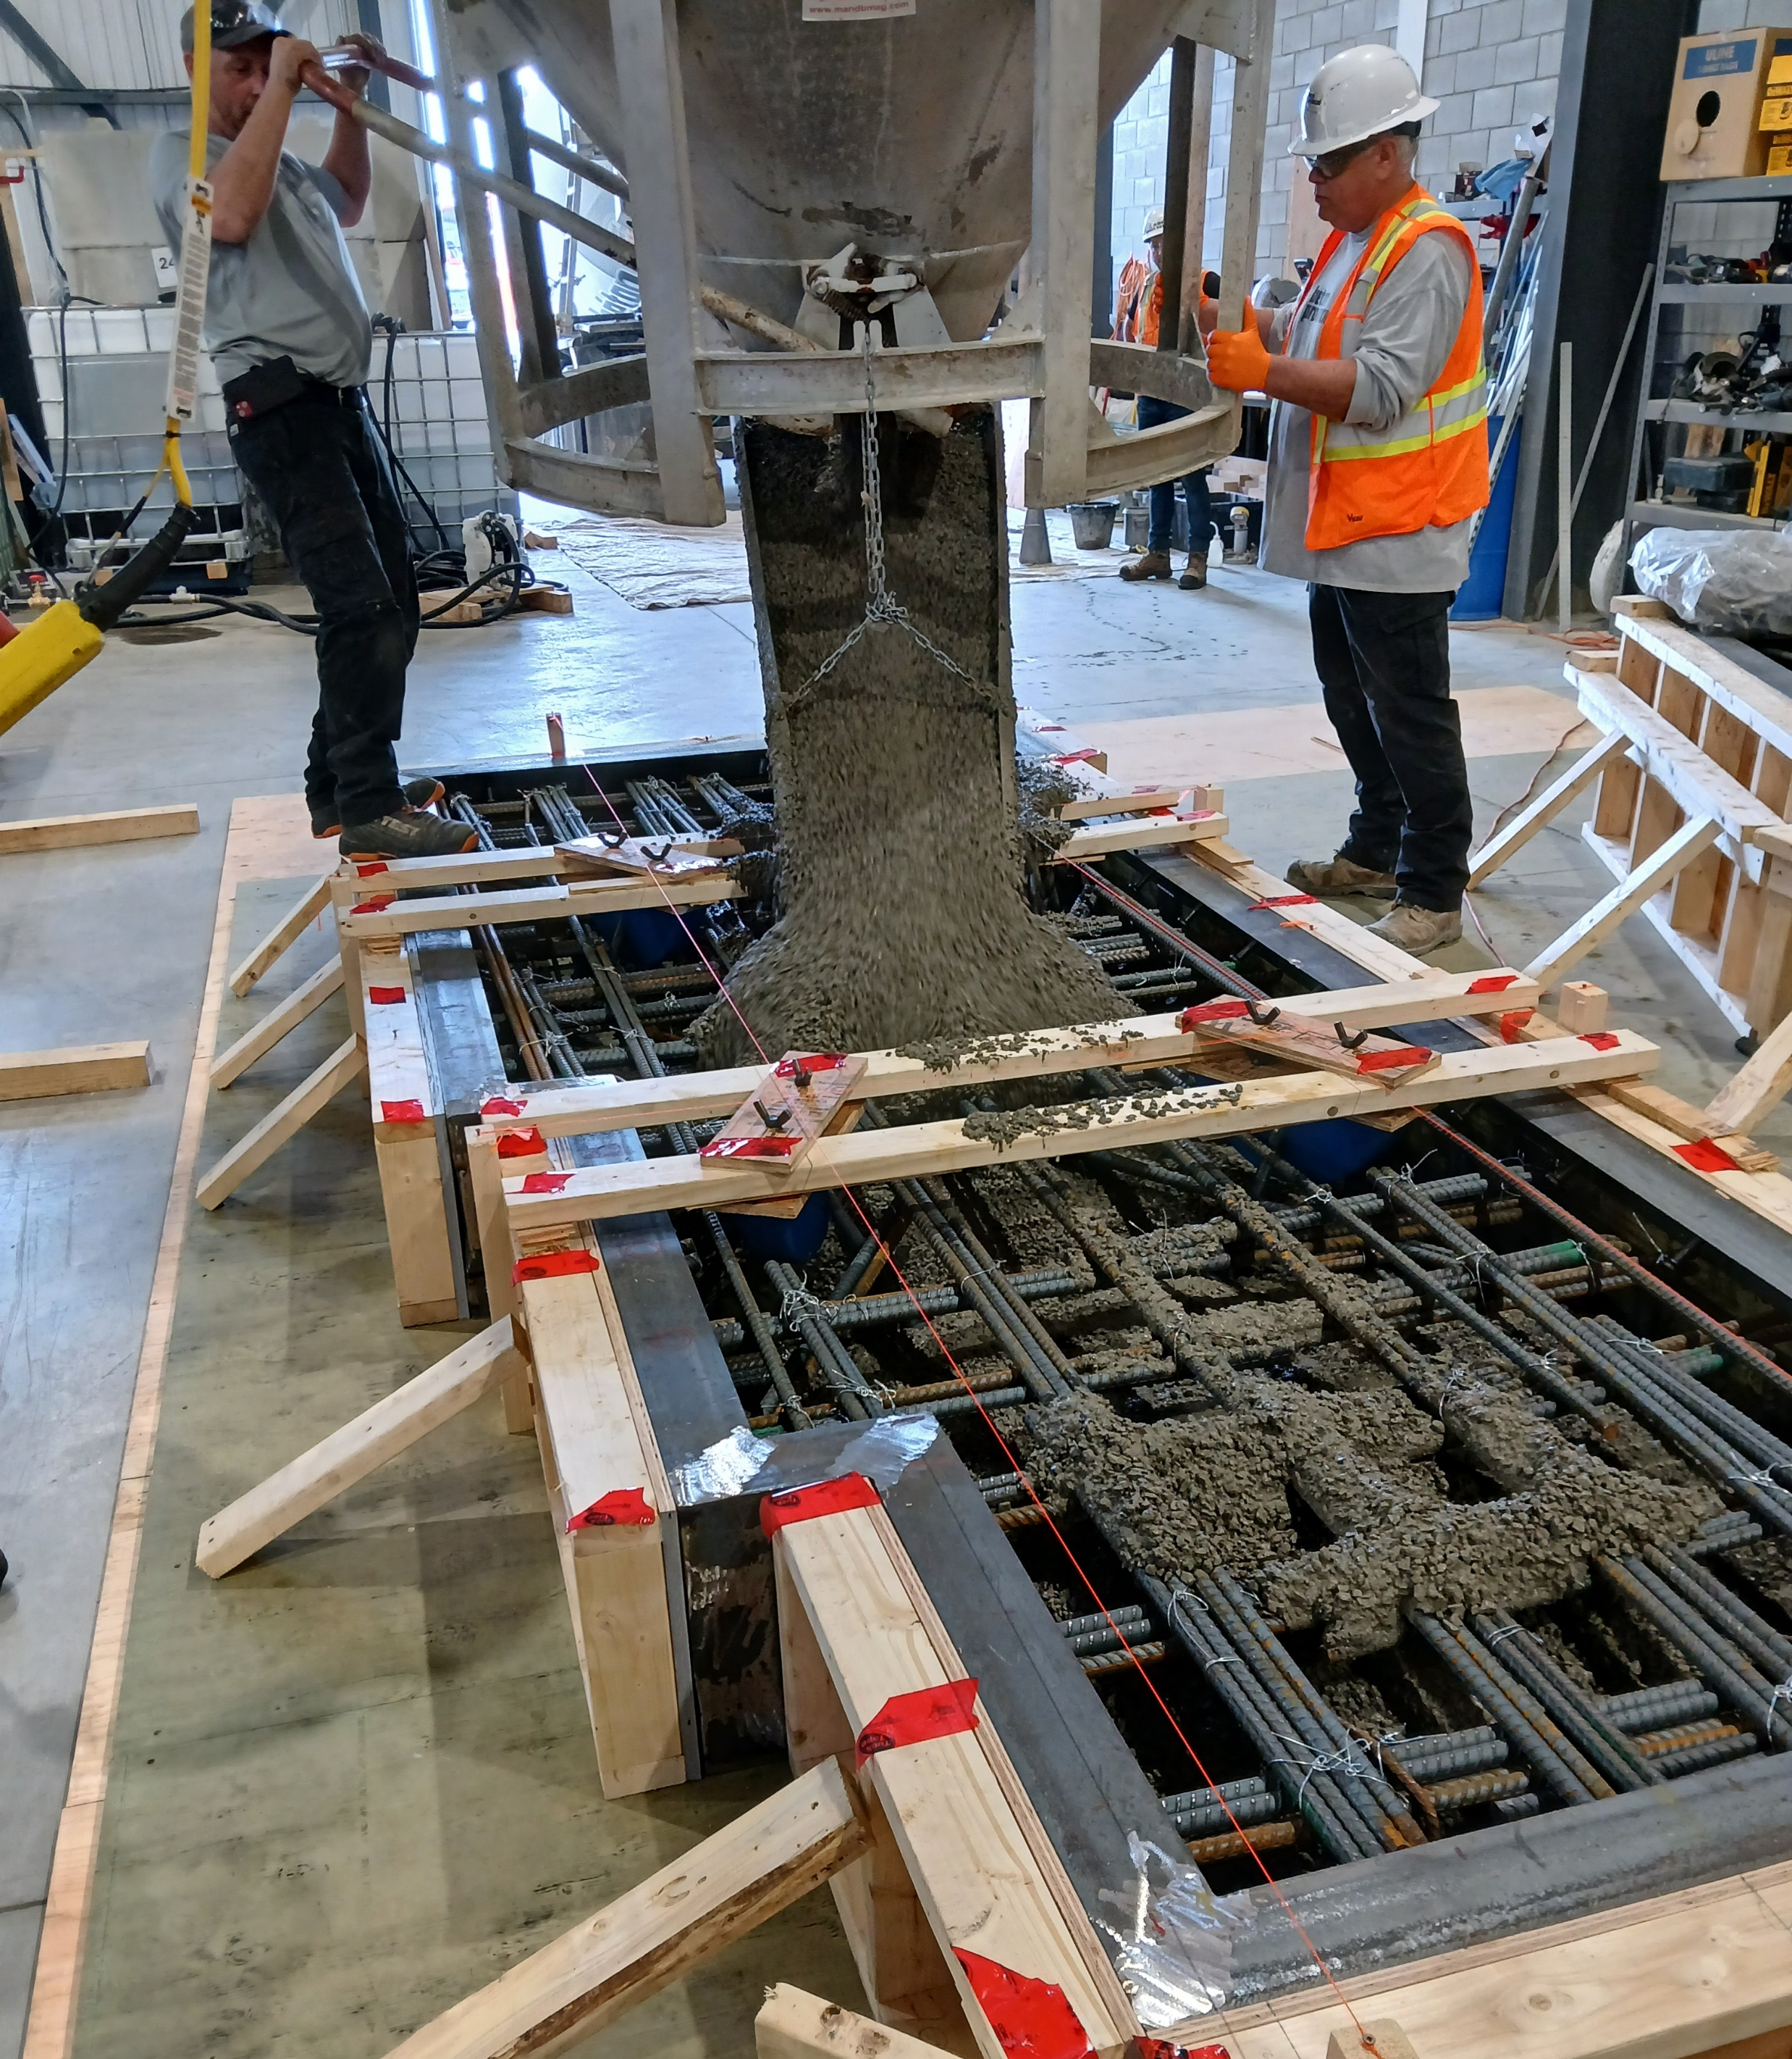
Accomplishments Since Last ASSC Meeting
Concrete Cap Shielding Blocks Manufacturing, $775K (Zaw TT)
Test block completed first to verify compliance.
Concrete constituent mix needed adjustment to bring Na levels within specification.
Test lift performed in June 2026.
Production of remaining blocks is now underway.
Delivery expected by February 2027 (including contingency).

Slide 5
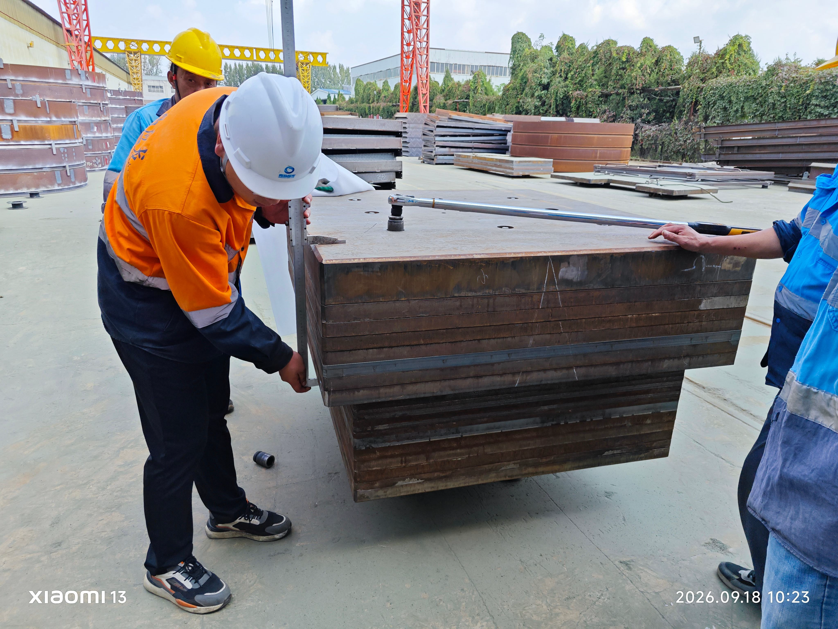
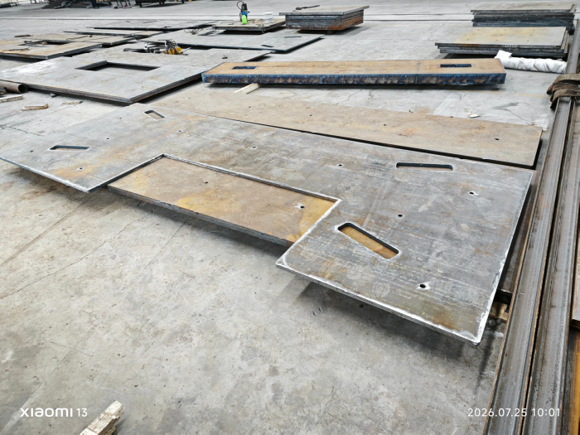
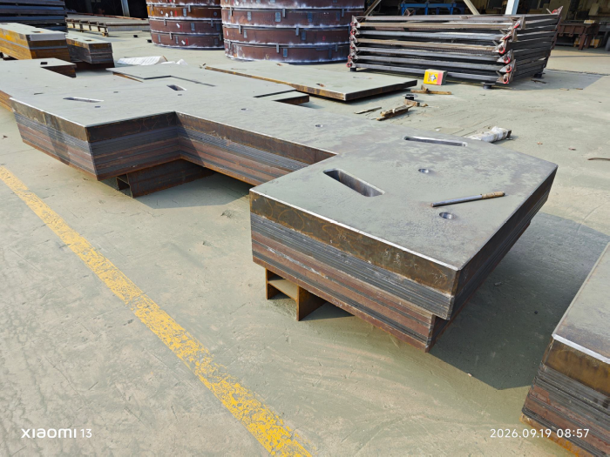
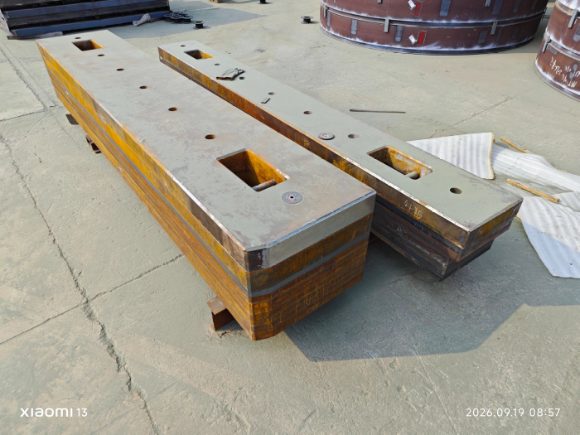
Accomplishments Since Last ASSC Meeting
Steel Cap Shielding Blocks Manufacturing, $320K (Zaw TT)
The PO for fabrication with our vendor in China was signed on May 27, 2026.
Fabrication is delayed, to allow solving the tie-bar concern (see below) and to allow FAT timing to be synchronized with the composite blocks.
Current manufacturing/design issue: change of tie-bar and torque specification to prevent inter-plate slippage.
On-site quality control inspections will be performed for FAT by November 2026.

Slide 6
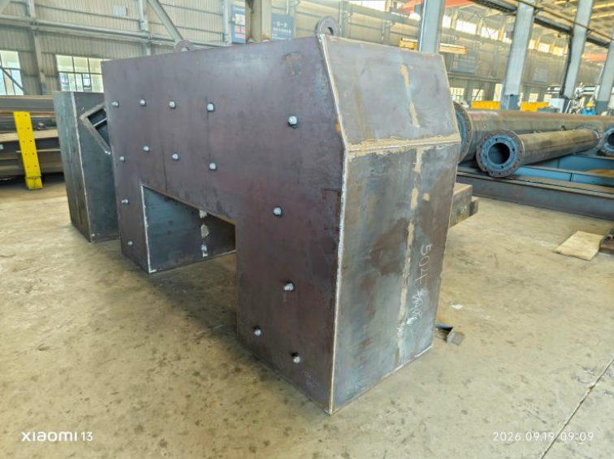
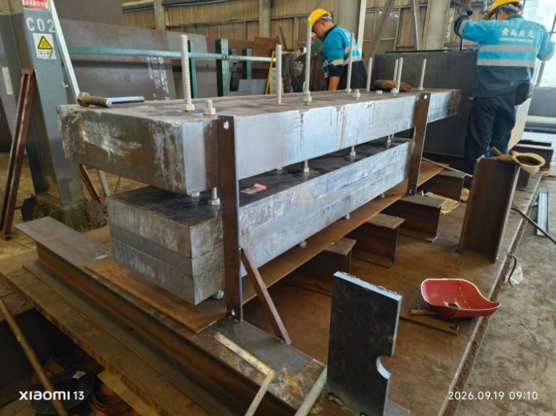
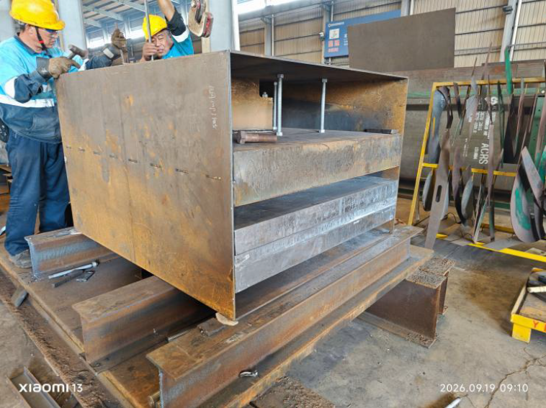
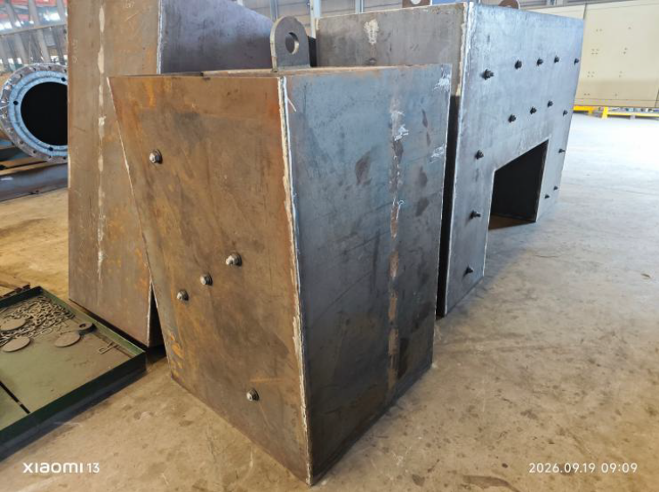
Accomplishments Since Last ASSC Meeting
Composite Cap Shielding Blocks Manufacturing, $455K (Zaw TT)
The PO for fabrication with our vendor in China was signed on June 12, 2026.
Fabrication is slightly delayed, progressing towards FAT.
Concrete fill quality control testing is actively underway.
Currently, there are no issues with manufacturing.
On-site quality control inspections will be performed for FAT by November 2026.

Slide 7
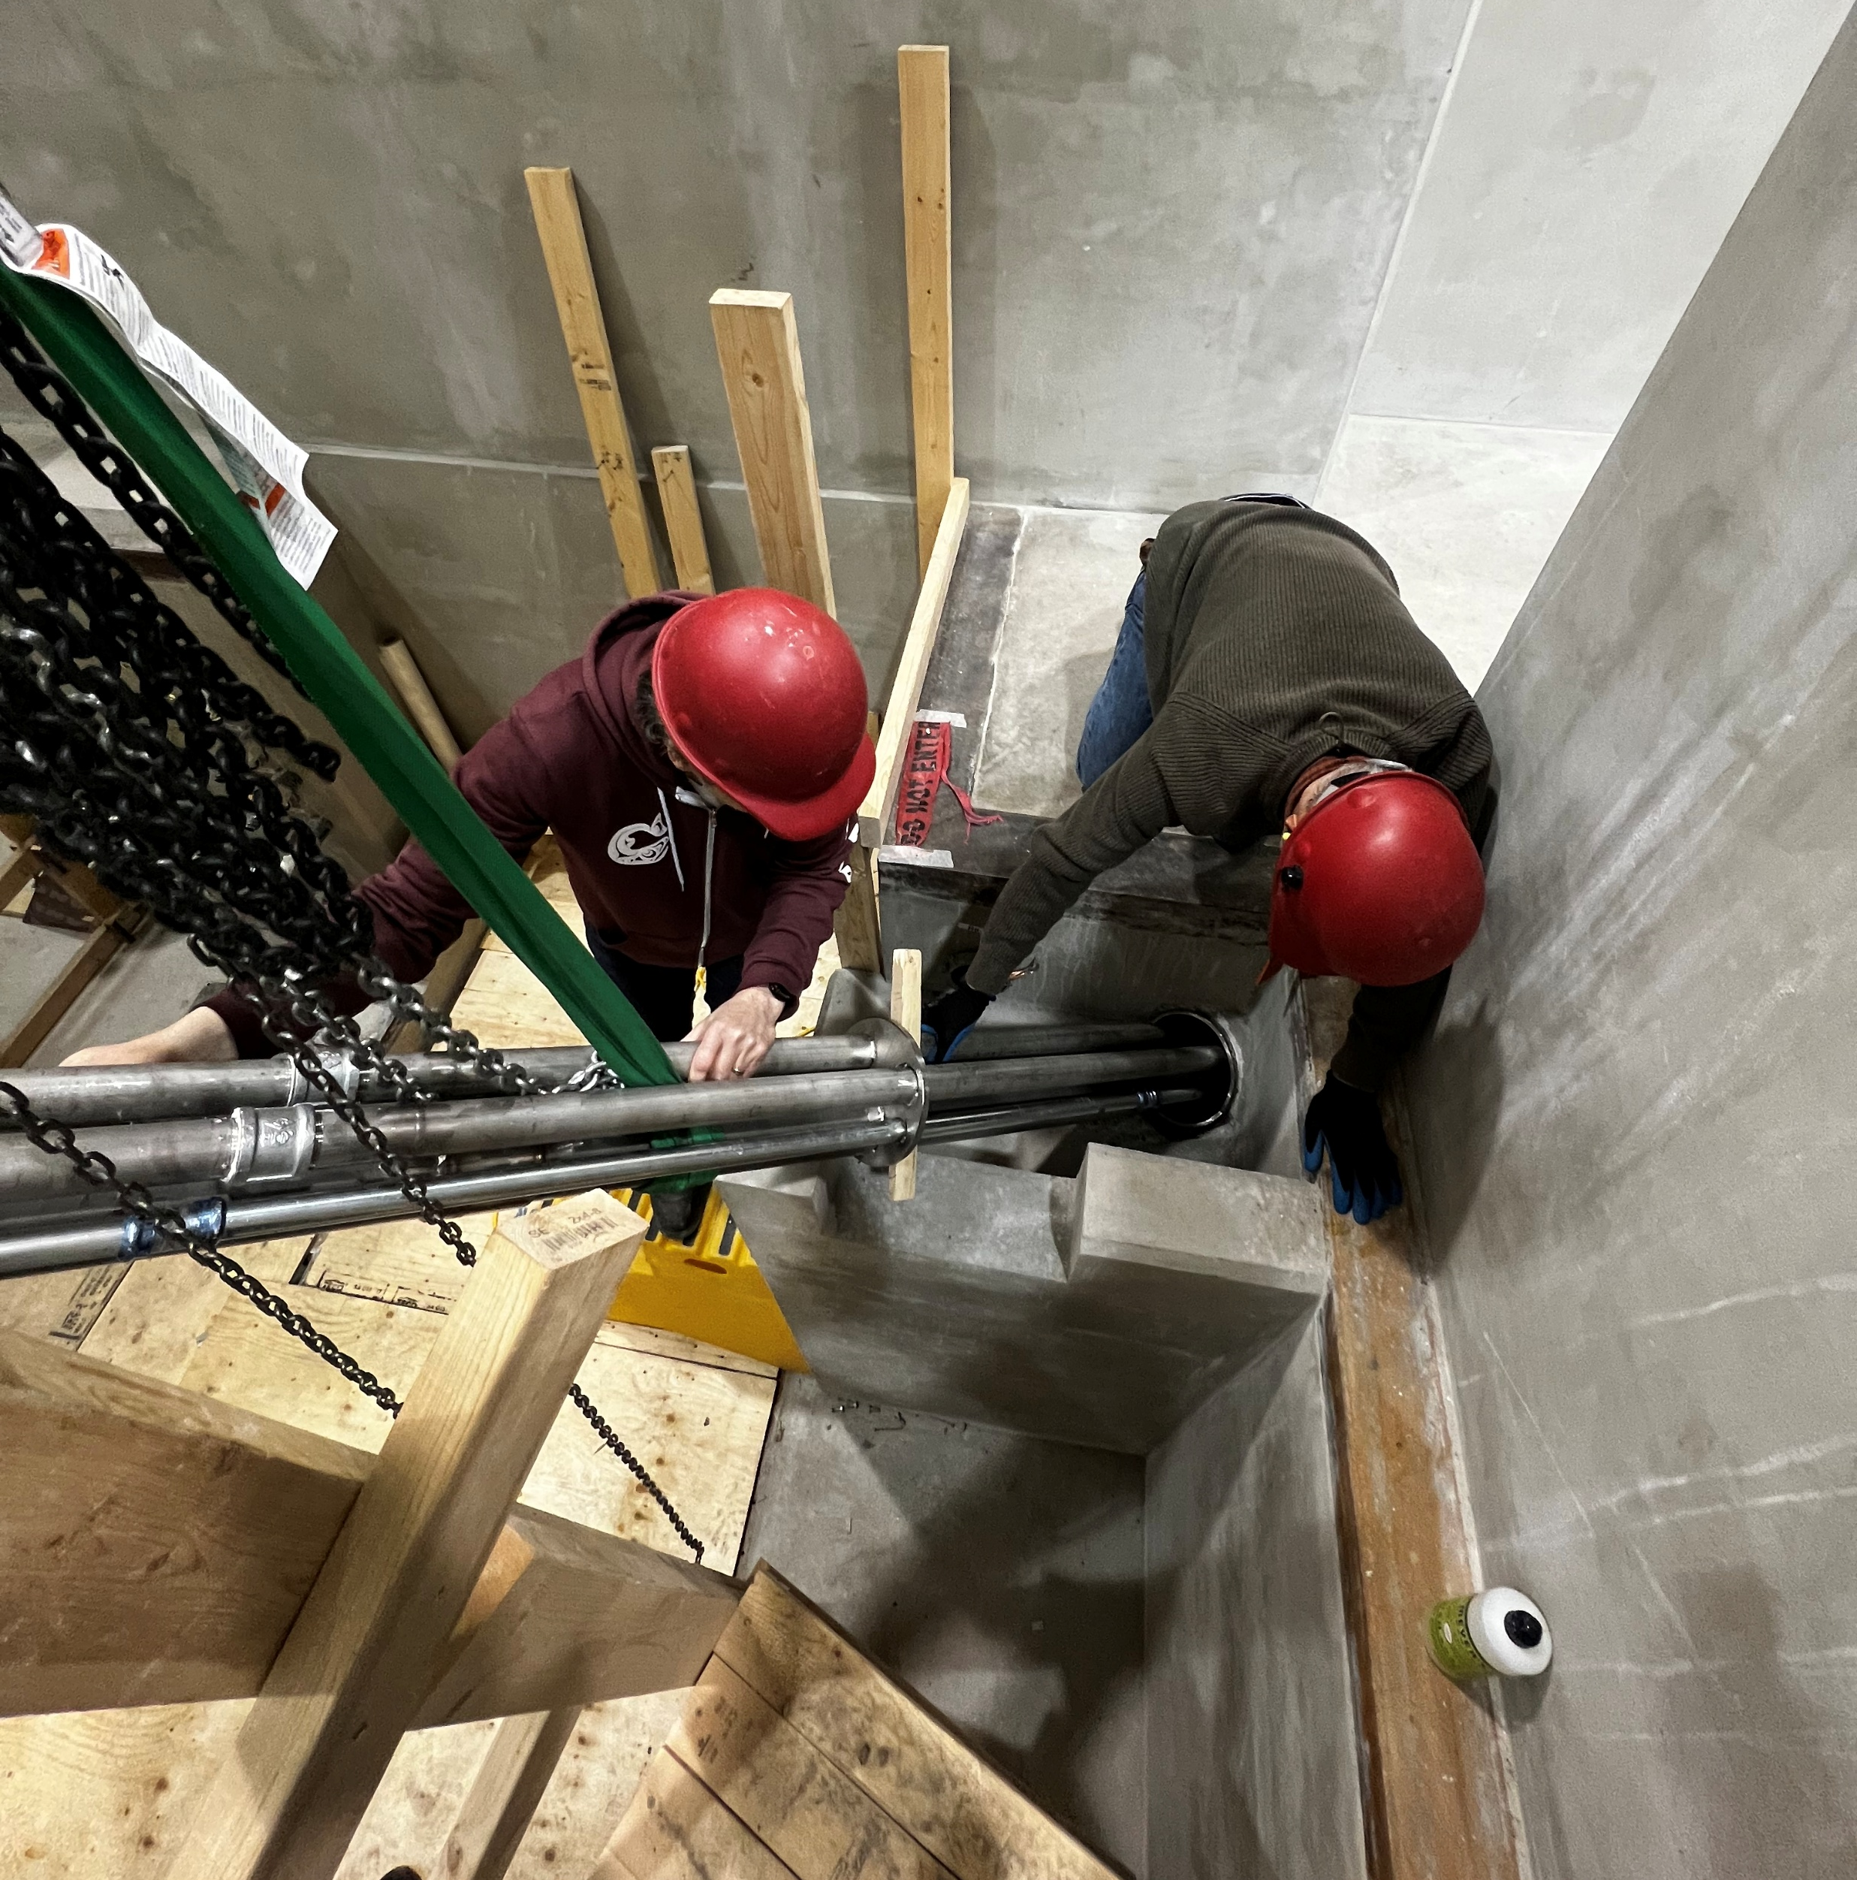
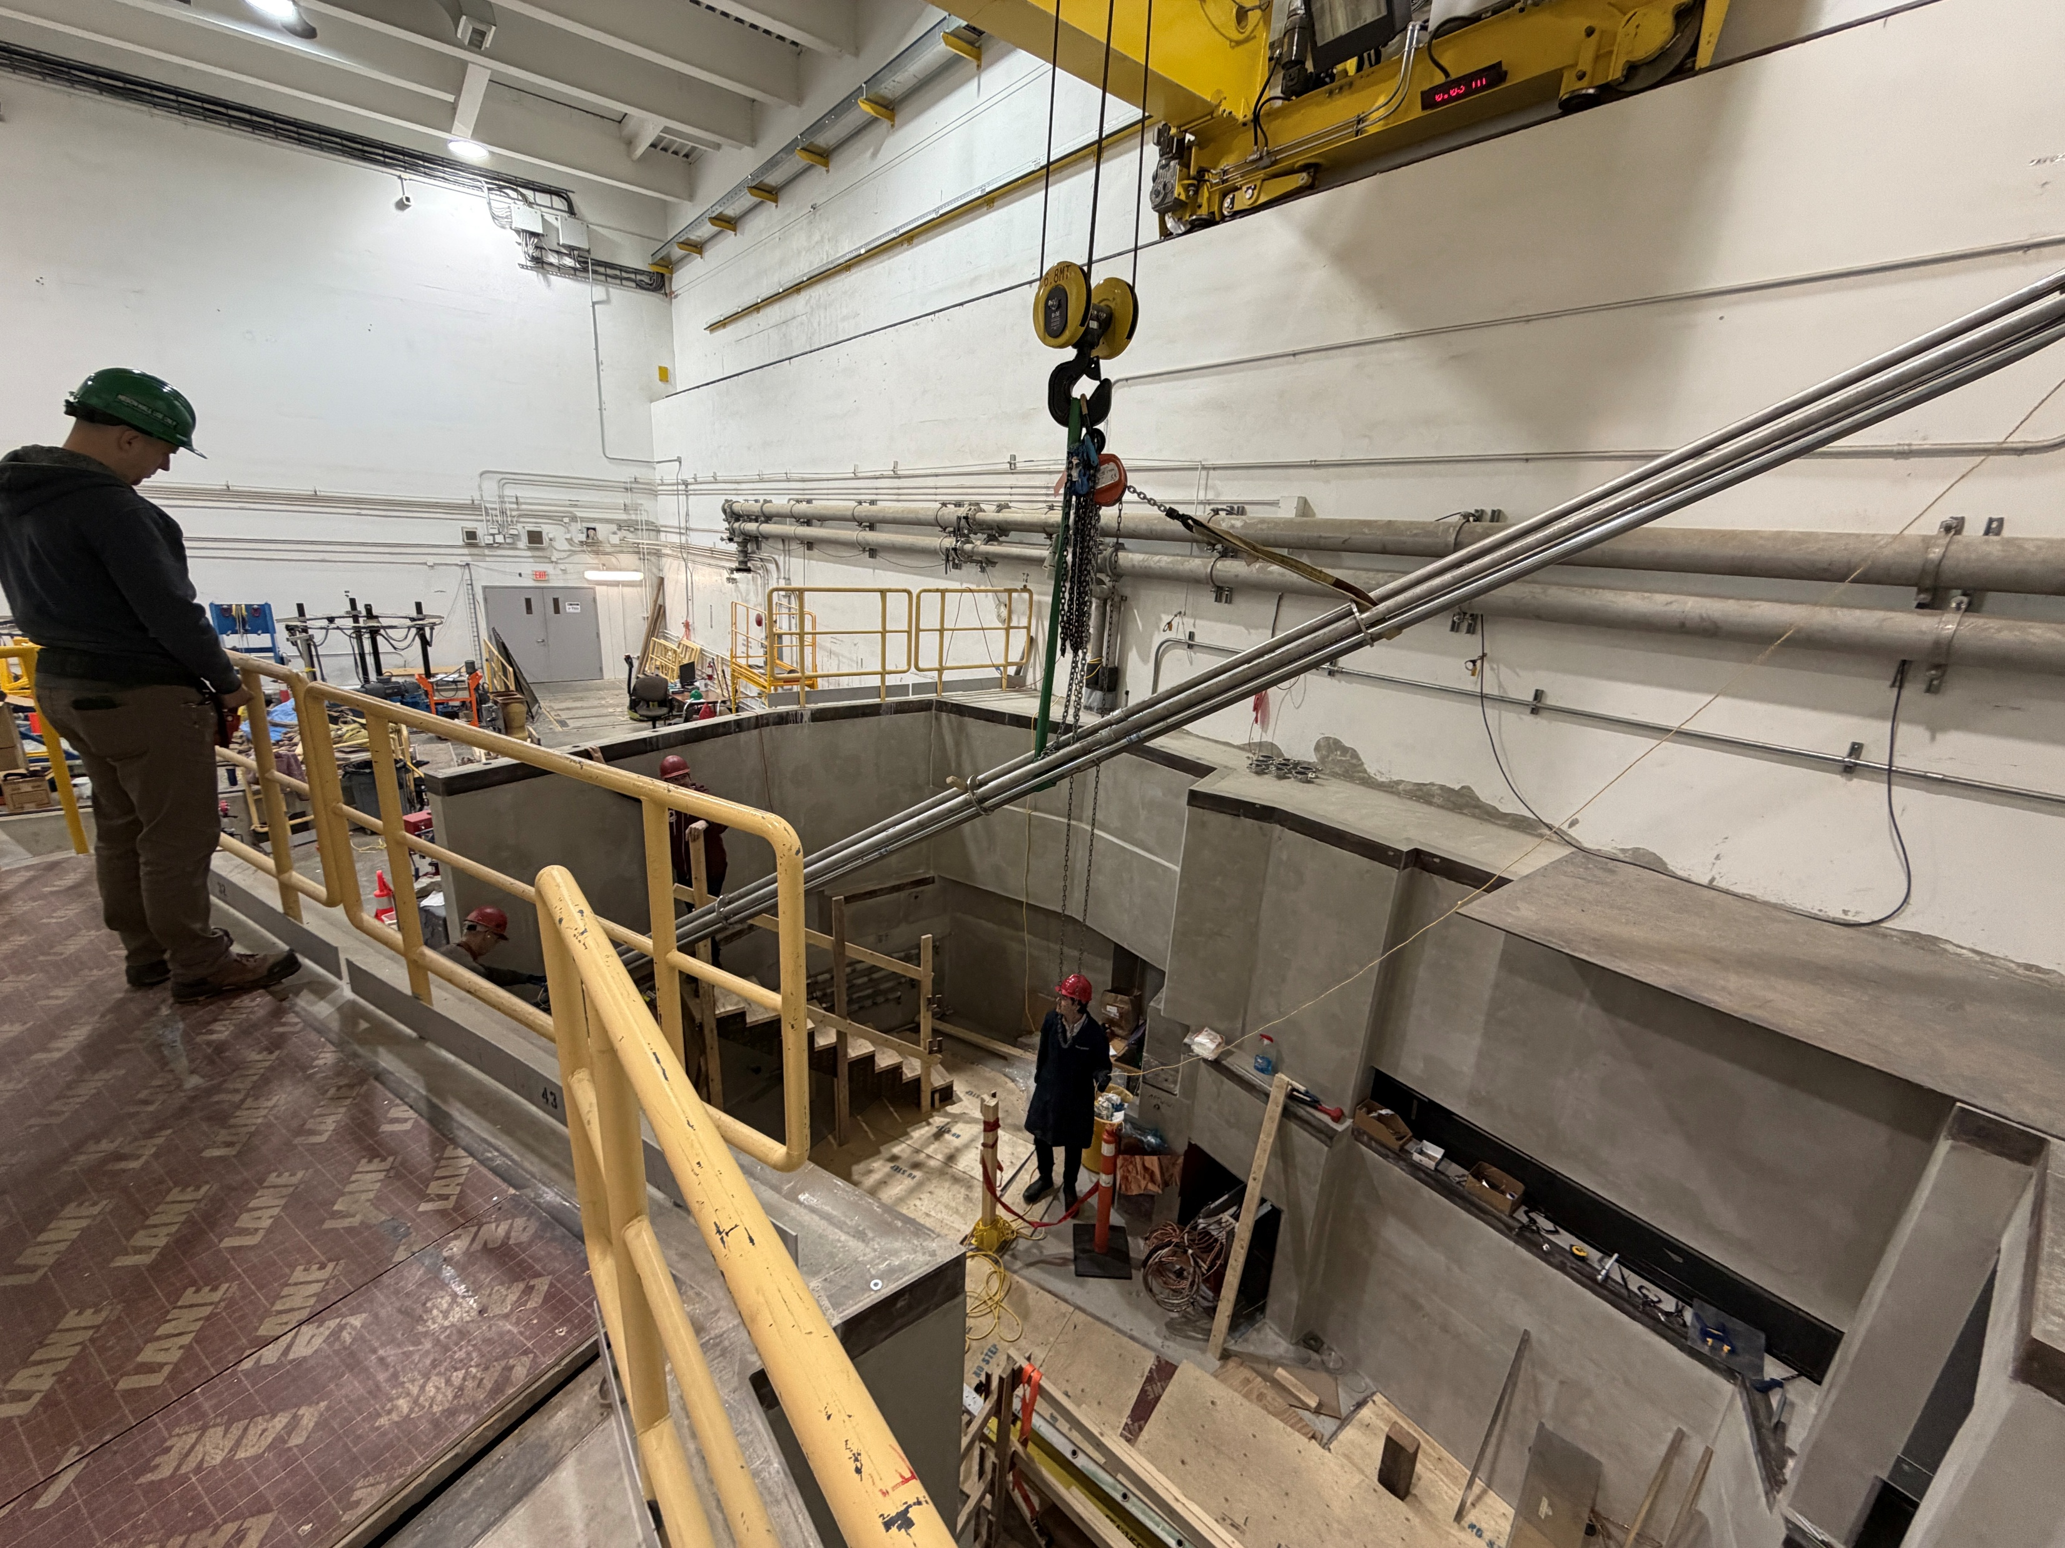
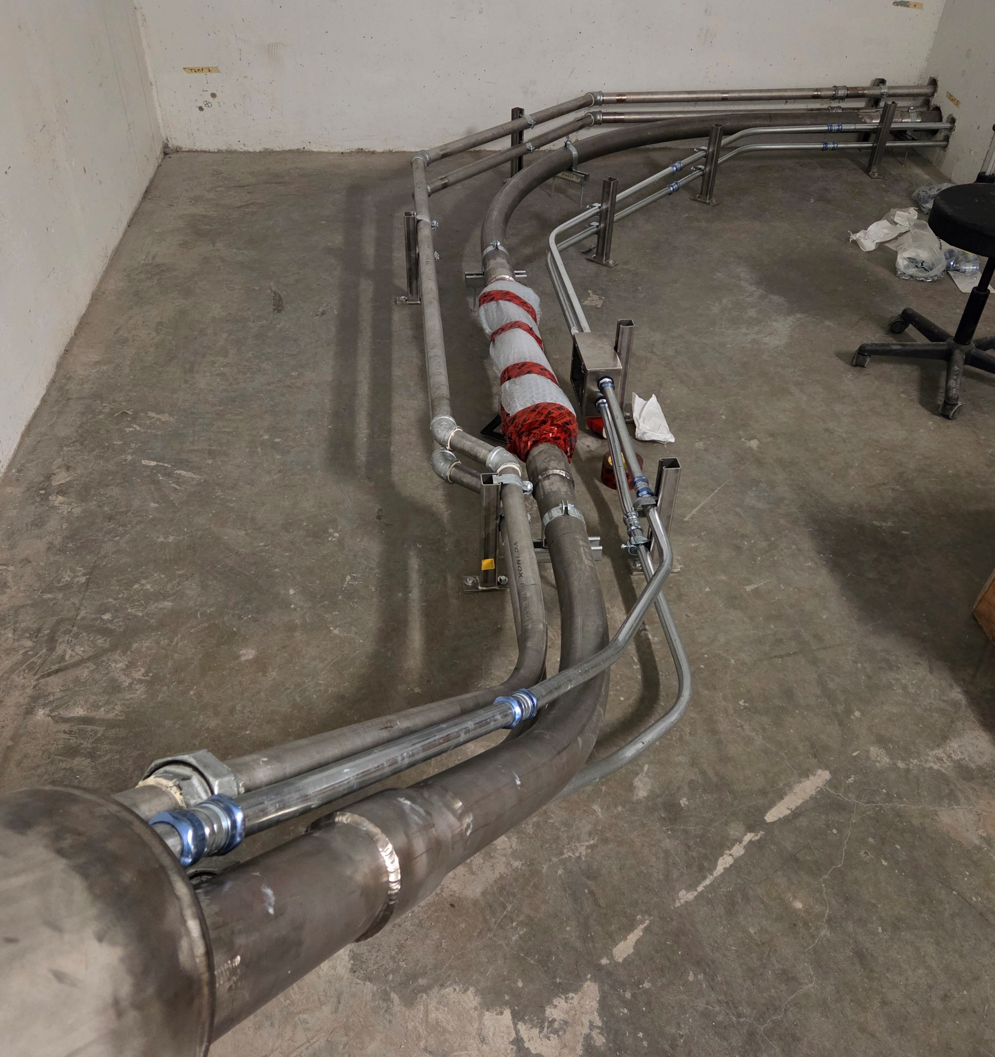
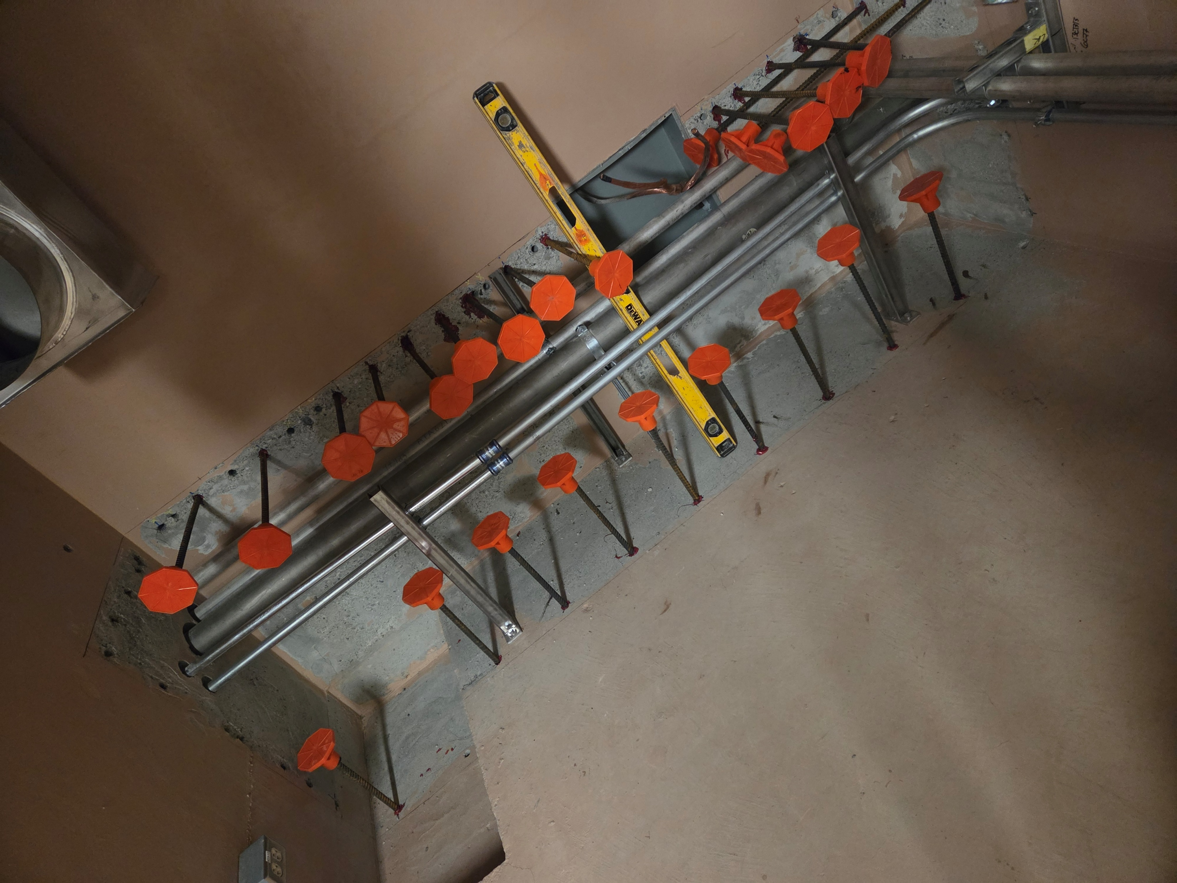
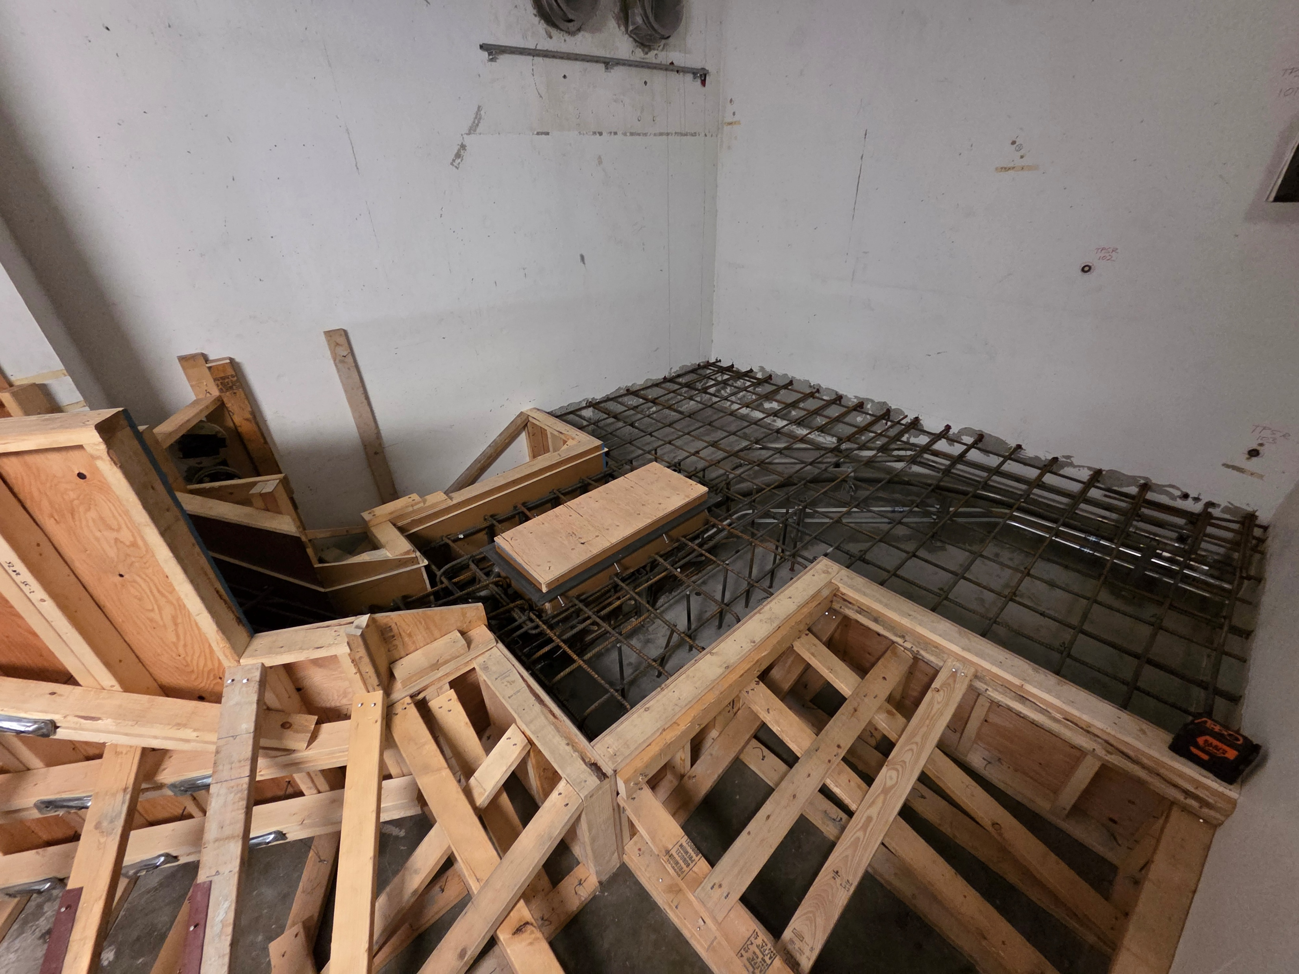
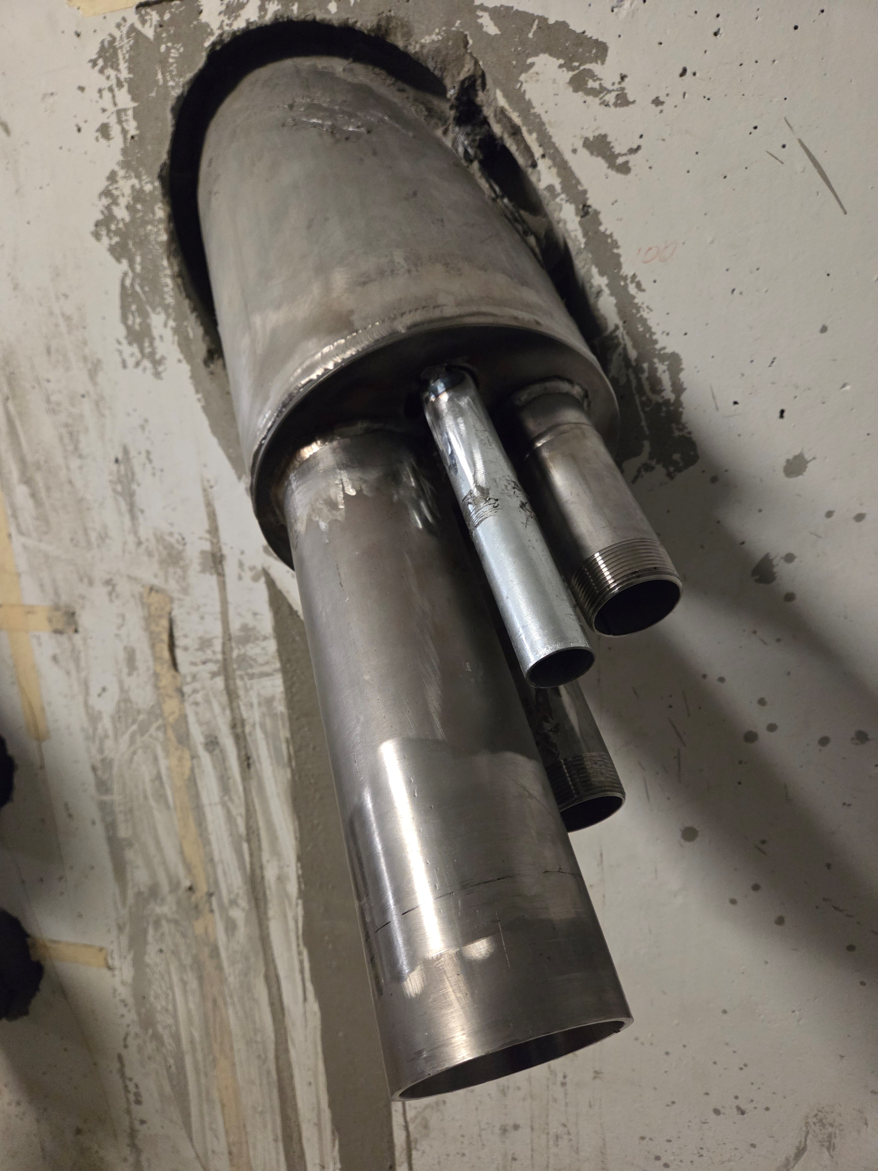
Accomplishments Since Last ASSC Meeting
Medical Target Transfer Line (Alex B, Keyur C)
Procurement, fabrication and installation completed.
Each welded segment was vacuum tested to ensure leak tightness within spec.
Blower lines, electrical EMTs installed.
Target transfer was tested (witness on tour!) prior to concrete slab being constructed over embedded segments.

Slide 8
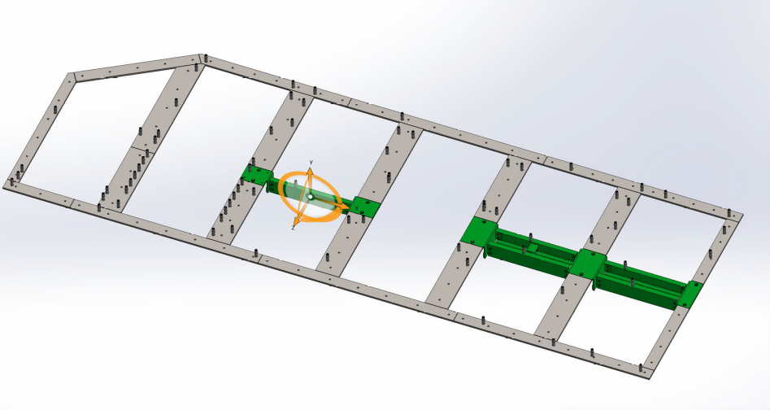
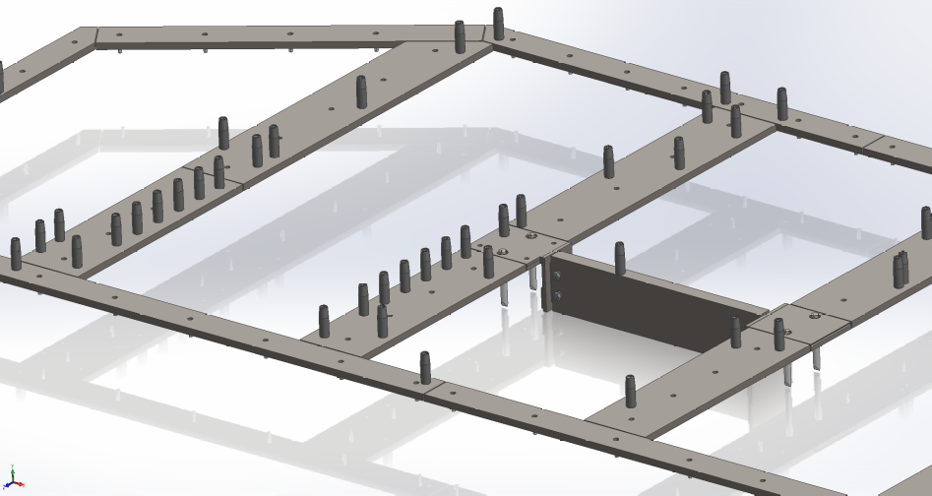
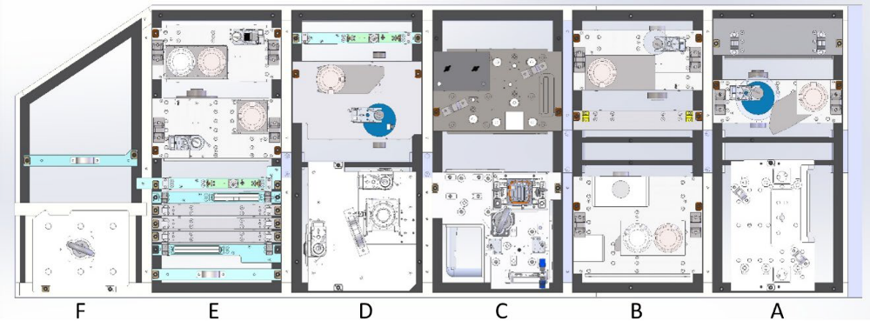
Accomplishments Since Last ASSC Meeting
Module Storage Pit (MSP) Frame Design + Manufacturing (Zaw TT)
The MSP is a storage location for AETE and APTW modules and remote handling tooling.
Module storage scenarios were carefully reviewed for compatibility and design integration within the MSP storage spaces (built in 2020).
The steel support frame elements will be fastened to the existing concrete wall structure.
Completed its Final Design Review (FDR) and drawings release by ECO.
The frame elements are currently in procurement with installation planned by end of October 2026.

Slide 9
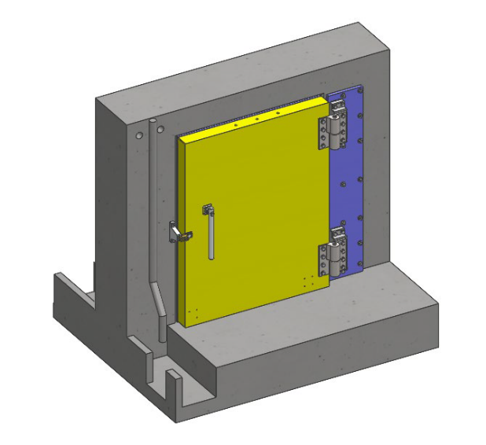
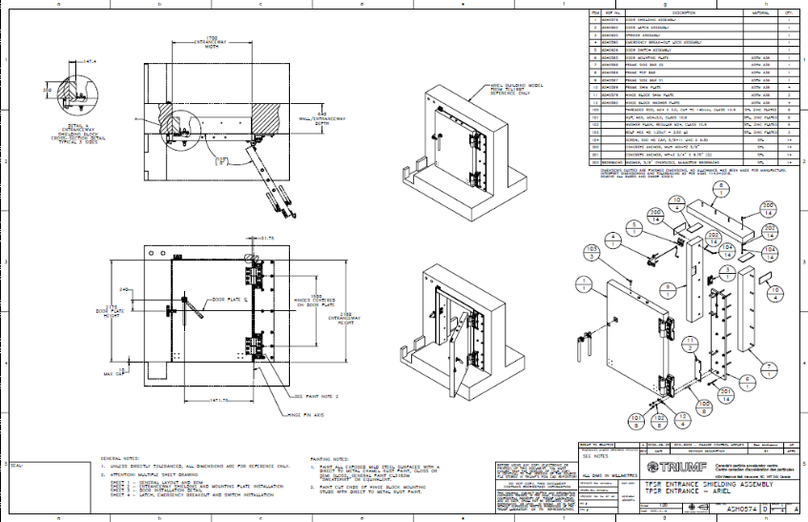
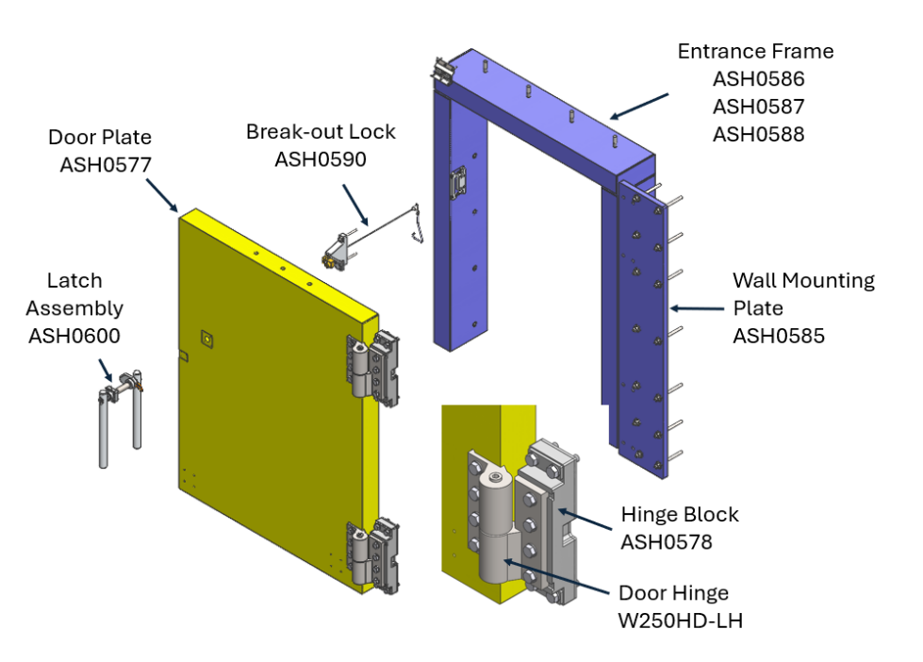
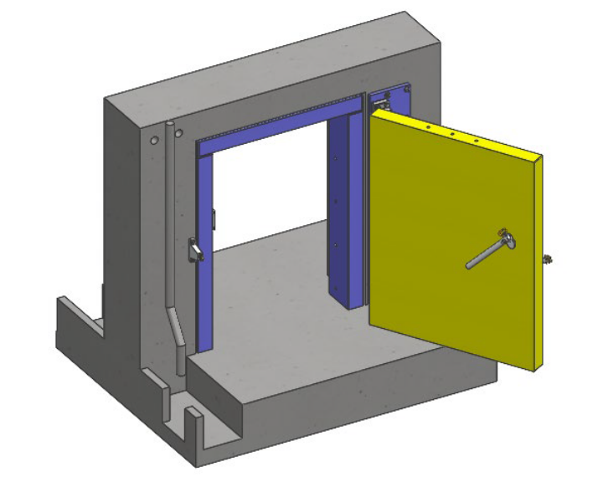
Accomplishments Since Last ASSC Meeting
Target Pit Services Room Entrance Shielding (SRF Group, Dragan M)
Requirements were released (Document 251759).
Design completed and Final Design Review held.
All drawings released for procurement by ECO.
Procurement underway with planned installation start by December 2026.

Slide 10
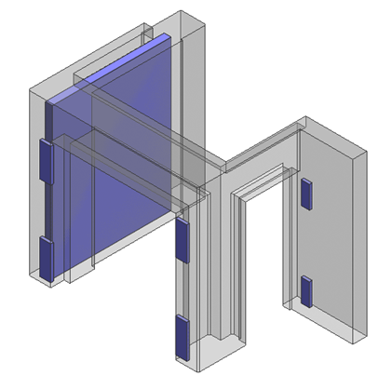
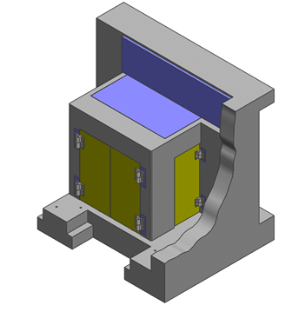
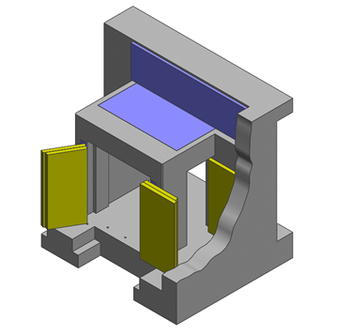
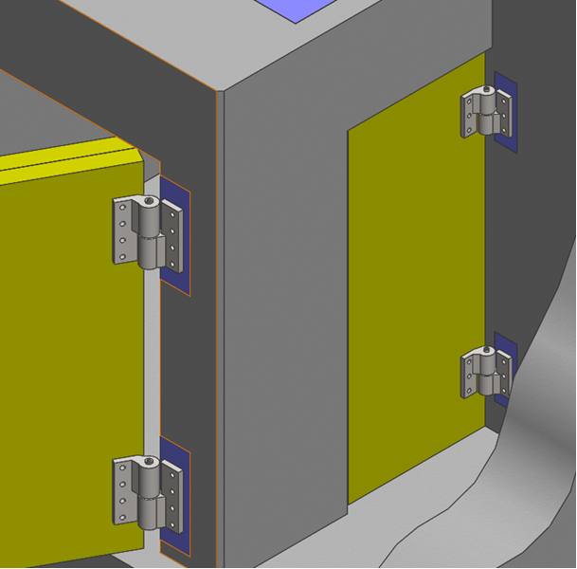
Accomplishments Since Last ASSC Meeting
Target Hall Entrance Shielding (SRF Group, Dragan M)
Requirements were released (Document 255569).
Design concept was iterated to improve constructability with input from our Structural Engineer (Dragan M).
Detail design is in process with design release planned to complete by November 2026.
Installation planned to start by March 2027.

Slide 11
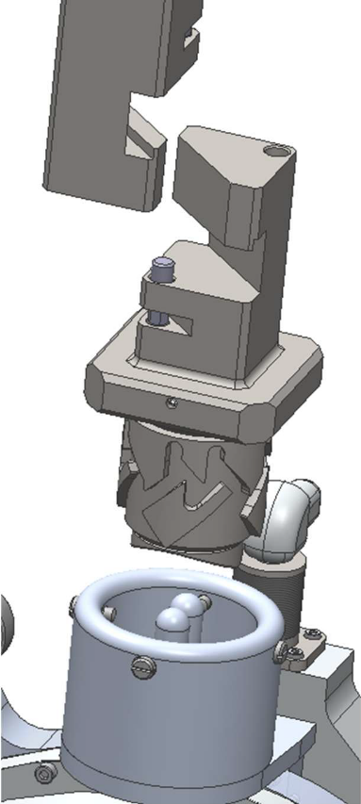
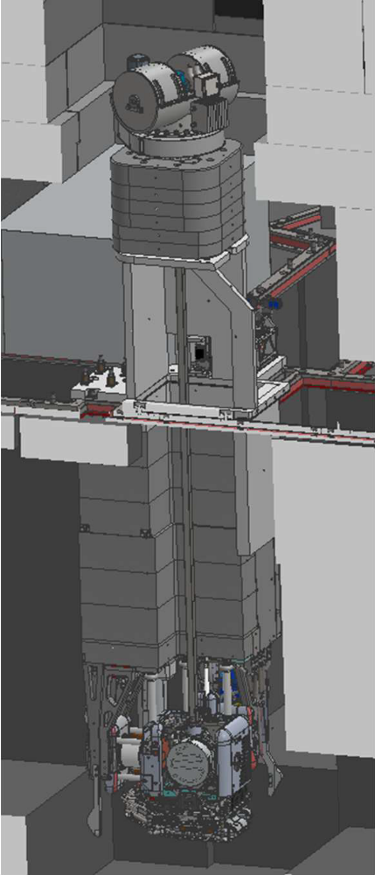
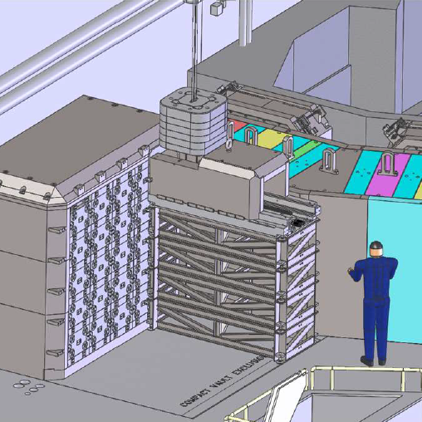
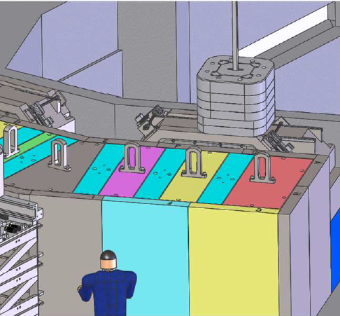
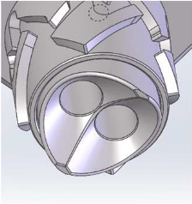
Accomplishments Since Last ASSC Meeting
Shielded Target Exchange System (Phoenix A)
Detail design revision of all components completed.
Supporting structure (shielded bell tower frame) redesigned from previous hinged design due to package limitations.
Revised latching mechanism.
Revised shielded target bell
Several further design refinements completed.
Final Design Review (FDR) held on September 17, 2026.
Drawings ECO by November 2026.
Cap Shielding
Crane Hook Block
Shielded Target Bell
HV Grounding Enclosure
Shielded Bell Tower Frame
Long Pole Tool
Latching Mechanism
HTV

Slide 12

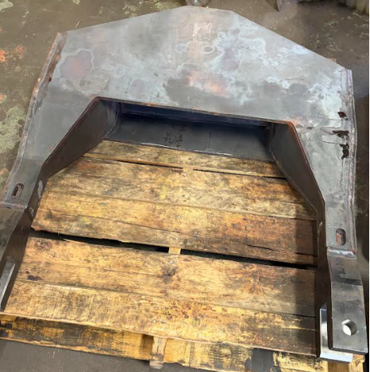
Accomplishments Since Last ASSC Meeting
Module Transfer System (Phoenix A)
Procurement of the module lifters is almost complete.
The fabrication vendor had made errors and needed to rework several of the lifters to bring them to our specification.
Lift testing of all lifters has now been completed.
Only painting and delivery remain in the procurement process.

Slide 13
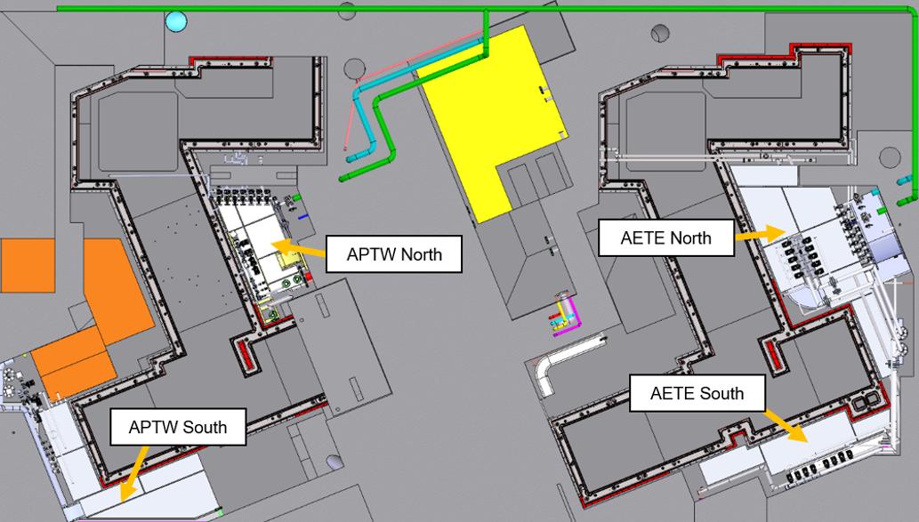
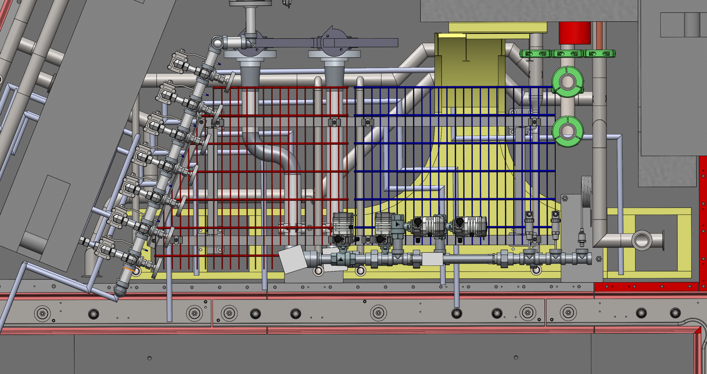
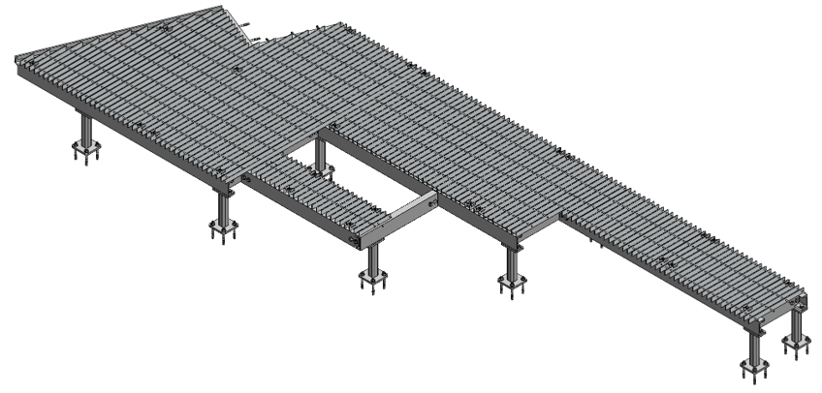
Accomplishments Since Last ASSC Meeting
Service Space Raised Floors (Garrett E, Dragan M)
Requirements Specifications released (Document-253837).
Concept design iterated with input from our Structural Engineer (Dragan).
Non-trivial design integration with electrical, mechanical, vacuum and personnel access considerations within the existing service space package volumes.
Detailed design completed and Final Design Review held on August 12.
Fabrication drawings release by ECO is now in progress.
Installation will occur after the services are placed (except legs).

Slide 14
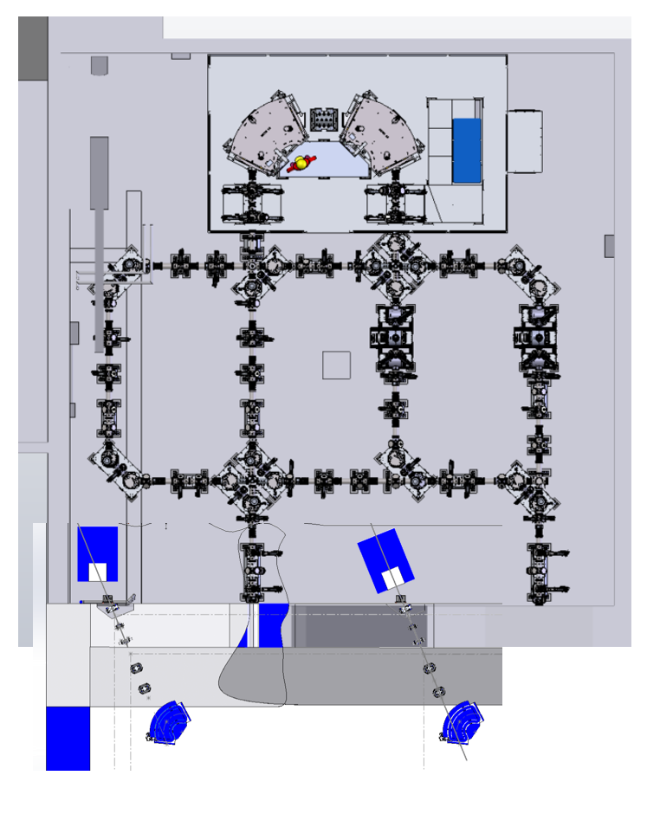
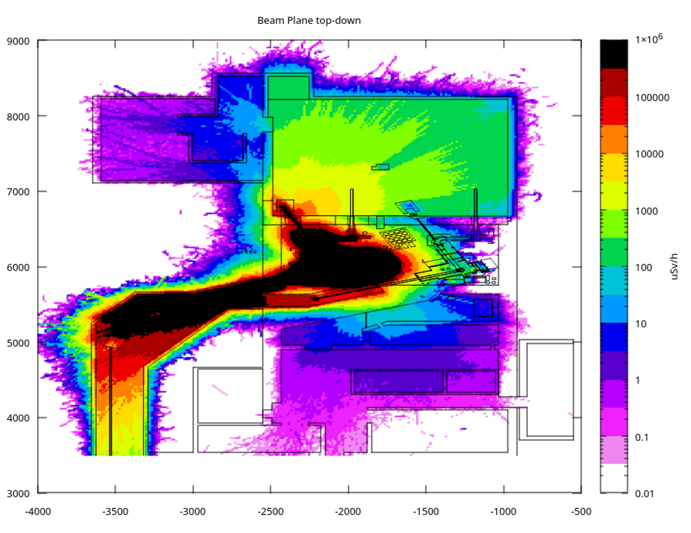
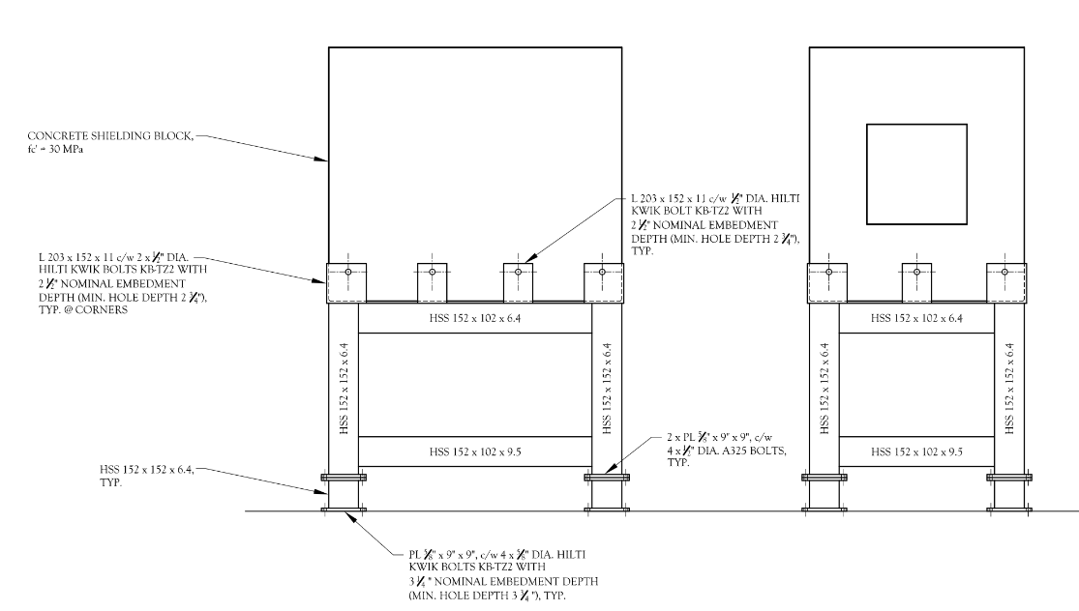
Accomplishments Since Last ASSC Meeting
Mass Separator Room ALIS Shielding Design
The design is largely complete and is approaching drawings completion for Final Design Review.
A procurement plan the concrete blocks has been determined and the vendor has submitted a quote for design + build.
TRIUMF will release the structural frame design, and fabrication will be performed by vendor or the TRIUMF Machine Shop.

Slide 15
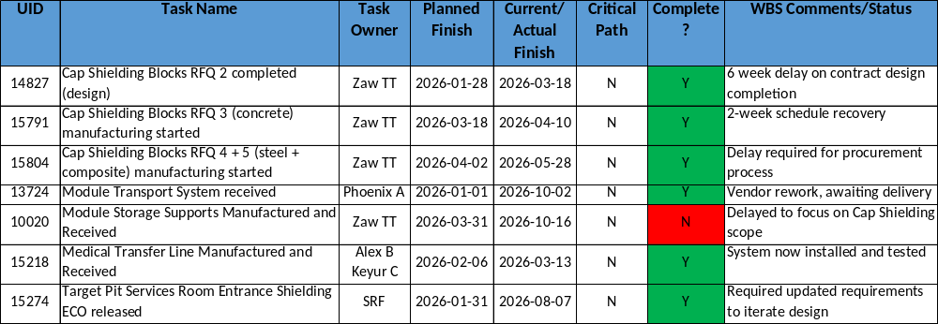
Progress on Plans Presented at previous ASSC Meeting

Slide 16
MTA Update
14829 Cap Shielding delayed delivery, now Feb 2027. Substantially off critical path.
8160 Module Storage Frame delay of 7 months to allow engineering resource to focus on Cap Shielding scope.
6390 P424 readiness for commissioning is dependent on the program critical path for when cap shielding can be installed. This milestone has moved with the program critical path, not under P424 control.

Slide 17
Major Risks, Issues, Concerns
Risk/Issue | Comments and Mitigations
Cap Blocks delivery later than planned | All three RFQs have experienced some technical delays in completing their scope. We are expecting delivery in the November timeframe, a bit later than planned and still well off the critical path.
TH Entrance Hut design later than planned with Dragan input | Late changes to the design concept have delayed progressing with detailed design. Scope is off critical path.
Safety Systems installation planning uncertainty | Installation planning reviewed with team; conduit routing needs to be completed by electrical team.

Slide 18
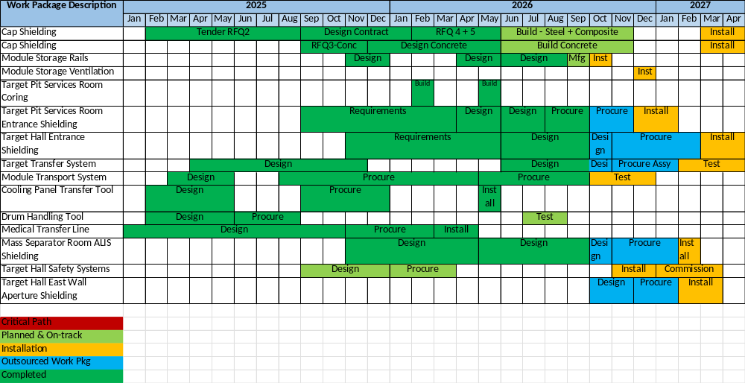
LS 26 Schedule

Slide 19
Gate 3 Checklist (for 17% uncompleted scope, 83% is now COMPLETE)
Task | Current Status (Yes/No/Partial%) | Comment
All released documents up-to-date? | 90% | Engineering Notes for Module Storage Supports, Entrance Shielding, MSR ALIS Shielding and Service Space Raised Floors outstanding
Commissioning plan drafted? | No | N/A, covered by testing
Drawings, diagrams or schematics released by ECO? | 90% | ECO for Module Storage Supports, Entrance Shielding, MSR ALIS Shielding and Service Space Raised Floors outstanding
All Requirements Specification documents released to Docushare? | 95% | RS Docs for Service Space Raised Floors outstanding
Schedule critical path understood? | Yes
Budget by fiscal year is updated and remaining funds enough to cover projected costs? | Yes
Have you sent to the Procurement Department a list of all major items (>$75k) to be purchased, with a timeframe, and agree with them on a procurement strategy for each? | 90% | Cap Shielding procurement in process ($1.9M) TPSR Entrance Shielding Door in process. Target Hall Entrance Shielding design does not have a procurement plan yet - WIP.
Top risks identified, with credible mitigation actions? | Yes | Support Gate 3 with planned design releases.
Integration and test plans reviewed by experts and project stakeholders (e.g. users)? | No | N/A
Controls (EPICS, data acquisition, MPS, etc…) specified? | N/A | N/A
Summary of lessons to learn thus far, presented at Gate review? | No | In process

Slide 20
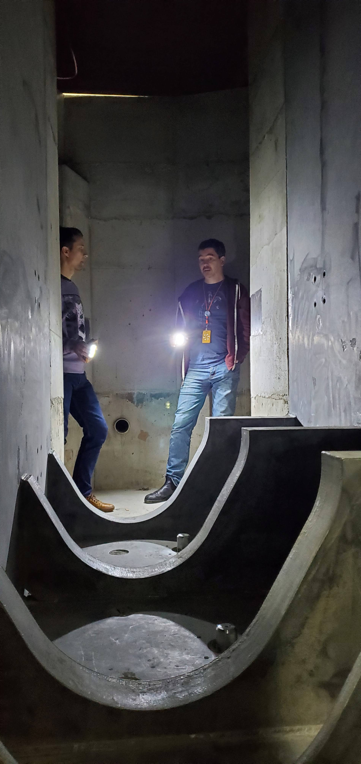
Plans and Objectives for the Next 6 Months
Next 6 Months | Critical Path
15794 - Cap Shielding Blocks RFQ 3 (concrete) received | N
15807 - Cap Shielding Blocks RFQ 4 + 5 (steel + composite) received | N
6925 - Module Storage Supports installed | N
15276 - Target Pit Services Room Entrance Shielding installed | N
7041 - Target Hall Entrance Shielding design released by ECO | N
9437 - ALIS Shielding installed | N
15627 - Service Space Raised Floors installed | N

Slide 21
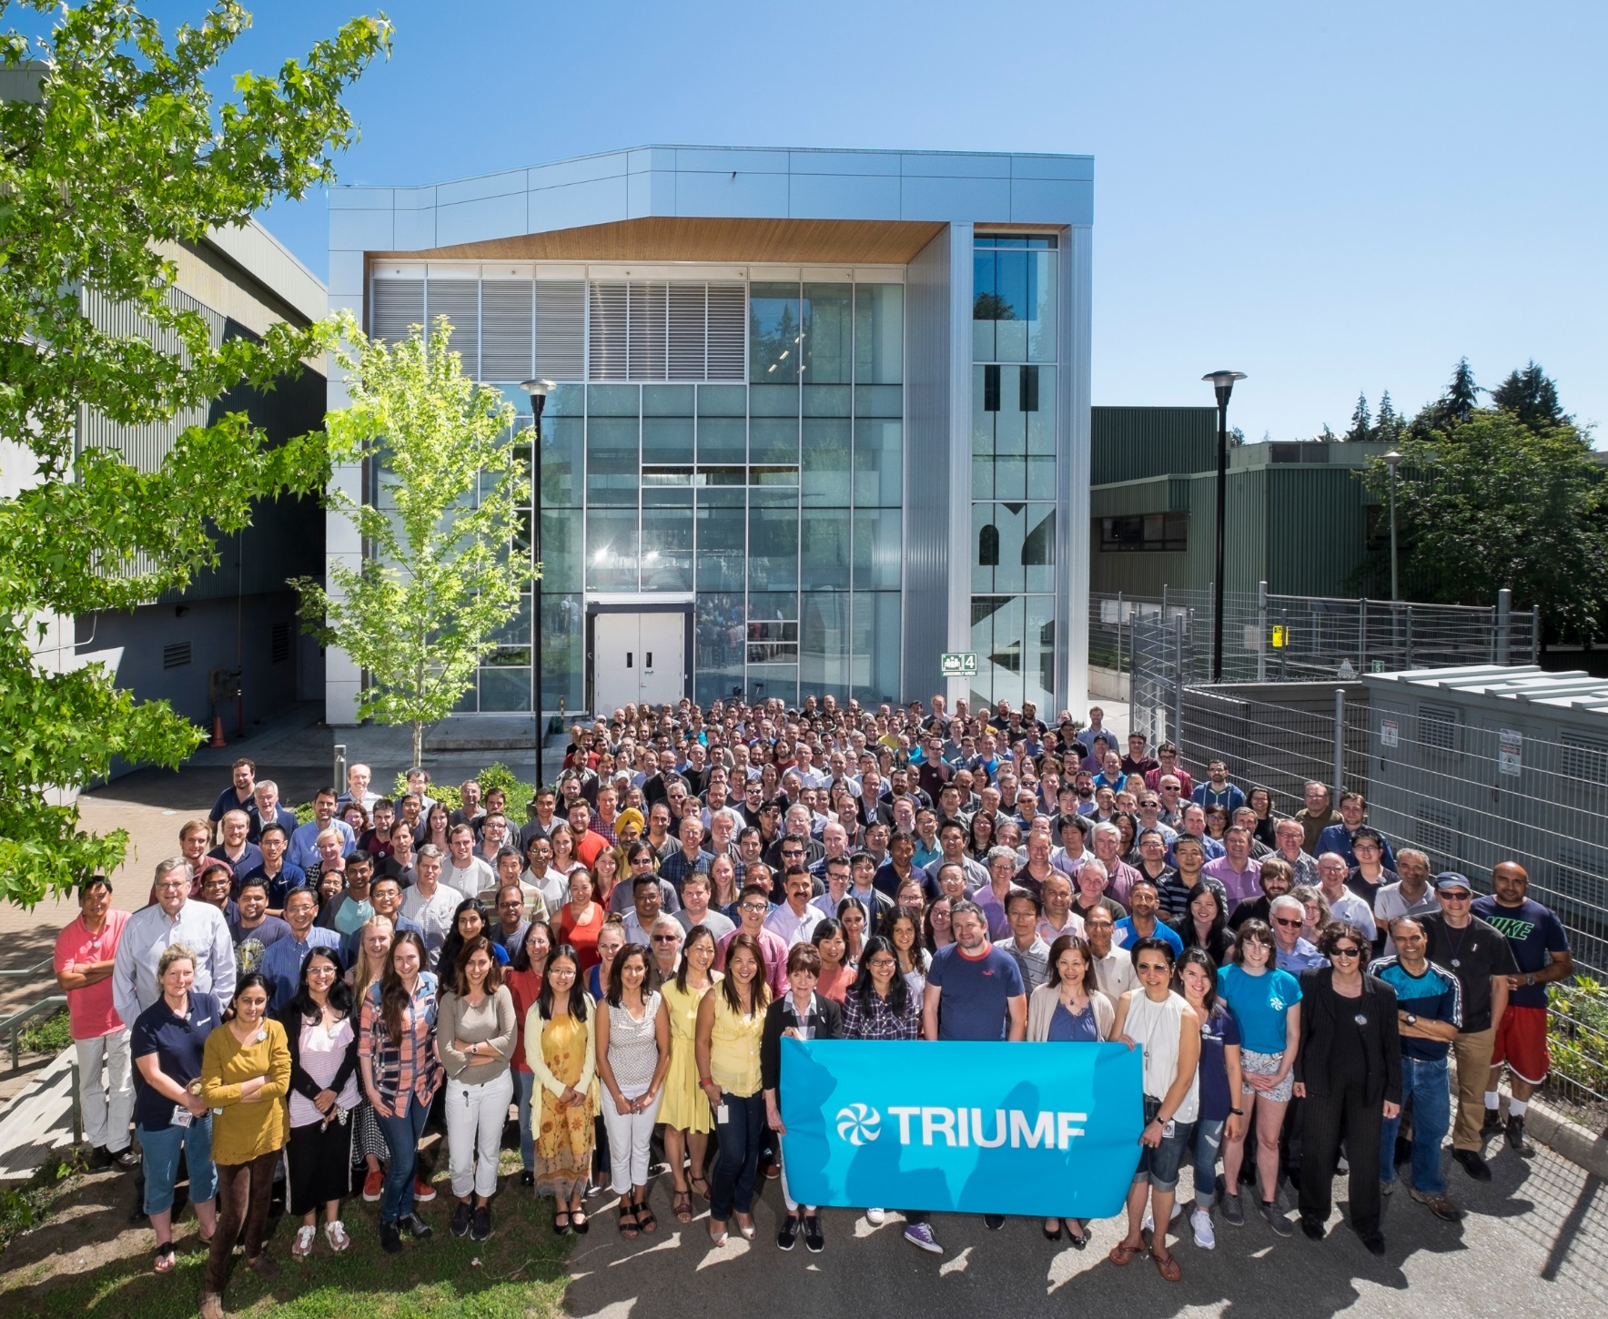




Thank you
Merci
www.triumf.ca
Follow us @TRIUMFLab
Discovery,
accelerated

