Slide 1
P358 Overview
Technical Infrastructures
ASSC Fall 2026
Oct 1, 2026
Project Leader: Bill Richert
Project Integrator:
Norman Muller (for Mel Almario) – Electrical
Mike Rowe/Julie Cho – Controls
Adrian Watt – Mechanical
Kevin Ardron – Safety Systems

Slide 2
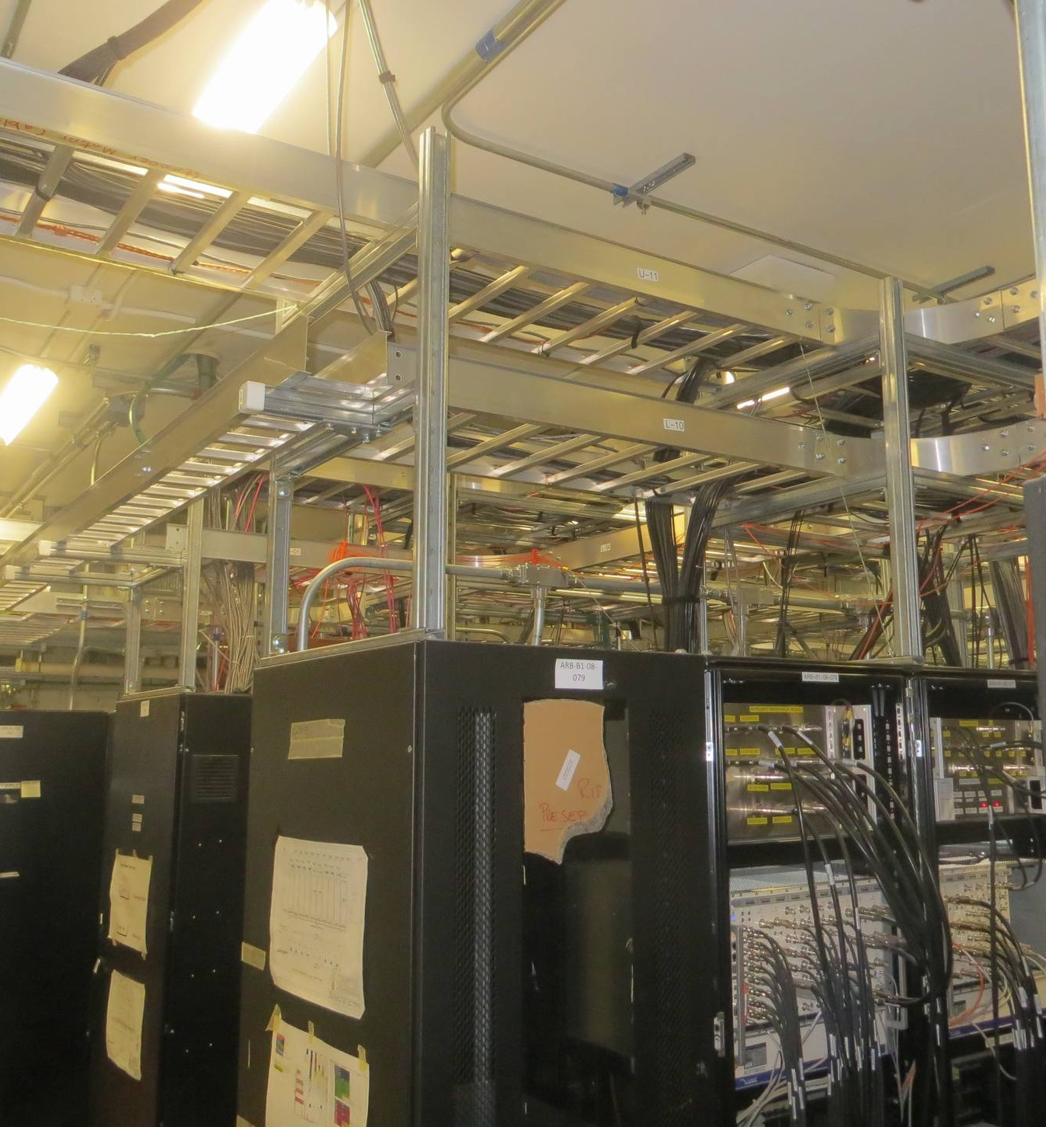
Scope
P358 – Scope
Mechanical, Electrical, Controls for:
  Nuclear Ventilation (M&E only)
  Cooling Systems: RW, LCW, ALCW, Chilled Water
  UPS system
  Tray design in B1-08 (additional scope) for
  controls, diagnostics, vacuum, etc.
  Actinide Lab (Mech)
Non-P358 – Scope
  Infrastructure support for other WBSs: electrical
  services, mechanical services, safety systems
    P179: BL4N, Proton Cave
    P353: Target Pit Services Room
    P424: Target Pit Services
    P355: Assembly Lab and Conventional Chem

Slide 3
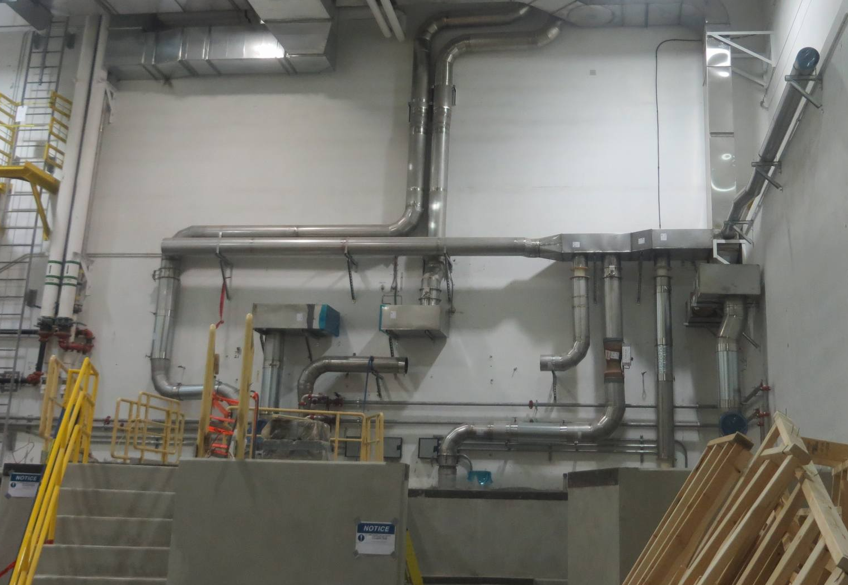
Accomplishments Since Last ASSC Meeting
P358 – Since Last ASSC Report
Mechanical: P358: Target Hall nuclear ventilation detailed design completed in 2022 originally scheduled for installation near the end of the Project. Since the design was ready it was rescheduled to start last fall.

Slide 4
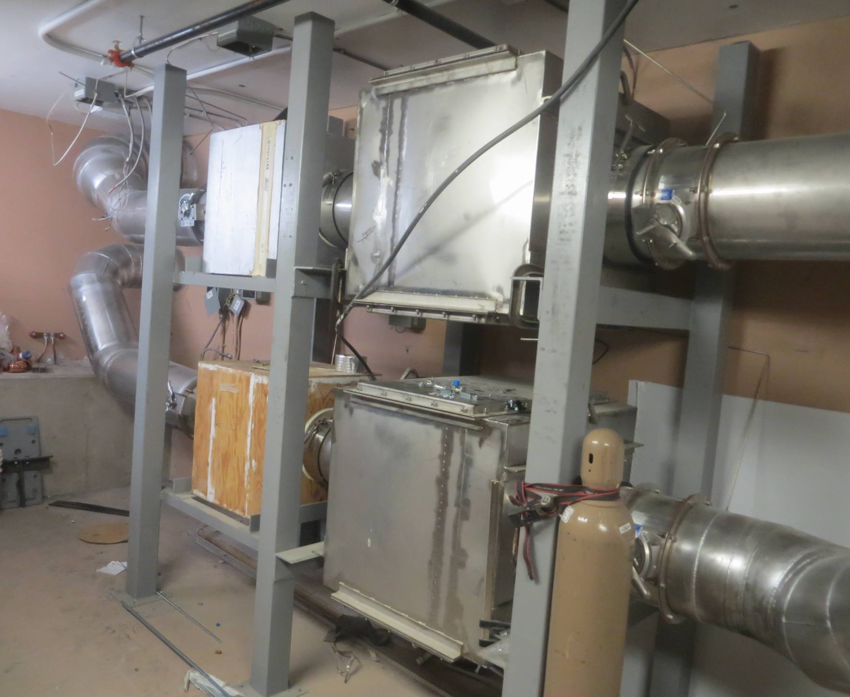
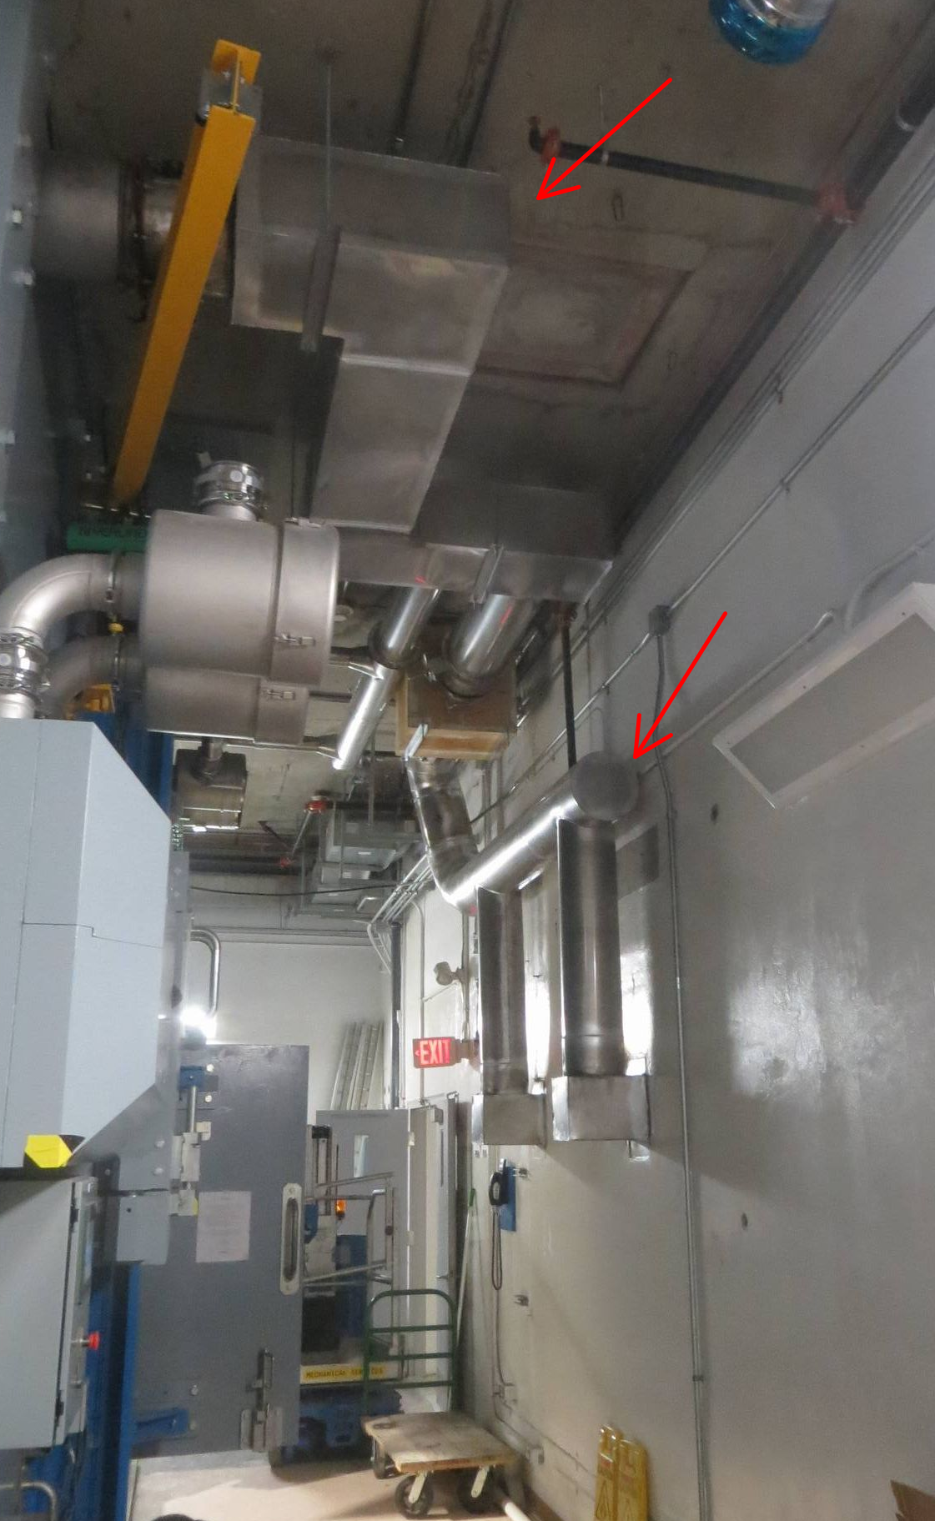
Accomplishments Since Last ASSC Meeting
P358 – Since Last ASSC Report
RGS: HEPA Filters and Carbon Adsorbers and Stand
HC Access Room: HEPA and ductwork
Mechanical: P358/P478: Hotcell NV 90% installed

Slide 5
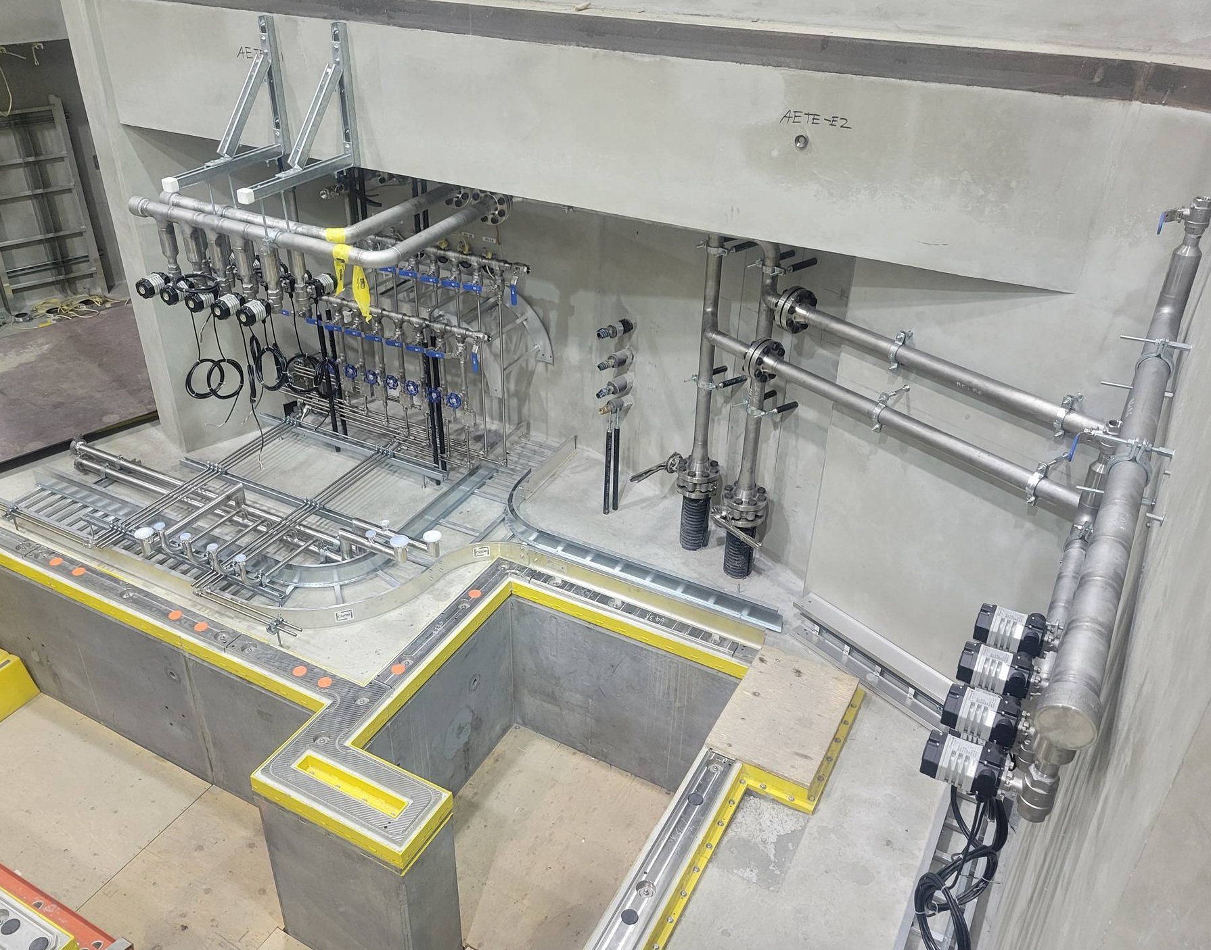
Accomplishments Since Last ASSC Meeting
Non-P358 – Since Last ASSC Report
Electrical and Mechanical: P424 (TH): Last ASSC: Detailed design ~90% (mech.) and ~80% (elec.)
  Now: the installation is ~75% (mech) and ~20% (elec, tray), 0% (elec, AC)

Slide 6
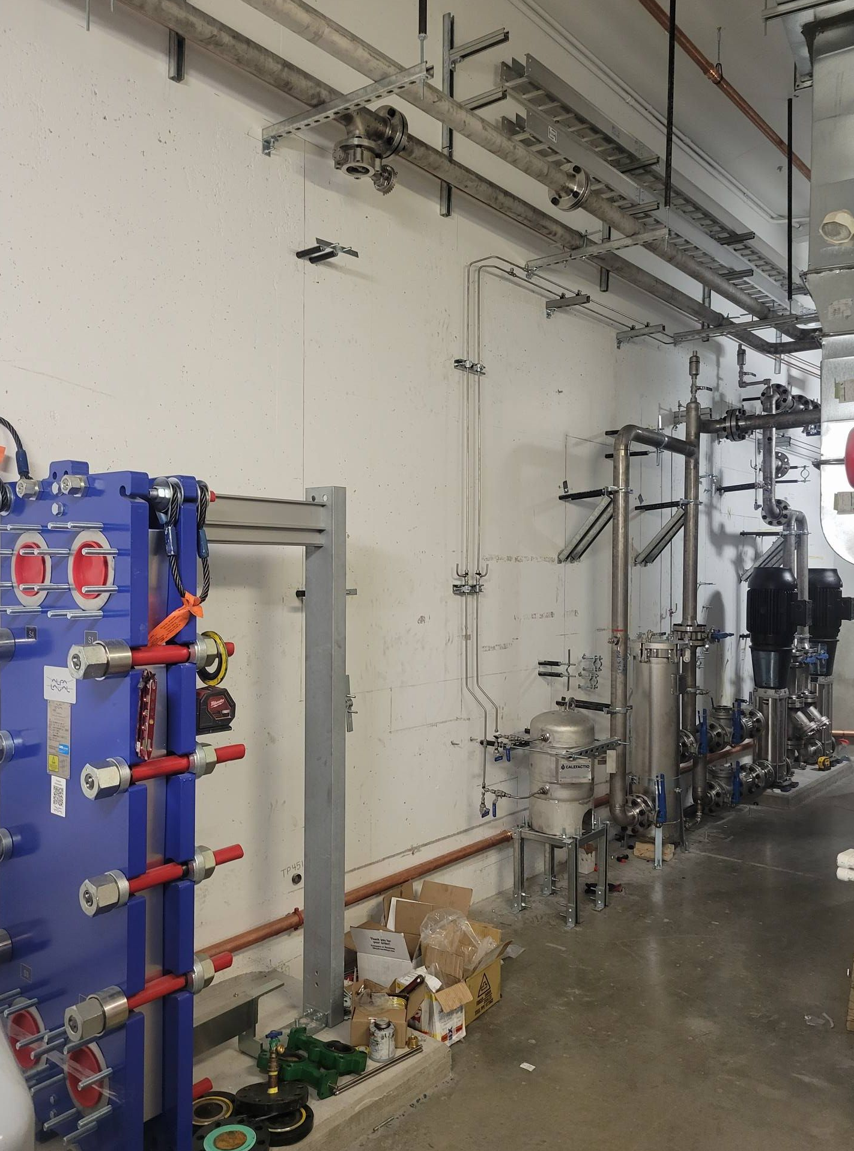
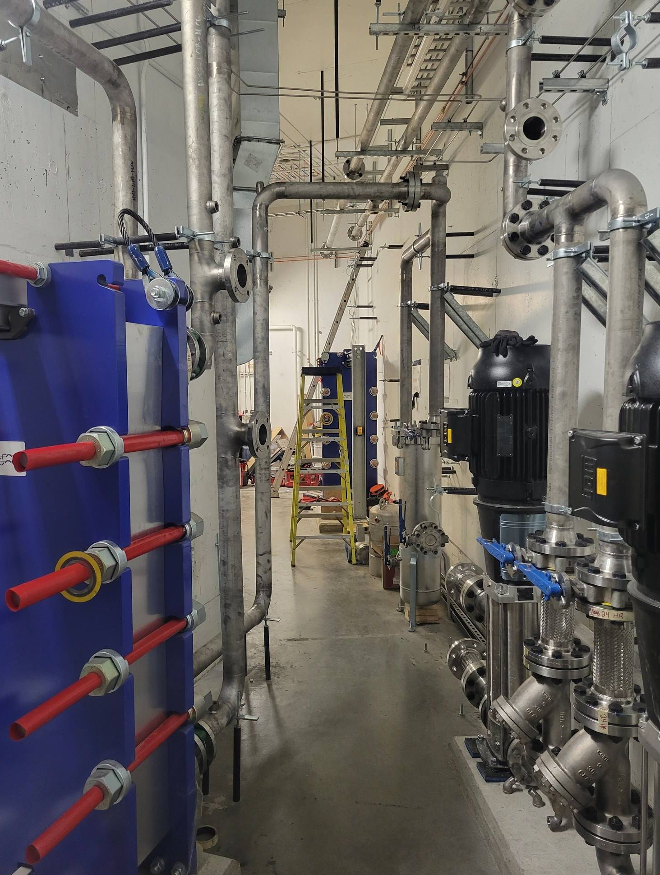
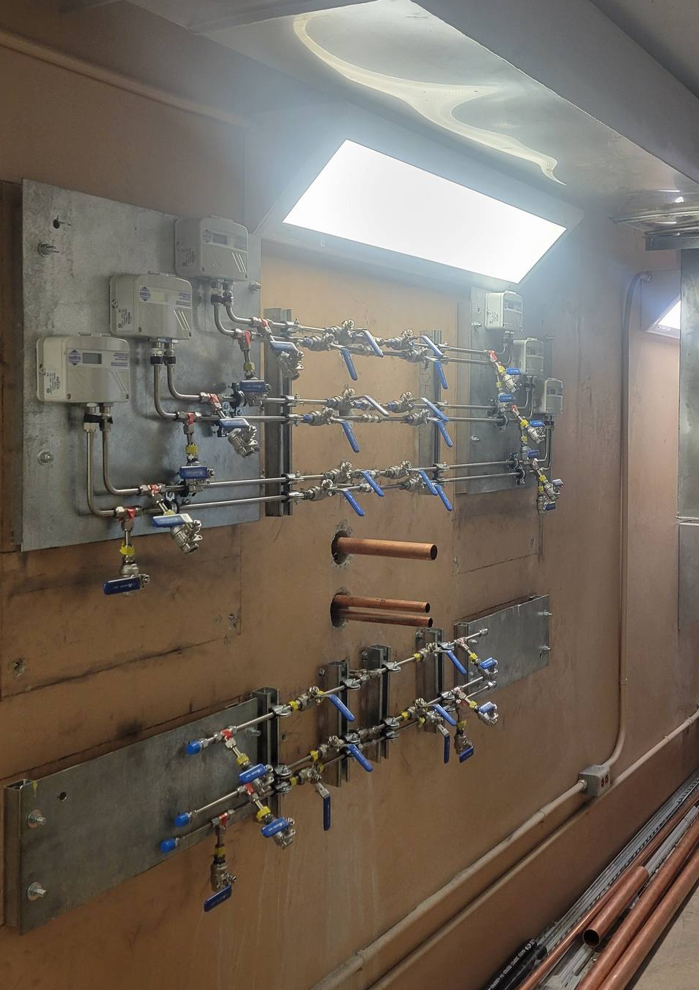
Accomplishments Since Last ASSC Meeting
Non-P358 – Since Last ASSC Report
Electrical and Mechanical: P353 (TPSR): Last ASSC: Detailed design ~90% (mech.) and ~20% (elec.)
  Now: the installation are ~75% (mech), ~20% (elec) and Seq. of Operation prepared

Slide 7
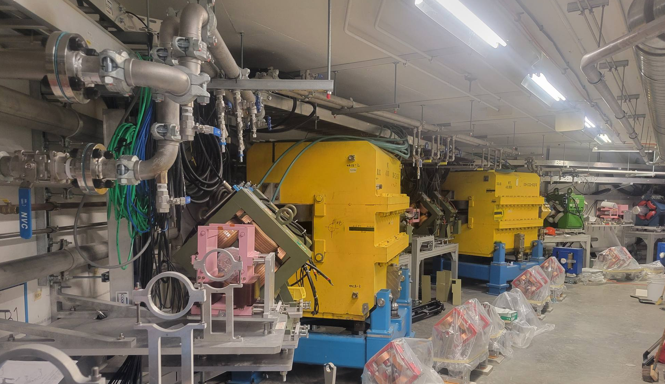
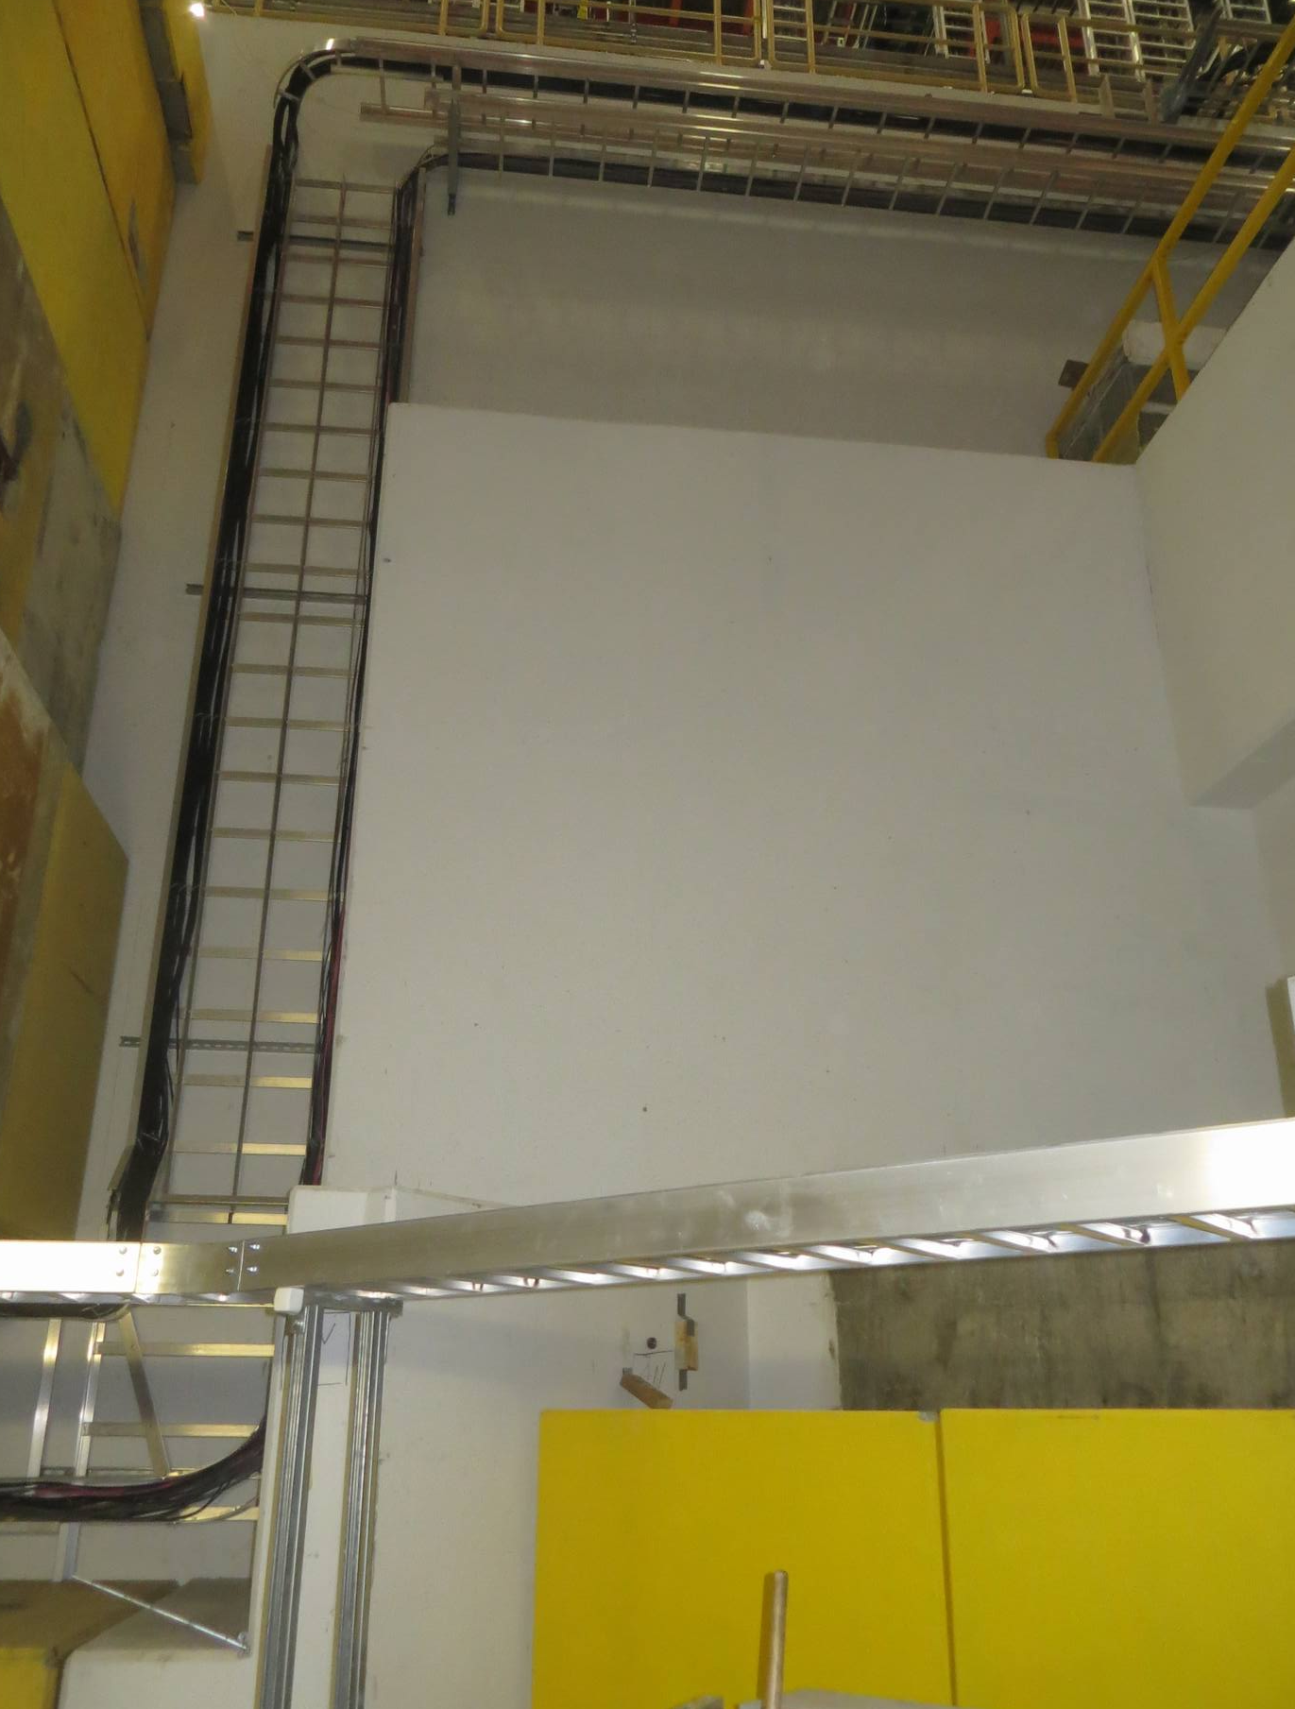
Accomplishments Since Last ASSC Meeting
Non-P358 – Since Last ASSC Report
ARIEL Tunnel
Proton Cave
Electrical and Mechanical: P179: (ARIEL Tunnel and Proton Cave): Comp. Air, ALCW, vacuum, Tray and Cables
Tunnel: Last ASSC: Conceptual Design (Engineering Note and Drawings) routed (Mech)
  Now: installation ~25% (mech) and ~70% (elec), Air cooling (on hold), DC cables pulled from B1-08.
  Proton Cave and 284 (Elec.): Now: the installation ~75%. AC done, DC cable pulling starting this week from elev. 284.

Slide 8
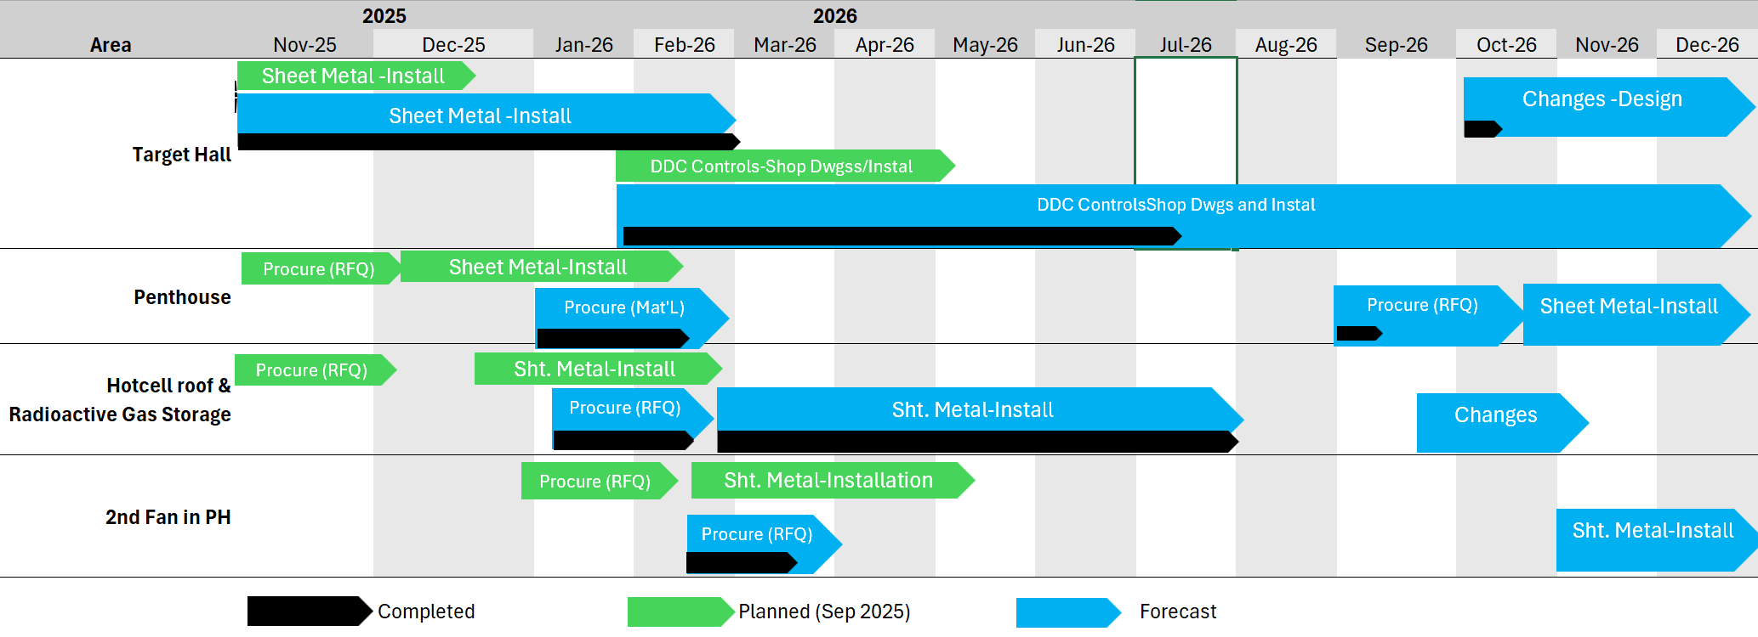
Progress on Plans Presented at previous ASSC Meeting
Target Hall and Hotcell NV: Installation prioritized while areas were accessible
NV Filter room work: In process of engaging sheet metal contractor

Slide 9
MTA Update
No MTA for P358.

Slide 10
Major Risks, Issues, Concerns
Risk | Mitigation
Elec. GL resignation raises consequence of losing remaining staff. Designs are done. Additional losses will stretch budget and resources. | Fortunately designs are done. Prioritized recruitment. Key staff returning from leave. Engage contracted professional engineer.
Lots of demand from non-P358 projects could stretch engineering resources (from Gate 3). | Continued professional CM help, allow OT, new MSRV resources very helpful. Continue to prepare detailed specs to allow contractors to efficiently execute work (Mech.)
Late requirements and interlock docs and late installation eating up slack and leading to controls delay at the end | PM continuously monitoring prerequisites and Controls Group assistance to identify missing info
Budget (from Gate3): Forecast to complete appears on budget, but is based estimates, not quotes. | Use estimators that are familiar with the type of work being performed (e.g. P353 TPSR estimate is within -10%.). Remain true to the P358 scope.
Tight space, schedule as driver, simultaneous installations, multiple employers and multiple supervisors leads to safety risk | Supervisors to support Qualified Coordinator program.

Slide 11
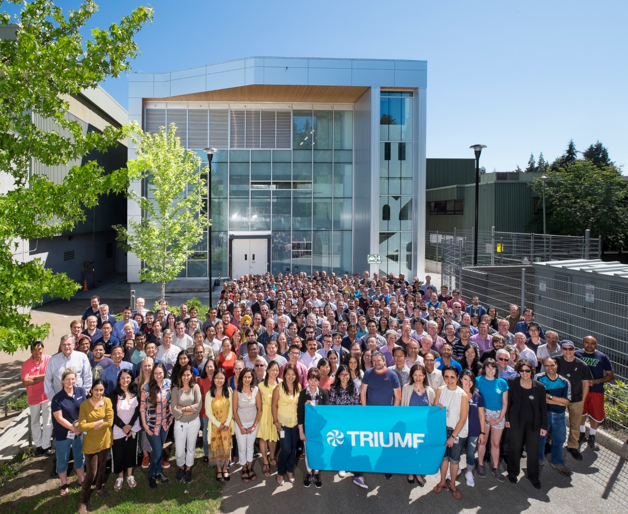




Thank you
Merci
www.triumf.ca
Follow us @TRIUMFLab
Discovery,
accelerated

