Slide 1
P310 Overview
CANREB
ASSC Fall 2026
Oct 1-2, 2026
Project Leader:
Brad Schultz

Slide 2
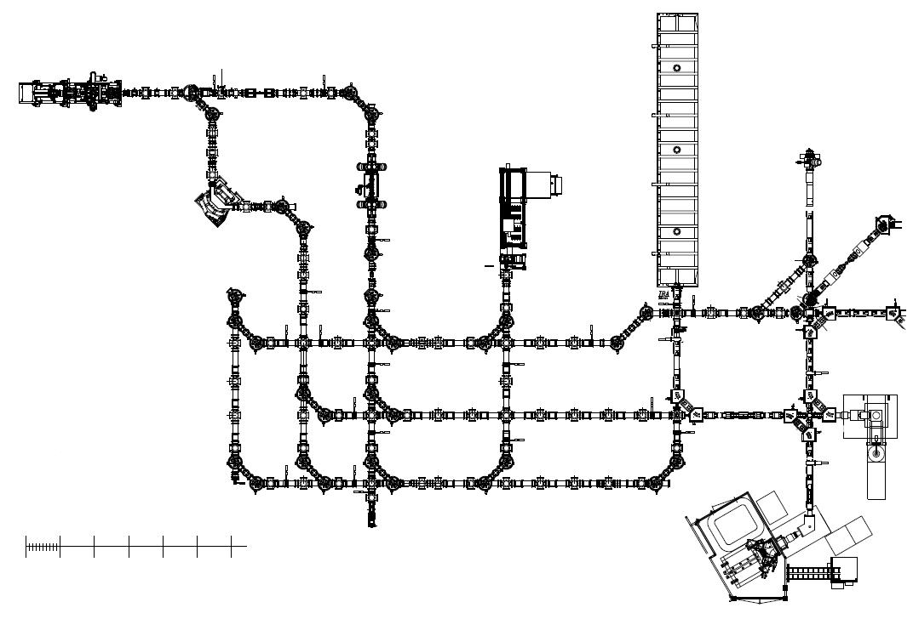
ARIEL radiofrequency quadrupole cooler buncher (ARQB)
Cools & bunches beam
CANREB overview (G)
ARIEL pulsed drift tube (APDT)
Matches beam energy for EBIS injection
ARIEL-G
Radiofrequency quadrupole
Post-acceleration of ions (A/q < 30)
ARIEL yield station (AYS)
Measured radioactive yield
Electron beam ion source (EBIS)
Charge breeds beam (3 < A/q < 7)
Nier spectrometer (NIS)
m/q separation of charge bred beams (R < 300)
ISAC-I
Beam in ISAC)
ISAC target (B2)
Source of RIB
Beam out
Beam in (B2)
0
2
4
6
Scale (in meters)
Off-Line Ion Source (OLIS)
Stable ion beams

Slide 3
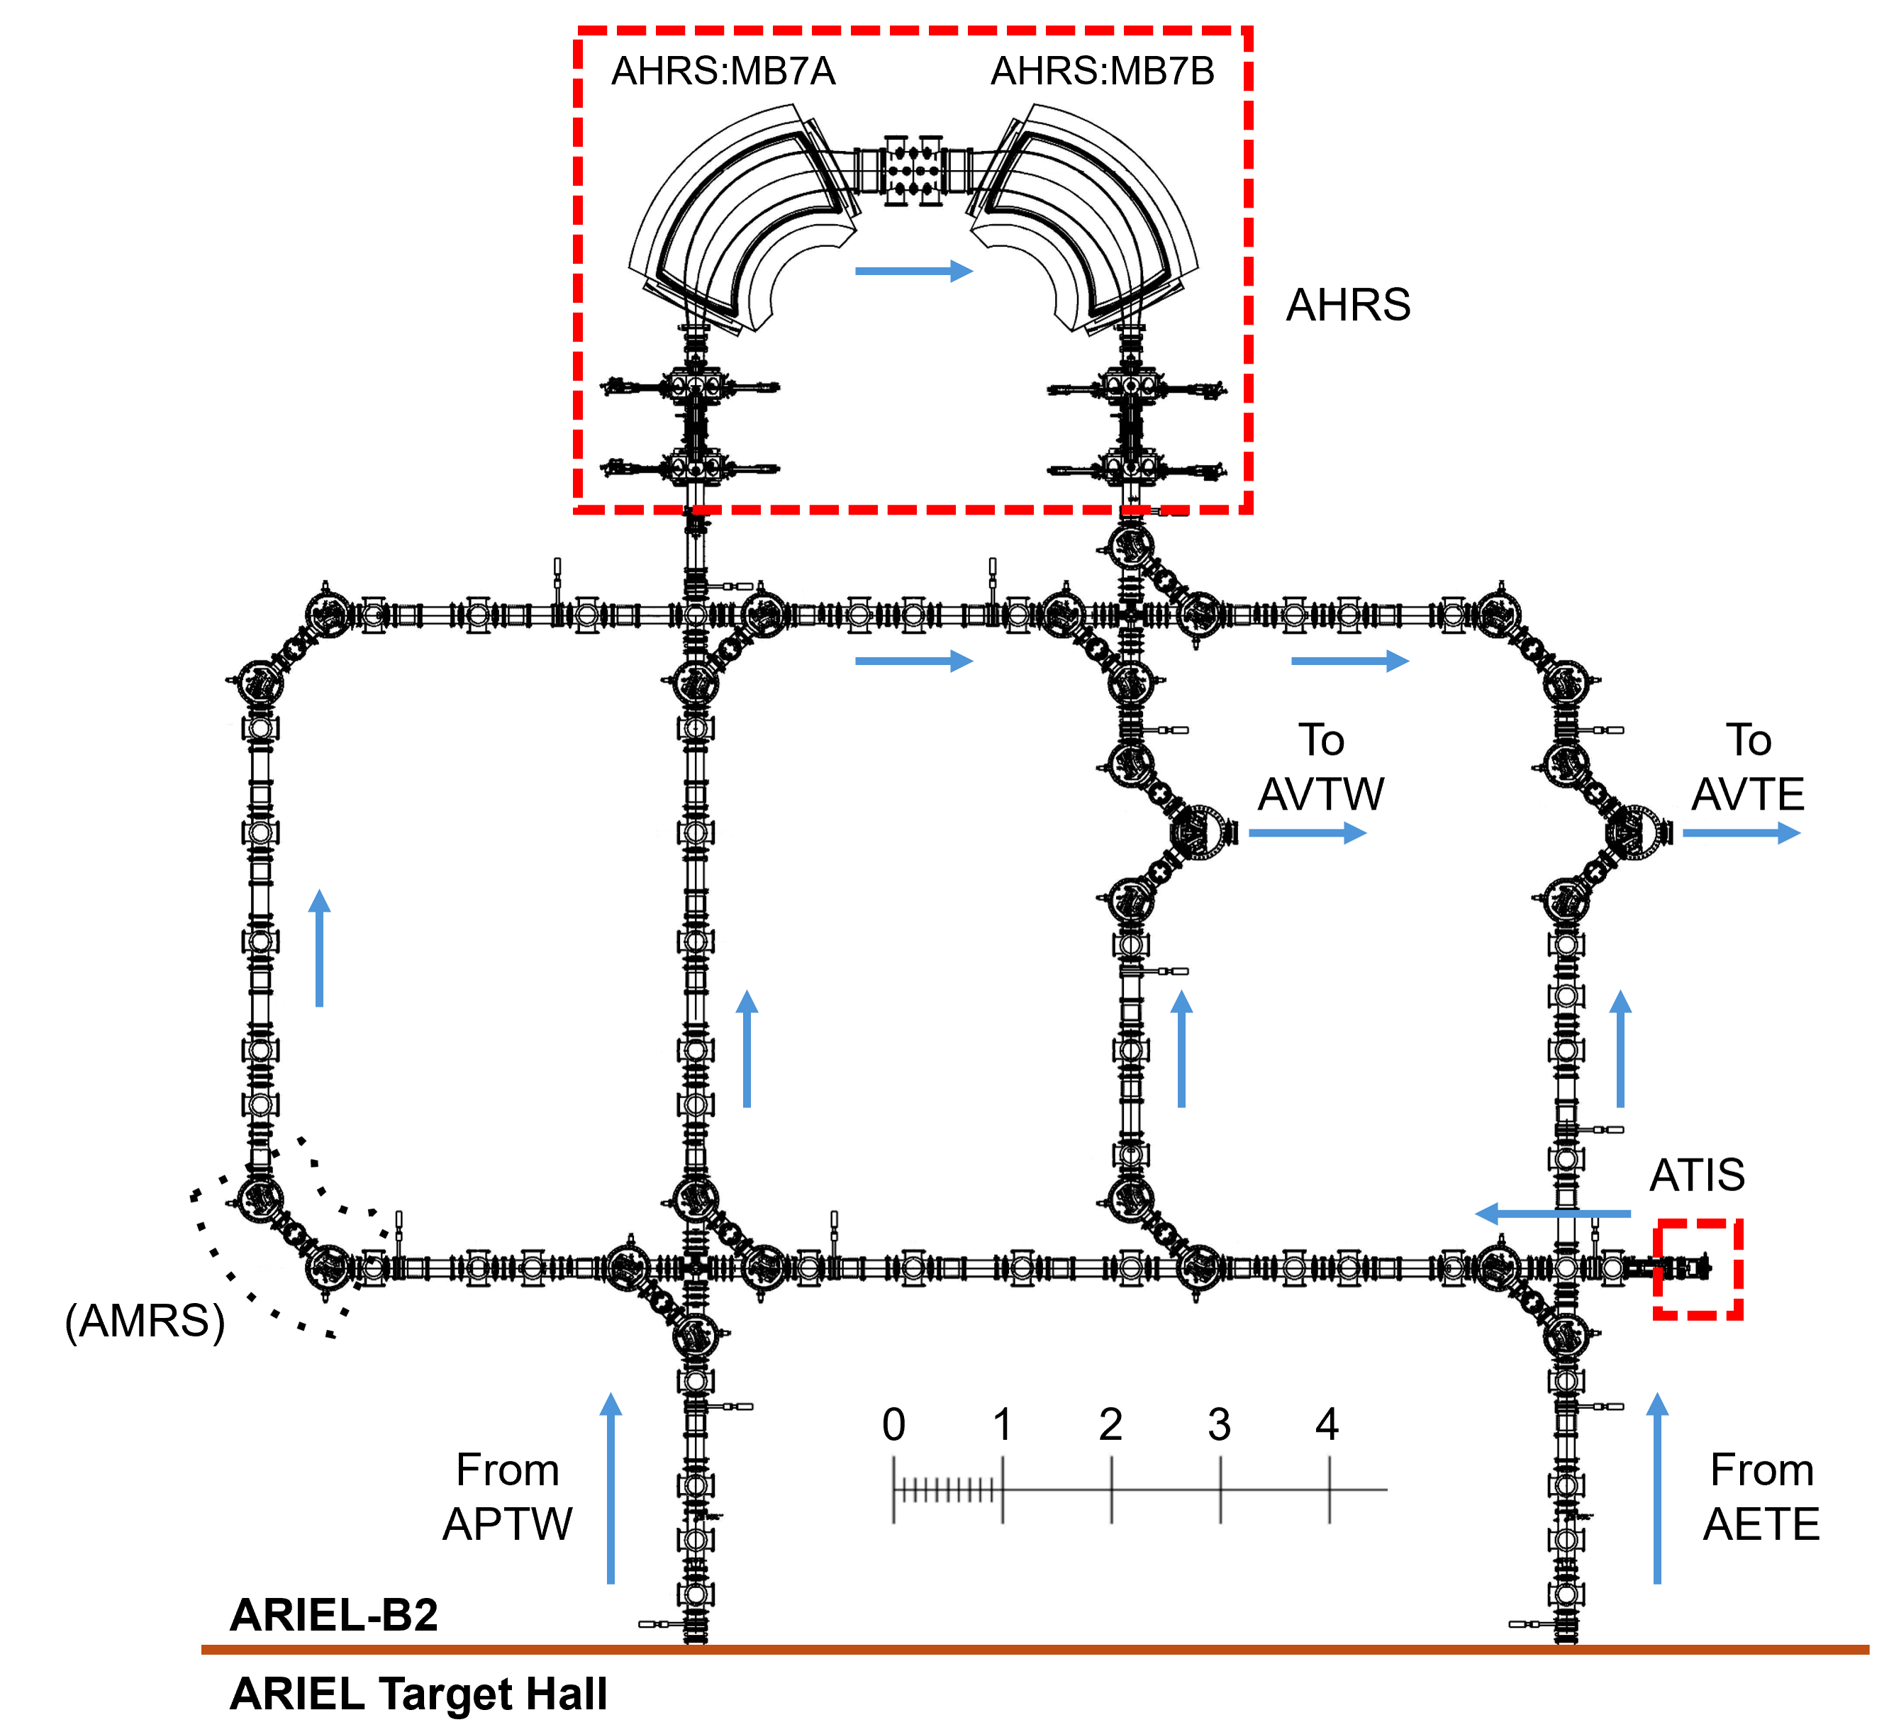
CANREB overview (B2)
ARIEL high resolution separator (AHRS)
Isobaric purification ~1/20,000
Beam is injected into ARIEL-B2 from APTW and AETE
One beam through AHRS, second beam through bypass
ARIEL high resolution separator (AHRS)
  Dual magnetic dipole mass separator
  R ~ 20,000
Beams transported upstairs to ARIEL-G through two vertical riser beamlines spanning ARIEL-B1 (AVTW, AVTE)
Contains ARIEL test ion source (ATIS) → Small surface ion source, alkali elements @ 60 keV maximum
(HRS bypass)

Slide 4
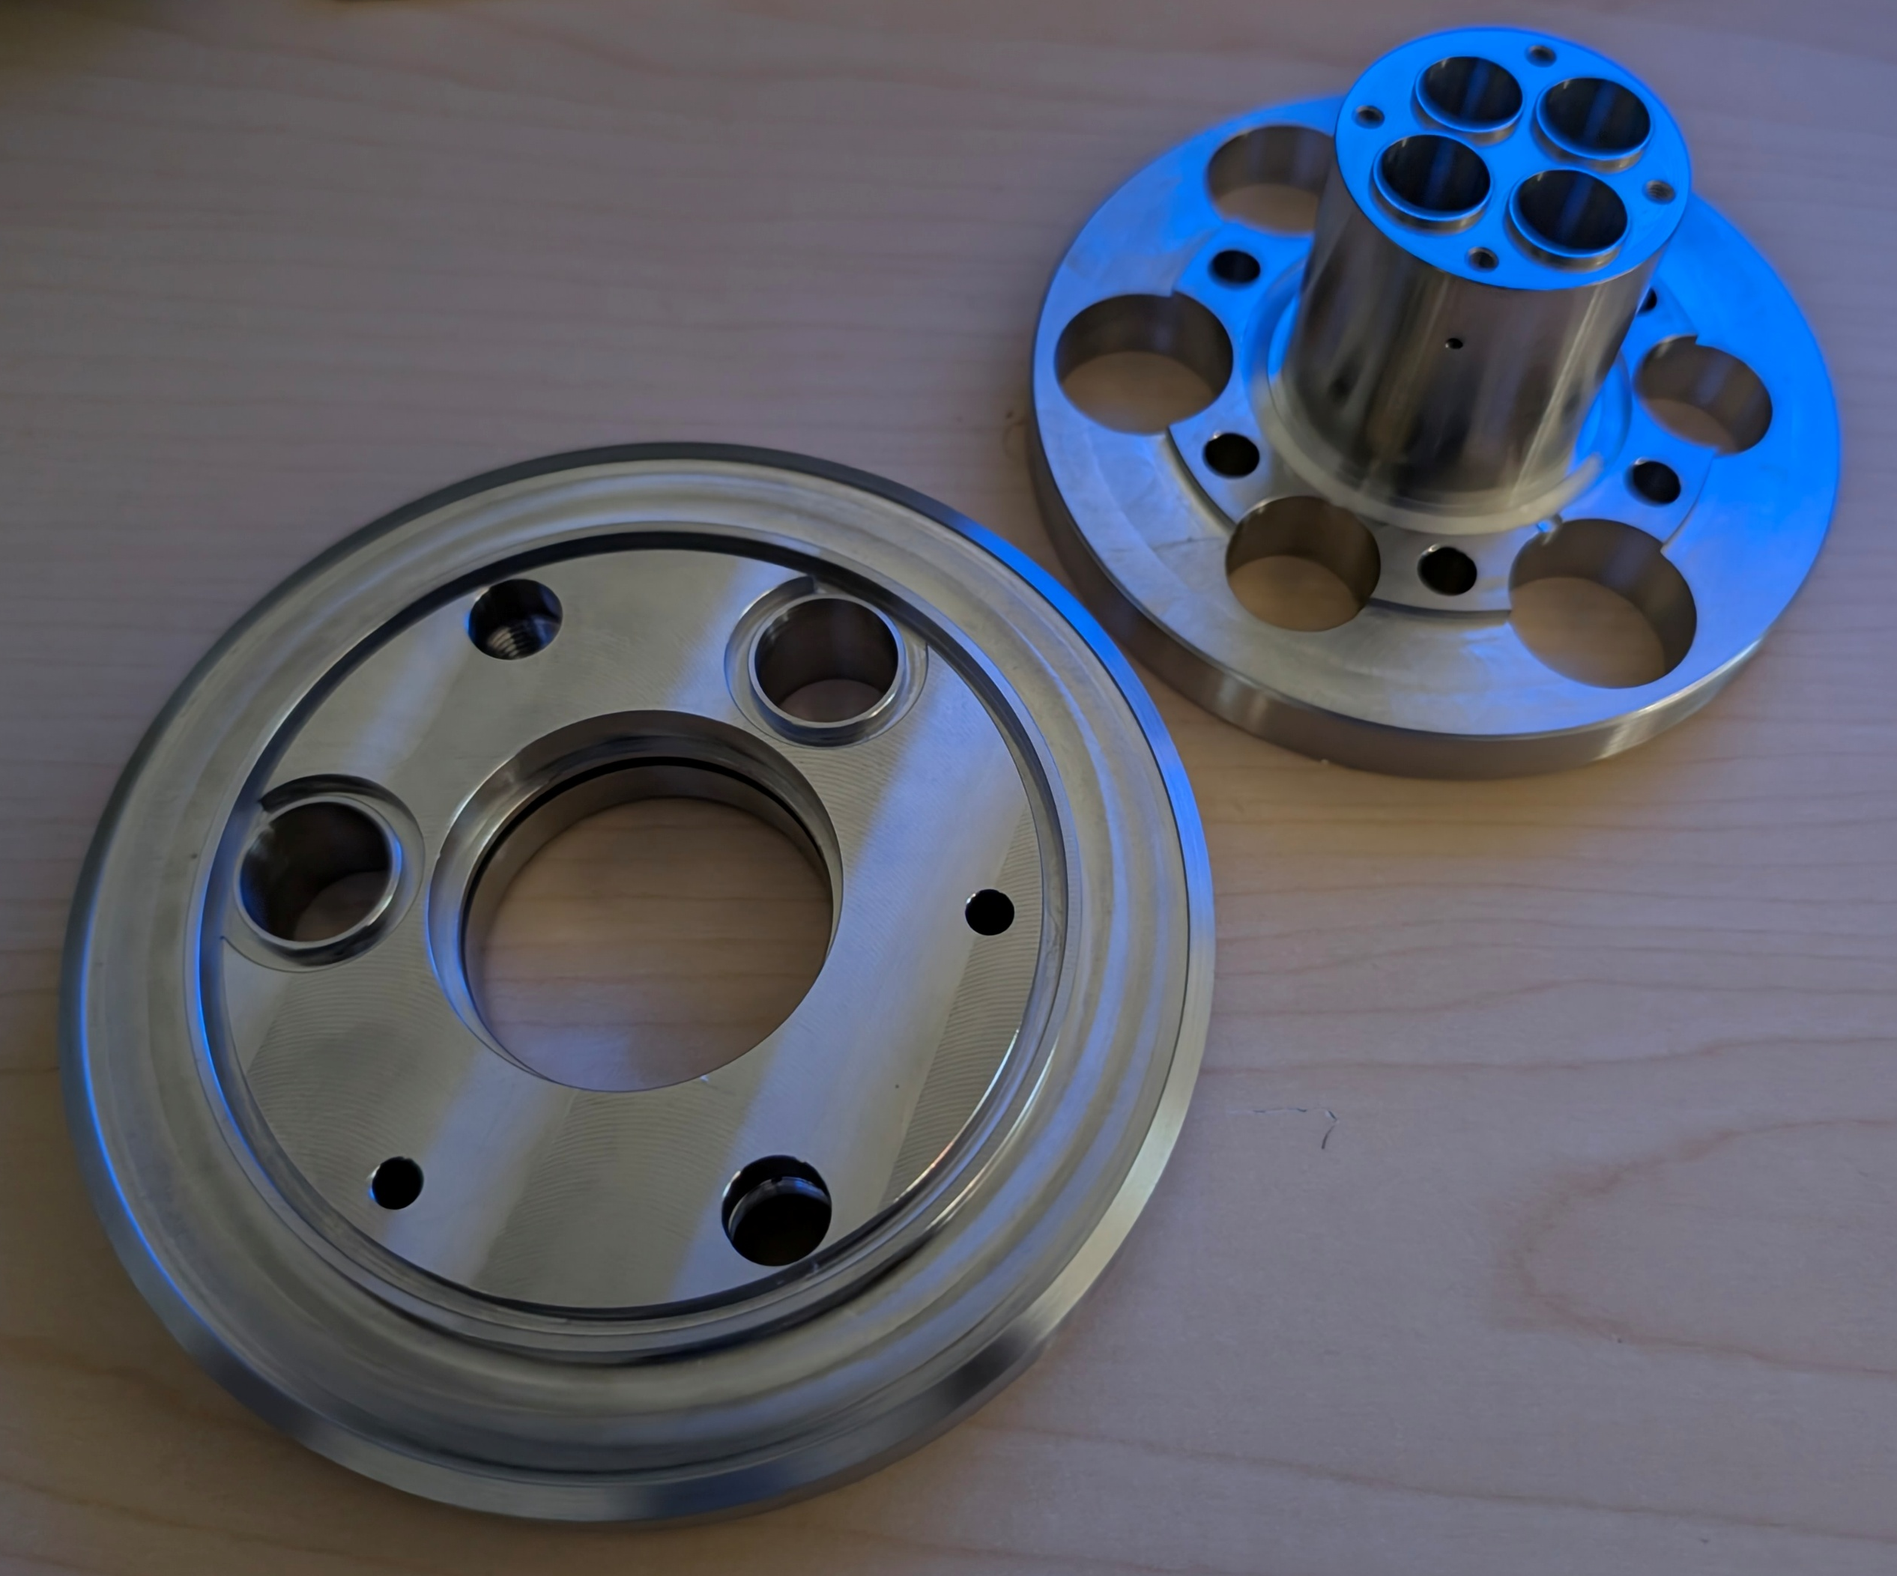
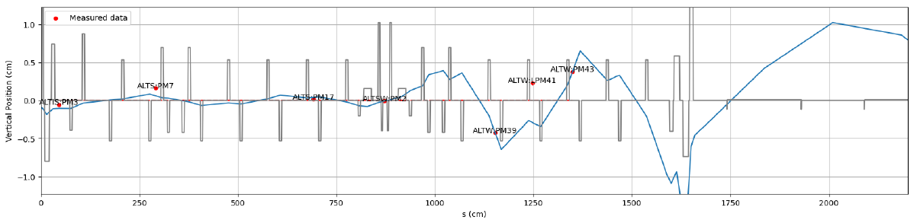
Accomplishments Since Last ASSC Meeting
AHRS commissioning/development
  Beam-based investigations of beamline using corrector scans to validate transport model and injection conditions
  Centering error mainly associated with incoming beam position and angle
  Achievement of required beam-centering tolerance will require improvements to beam centering diagnostics, monitor calibration, and data acquisition
EBIS
  Most e-gun parts (TITAN design) have been fabricated: machine shop got ~80% done before ARIEL surge; remaining pieces will be outsourced
  Conceptual design for e-gun test stand is complete; next steps (final design, procurement, etc.) are underway (also looking to outsource some of it)

Slide 5
Progress on Plans Presented at previous ASSC Meeting
Items required/planned for LS26 (with a focus on installation) to facilitate beam delivery in 2028
  Fabrication & installation of EBIS e-gun → Most pieces completed; order submitted for external fabrication of remaining pieces
  Modification of ARQB optics → Machine characterization and stability testing underway; looking at mitigation options if unsuccessful
    Consistent with charging of insulators near trap extraction → Data points to downstream extraction lens as culprit
    Likely a result of (or at least exacerbated) by ion extraction systematics
    Physical intervention: (a) modify design in region to shield insulators from stray ions, (b) resistive coating of existing insulators to allow for charge dissipation
  Complete ARQB 6 MHz circuit → Some work was done in summer, will resume when RF tech returns
  Complete installation of ARIEL LE beamlines → Waiting for installation of RIB modules
  Fabricate & install HRS HV cage → Work order submitted to Machine Shop; fabrication and installation resource dependent
  Replace Sikler lens → On hold: lens testing and systematics will be done when EBIS beam is available, but this is a more long-term item
Additional tasks, including commissioning and performance ramp-up, will depend on availability of ion beam through LS26 → ARQB activities are underway right now. AHRS commissioning/development on hold due to hardware issues (next slide).

Slide 6
Major Risks, Issues, Concerns
Risk | Mitigation
EBIS HV stability insufficient for beam delivery | Systematic testing underway to determine operational limits
New e-gun design cannot reach required performance | Design will be validated offline
Beam instability from RFQ cooler buncher (possibly due to charging insulators) | Testing underway to try and pin down systematics Consider physical modifications if mitigation strategy insufficient
AHRS commissioning/development delayed | A turbopump failed catastrophically and spread debris through a diagnostic box Some devices will be pulled and cleaned/replaced (already started)

Slide 7
LS 26
Remaining assembly & installation items for LS26
  Completion of e-gun fabrication and assembly
  E-gun test stand: final design, design review, procurement, assembly, etc.
  Late 2026/early 2027: assembly and offline testing of e-gun
  Early 2027 (LS26 or SAS): assembly of remaining low-energy beamlines

Slide 8
Gate 3 Readiness
Report from 2025 G3 reaffirmation
Gate 3 RA item | Status/Comments
Need to have a plan to convince users that in 2028 they will have beams from the CANREB EBIS. | Working on a detailed plan for recommissioning and development activities in 2027. Focus on “must haves” for beam delivery and add other items to the mid/long-term roadmap (next slide). Determine criteria for successful completion of Gate 4B.
If the repair of the EBIS fails, how would a “Plan B” look like? Outline troubles in the past, the path forward, and potential limitations and what it means for reaccelerated beam delivery.
Timeline for the whole EBIS project is not detailed.
Risk registry was not updated and no lessons learnt was provided.
The Gate 4A review will be with the new EBIS gun. | We will have a second Gate 4A to discuss framework for remaining CANREB development.
It was not presented if an engineer is involved and has taken responsibility for the installation of the gun test stand. | We will have a design review and ensure proper mechanical & electrical concerns are addressed.

Slide 9
EBIS development overview
Once EBIS hardware is in place, plan is as follows:
  Commissioning of e-gun in EBIS → Transport through main magnet to collector (initial commissioning will be done “offline” without a magnetic field)
  Recommissioning of EBIS → Need to reestablish basic charge breeding operating with new e-gun
  Core EBIS development:
    Goal: Develop foundational (systematic) understanding of EBIS + CANREB operation in preparation for further development and beam delivery (prioritize must-haves for delivery)
    Solidify trapping scheme → Previous operation showed odd charge state distributions (CSD) (e.g. bimodal structure, odd behaviour of distribution with charge breeding time, etc.) → Likely due to modification of trap potentials with space charge and/or poor ion/electron overlap
    Injection & extraction tune investigation → Investigation of Sikler lens behaviour, energy matching using APDT, emittance matching into RIB transport, etc.
    Characterization of ionization factor (J-tau) → Figure of merit for EBIS; this will give us knobs to turn to control current density, peak of CSD, breeding efficiencies, etc.
  Further development:
    Pulse stretching (to reduce instantaneous intensity at experiment) (already demonstrated)
    Closed shell breeding (can be used to in some cases to increase breeding efficiency and possibly beam cleaning), etc.

Slide 10
Plans and Objectives for the Next 6 Months
Final assembly of electron gun and design validation using offline testing to Faraday cup
Recommissioning of EBIS with new electron gun
Characterize ARQB extraction and determine requirements for stability, including physical mitigation strategies
AHRS commissioning and development – push towards 20,000 and develop operational procedures
Installation of remaining RIB transport sections (including low-energy ISAC tie-in)
Finish development of ARQB 6 MHz circuit

Slide 11
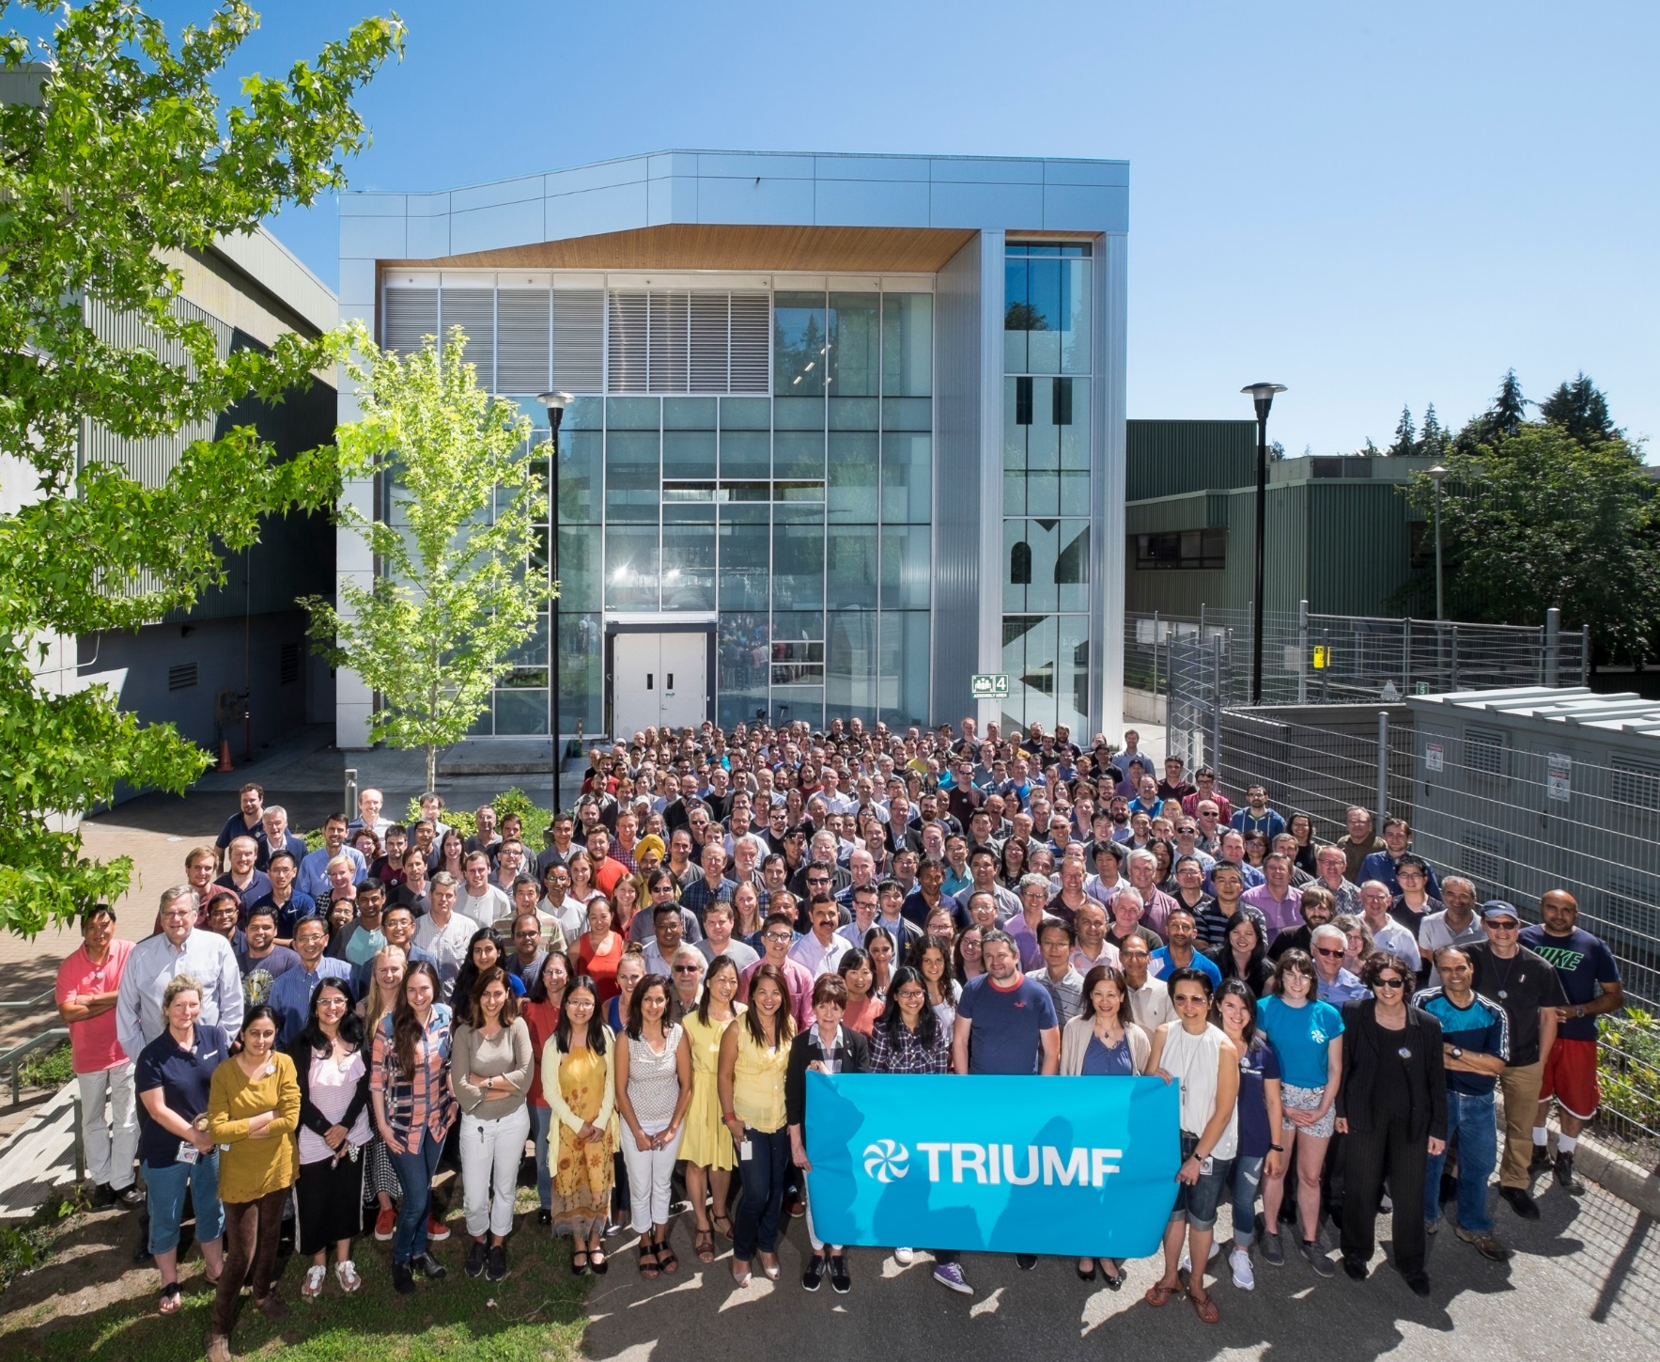




Thank you
Merci
www.triumf.ca
Follow us @TRIUMFLab
Discovery,
accelerated

