Slide 1
P355
ARIEL Laboratories
ASSC Fall 2026
Oct 1-2, 2026
Project Leader:
Peter Kunz
Project Integrator:
Keyur Chauhan

Slide 2
Intro: P355
WBS | Name | Location
3.1 | ARIEL Conventional Chemistry (Cold) Lab | ARIEL G-04
3.4 | ARIEL Actinide Radiochemistry (Hot)Lab | ARIEL B1-05
3.2 | ARIEL Target Assembly Lab | ISAC1 B1-07
3.3 | ARIEL Yield Station | Yield Station Enclosure
P355 Team
Aaron Schmidt
Brady Borrmann
Darwin Ortiz Rosales
Marla Cervantes
Ferran Boix Pamies
Keyur Chauhan
Peter Kunz
Aim:
AIREL laboratories commissioned and ready for operation by end of 2026.
Planning – Procurement – Documentations – Installations – Commissioning

Slide 3
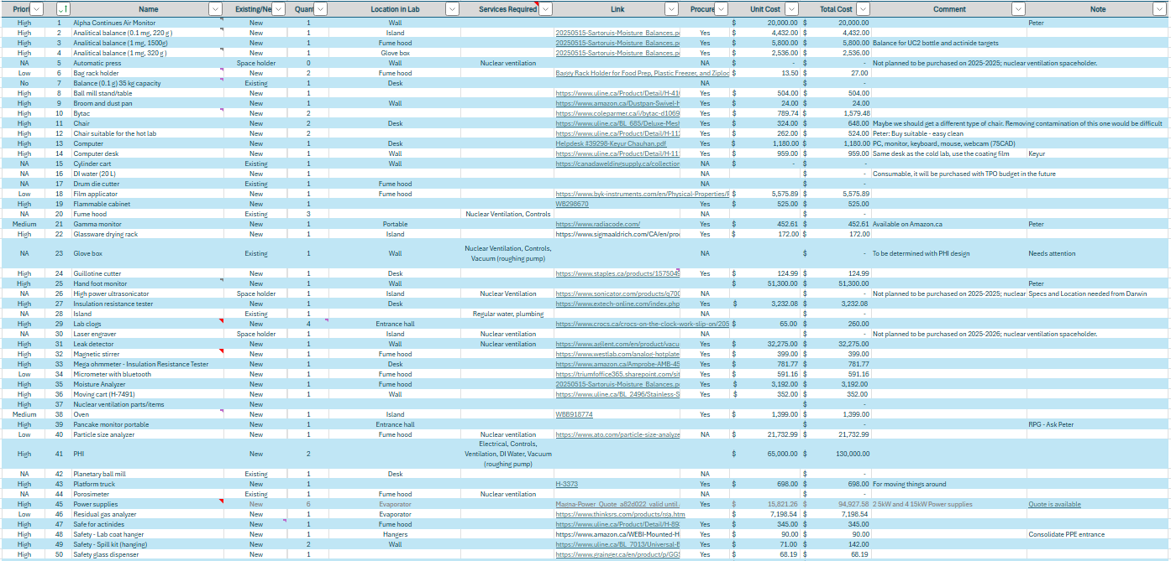
Accomplishments Since Last ASSC Meeting: Procurement
P355 Budget Allocation
$1M in Apr 2025.
Aim: Spend FY25/26 70%
First goal achieved through procurement: Task successfully completed as planned
  Equipment
  Storage
  Furniture
Procurement List
Spent 66% through FY25/26 procurement and left with 34% for the remaining scope.
ARIEL Labs:
Actinide Radio-chemistry lab, Conventional Chemistry lab, Assembly lab

Slide 4
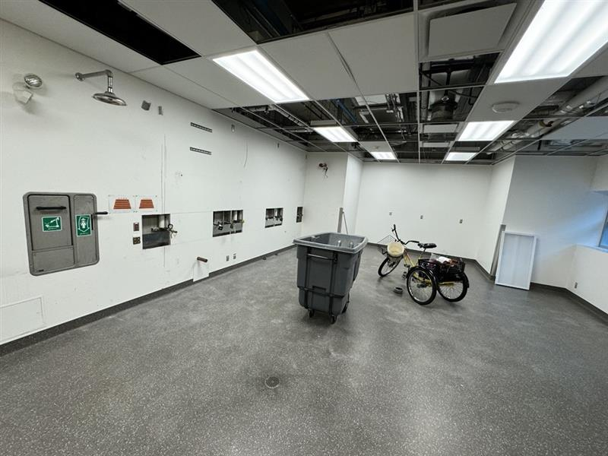
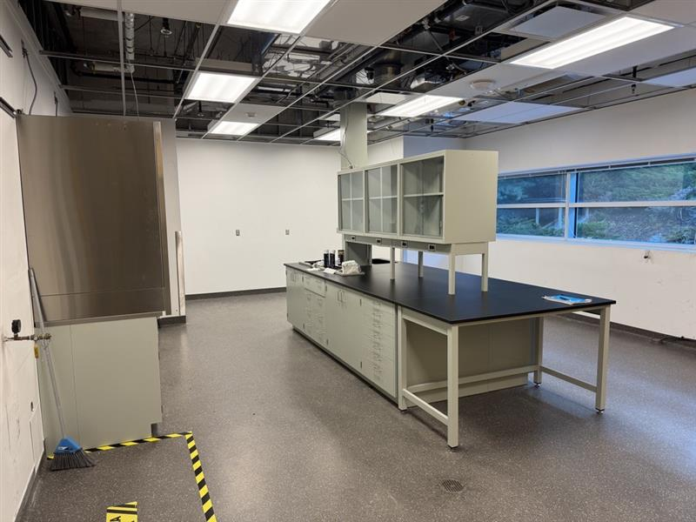
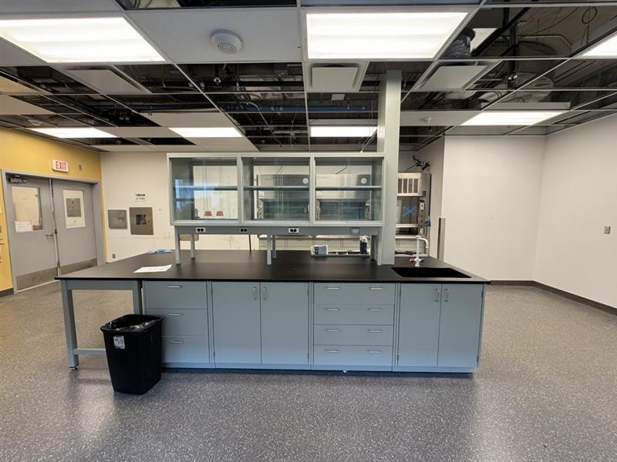
Accomplishments Since Last ASSC Meeting: Procurement
ARIEL Cold Lab @beginning
ARIEL Cold Lab – Island & Fume hoods installed
ARIEL Cold Lab – Island & Fume hoods installed
ARIEL Cold Lab – After procurement
ARIEL Cold Lab – After procurement
ARIEL Cold Lab – After procurement

Slide 5
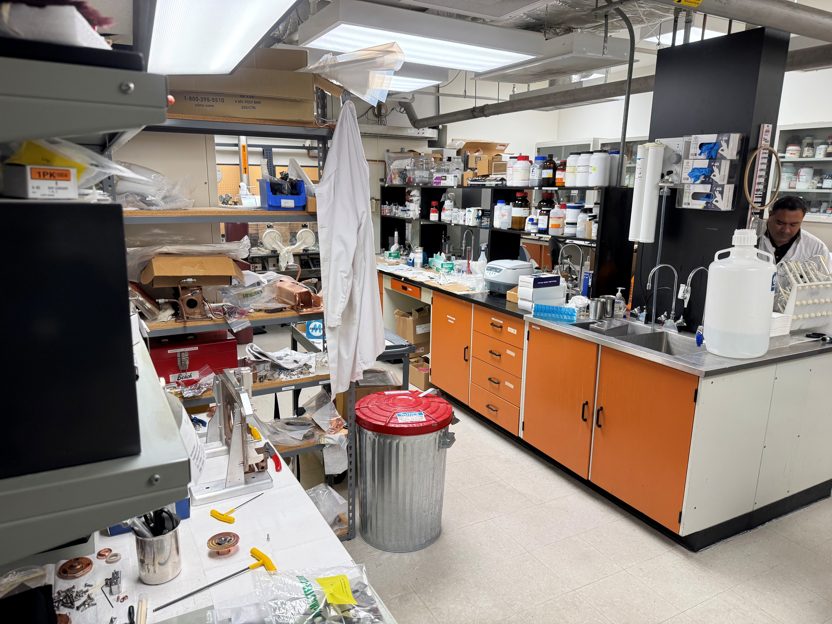
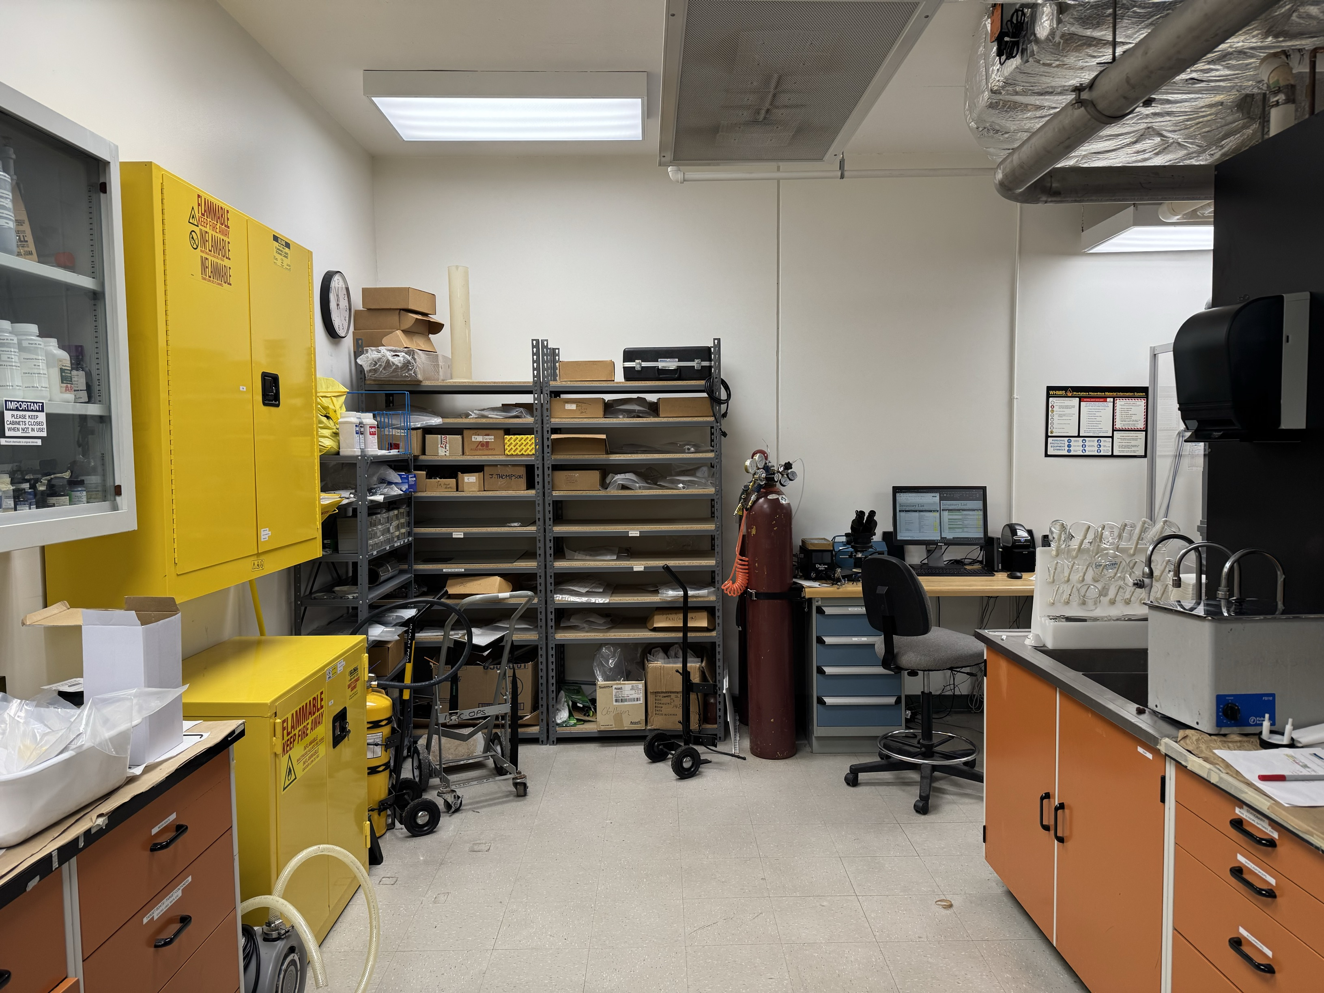
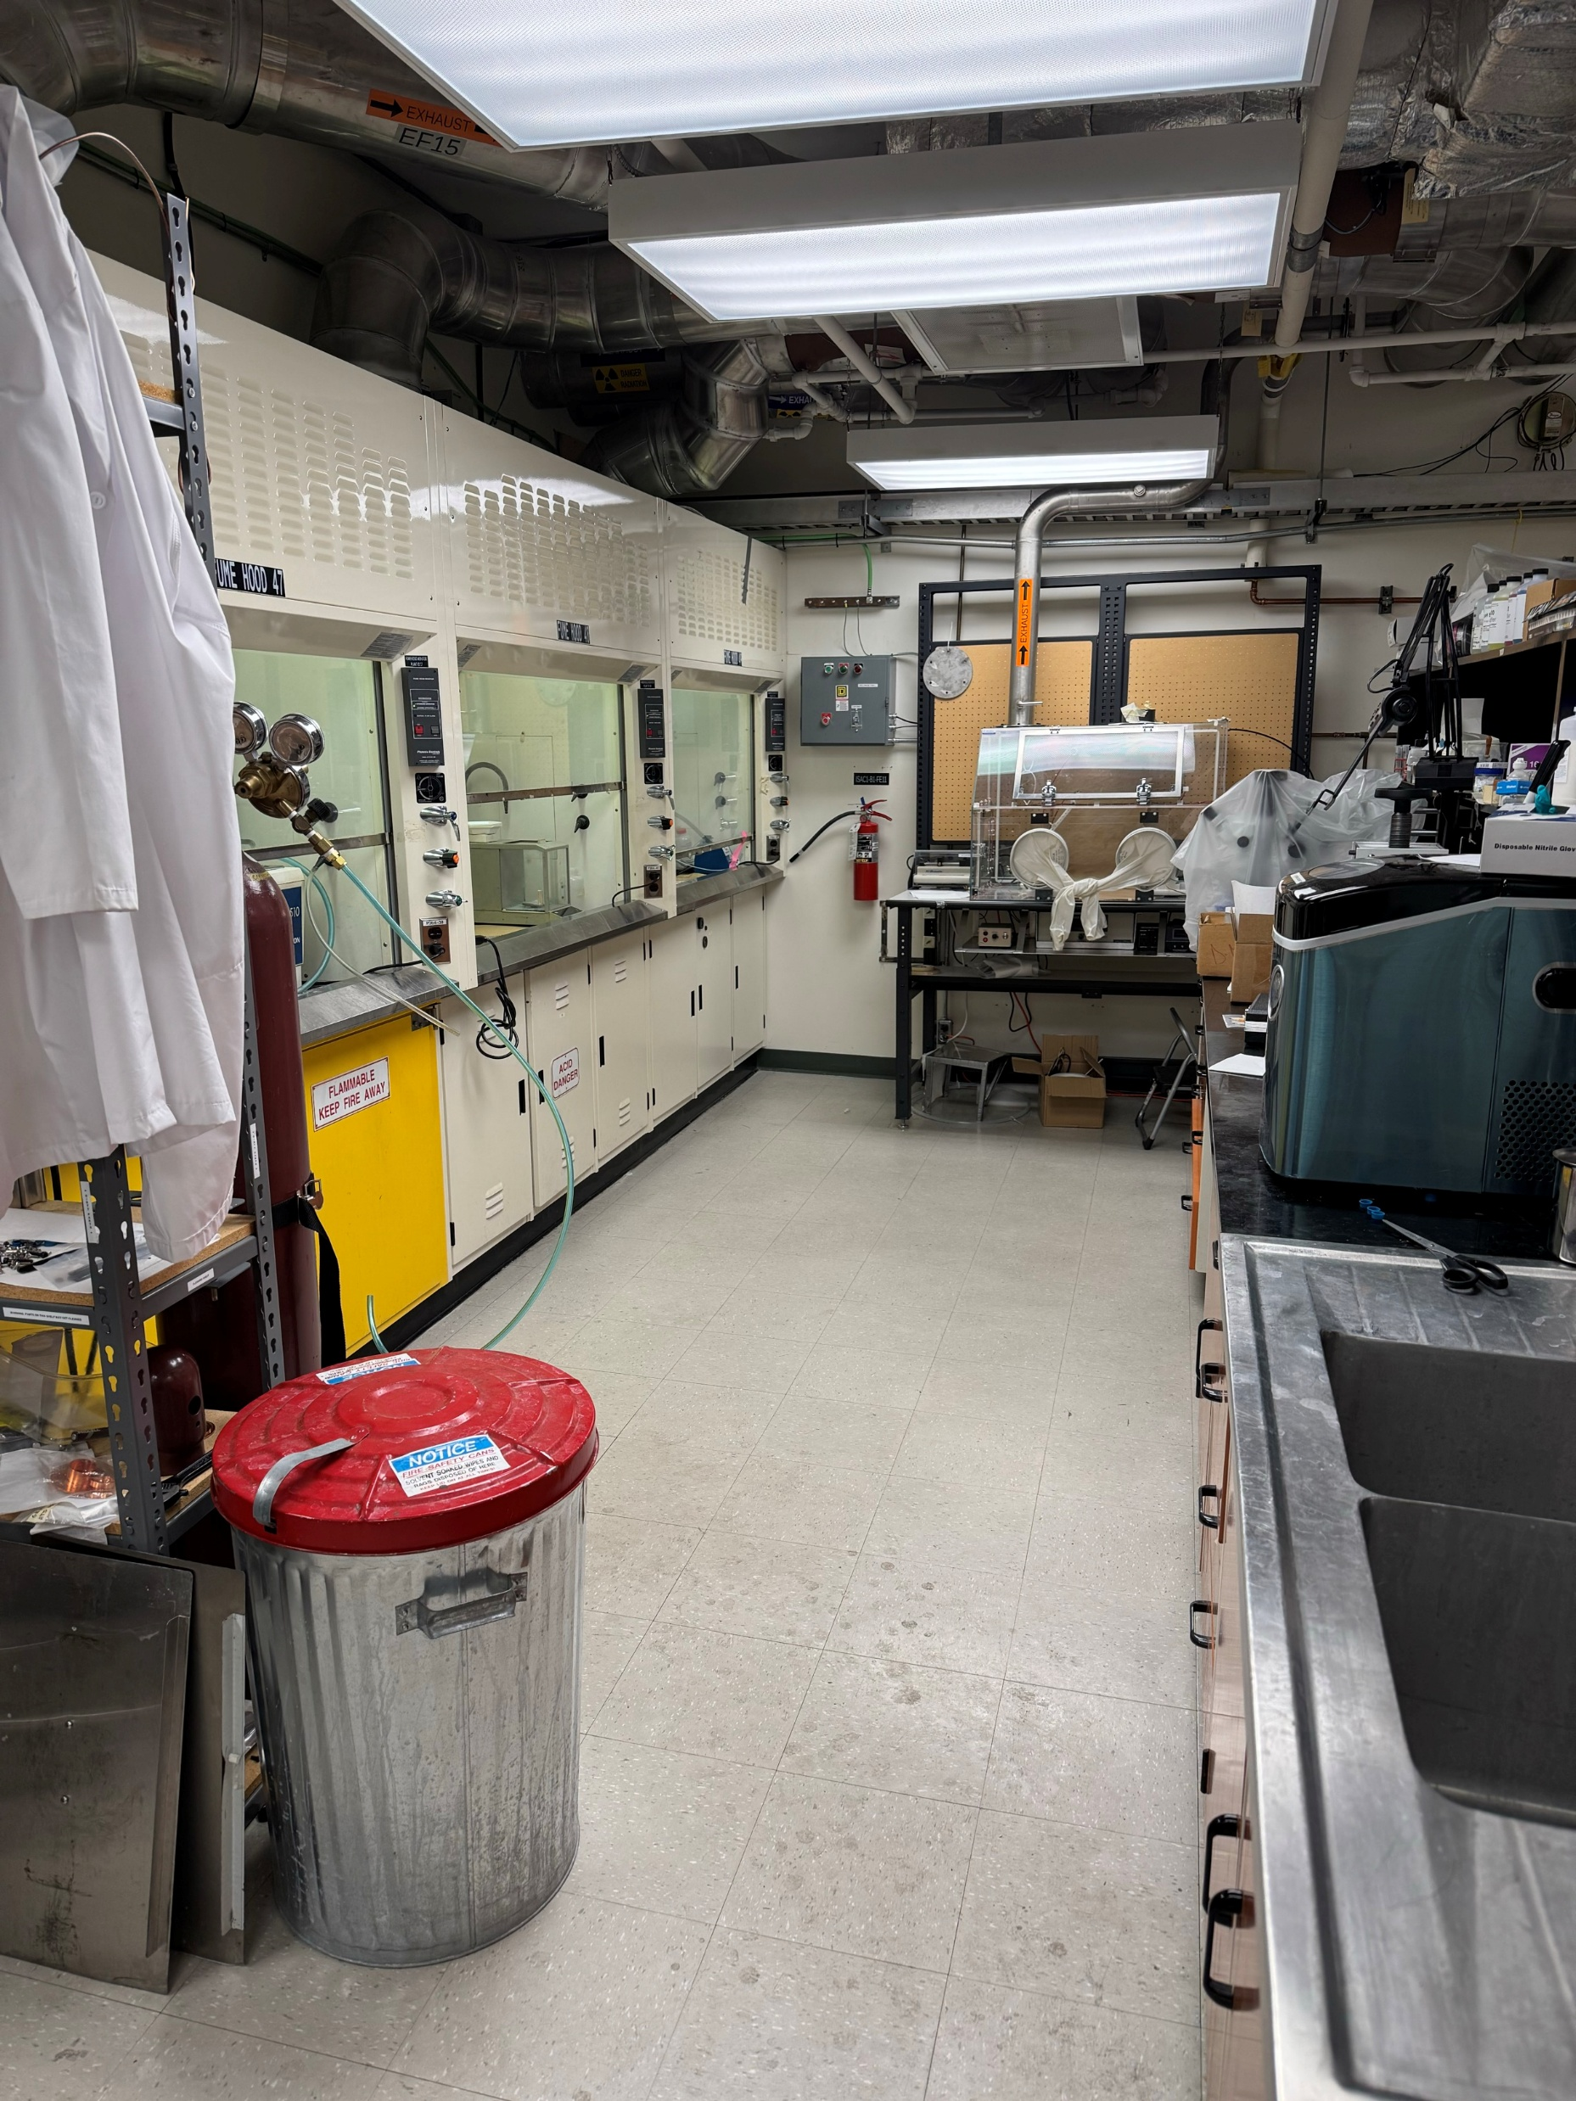
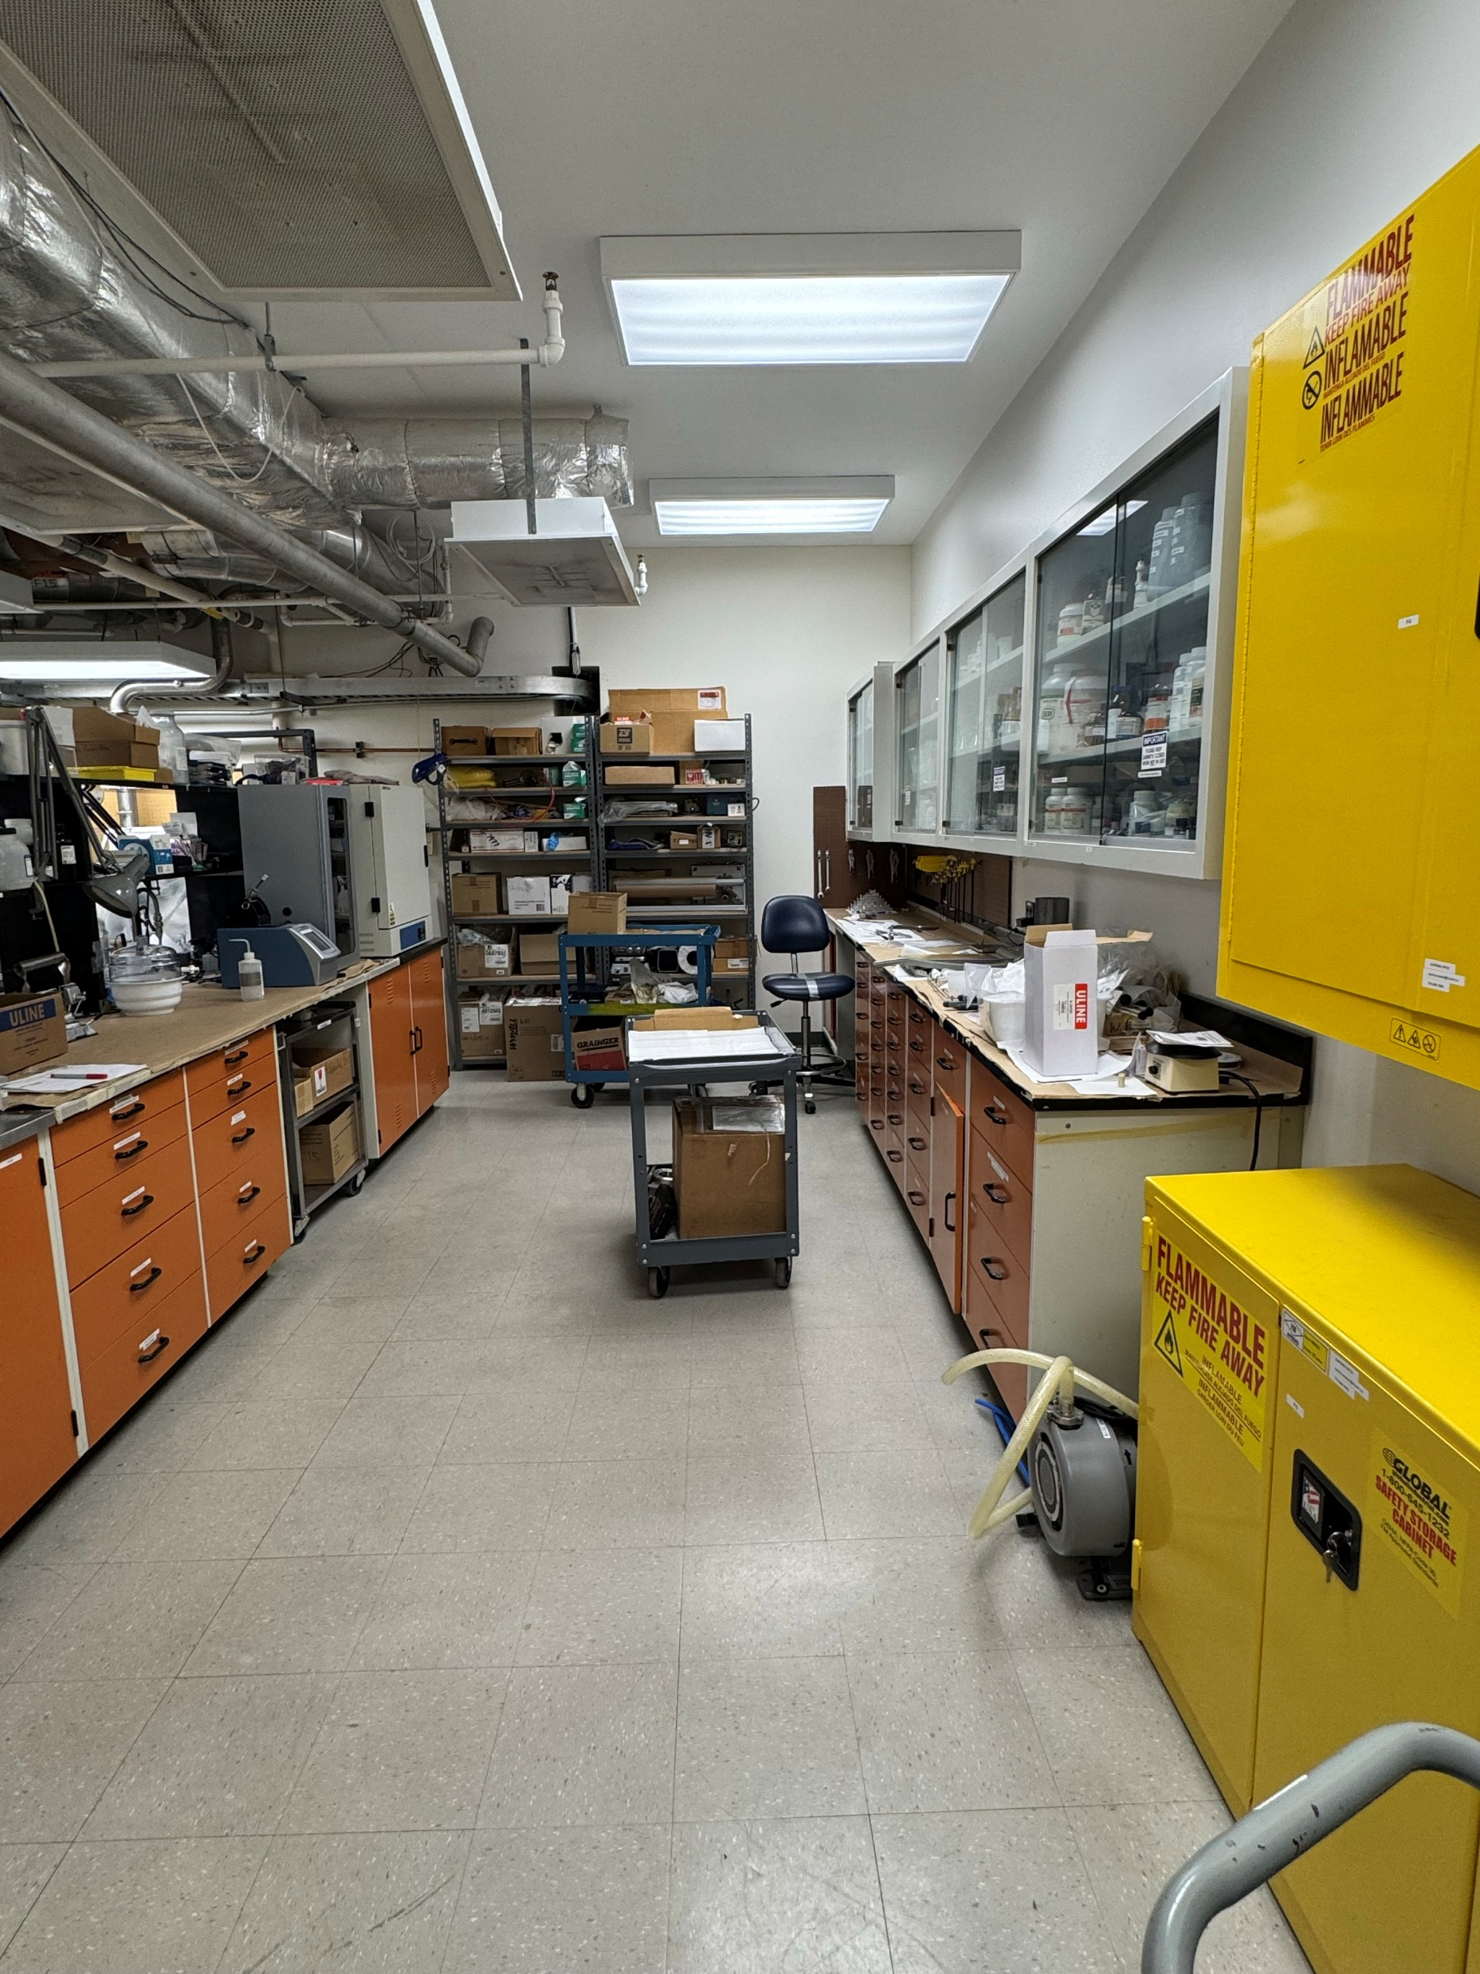
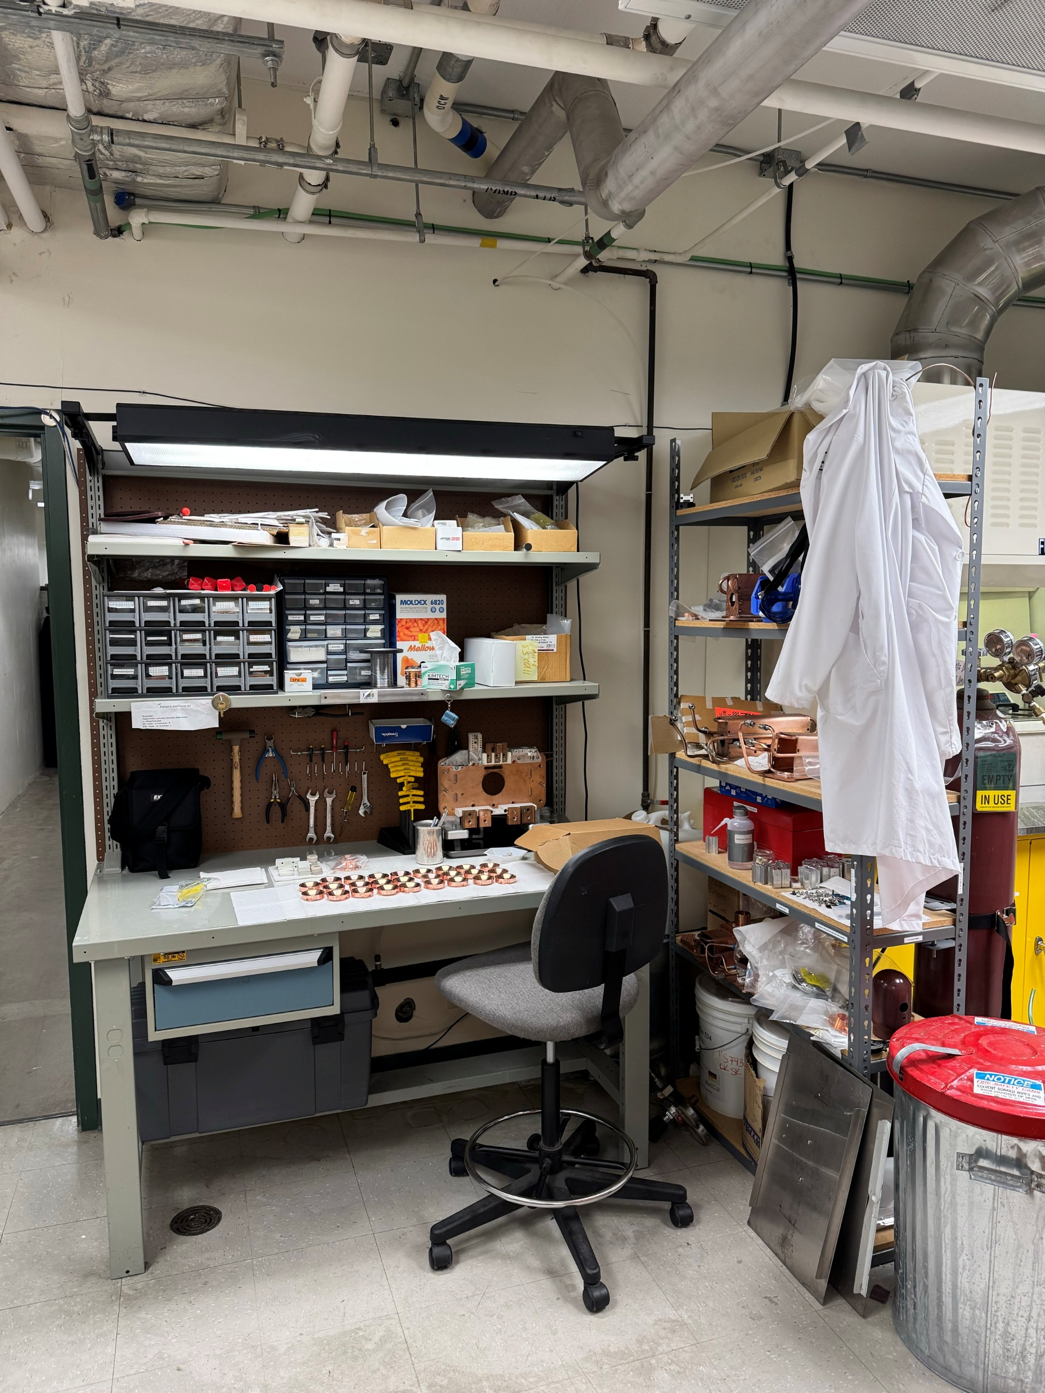
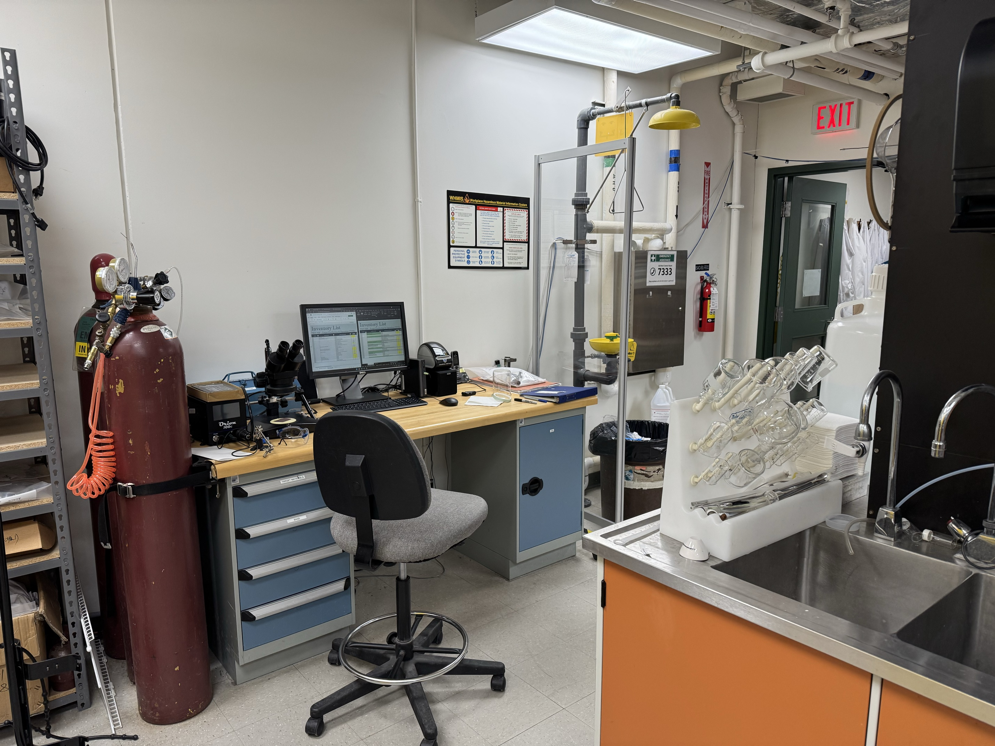
Accomplishments Since Last ASSC Meeting: ISAC Cold Lab Renovations
Assembly lab Prep:
  Hazardous conventional chemical lab Assembly lab
  Decommission
  Renovate
  Commission as a brand-new Assembly lab
ISAC Cold Lab – Before renovations
ISAC Cold Lab – Before renovations
ISAC Cold Lab – Before renovations

Slide 6
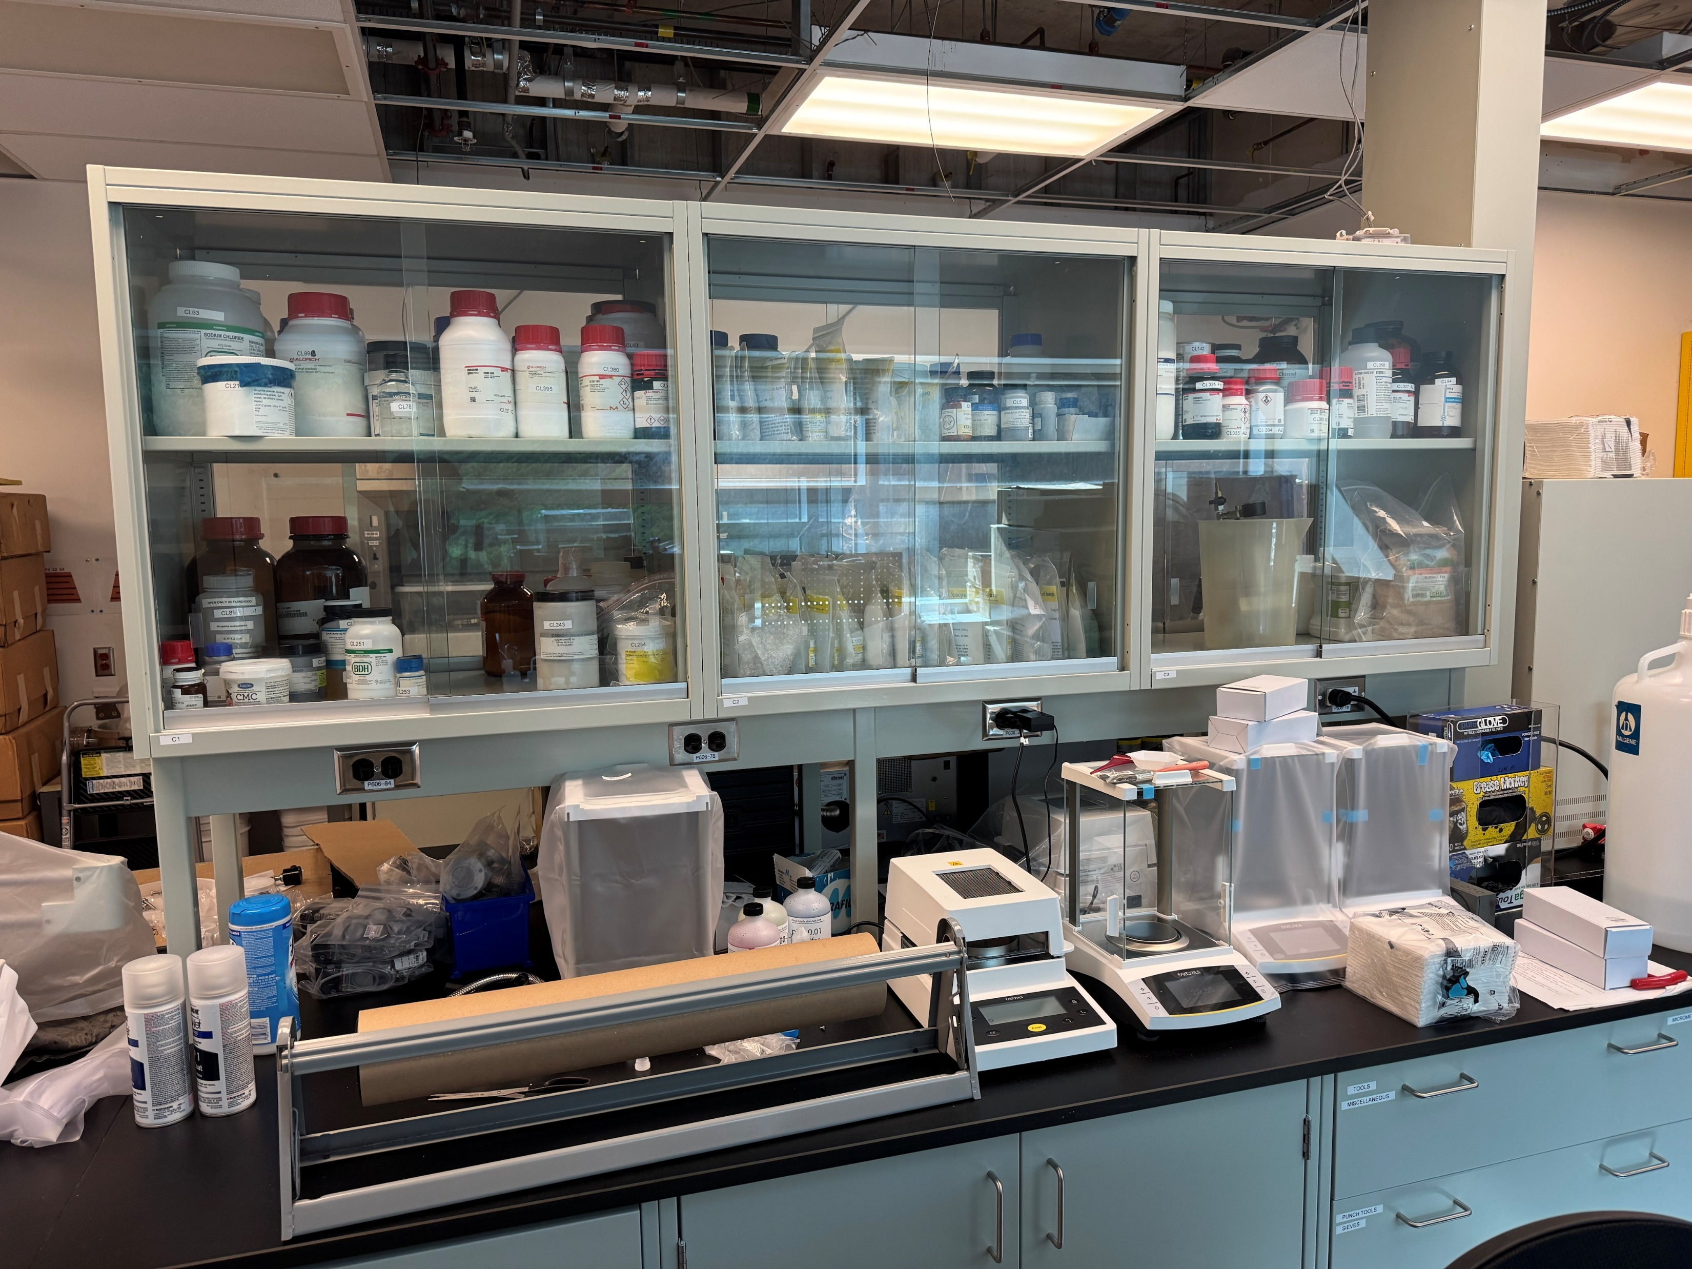
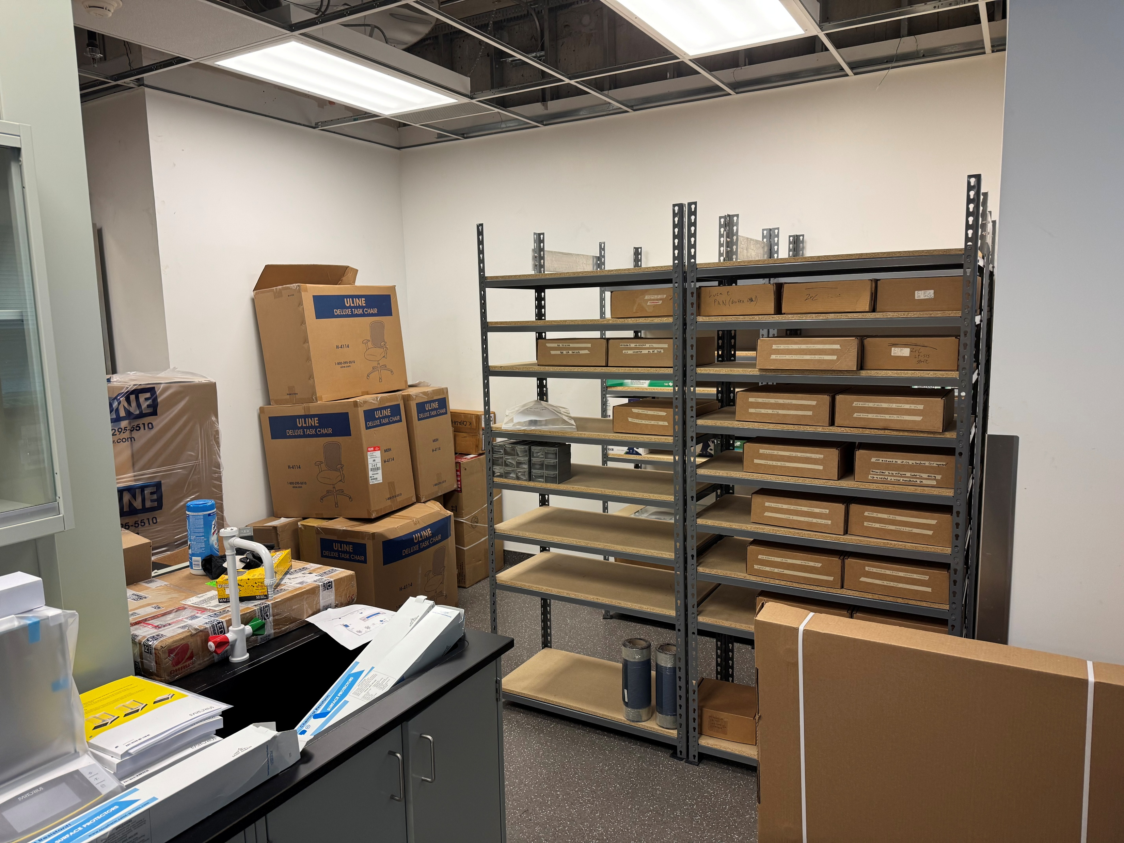
Accomplishments Since Last ASSC Meeting: ISAC Cold Lab Renovations
Moved – Chemicals and inventory
Lab move:
  Chemicals
  Equipment
  Storage
  Inventory
  Other items
Moved – Chemicals and inventory

Slide 7
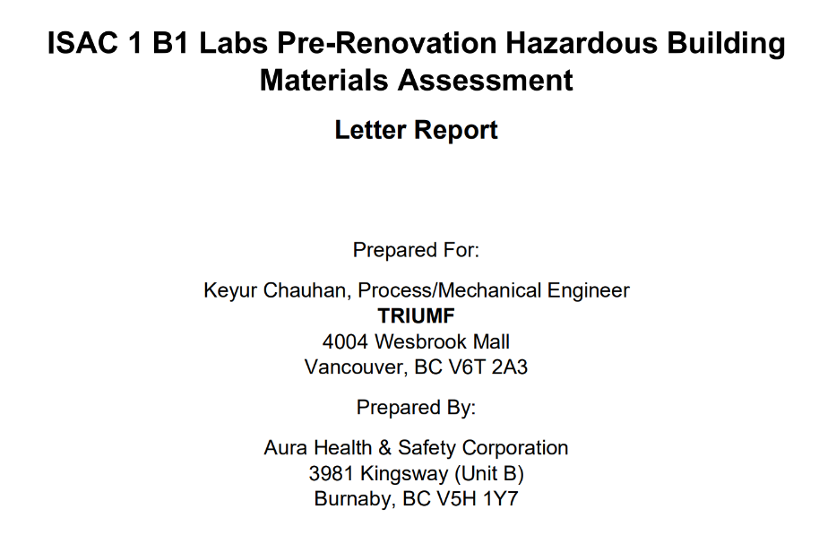
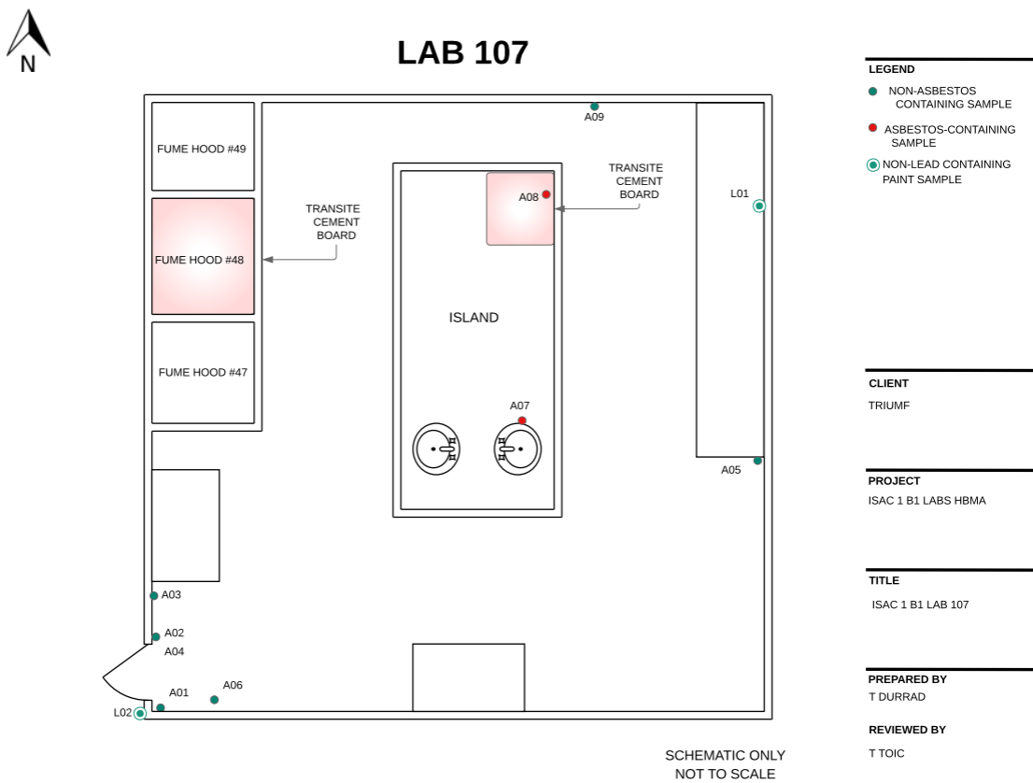
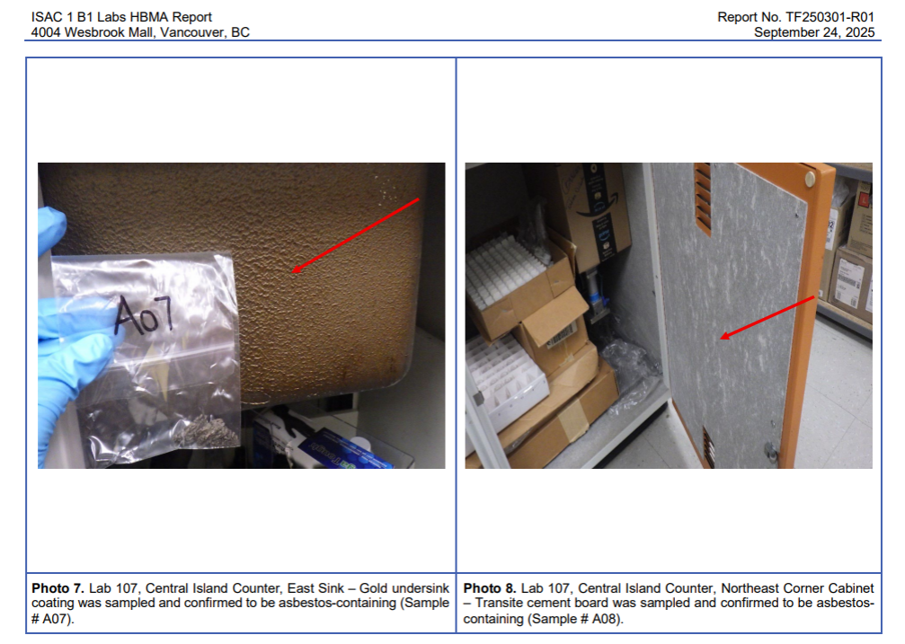
Accomplishments Since Last ASSC Meeting: ISAC Cold Lab Renovations
Hazmat Test & Abatement (contractors):
  Following WorkSafeBC and OH&S regulations: Hazardous Material Testing
  Asbestos found
  Abatement: using the certified abatement contractors
  Certificate issued for renovations to begin
Asbestos Detection
Asbestos Detection

Slide 8
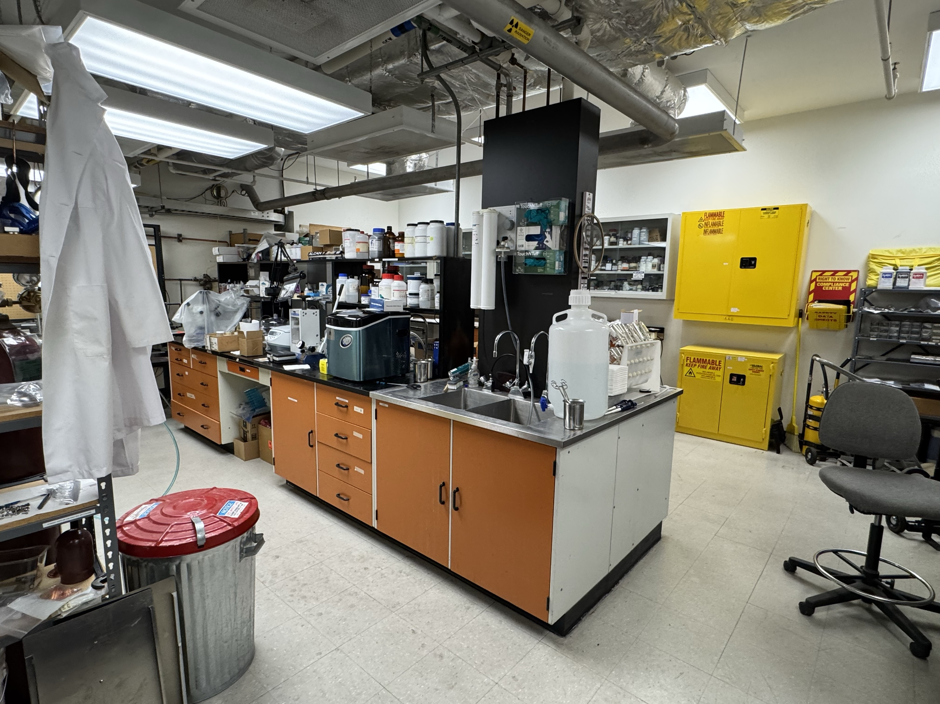
Accomplishments Since Last ASSC Meeting: ISAC Cold Lab Renovations
Fume hoods &
Glovebox
Decommissioning (contractors):
  Uninstalled: Fume hoods, Glovebox
  Disconnected: Mechanical, Electrical Services
  Disposed unwanted furniture and items
Island

Slide 9
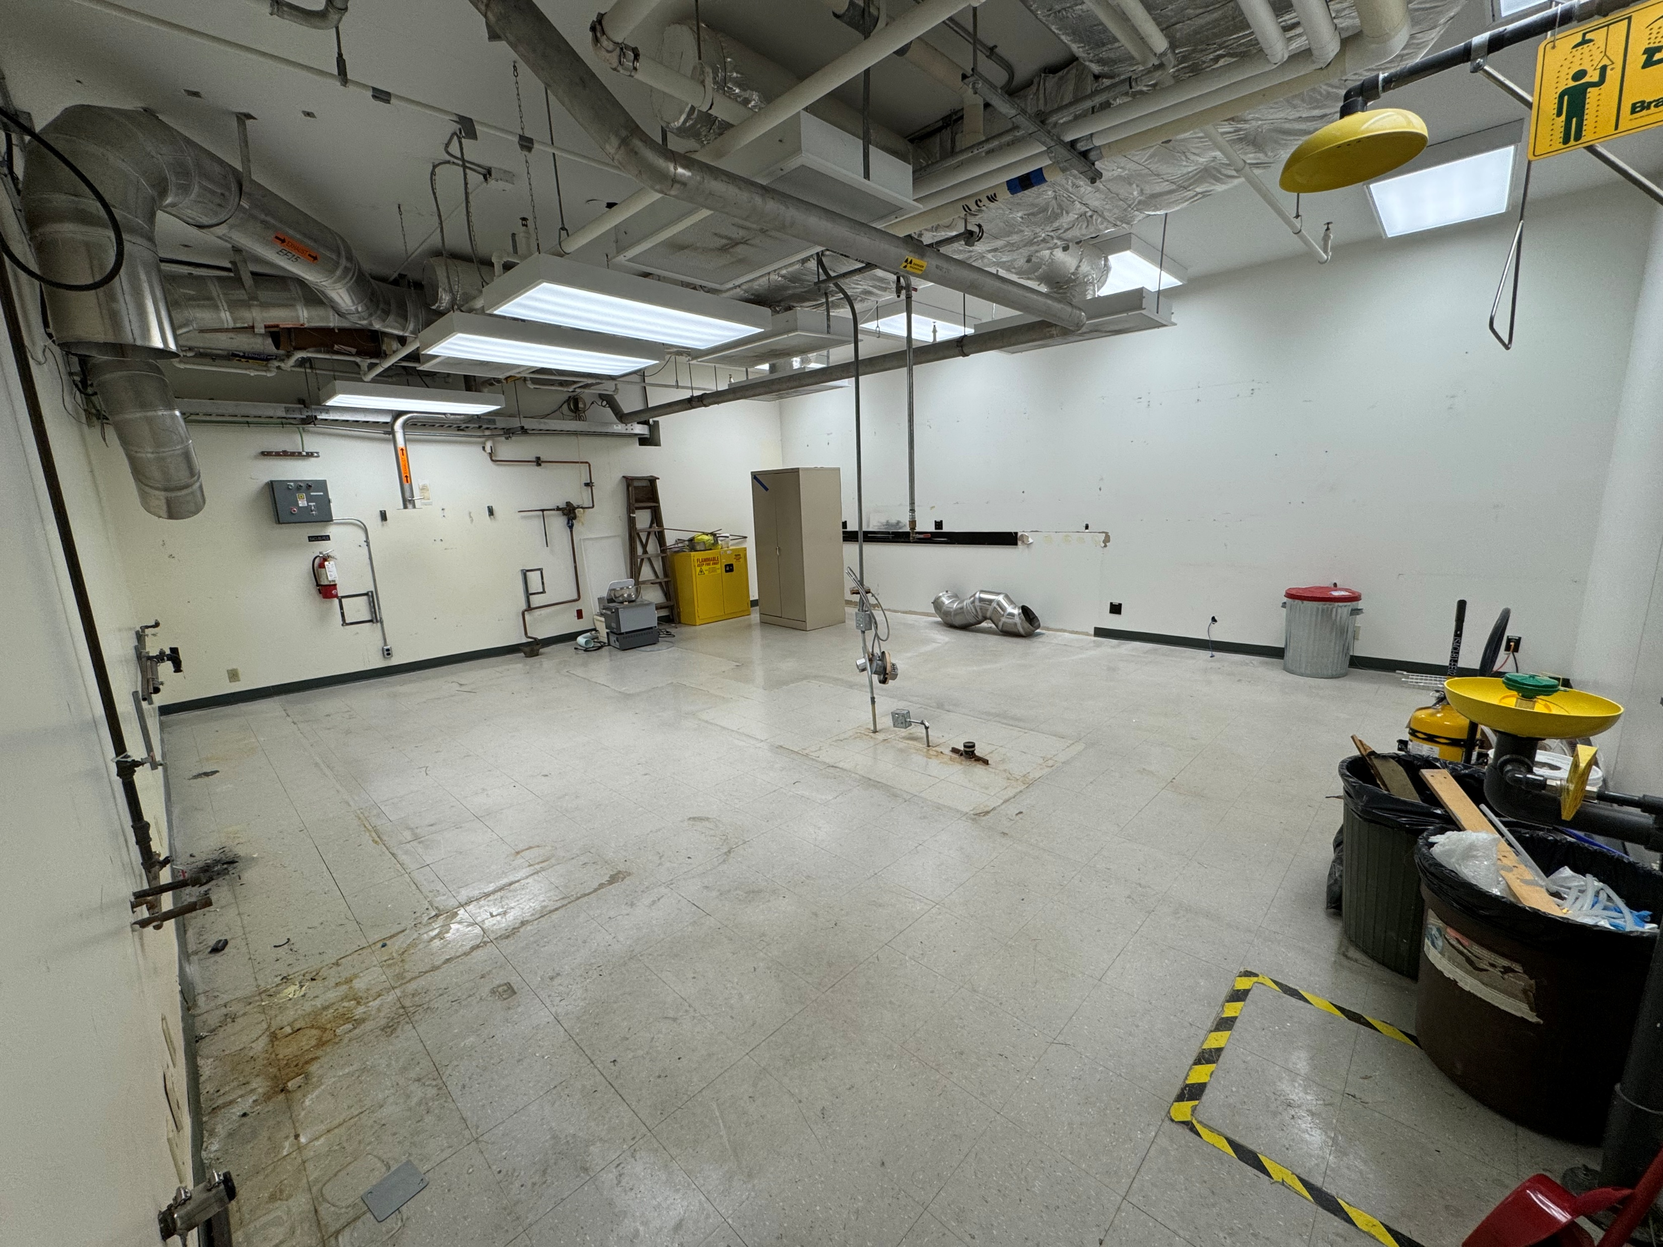
Accomplishments Since Last ASSC Meeting: ISAC Cold Lab Renovations
Before/After Decommissioning:
All set
for
the Renovations
Before Decommissioning
After Decommissioning

Slide 10
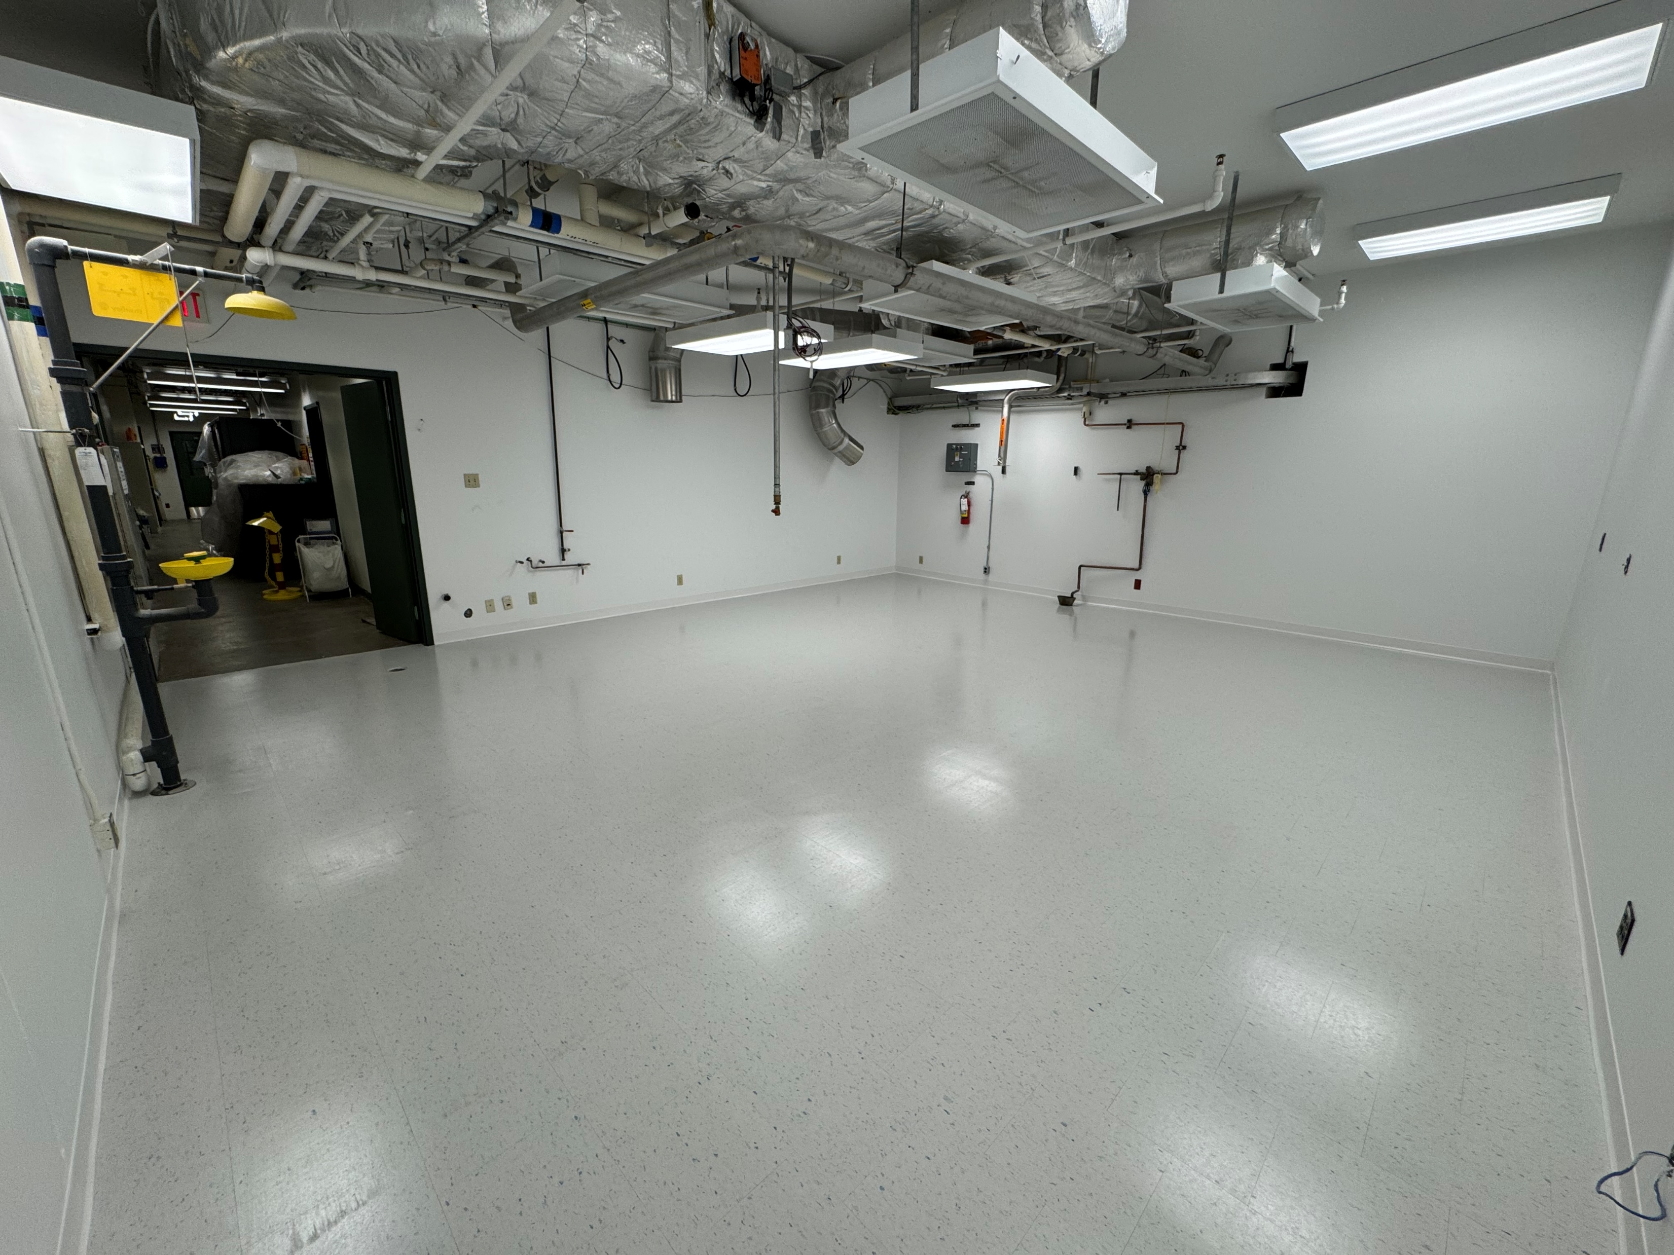
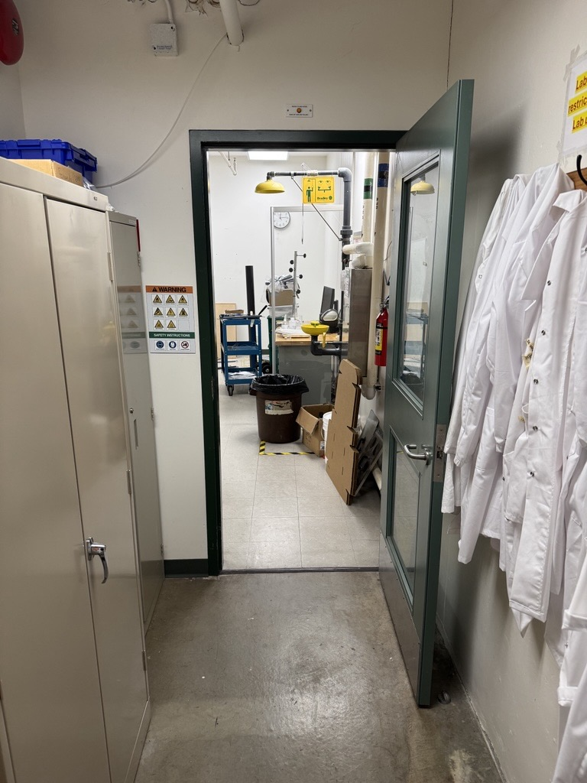
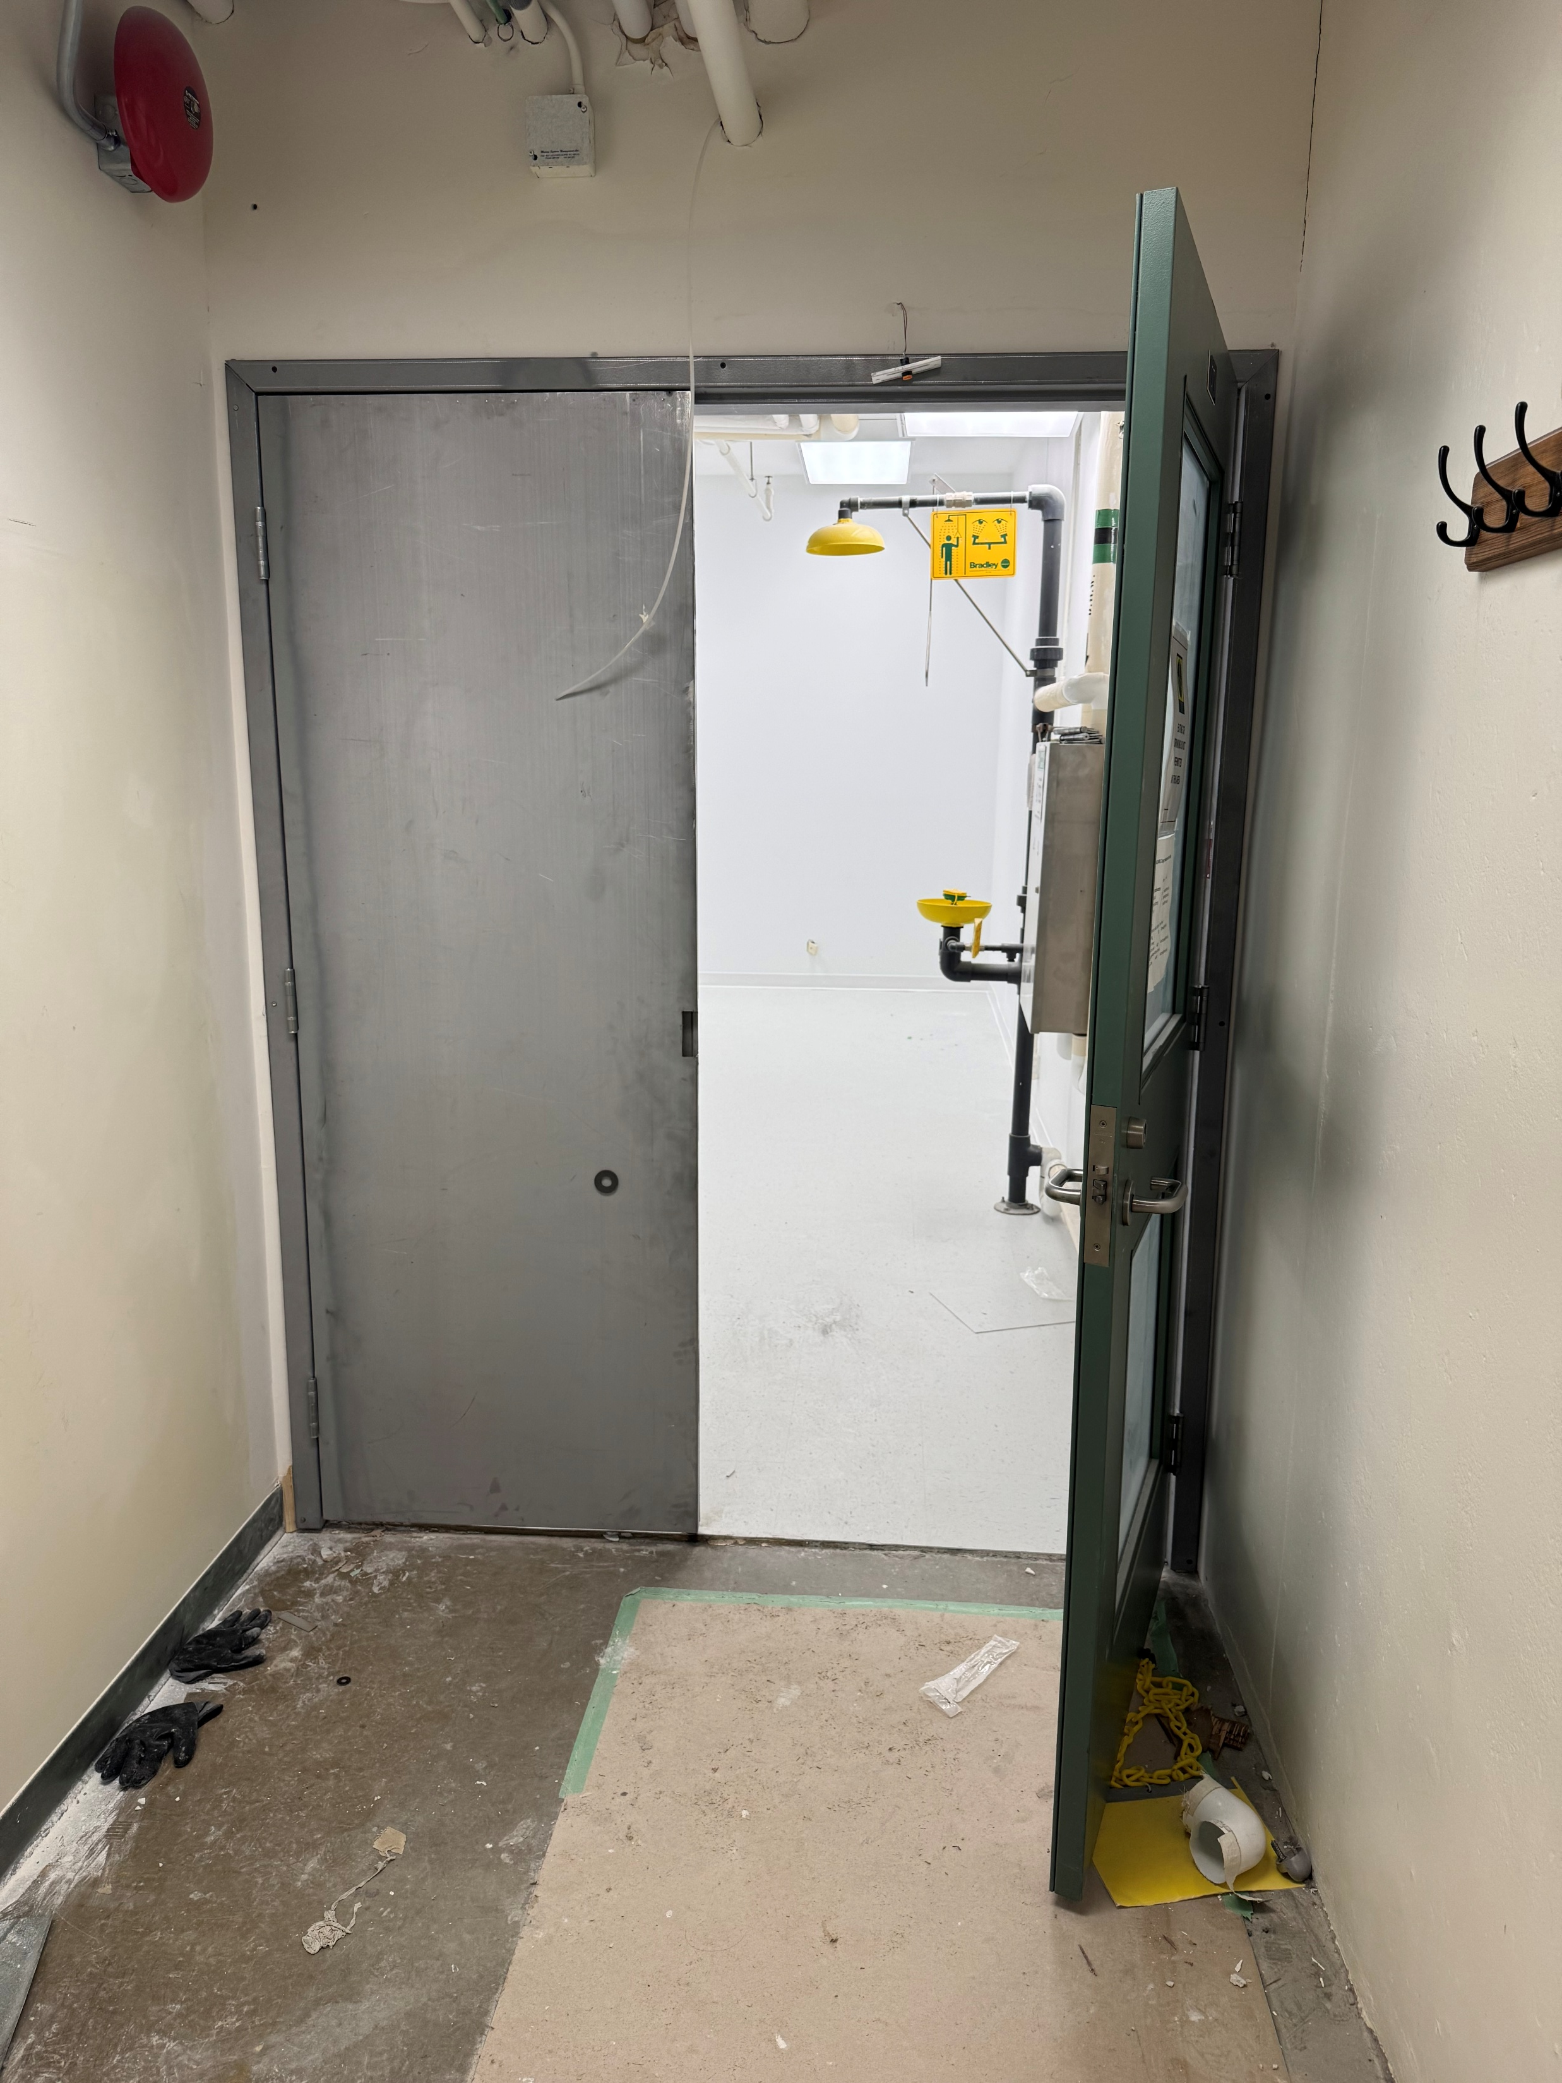
Accomplishments Since Last ASSC Meeting: ISAC Cold Lab Renovations
Renovations (contractors):
  Flooring
  Door widening
  Paint
Single Door unit
Double Door unit
Renovated ISAC Cold lab

Slide 11
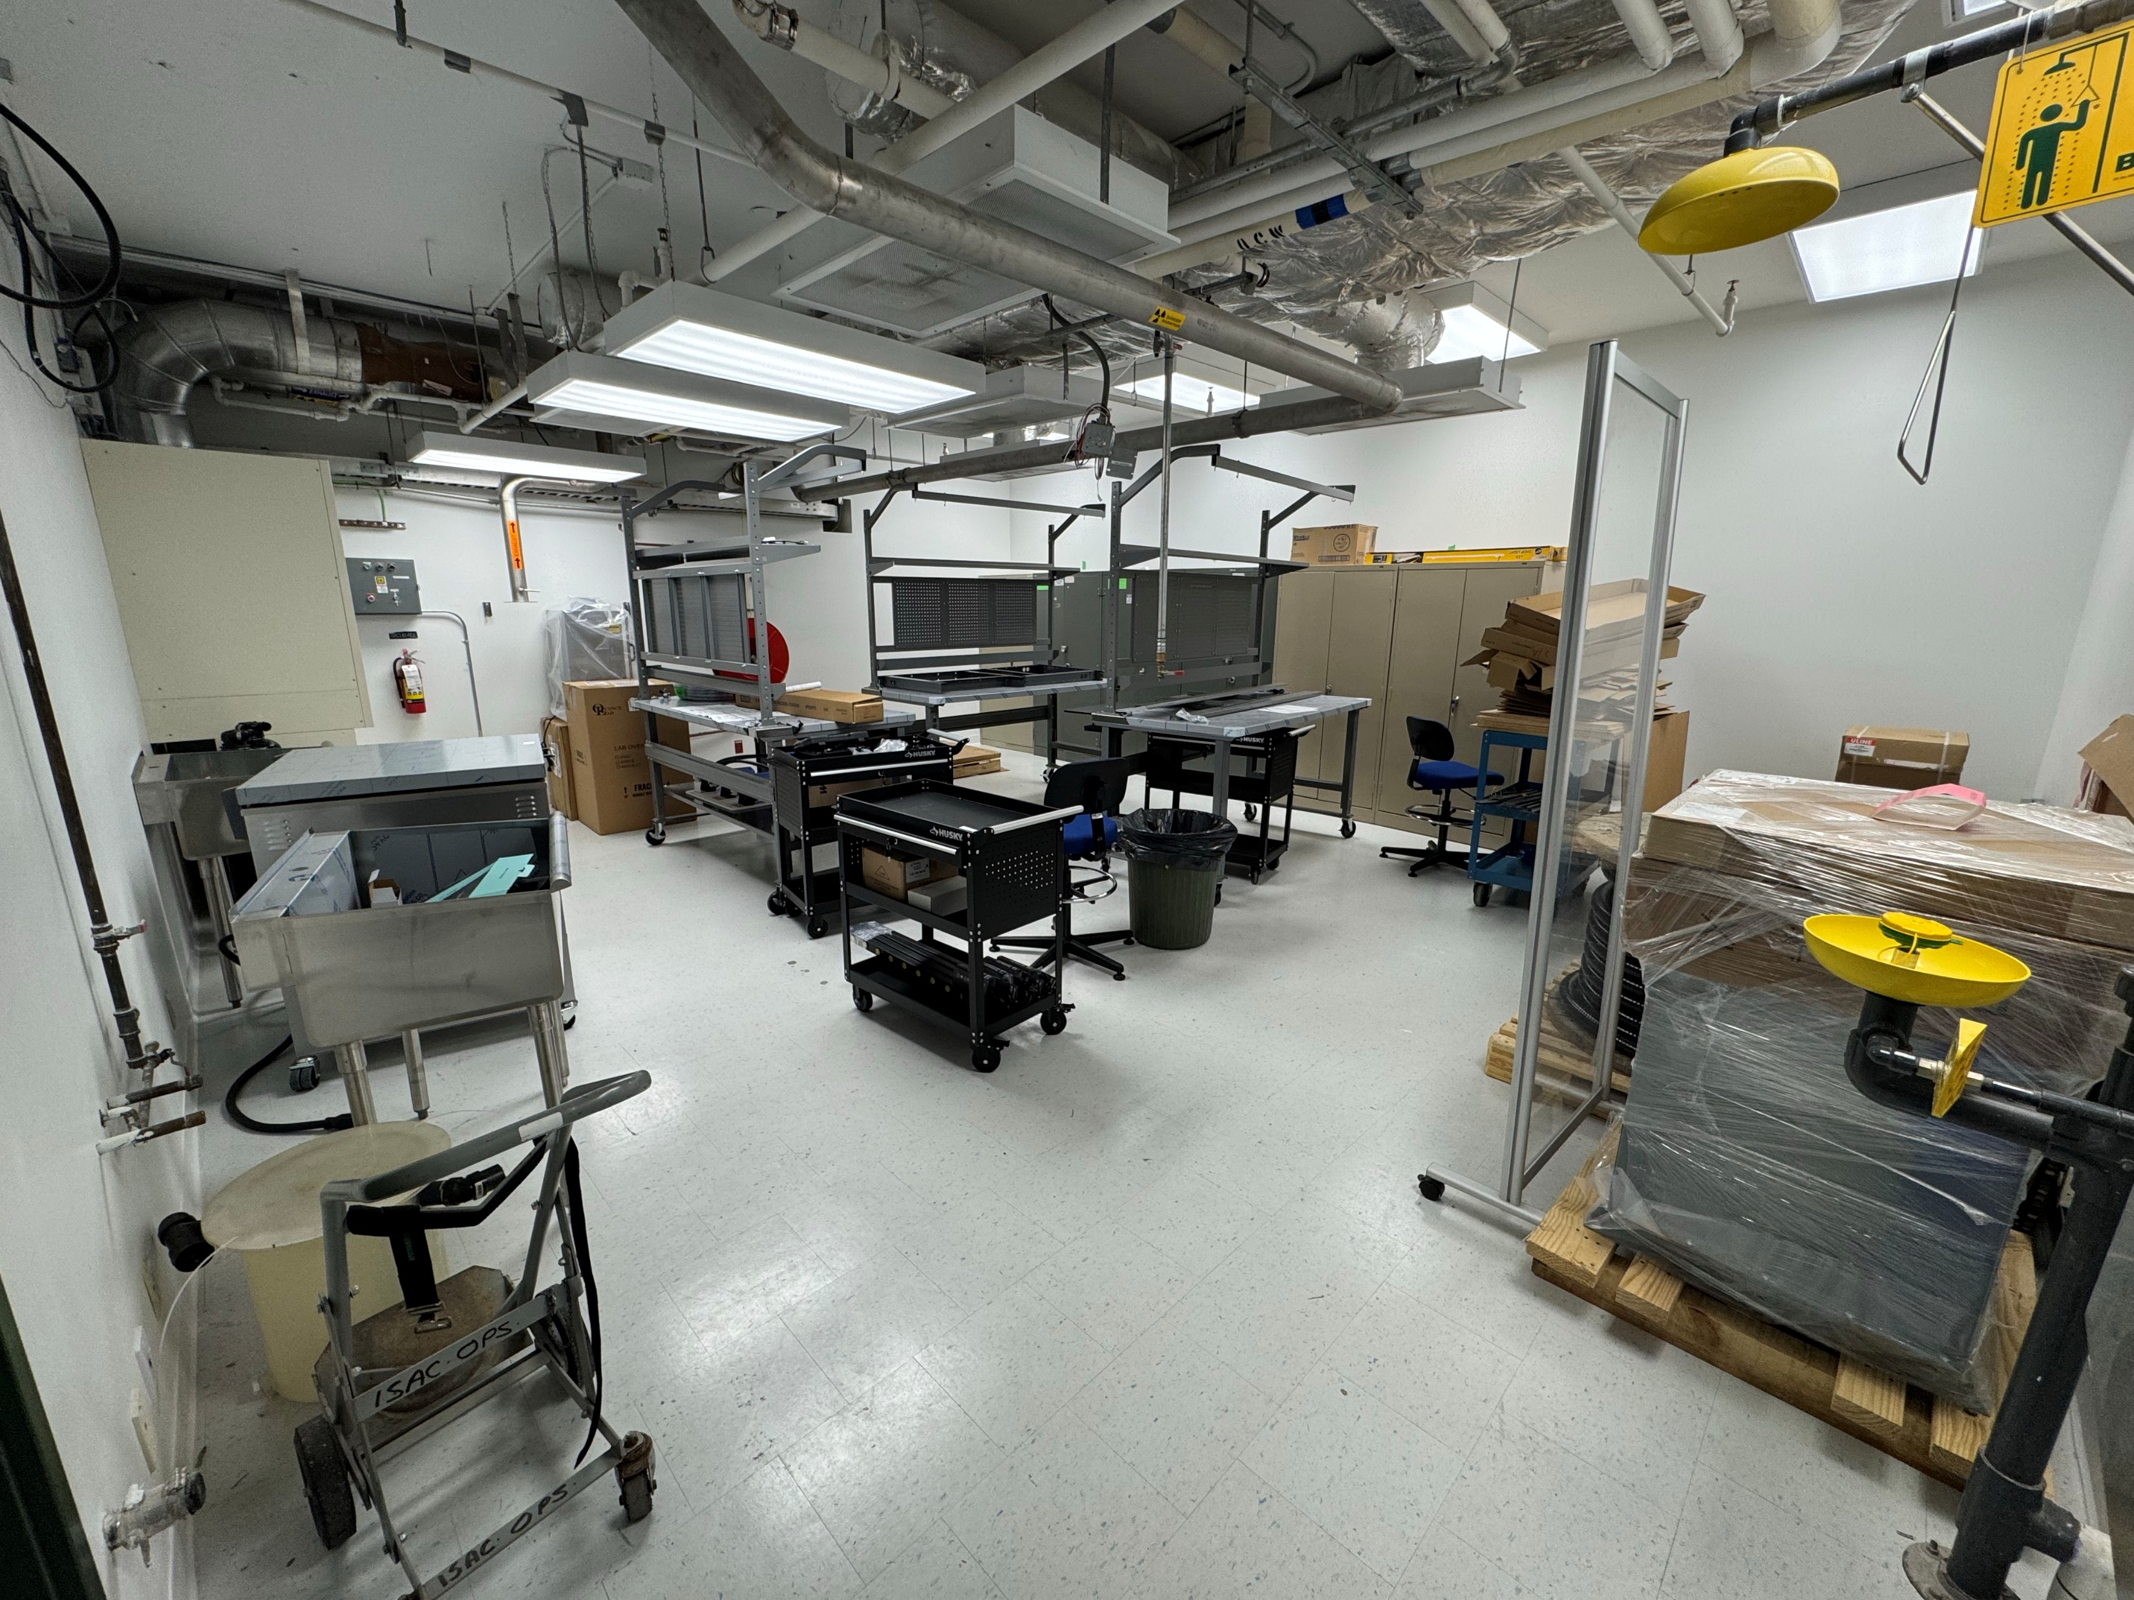
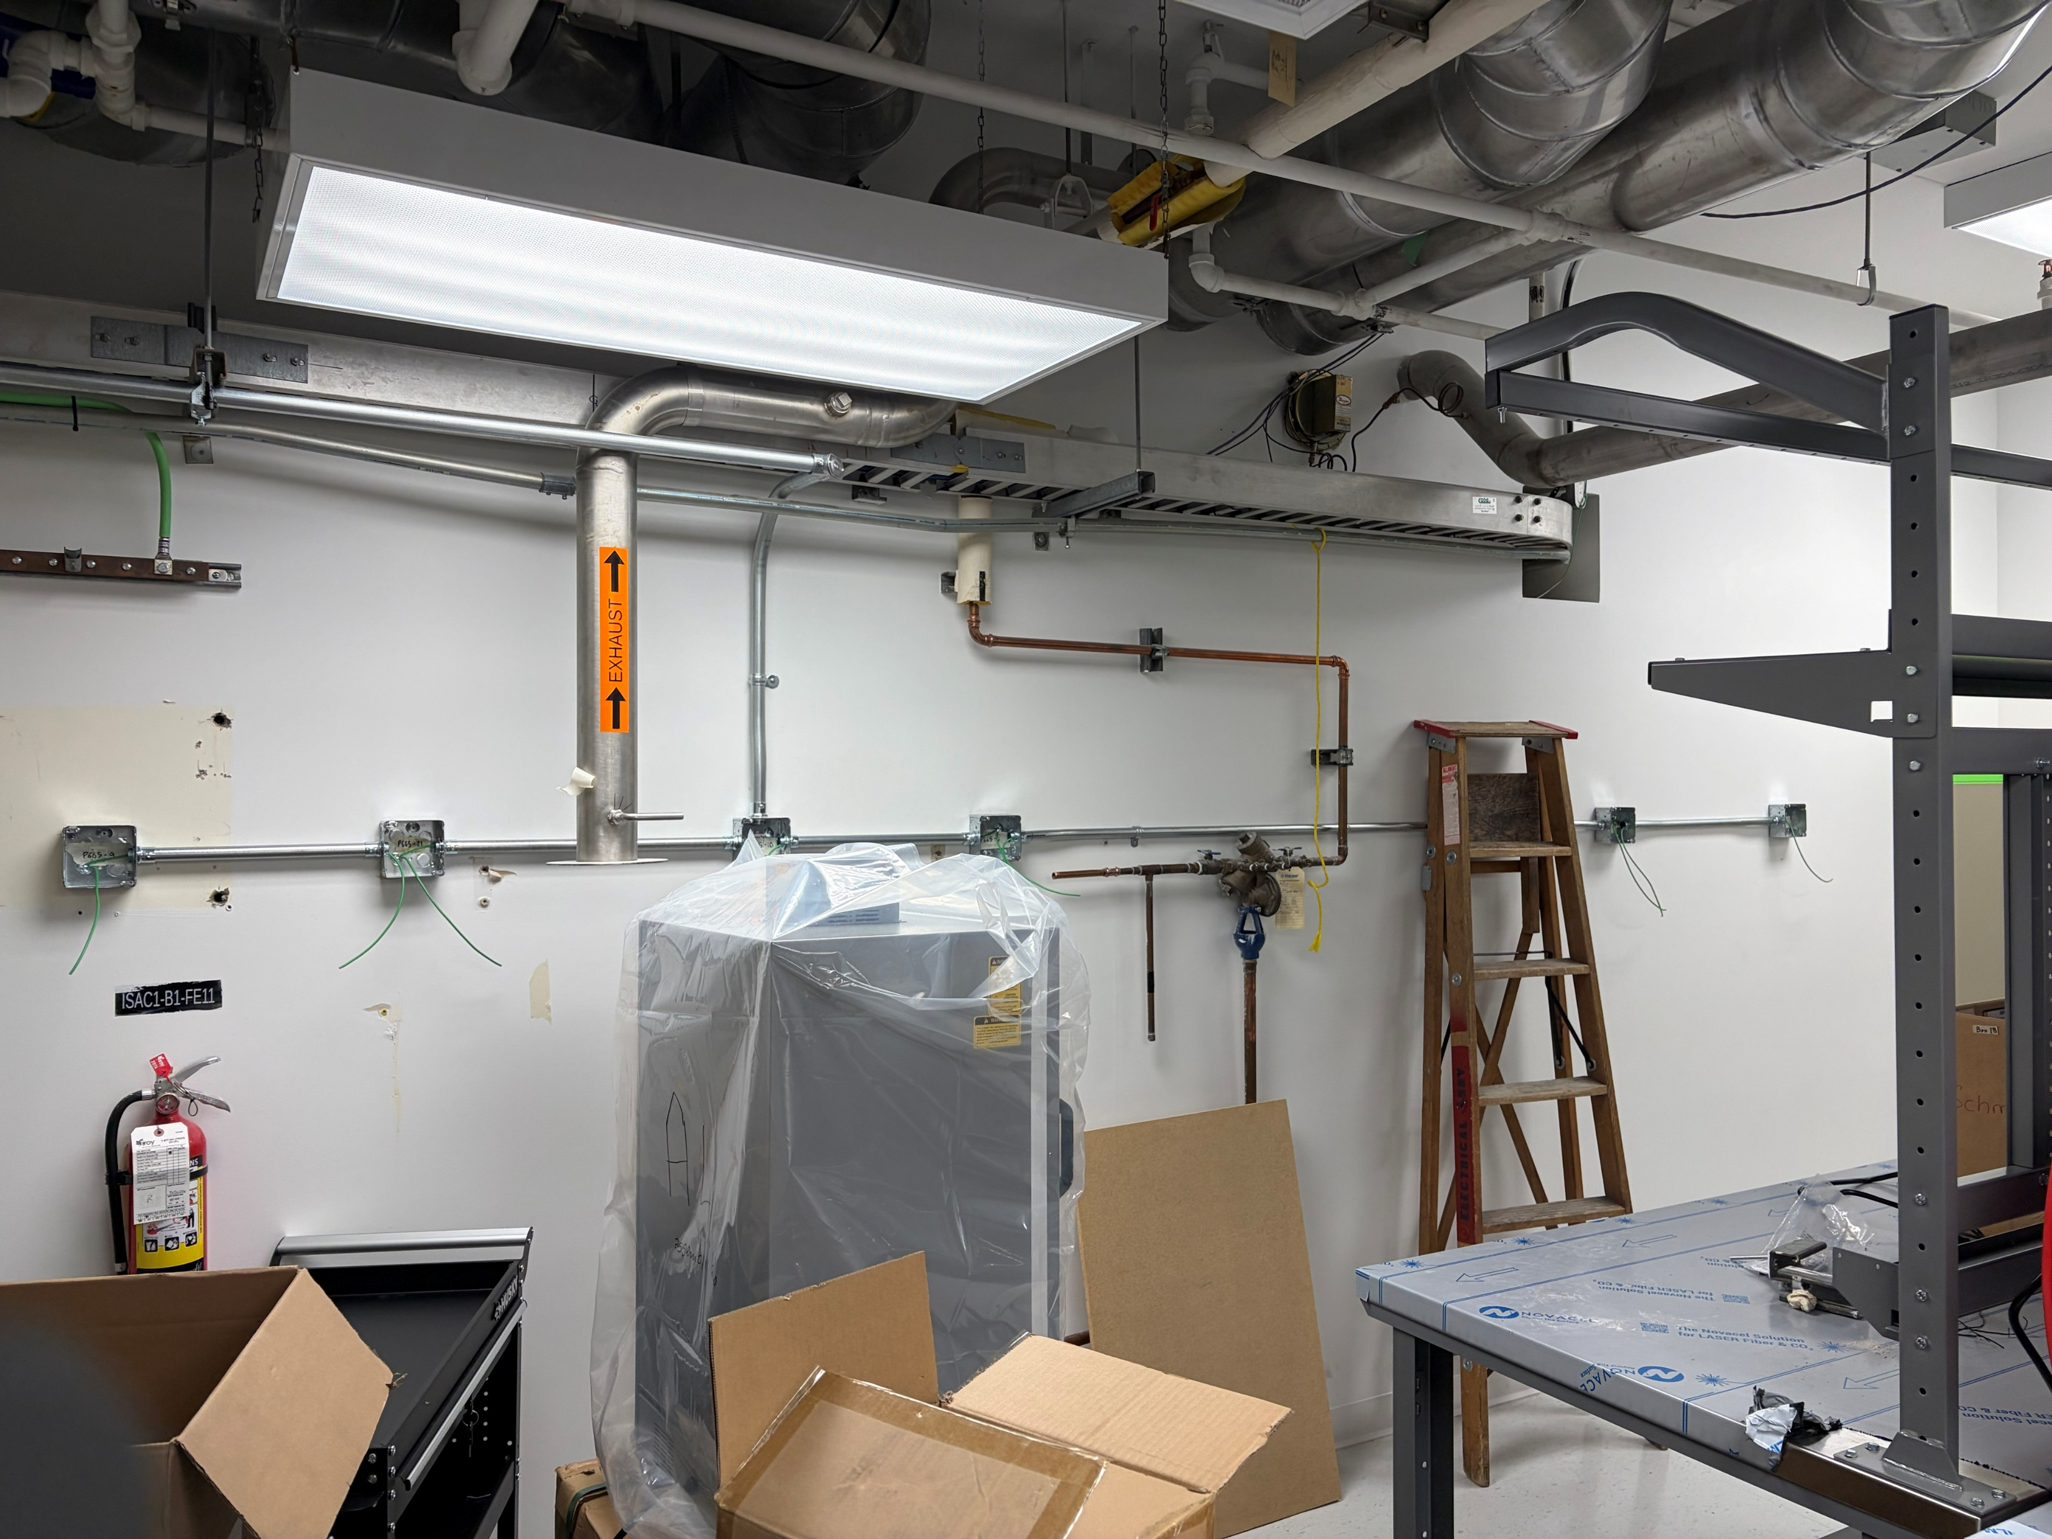
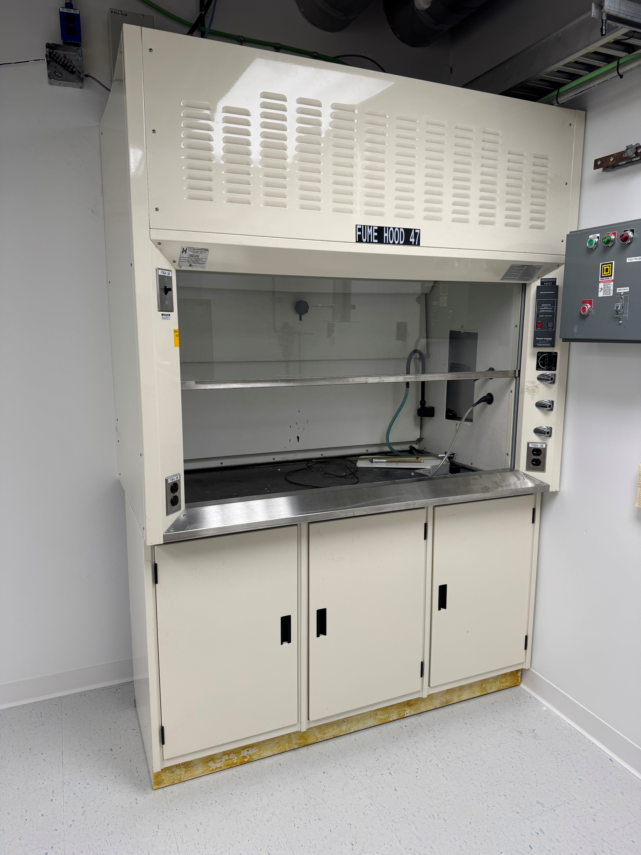
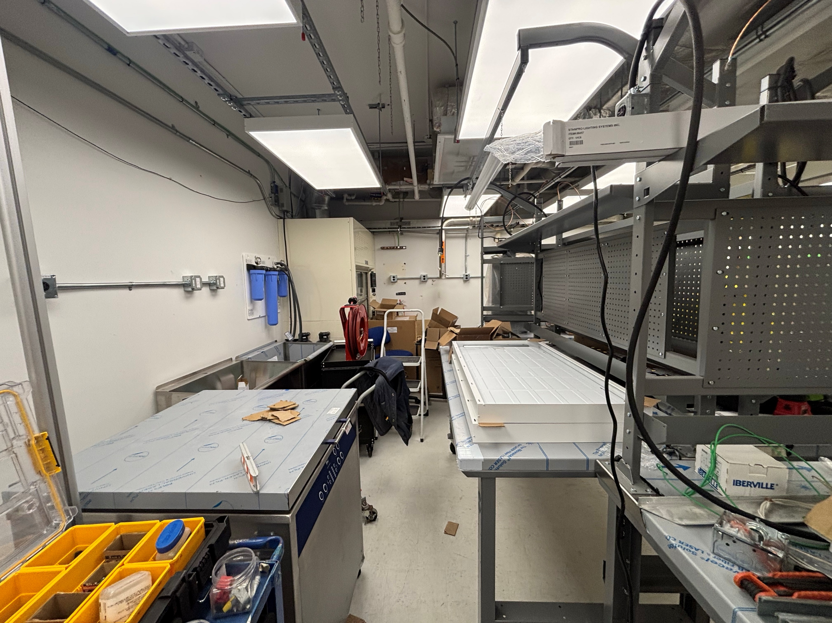
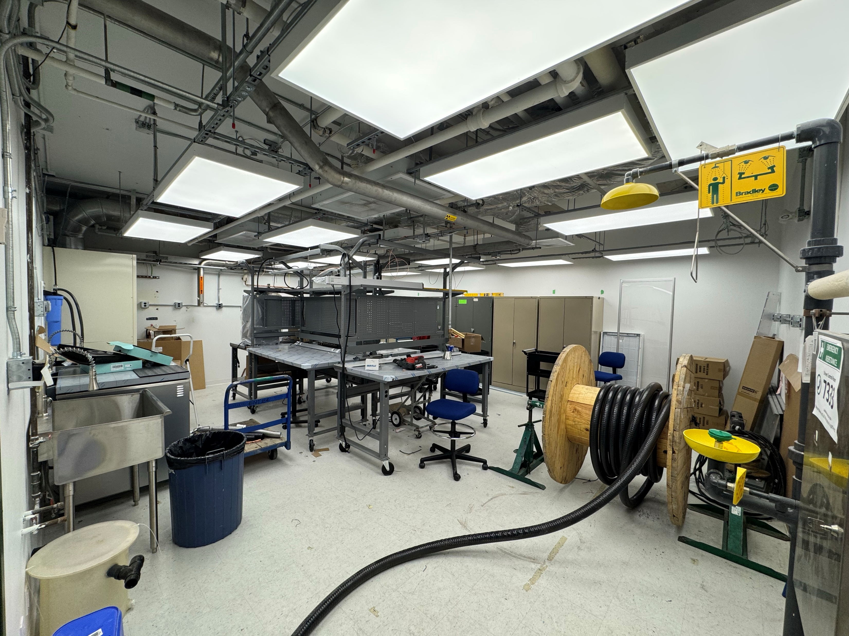
Accomplishments Since Last ASSC Meeting: Assembly Lab Set-up
Assembly Lab Set-up (Contractors):
  Fume hood installed
  Assemble the procured items
  Electrical connections (ongoing)
  Mechanical connections (initiated)
2
3
1
3
3

Slide 12
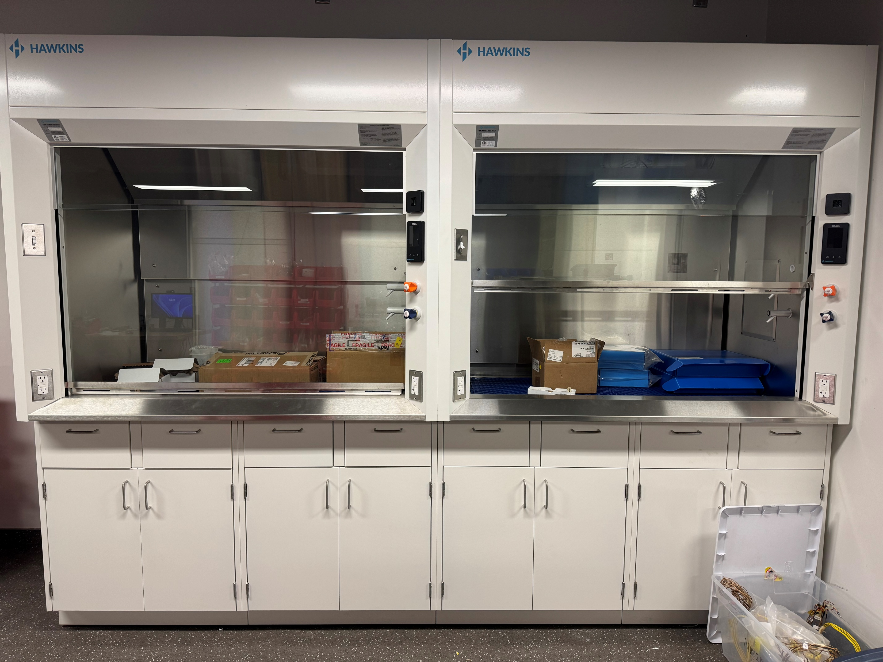
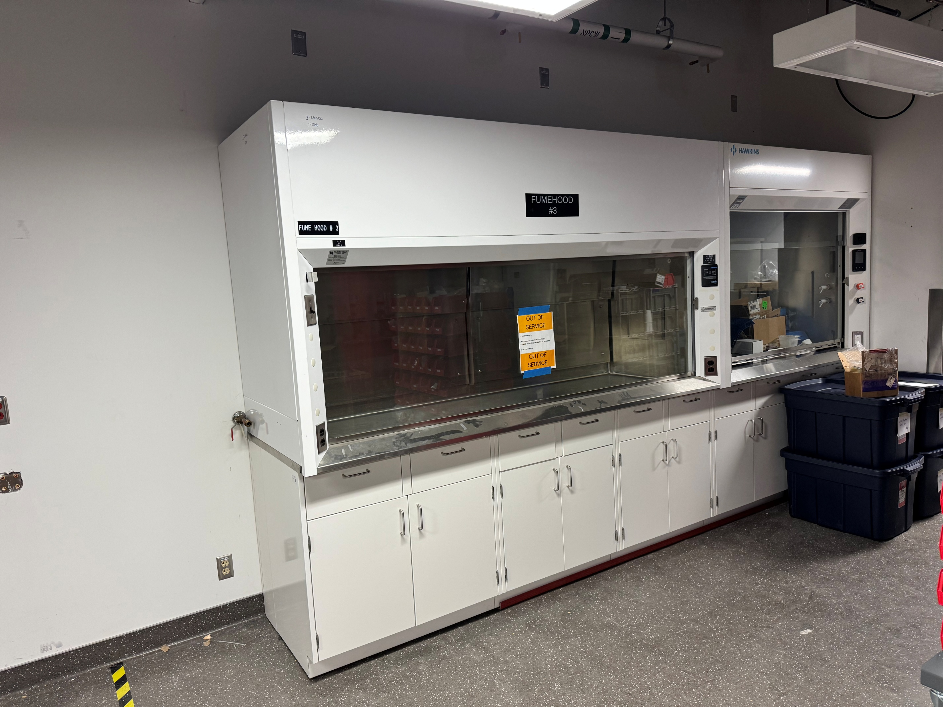
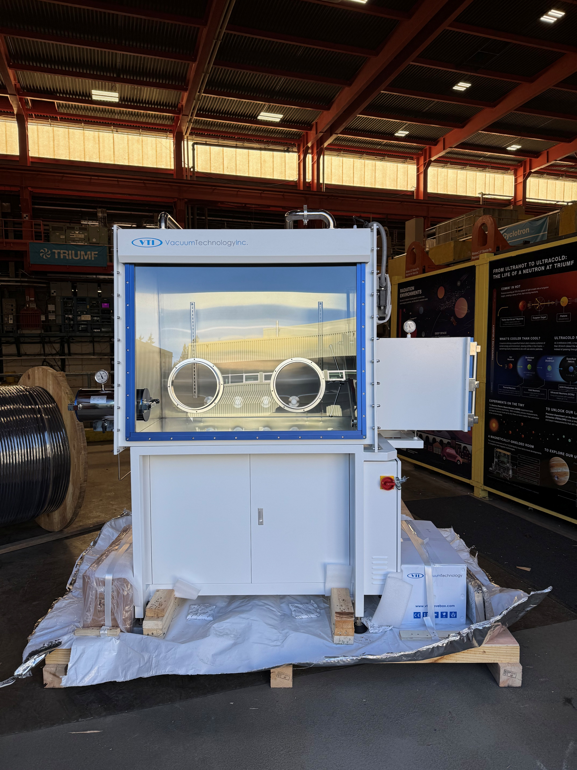
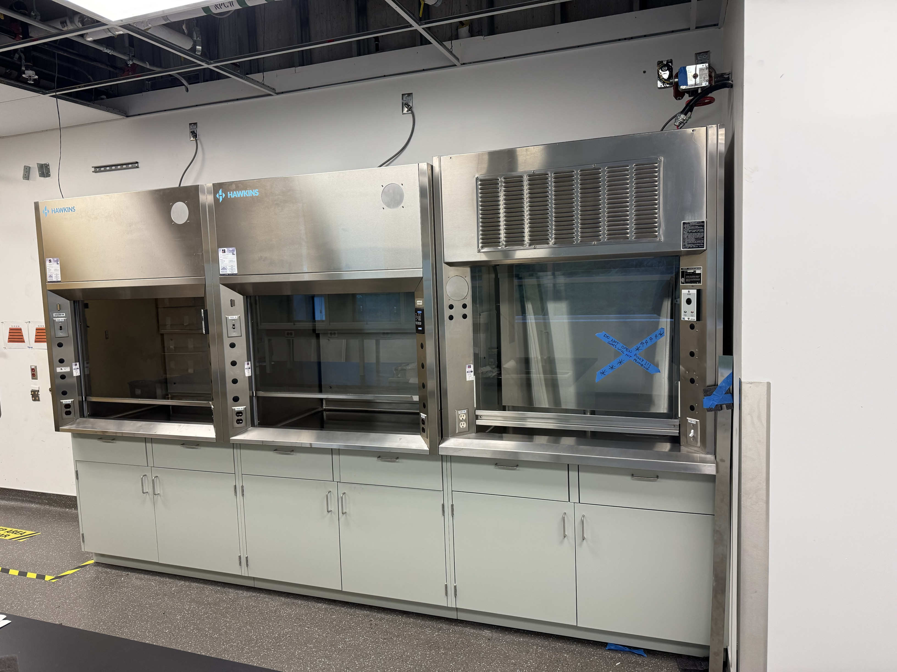
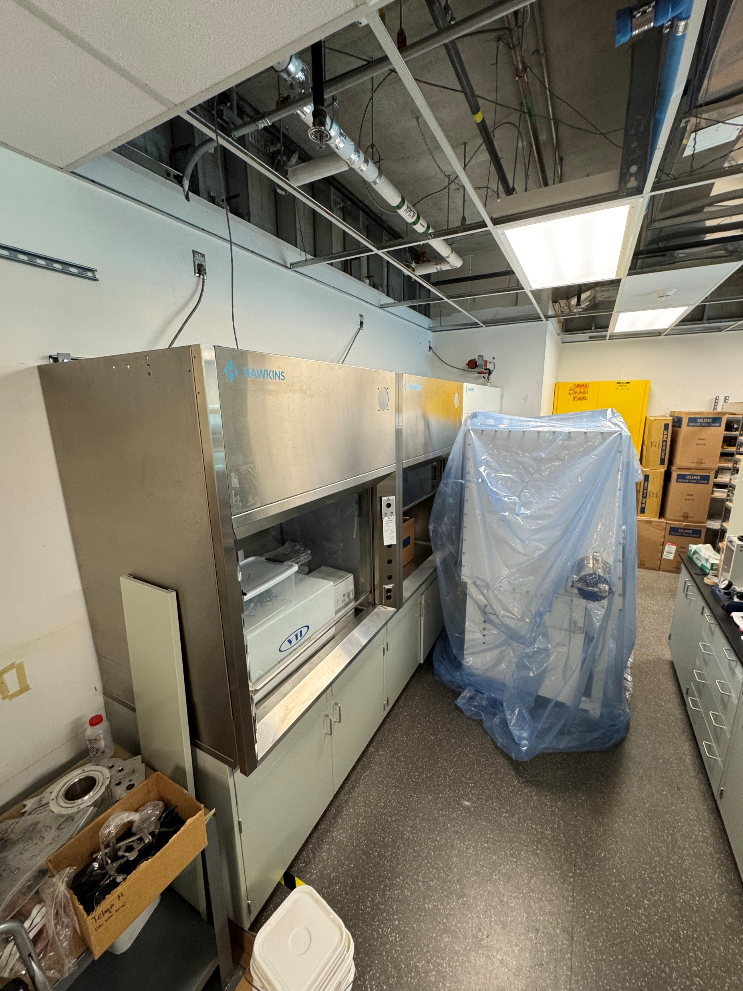
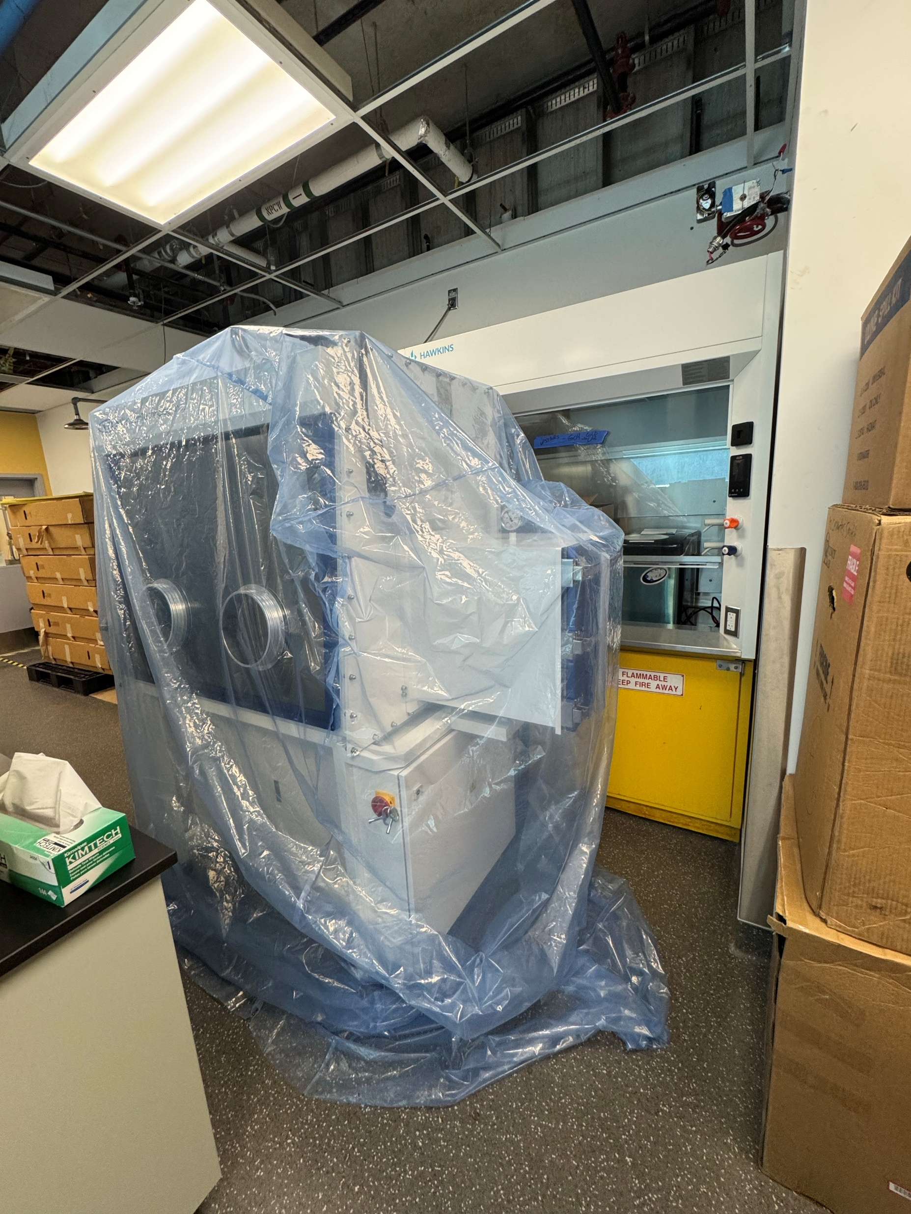
Accomplishments Since Last ASSC Meeting: ARIEL Labs Current State
ARIEL Labs Set-up
(Hot & Cold Labs)
  Fume hood swap
ARIEL Cold Lab
  Set-up moved items
  Use as storage space
Glovebox for
ARIEL Hot lab
ARIEL Hot lab – Fume hoods swapped
ARIEL Cold lab – Fume hood swapped

Slide 13
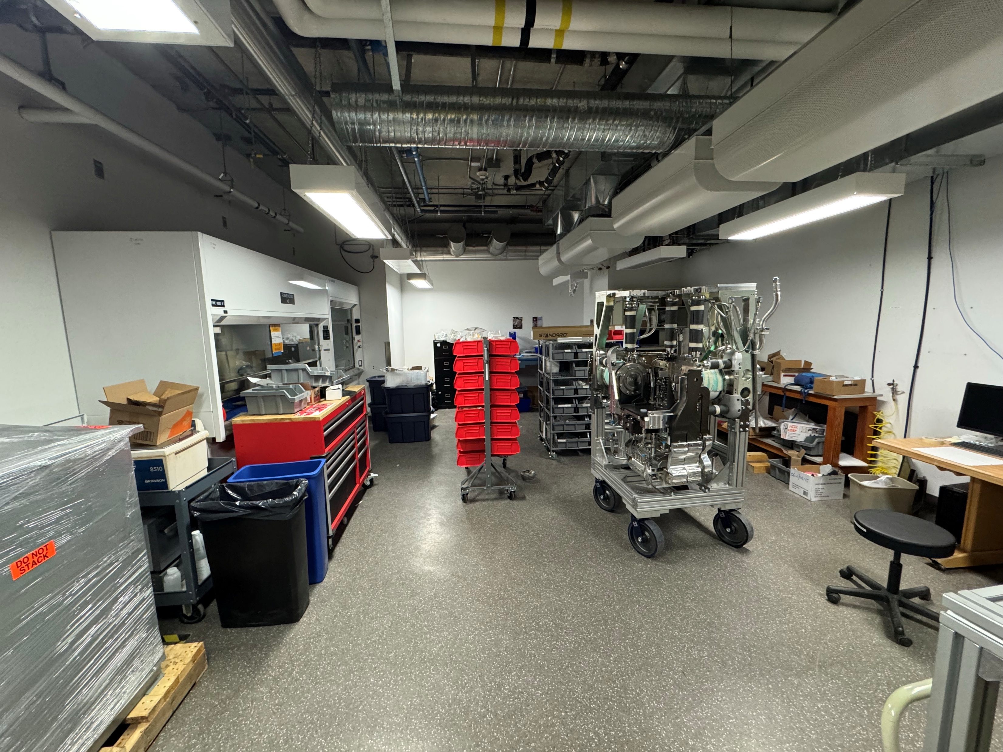
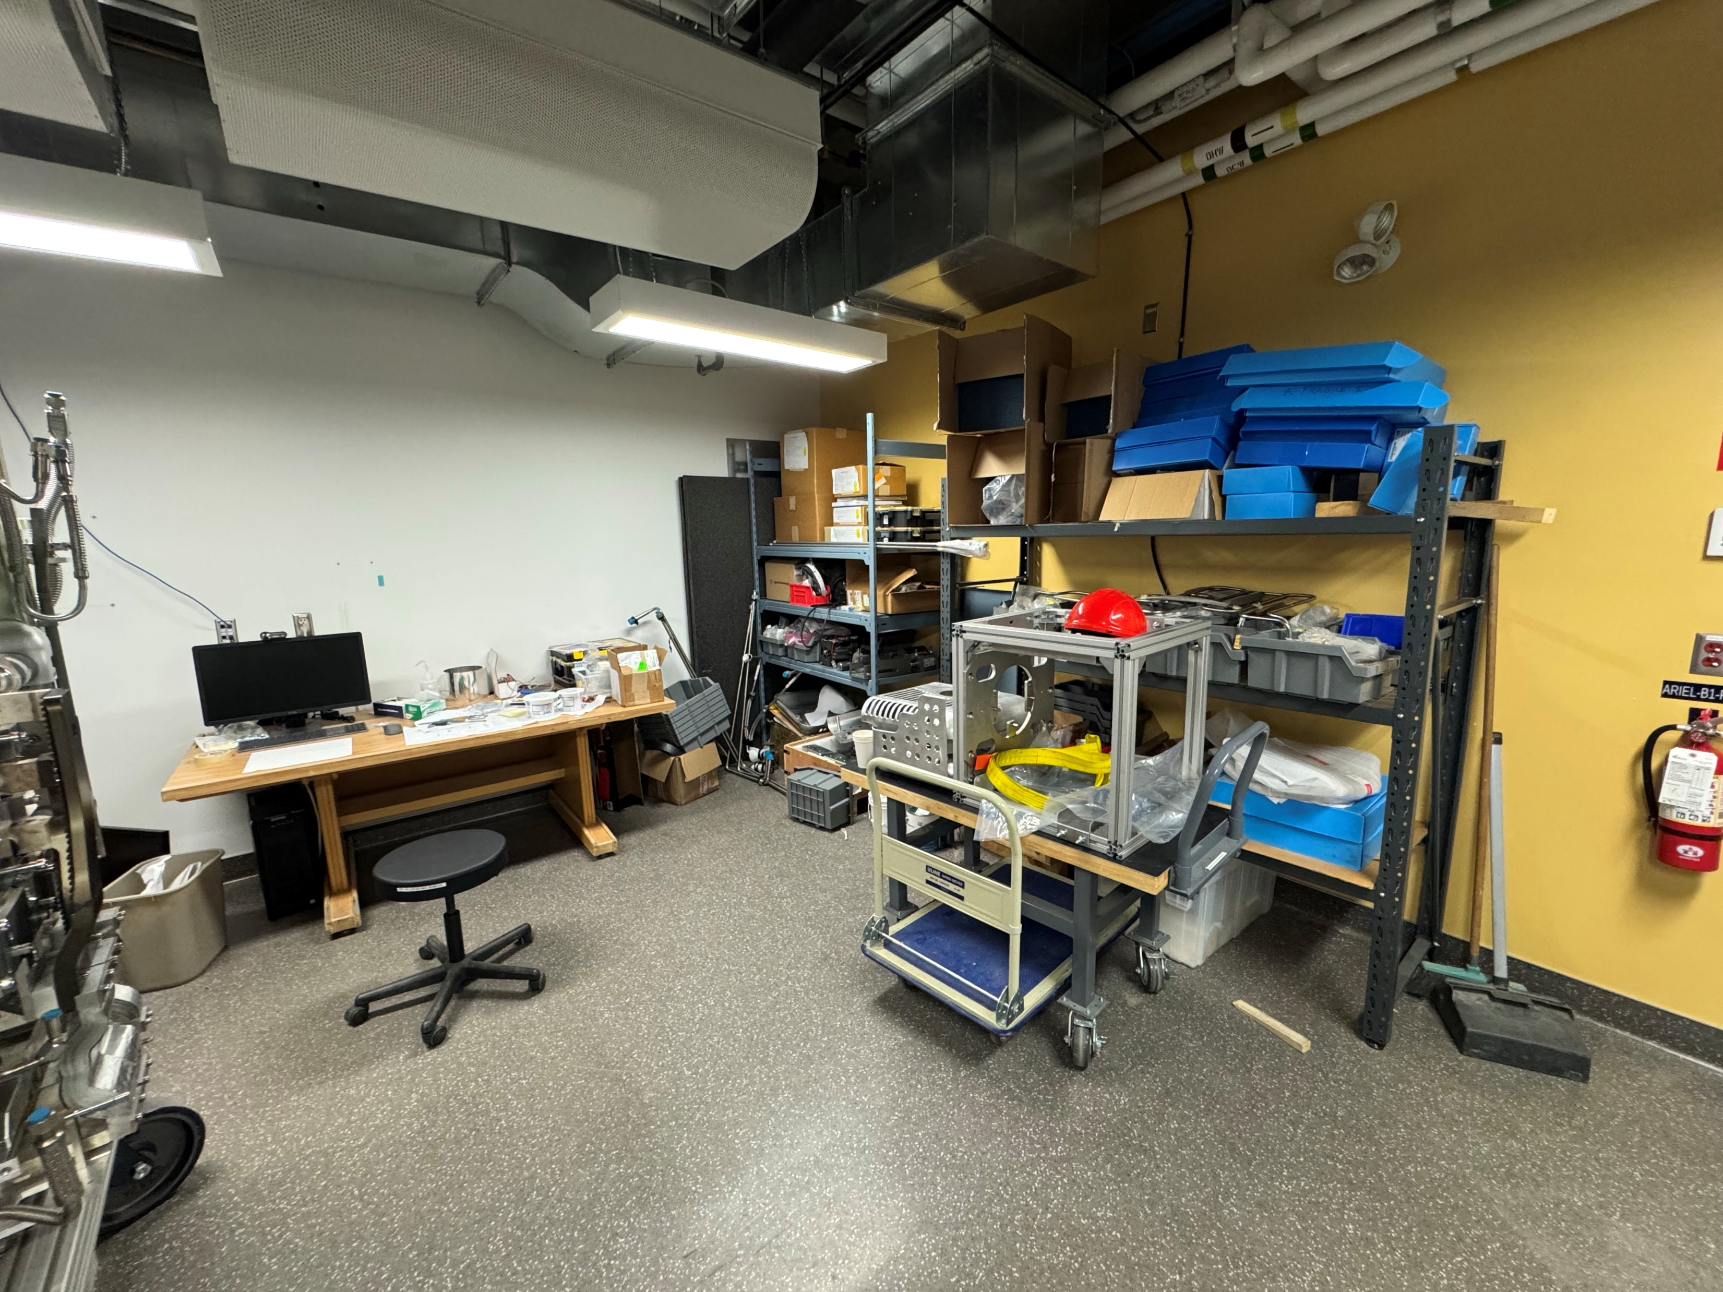
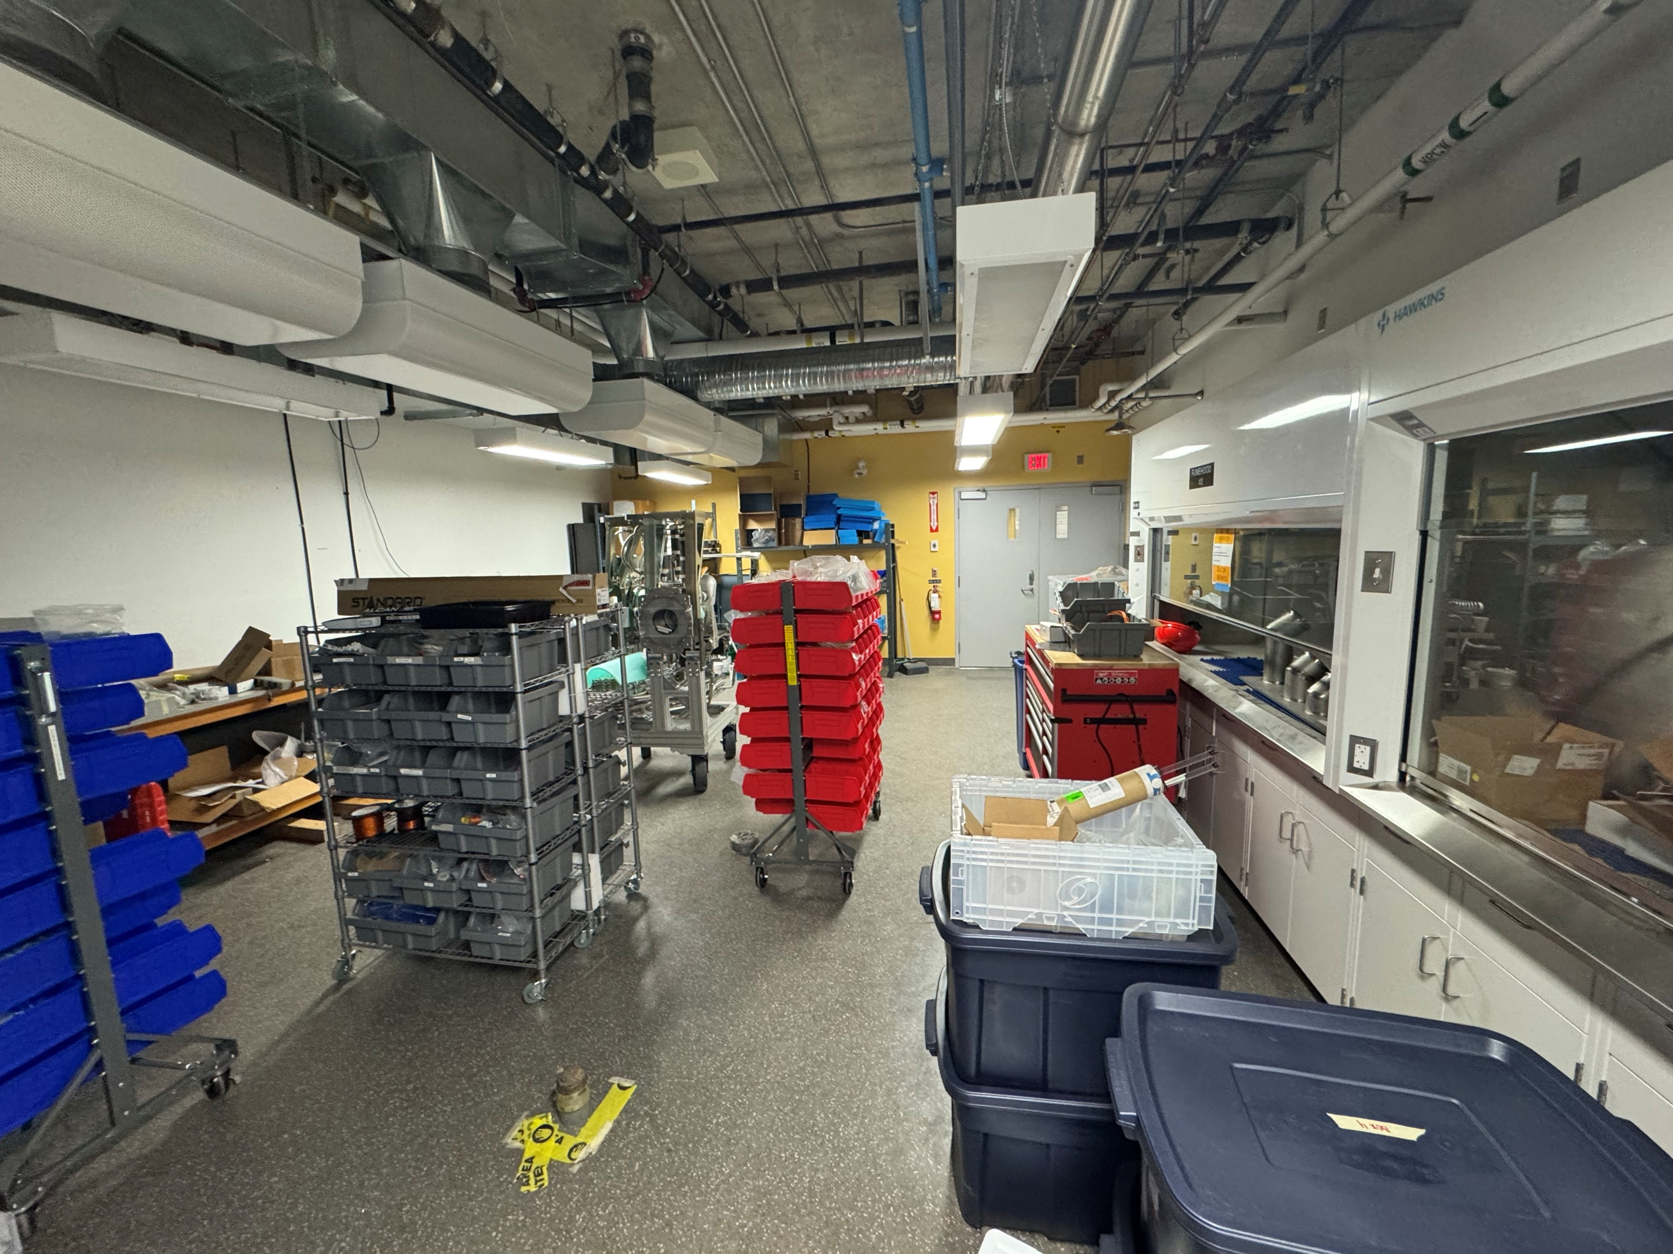
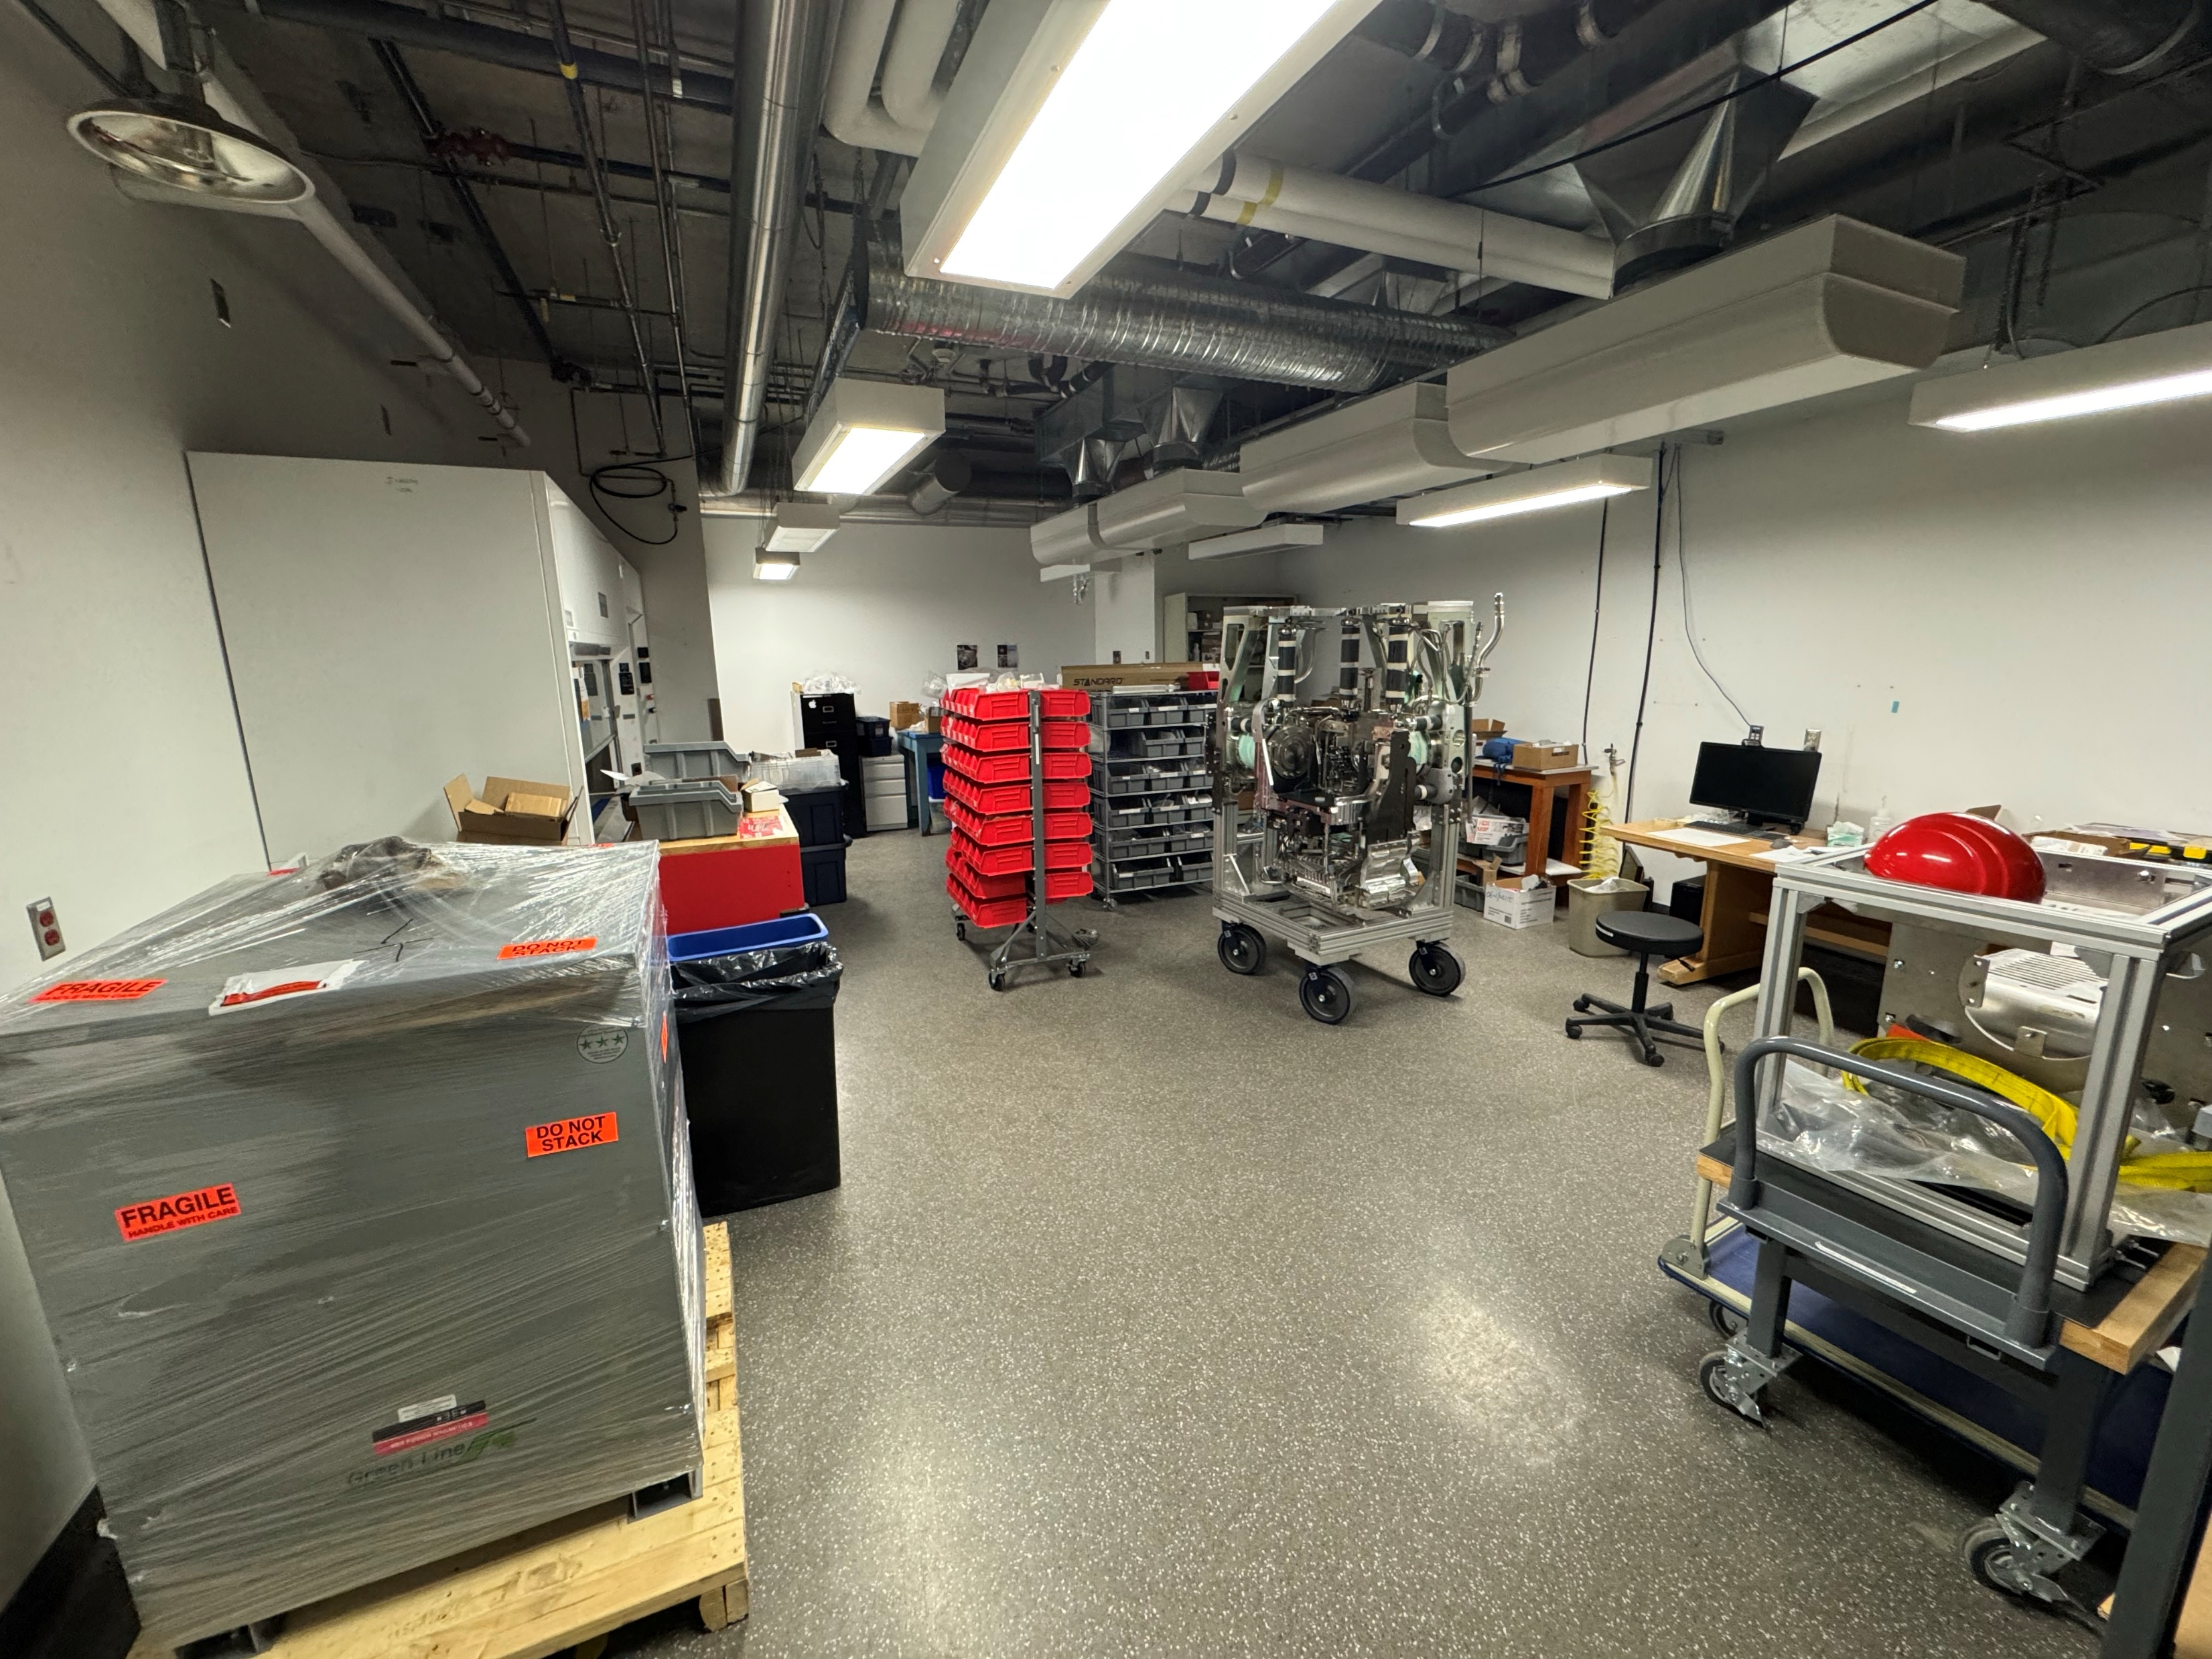
Accomplishments Since Last ASSC Meeting: ARIEL Labs Current State
ARIEL Hot lab
Lab space occupied by other priority project
Lack of services resources support
Critical Path Activities:
Engineering/Mechanical Services connections (Nuclear Ventilation, Plumbing)
Electrical Services connections
Current state – ARIEL Hot lab
Current state – ARIEL Hot lab
Contractual work on standby:
Island installation
Glovebox installation
Current state – ARIEL Hot lab
Current state – ARIEL Hot lab

Slide 14
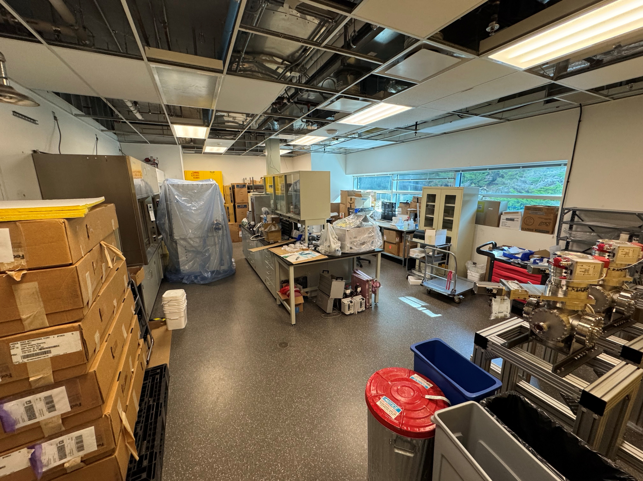
Accomplishments Since Last ASSC Meeting: ARIEL Labs Current State
Current state – ARIEL Cold lab
Current state – ARIEL Cold lab
ARIEL Cold lab
Lab space utilized as storage space (Items for Cold and Hot lab stored)
Lack of services resources/support
Critical Path Activities:
Engineering/Mechanical Services connections (Non-nuclear Ventilation, Plumbing)
Electrical Services connections
Current state – ARIEL Cold lab
Current state – ARIEL Cold lab

Slide 15
Accomplishments Since Last ASSC Meeting: ARIEL Labs Documents
# | Document/s | Status | DocuShare Link
1 | Requirement Specifications | 100% complete | Link
2 | Hazard Analysis | 100% complete | Link
3 | Detailed Lab Layouts | 100% complete | Link
4 | ECR – Renovations | 100% complete | Link
5 | Safety Analysis Report | 100% complete | Link
6 | Integration and Test Plan | Drafted – Under Review | Link
7 | Commissioning Plan | Drafted – Under Review | Link

Slide 16
Progress on Plans Presented at previous ASSC Meeting
# | Plans for the next 6 months presented at last ASSC (Nov 2025) | Current Status / Comment
1 | Finish essential procurement​ | 100%
2 | Complete remodeling of target assembly lab​ | 100%
3 | Implement lab move plan including center island installation and reorganization of fume hoods​ | 67% – Unavailability of the ARIEL Hot lab
4 | Complete modifications and begin assembly of vacuum furnaces​ (PHI) | 40% – Collab with UoM
5 | Installation of services as far as possible – ARIEL Labs (All labs) | 20% – Unavailability of TRIUMF resources
6 | Continue documentation​ | 99%

Slide 17
MTA Update

Slide 18
Major Risks, Issues, Concerns
Risk | Mitigation
Infrastructure (Ventilation, Plumbing, Electrical) Installation: ARIEL labs (Cold & Hot) commissioning delay​ | Initiate the infrastructure (design, fabrication, and installation for the nuclear and non-nuclear ventilation, Mech., & Elec.) work for the ARIEL labs
Hot lab space not released: installation & set-up delay (for both ARIEL labs – hot & cold) | Partial lab provided for installations and services connection.
Commissioning delayed due to unavailability of crucial TRIUMF resources (above provided)​: ISAC target production & ARIEL initial target production delay | ISAC and ARIEL targets produced using the other facilities (ISAC Hot lab, TISA)​
TRIUMF’s resources not available following priority: overall commissioning delay | Hire costly outside contractors to complete the services installation scope (just like Target Assembly lab) – additional budget needed

Slide 19
LS 26
Critical sequence for the remaining planned LS2026 work:
# | UID | Tasks
1 | 16037 | ARIEL Hot & Cold labs set-up (assemble and set-up labs with Equipment, Storage, and Furniture)
2 | 16086 | ARIEL Hot lab Contractor work (Island and Glovebox installation)
3 | 16051 | ARIEL labs – Electrical services (Services connection)
4 | 16098 | ARIEL labs – Mechanical services (Services connection)
5 | 16071 | ARIEL labs – Eng services (Ventilation installation )
6 | 16116 | High-temperature vacuum furnace (PHI) upgrade
7 | 16128 | Replicating 3 additional High-temperature vacuum furnaces – PHI (machine shop parts)
8 | 16010 | ARIEL Hot lab Radiation protection equipment procurement (may have to descope)
9 | 16135 | ARIEL labs – Computer, phone, and network connection
10 | 16140 | ARIEL labs – Commissioning

Slide 20
Gate 3 Readiness
Gate 3 review checklist​ | Yes/No​ | Comment​
All released documents up-to-date?​ | Yes​ | ​
Commissioning plan drafted?​ | Yes​ | PHI system commissioning plan in progress
Drawings, diagrams or schematics released by ECO?​ | No​ | PHI design update ongoing & ECO pending​ – 40% work complete
All Requirements Specification documents released to Docushare?​ | Yes​ | ​
Schedule critical path understood?​ | Yes​
Budget by fiscal year is updated and remaining funds enough to cover projected costs?​ | No​ | Not enough if contractors hired for the building infrastructure/services work
Top risks identified, with credible mitigation actions?​ | Yes​
Integration and test plans reviewed by experts and project stakeholders (e.g. users)?​ | No​ | Draft ready – in review
Controls (EPICS, data acquisition, MPS, etc…) specified?​ | No​ | WIP (working with controls group)​

Slide 21
Plans and Objectives for the Next 6 Months
Sub-set of LS26 planning and accomplishments critical for the milestones in the MTA.
  ARIEL Hot & Cold labs set-up (assemble and set-up labs with Equipment, Storage, and Furniture) –after ARIEL Hot lab space released
  ARIEL Hot lab Contractor work (Island and Glovebox installation) – after ARIEL hot lab space released
  ARIEL labs – Electrical services (Services connection)
  ARIEL labs – Mechanical services (Services connection)
  ARIEL labs – Eng Services (Ventilation installation )
  PHI upgrade
  Replicating 3 additional High-temperature vacuum furnaces: PHI (machine shop parts)
  ARIEL Hot lab – Radiation protection equipment procurement
  ARIEL labs – Computer, phone, and network connection
  ARIEL labs – Commissioning
Direct P355 Control | External Dependency

Slide 22
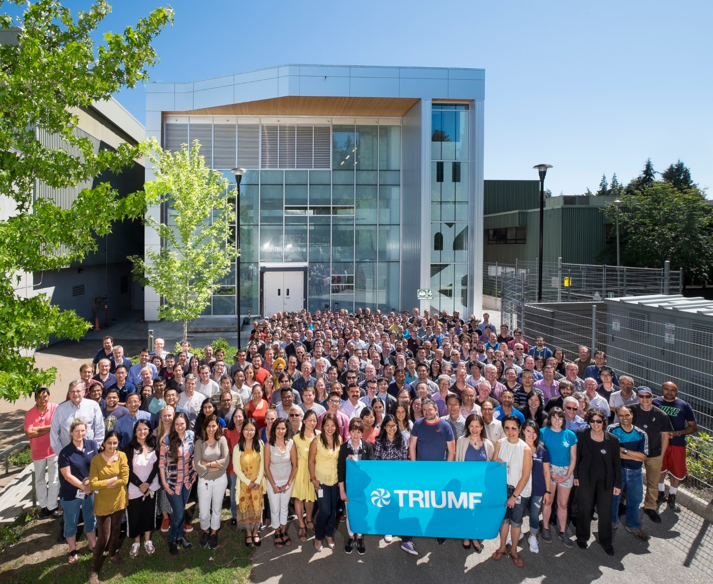




Thank you
Merci
www.triumf.ca
Follow us @TRIUMFLab
Discovery,
accelerated

