Slide 1



HAICU
UBC Research Update
UBC × TRIUMF
20 OCTOBER 2026
Colin Noort, Giulia Marcoux, & Takamasa Momose
Experimental progress and next steps
HAICU

Slide 2
01 PROJECT CONTEXT
Progress Update
PROJECT POSITION
Short decelerator section (96 traps / 480 mm length) set up for testing
Focused on detecting decelerated atomic H with 243 nm laser and MCP detector
Showed that nozzle, decelerator and detection scheme are all working by using O2
Confirmed transmission of atomic H beam through short decelerator section
PROGRESS THIS PERIOD
Low signal to noise ratio (SNR) of detected signal
Inconsistent H signal at detection point
Unsuccessful in decelerating or guiding H thus far
CURRENT LIMITATION
Obtain a repeatable and consistent free flight H signal (no magnetic trap interaction)
Obtain a repeatable and consistent guided H signal (constant trap velocity)
Obtain a repeatable and consistent decelerated H signal (constant trap deceleration)
NEXT OBJECTIVE
UBC CHEMISTRY × TRIUMF
HAICU / UBC RESEARCH UPDATE

Slide 3
01 PROJECT CONTEXT
Current Experimental Setup
Gas Supply
BNC Pulse Generator
Python / LabView / Scopes
MEASUREMENT
H ion flux at detection point using MCP
Source / DBD
Entry to Beamline
Short Decelerator
Detection Chamber (MCP)
RECENT CHANGES
Moved from 121 nm to 243 nm
Changed from PMT to MCP
Moved from O2 to CH4
10 Hz / 243 nm Laser
Scroll + Turbo pumping
OPERATING POINT
120 PSI gas supply pressure
10⁻⁷ torr vacuum pressure
50 us gas pulse width
UBC CHEMISTRY × TRIUMF
HAICU / UBC RESEARCH UPDATE

Slide 4
01 PROJECT CONTEXT
Current Experimental Setup (Schematic Diagram)
Axial distances as specified. Chamber sizes and component cross sections are schematic.
270 mm
480 mm
170 mm
Free flight
96 traps
Free flight
MCP
SOURCE CHAMBER
ZEEMAN DECELERATOR
DETECTION CHAMBER
Gas supply
Valve
120 psi
Particle beam
DBD
Beamline orifice
243 nm
Source turbopump
Detection turbopump
UBC CHEMISTRY × TRIUMF
HAICU / UBC RESEARCH UPDATE

Slide 5
02 COMPLETED WORK
Tests Completed
August 1st – October 20th
TEST CAMPAIGN | QUESTION | CONDITIONS VARIED | MAIN RESULT
Valve to Beamline Offset Tests (O2) | Optimal orifice position WRT valve? | Offset from valve to beamline | Determined that optimal offset distance is about 28 cm
Control System Timing Optimization Tests (O2) | What are the timings required to guide, and decelerate effectively? | Trap pickup time Valve to trap 1 delay Trap 96 to MCP delay | Determined exact distance between valve, TW, and detection point
Deceleration / Trap Functionality Tests (O2) | Are the electronics and controls systems working as expected? | Pickup time Trap overlap and velocity Coil voltage | Determined pickup time for first trap, trap overlap, trap velocity, and coil voltage for guiding / deceleration
Valve / DBD Tests (H) | Is the valve producing a beam and is DBD producing H? | Valve Voltage and PW DBD Voltage and # of pulses | Showed that valve is producing a detectable hydrogen beam
Frequency Scan Tests (H) | Is the signal we’re seeing H? | Laser frequency | Showed that signal being detected is in fact H
UBC CHEMISTRY × TRIUMF
HAICU / UBC RESEARCH UPDATE

Slide 6
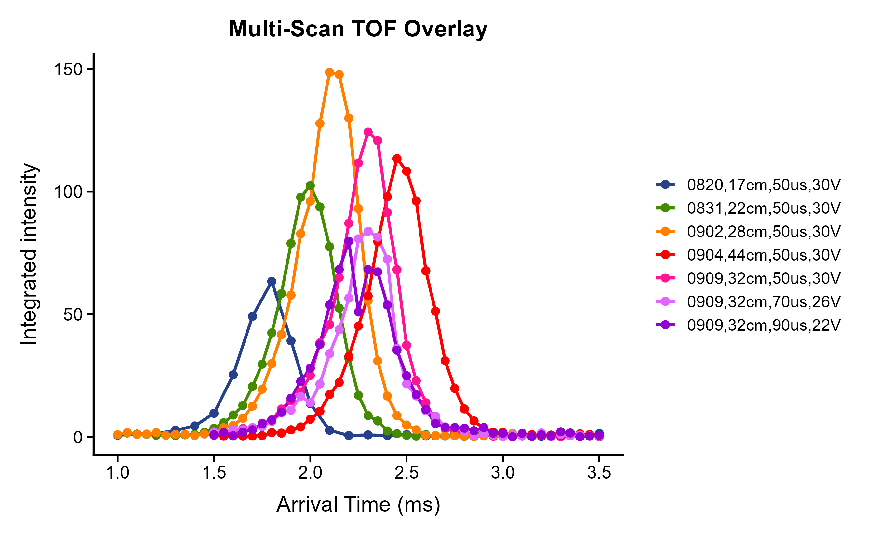
02 COMPLETED WORK
Key Experimental Result
Valve to Beamline Offset Tests (O2)
KEY FINDING
Determined that optimal offset distance is about 28 cm
EVIDENCE
Consistently lower signal detected at all other offsets
IMPLICATION
Leave valve location as is at 28 cm offset from beamline
UBC CHEMISTRY × TRIUMF
HAICU / UBC RESEARCH UPDATE

Slide 7
02 COMPLETED WORK
Tests Completed
August 1st – October 20th
TEST CAMPAIGN | QUESTION | CONDITIONS VARIED | MAIN RESULT
Valve to Beamline Offset Tests (O2) | Optimal orifice position WRT valve? | Offset from valve to beamline | Determined that optimal offset distance is about 28 cm
Control System Timing Optimization Tests (O2) | What are the timings required to guide, and decelerate effectively? | Trap pickup time Valve to trap 1 delay Trap 96 to MCP delay | Determined exact distance between valve, TW, and detection point
Deceleration / Trap Functionality Tests (O2) | Are the electronics and controls systems working as expected? | Pickup time Trap overlap and velocity Coil voltage | Determined pickup time for first trap, trap overlap, trap velocity, and coil voltage for guiding / deceleration
Valve / DBD Tests (H) | Is the valve producing a beam and is DBD producing H? | Valve Voltage and PW DBD Voltage and # of pulses | Showed that valve is producing a detectable hydrogen beam
Frequency Scan Tests (H) | Is the signal we’re seeing H? | Laser frequency | Showed that signal being detected is in fact H
UBC CHEMISTRY × TRIUMF
HAICU / UBC RESEARCH UPDATE

Slide 8
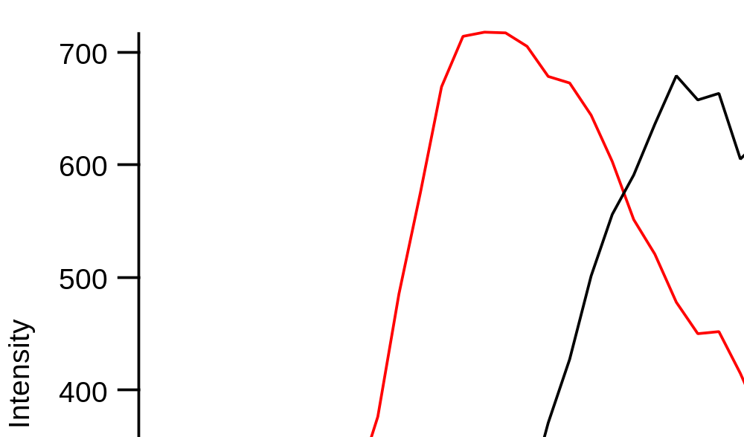
02 COMPLETED WORK
Key Experimental Result
Control System Timing Optimization Tests (O2)
KEY FINDING
Determined exact distance between valve, TW, and detection point
EVIDENCE
Maximum signal clearly at 1 delay time
IMPLICATION
Clear set of timings for control system (valve, traps, detection) found
UBC CHEMISTRY × TRIUMF
HAICU / UBC RESEARCH UPDATE

Slide 9
02 COMPLETED WORK
Tests Completed
August 1st – October 20th
TEST CAMPAIGN | QUESTION | CONDITIONS VARIED | MAIN RESULT
Valve to Beamline Offset Tests (O2) | Optimal orifice position WRT valve? | Offset from valve to beamline | Determined that optimal offset distance is about 28 cm
Control System Timing Optimization Tests (O2) | What are the timings required to guide, and decelerate effectively? | Trap pickup time Valve to trap 1 delay Trap 96 to MCP delay | Determined exact distance between valve, TW, and detection point
Deceleration / Trap Functionality Tests (O2) | Are the electronics and controls systems working as expected? | Pickup time Trap overlap and velocity Coil voltage | Determined pickup time for first trap, trap overlap, trap velocity, and coil voltage for guiding / deceleration
Valve / DBD Tests (H) | Is the valve producing a beam and is DBD producing H? | Valve Voltage and PW DBD Voltage and # of pulses | Showed that valve is producing a detectable hydrogen beam
Frequency Scan Tests (H) | Is the signal we’re seeing H? | Laser frequency | Showed that signal being detected is in fact H
UBC CHEMISTRY × TRIUMF
HAICU / UBC RESEARCH UPDATE

Slide 10
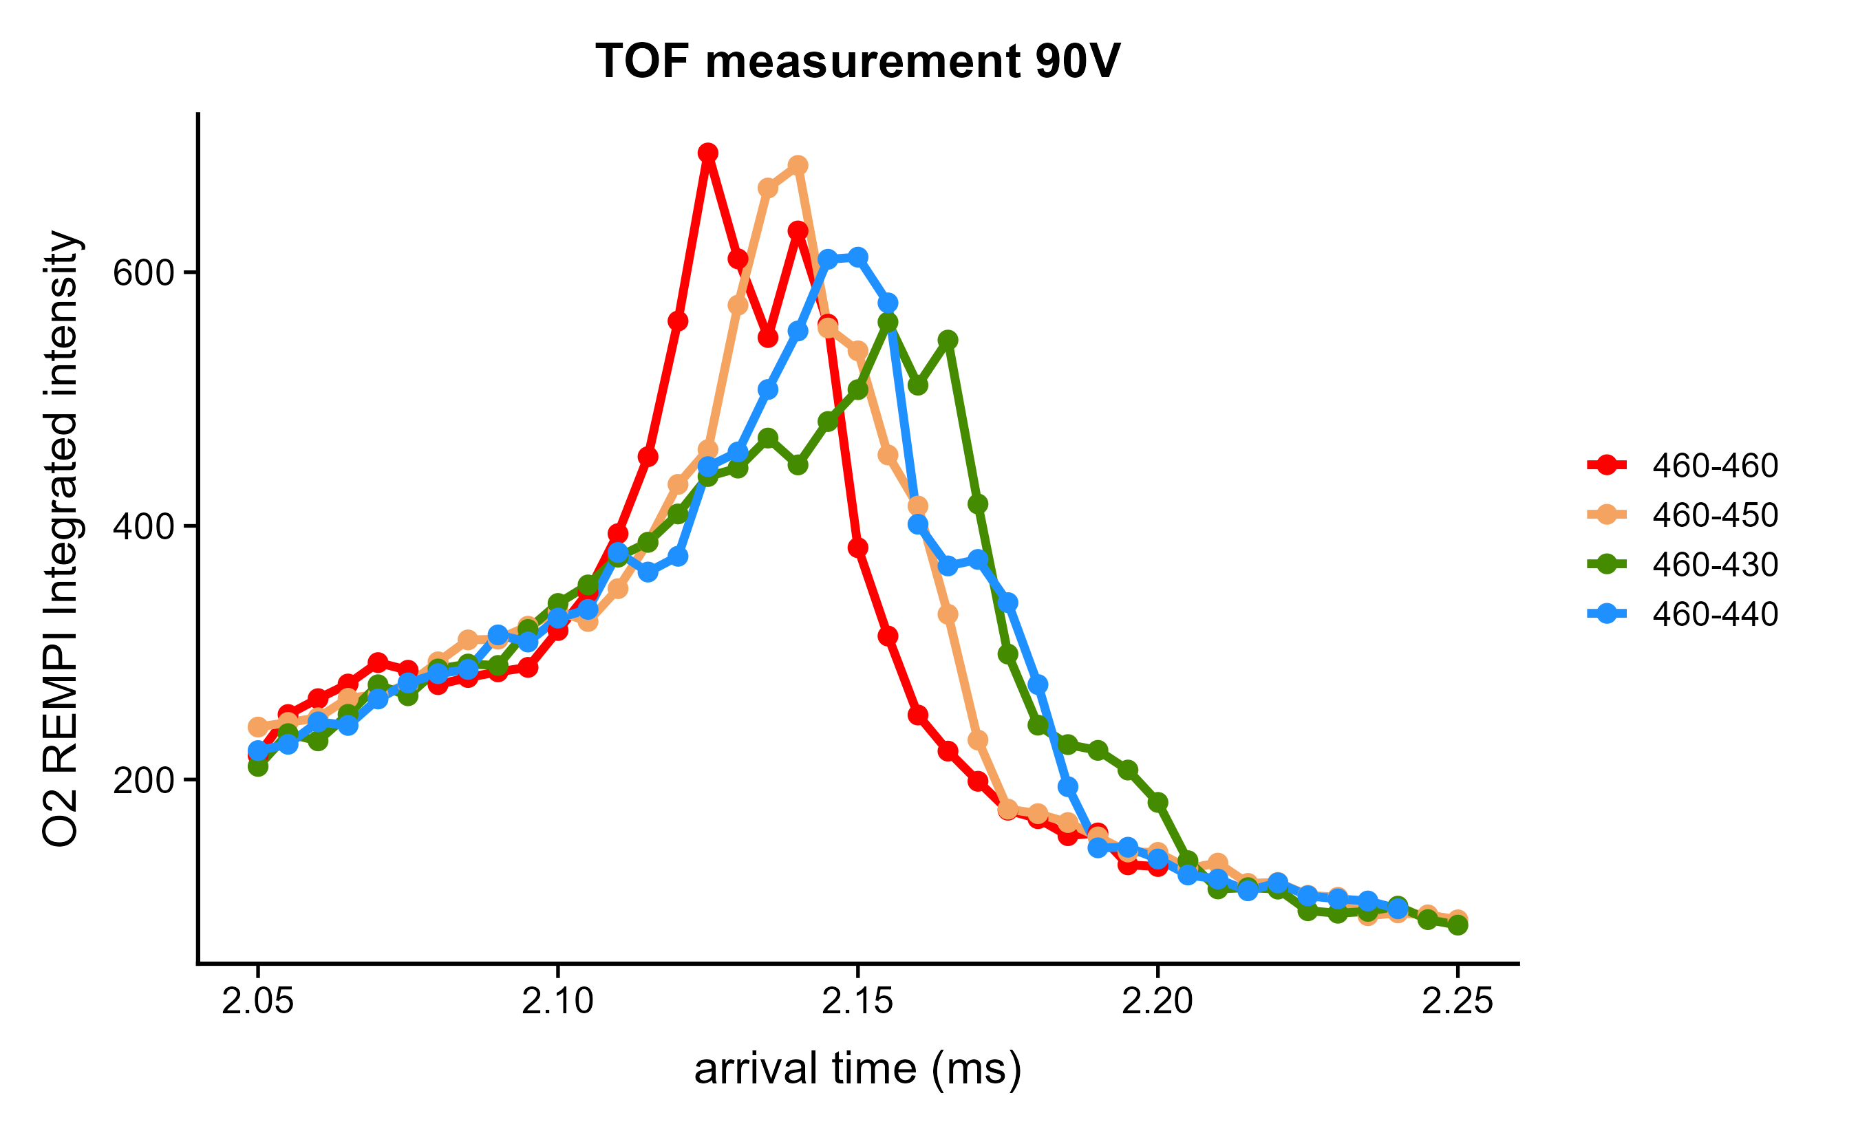
02 COMPLETED WORK
Key Experimental Result
Deceleration / Trap Functionality Tests (O2)
KEY FINDING
Determined pickup time for first trap, trap overlap, trap velocity, and coil voltage for guiding / deceleration
EVIDENCE
Peak arrival of O2 signal changing with deceleration variation. Clear peak retained
IMPLICATION
Deceleration scheme (pickup time, trap overlap, trap velocity etc.) is working
UBC CHEMISTRY × TRIUMF
HAICU / UBC RESEARCH UPDATE

Slide 11
02 COMPLETED WORK
Tests Completed
August 1st – October 20th
TEST CAMPAIGN | QUESTION | CONDITIONS VARIED | MAIN RESULT
Valve to Beamline Offset Tests (O2) | Optimal orifice position WRT valve? | Offset from valve to beamline | Determined that optimal offset distance is about 28 cm
Control System Timing Optimization Tests (O2) | What are the timings required to guide, and decelerate effectively? | Trap pickup time Valve to trap 1 delay Trap 96 to MCP delay | Determined exact distance between valve, TW, and detection point
Deceleration / Trap Functionality Tests (O2) | Are the electronics and controls systems working as expected? | Pickup time Trap overlap and velocity Coil voltage | Determined pickup time for first trap, trap overlap, trap velocity, and coil voltage for guiding / deceleration
Valve / DBD Tests (H) | Is the valve producing a beam and is DBD producing H? | Valve Voltage and PW DBD Voltage and # of pulses | Showed that valve is producing a detectable hydrogen beam
Frequency Scan Tests (H) | Is the signal we’re seeing H? | Laser frequency | Showed that signal being detected is in fact H
UBC CHEMISTRY × TRIUMF
HAICU / UBC RESEARCH UPDATE

Slide 12
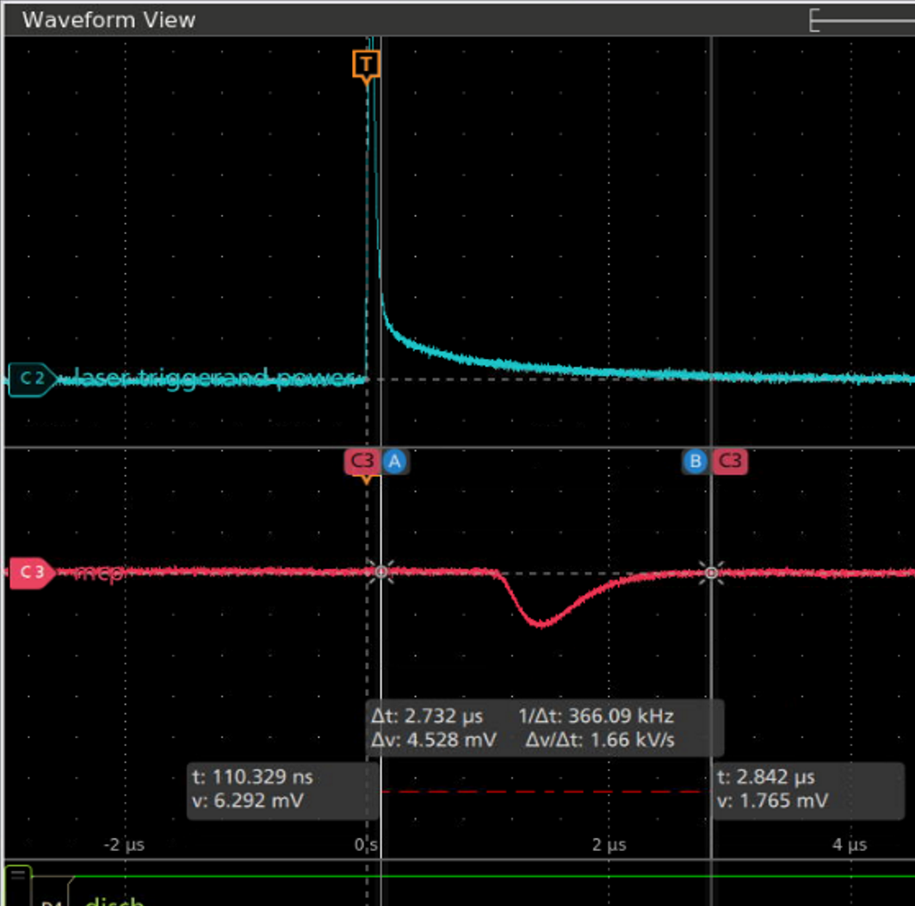
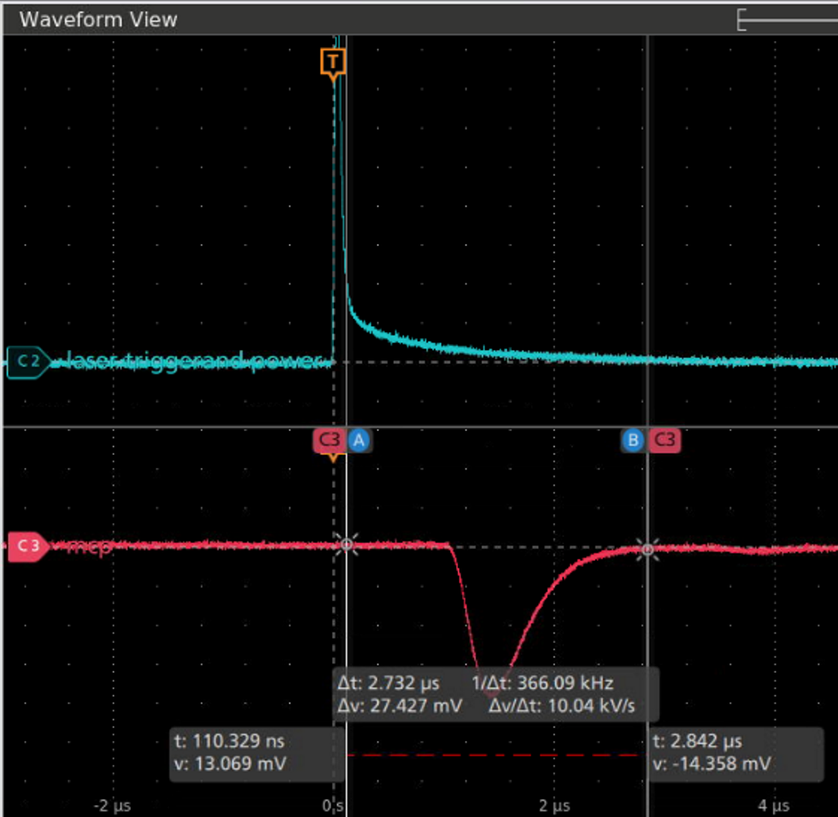
02 COMPLETED WORK
Key Experimental Result
Valve / DBD Tests (21% C2H2 Kr)
Nozzle Off
Nozzle On
KEY FINDING
Showed that valve is producing a detectable hydrogen beam
EVIDENCE
Signal strength without pulse is much lower than with pulse on
IMPLICATION
Gas pulse increases H detection
200 mV
800 mV
UBC CHEMISTRY × TRIUMF
HAICU / UBC RESEARCH UPDATE

Slide 13
02 COMPLETED WORK
Tests Completed
August 1st – October 20th
TEST CAMPAIGN | QUESTION | CONDITIONS VARIED | MAIN RESULT
Valve to Beamline Offset Tests (O2) | Optimal orifice position WRT valve? | Offset from valve to beamline | Determined that optimal offset distance is about 28 cm
Control System Timing Optimization Tests (O2) | What are the timings required to guide, and decelerate effectively? | Trap pickup time Valve to trap 1 delay Trap 96 to MCP delay | Determined exact distance between valve, TW, and detection point
Deceleration / Trap Functionality Tests (O2) | Are the electronics and controls systems working as expected? | Pickup time Trap overlap and velocity Coil voltage | Determined pickup time for first trap, trap overlap, trap velocity, and coil voltage for guiding / deceleration
Valve / DBD Tests (H) | Is the valve producing a beam and is DBD producing H? | Valve Voltage and PW DBD Voltage and # of pulses | Showed that valve is producing a detectable hydrogen beam
Frequency Scan Tests (H) | Is the signal we’re seeing H? | Laser frequency | Showed that signal being detected is in fact H
UBC CHEMISTRY × TRIUMF
HAICU / UBC RESEARCH UPDATE

Slide 14
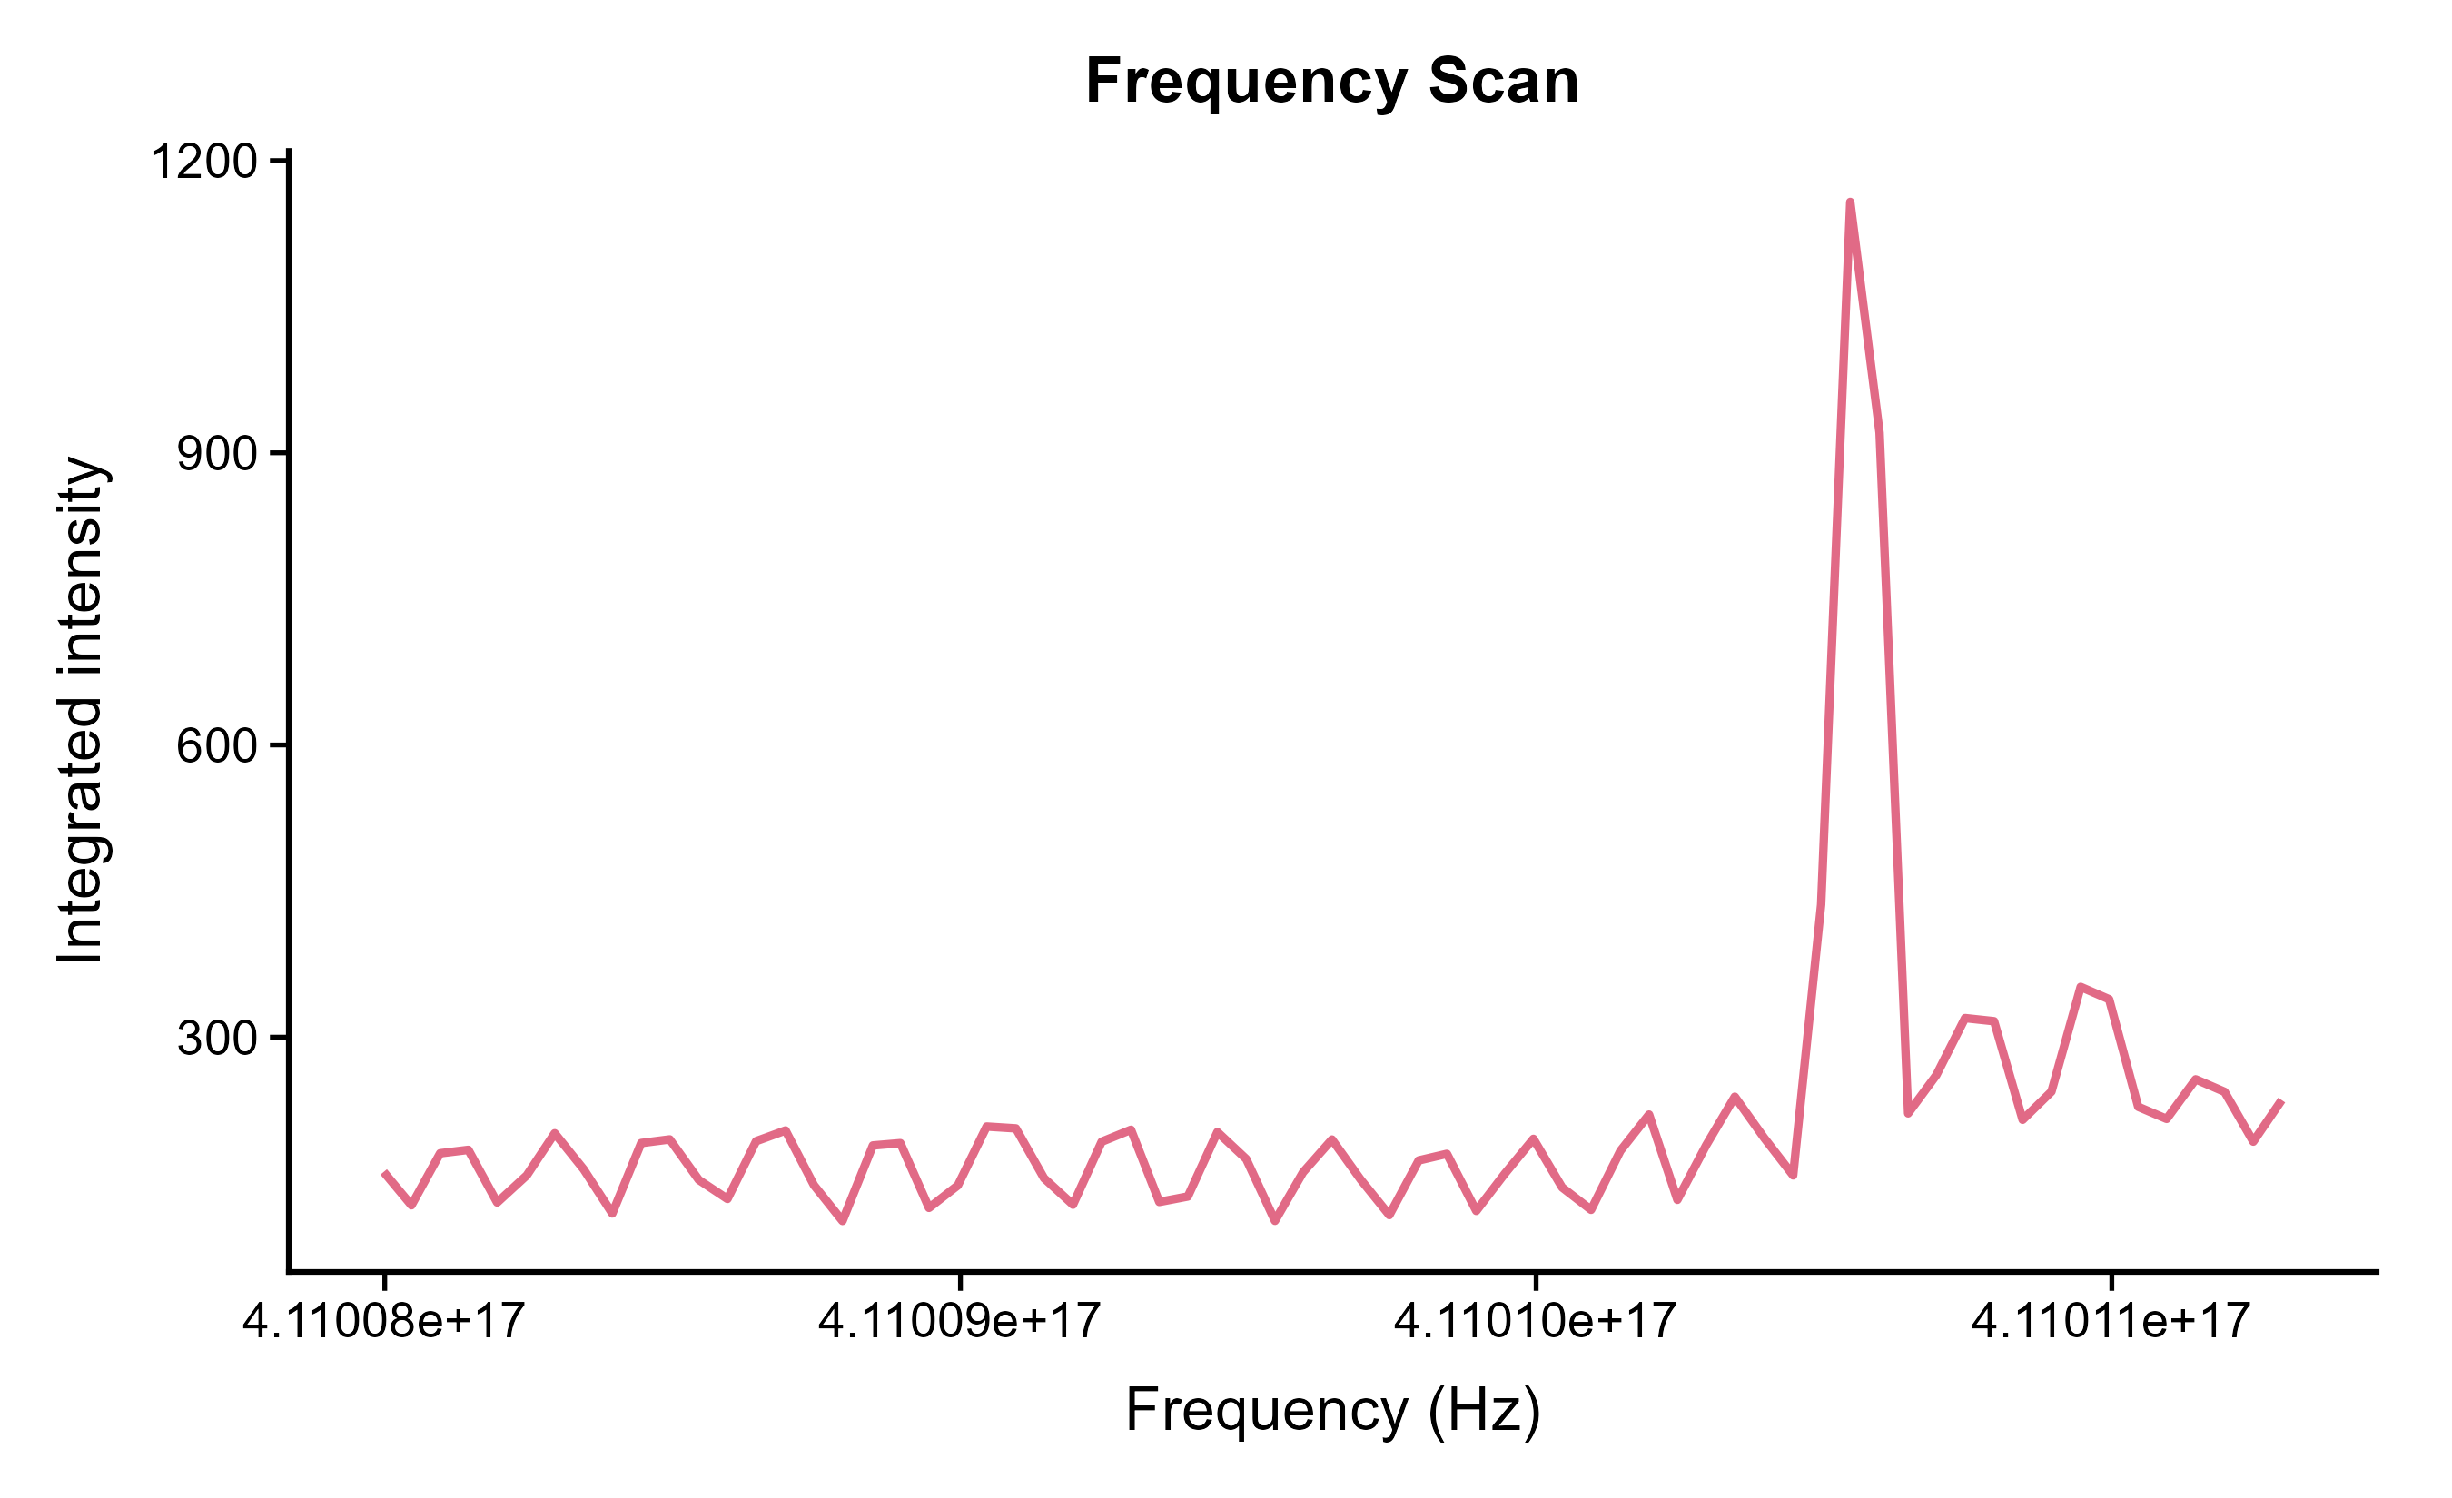
02 COMPLETED WORK
Key Experimental Result
Frequency Scan Tests (21% C2H2 Kr)
KEY FINDING
Showed that signal being detected is in fact H
EVIDENCE
Clear peak at H frequency ~411.0105 THz with 64avg acquisition.
IMPLICATION
H signal is frequency dependent
UBC CHEMISTRY × TRIUMF
HAICU / UBC RESEARCH UPDATE

Slide 15
03 CURRENT ISSUES
Issues Affecting Progress
ISSUE | EVIDENCE | EFFECT ON PROGRESS | NEXT ACTION
Sporadic H signal | SNR varies and H signal strength varies | Inconsistent results | Work on getting a more repeatable and consistent H signal
243 nm may be photolyzing H beam | H signal seen is generated via photolysis MCP, Signal increases with gas pulse with DBD. Signal appears less effected when DBD used. | Harder to optimize DBD and find best operating conditions for it (V, timing, # of pulses) | Test to see if photolysis right after valve will produce higher signal
Dropping signal over scan times | When performing longer scans (10 – 30 mins) signal drops over time | Means we can’t perform clean scans whose results we can trust consistently | Confirm that changes we made to gas line / valve helped with issue
UBC CHEMISTRY × TRIUMF
HAICU / UBC RESEARCH UPDATE

Slide 16
04 PLANS
Decelerator Electronics
ITEM | PURPOSE
Implement charging scheme for decelerator tuneboxes | Apply logic to implemented schemes Allows seamless operation when changing input/output parameters Provides a basis for future development
MLD Programming Procedure | Create procedure for programming new MLDs and ensure all required files are accessible
MLD SFP (Fiber) Implementation | Implement changes required for SFP in case fiber is desired in the future. (Chris Pearson mentioned he got the SFP for the MLDs working.) Close out task
Software (Python, Midas) | Single platform for cohesive integration with complete HAICU assembly. Anyone can modify/ upgrade
UBC CHEMISTRY × TRIUMF
HAICU / UBC RESEARCH UPDATE

