Slide 1
HAICU in-person meeting
Oct 20, 2026 at UBC

Slide 2
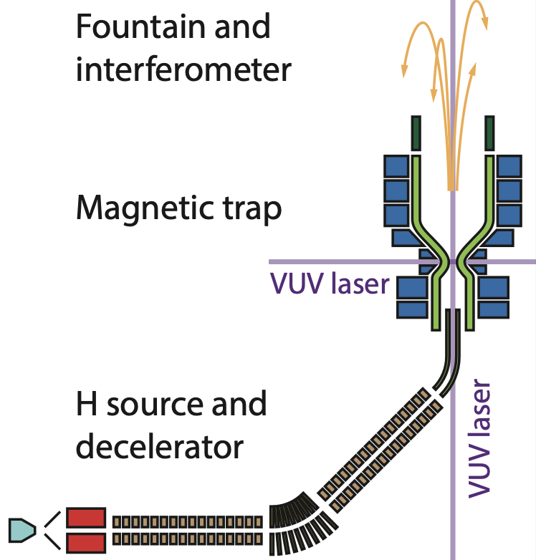
Long-term & short-term objectives
Thank you for your continued hard work!
Long-term objective: Develop (anti)hydrogen fountain & interferometer!
  Towards ultra-precise measurements of matter-antimatter symmetries
Many intermediate “world firsts” milestones
  3D laser cooling, Raman transitions, coherent quantum control (e.g. STIRAP), fountain launch etc
Immediate short-term milestone: trapping of H
  It will be first time H be trapped in a trap which is (i) stable (i.e. without holes), (ii) with dry loading (i.e. without superfluid He walls), (iii) with quadrupolar radial field, and (iv) with radial optical access.
  All 4 conditions are necessary for 3D laser cooling and efficient fountain production.
Figure: Chukman

Slide 3
Shopping list
All the purchases must be completed by Aug 2027 (delivered and paid)
Scope (Giulia)
DAQ (Andrea)
Microwaves (Tim/Mike)
Magnet power supplies (Chukman)
121 + 243 nm laser? (Taka)
Interferometer laser (Makoto/Taka)
Design work for new laser room? (Nicolas)
Etc

Slide 4
Agenda https://indico.triumf.ca/event/973/
Objectives: high level review of current status and what needs to be done in next few months
14:00 - 14:10: Intro [Makoto]
14:10 - 14:55 Status and plans for UBC source, decelerator, laser [Colin, Giulia, Taka]
14:55 - 15:10: Source simulation [Filo]
15:10 - 15:30: TRIUMF overview, infrastructure [Nicolas]
15:30 - 15:40: Magnets and trap [Chukman/Lars]
15:40 - 15:50: Controls & detectors [Andrea/Lars/Zach]
15:50 - 16:00: AOB
16:00: Drinks

